Slide 1
New materialism
Petr Ocelík
MEB401 Teorie bezpečnosti a metodologie / MEB427 Bezpečnost: teorie a koncepty
8th December 2016

Slide 2
Outline
New materialism (NM): assumptions
Actor-Network Theory (ANT)

Slide 3
New materialism: assumptions
Reaction to predominance of cultural and discursive approaches
Trans-disciplinary enterprise
Materialism
Empiricism
Relational perspective

Slide 4
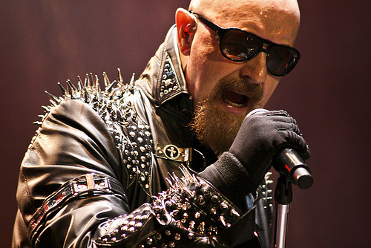
Materialism
“Truth and falsehood. Large and small. Agency and structure. Human and non-human. Before and after. Knowledge and power. Context and content. Materiality and sociality. Activity and passivity…all of these divides have been rubbished in work undertaken in the name of actor-network theory.” (Law 1999: 3)
NM rejects Cartesian dualism between social and natural world
Physical things are central to our identities which are practiced through objects we use
The world is a socio-material construction

Slide 5
Empiricism
NM rejects abstract theory and the imposition of general categories upon the empirical data
“The task of the researcher is no to impose order, limit the range of acceptable entities or add reflexivity to [actors’] practice. But follow the actors, their wild innovations, methods, and accounts.” (Latour 2005: 11)
NM uses rather an ethnographic research approach that allows to unfold the story in its complexity

Slide 6
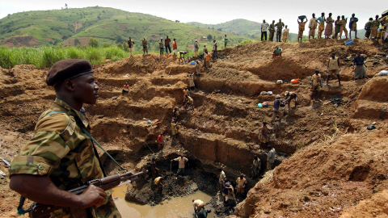
Relational perspective
The world is full of hybrid entities containing both human and non-human elements that are mutually related
→ Social world is created by entanglements (Actor-Networks, assemblages) of human and non-human actors

Slide 7
Human actors vs. non-human actants
Agency: capacity of a thing or person to impact its surroundings (no intentionality needed)
Human actors and non-human actants
Actants: anything that “…modify other actors through a series of…” actions (Latour 1999: 75)
If the entity modifies other entities, contributes something new to the entanglement that cannot be reduced to the other entities, then it is an actant

Slide 8
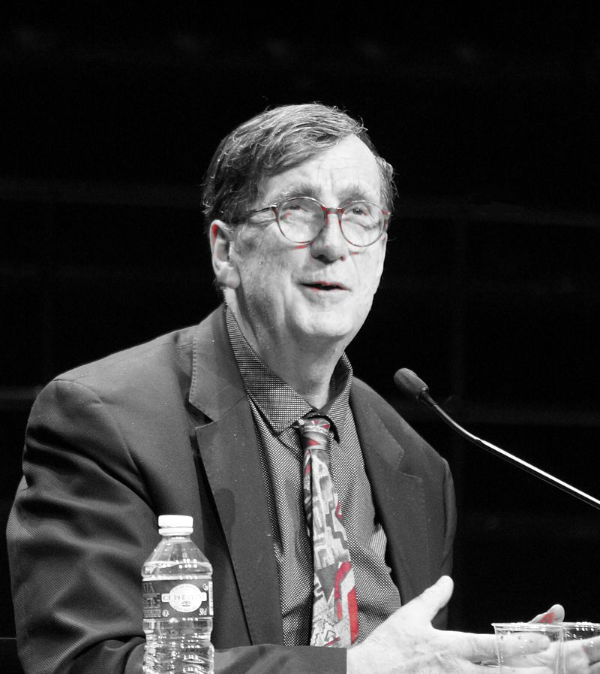
Actor-Network Theory
ANT mostly connected with a French philosopher and
sociologist Bruno Latour (1947 - )
It is rather a research methodology
The central concept: Actor-Network that mediates interactions between people (and other entities)
ANT focuses on how, rather then why, are certain Actor-Networks formed, maintained, and destroyed

Slide 9
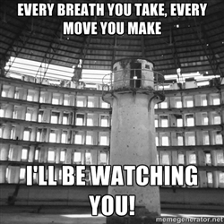
Panopticon

Slide 10
ANT in energy studies
[Actor-Network Theory] can be noteworthy, then, for de-centering the technological artefact as the object of inquiry and expanding scholastic focus on ‘technology’ to include the vast social and cultural networks that surround it... By focusing on the relational aspects among engineers, inventors, analysts, politicians, artifacts, manufacturing techniques, marketing strategies, historical context, economics, and social and cultural factors, ANT highlights that technology emerges through a seamless web of material objects and immaterial epistemologies. This situates energy technologies as neither inevitable nor static. Instead, energy technologies are the product of a complex power play between divergent actors and their interests.
Sovacool 2006: 10-11

Slide 11
Translation
“I use translation to mean displacement, drift, invention, mediation, the creation of a link that did not exist before and that to some degree modifies two elements of agents.” (Latour 1994: 32)
Translation focuses on the manner in which actors’ interests and goals are represented, simplified, and transformed into construction of an Actor-Network
Often, few actors become spokespersons for many of other by defining and linking identities of others in increasingly simplified and fixed ways (e.g. “we - as a nation - are threatened and need to be protected”)

Slide 12
Conclusions
NM (ANT) allows to accommodate and focus on non-social, non-cultural entities that populate the world and integrate them with the social ones
It moves away from abstract thinking and anthropocentrism
The entanglements are seen as provisional and historically contingent (room for intervention)

