Slide 1
QCA
Kateřina Fridrichová

Slide 2
Sequence of the research
Theory survey
Conceptual work and study of the cases
Data collection
Data calibration
Necessity analysis
Truth table construction
Boolean minimization

Slide 3
Standard analysis
Conceptual research – the research question, population of interest, outcome of interest, conditions to analyze
Data matrix – calibration of the measurements
Transformation of data matrix into truthtable
Testing for necessity
  Assessment of the outcome – consistency and coverage
Testing for sufficiency
  Assessment of the outcome – consistency and coverage
Repeating the process for non-outcome.
Notes:
QCA does not allow you to discover new things about the matter. The crucial research is done by looking at the cases

Slide 4
Truth table
Truth table reflects data from the data matrix
One row of truth table reresents combination of conditions that can appear
2^{k} (k = number of conditions)
Not all of the conditions then appear in the reality = incomplete truth table – logical remainders
If there is 1 in the outcome column that row expresses statement of sufficiency (under this combination of conditions the outcome of intererest happens)
You take the truth table row and if it shows the outcome, than it is added to the logical minimization by Quine-McCluskey
Fuzzy sets – fuzzy sets (as crisp ones) establish qualitative difference between membership and nonmembership in the set – property space – still belong into only one truth table row, because they will always have the value below 0.5 or above 0.5 for that condition
Notes:
Draw the Venn diagram and how it connects.

Slide 5
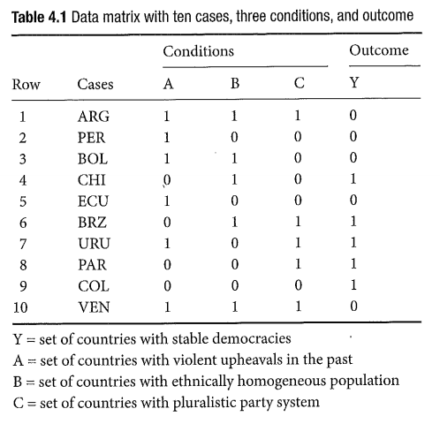
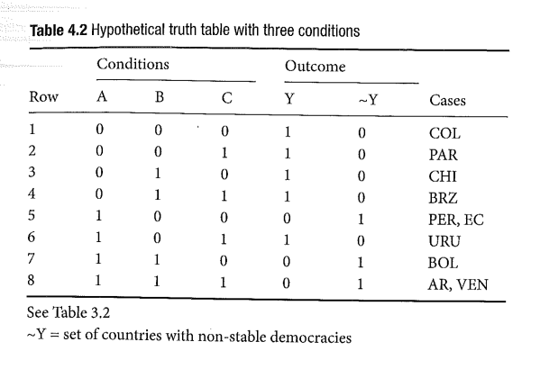
Data matrix into the truth table

Slide 6
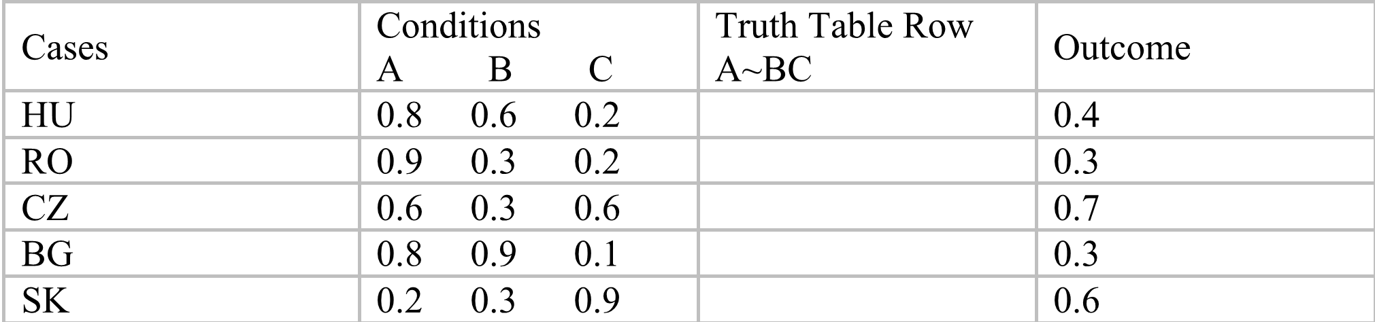
Fuzzy set truth table

Slide 7
Dealing with contradictory rows and logical remainders
Logical remainders – those combinations that do not realize in the data
  Either use no assumpitons on logical remainders – bar them from logical minimization → conservative solution
  Assign assumptions on logical remainders – the program itslef decides what to do with the remainders (uses those that lead to more effective logical minimization) → parsimonious solution
  Directional expectations → intermediate solution
  Contradictory row - If the same combination of conditions shows both outcome and non-outcome
Before logical minimization:
  adding a condition
  respecify the population of interest
  respecify the definition, conceptualization, or measurement of the outcome or conditions

Slide 8
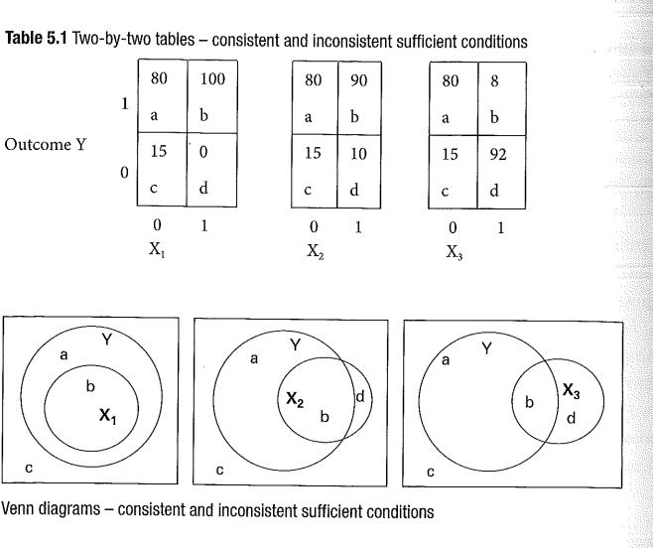
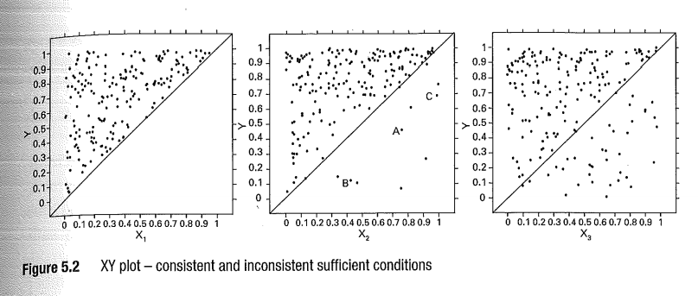

Sufficiency and its consistency
Consistency of X as a sufficient condition for Y = number of cases where X=1 and Y= 1/ number of cases where X=1
$${Consistency}_{Sufficient conditions\left(X_{i}≤Y_{i}\right)}=\frac{\sum_{i=1}^{I}{min(X_{i},Y_{i})}}{\sum_{i=1}^{I}{X_{i}}}$$

Slide 9
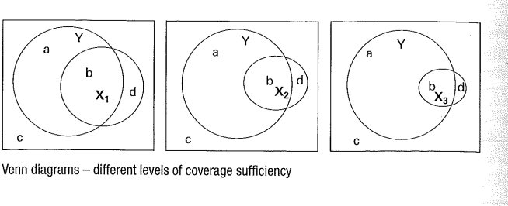
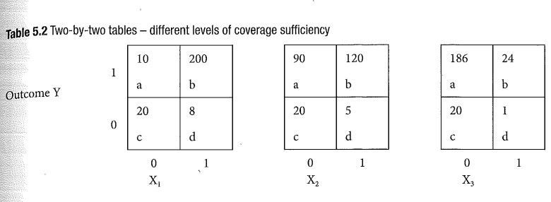
Sufficiency and its coverage

Slide 10
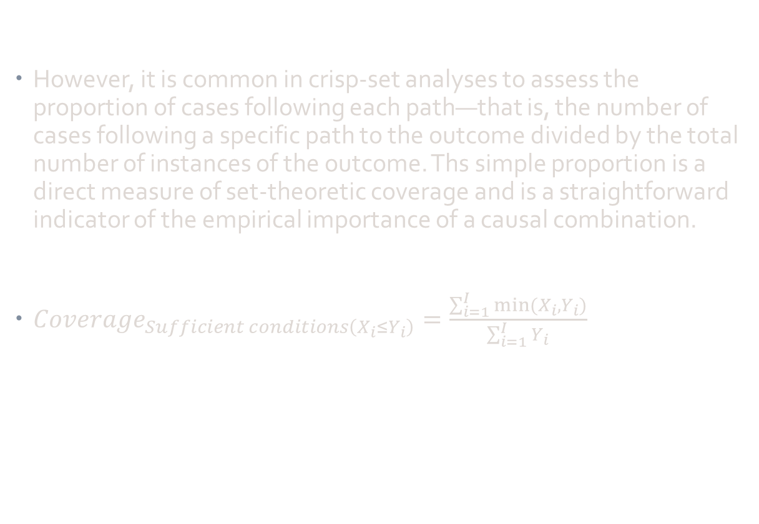
Sufficiency and its coverage
However, it is common in crisp-set analyses to assess the
proportion of cases following each path—that is, the number of cases following a specific path to the outcome divided by the total number of instances of the outcome. Ths simple proportion is a direct measure of set-theoretic coverage and is a straightforward indicator of the empirical importance of a causal combination.
${Coverage}_{Sufficient conditions\left(X_{i}≤Y_{i}\right)}=\frac{\sum_{i=1}^{I}{min(X_{i},Y_{i})}}{\sum_{i=1}^{I}{Y_{i}}}$

Slide 11
Necessity and its coverage and parameters of fit

Slide 12
Conceptual work
Research question: What factors motivate UN intervention.
  causally complex phenomenon
  outcome: the strength of international response (“STRONG”)
  conditions:
    Extent of the crisis
    Spillover effects
    Countervailing power
    Institutional involvement
    Media attention

Slide 13
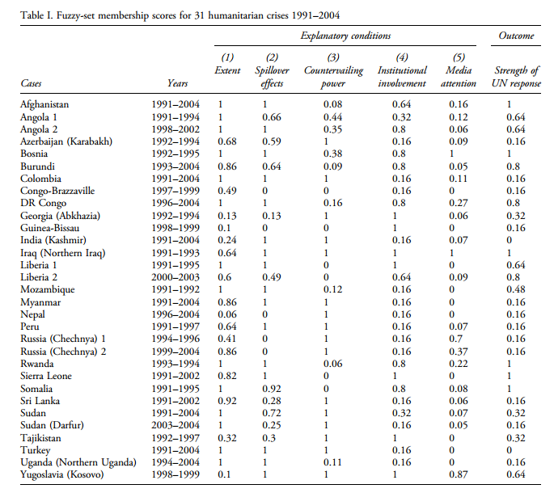
Data matrix

Slide 14
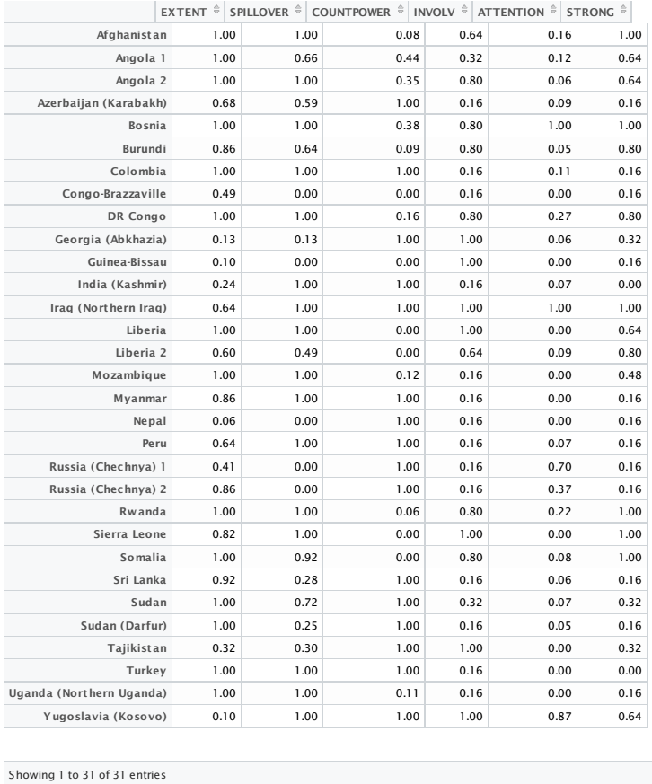
Data matrix in RStudio

Slide 15
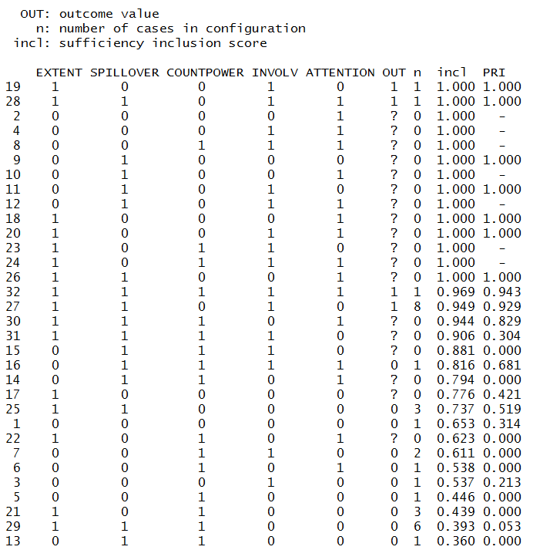
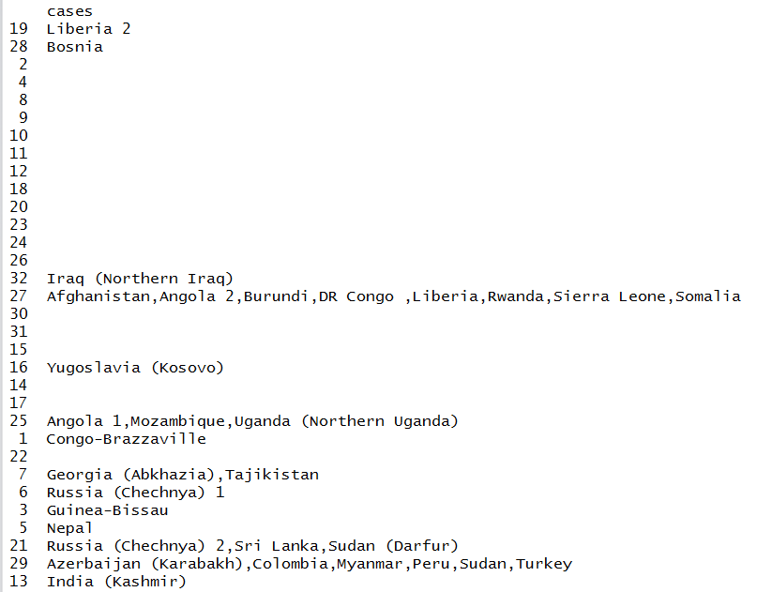
Truth table

Slide 16
Bibliography
Binder, Martin. 2015. “Paths to Intervention What Explains the UN’s Selective Response to Humanitarian Crises?” Journal of Peace Research, July, 0022343315585847. doi:10.1177/0022343315585847.
Ragin, Charles C. 2008. Redesigning Social Inquiry: Fuzzy Sets and Beyond. Chicago: University Of Chicago Press.
Schneider, Carsten Q., and Claudius Wagemann. 2012. Set-Theoretic Methods for the Social Sciences: A Guide to Qualitative Comparative Analysis. Cambridge: Cambridge University Press.

