Slide 1
SOC 585 MIGRATION, TRASNATIONALISM AND THE CITY Fall 2017
Session 5 November 28th
Radka Klvaňová
E-mail: klvanova@fss.muni.cz
Lenka Šafránková Pavlíčková
E-mail: safrankova.lenka@brno.cz

Slide 2
Outline of the session
Framing migration policy making in the city
Discussion on readings
Pexeso game
Lunch
Migration policy making in Brno
Group assignment

Slide 3
Globalization and the city as a political arena
Saskia Sassen – Whose city is it?
Denationalization of urban space
Formation of new claims due to immigration (global capital/immigrant workforce)
New solidarities and notions of membership

Slide 4
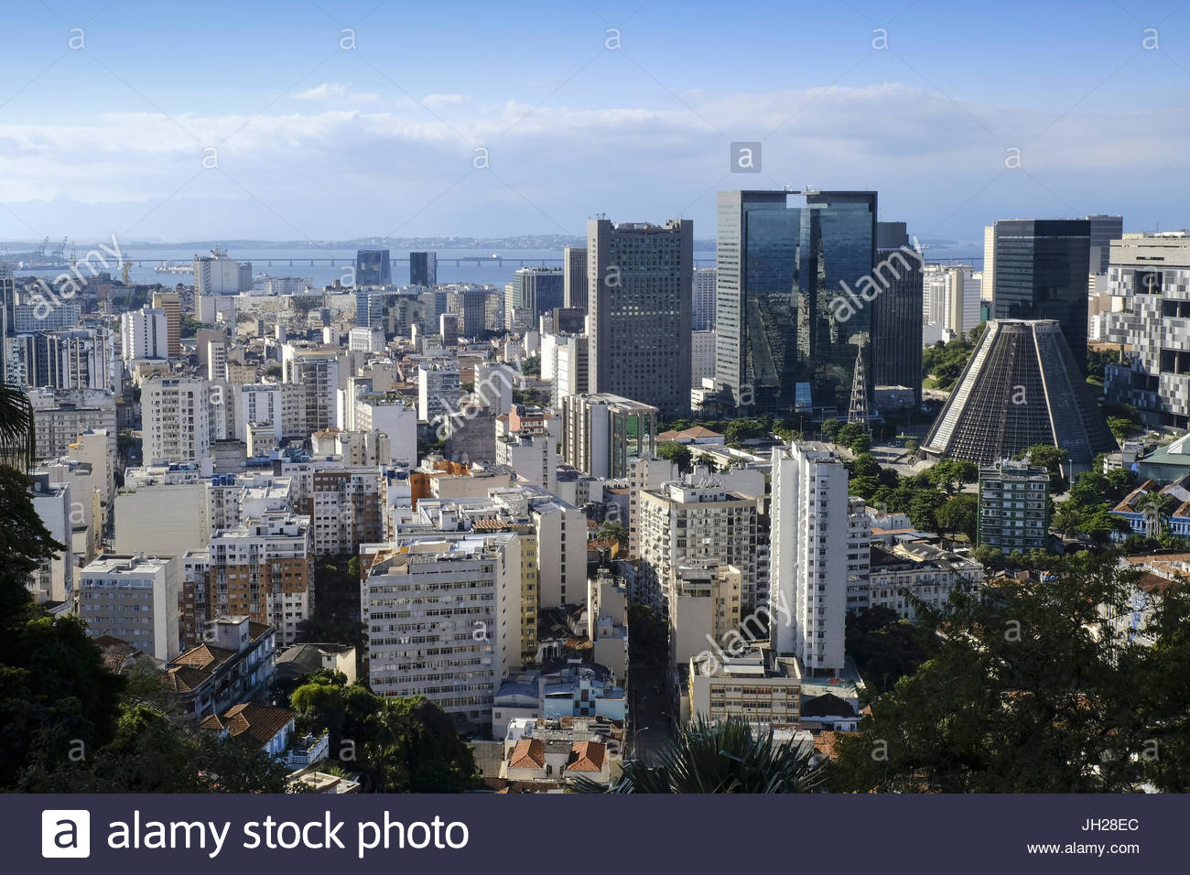
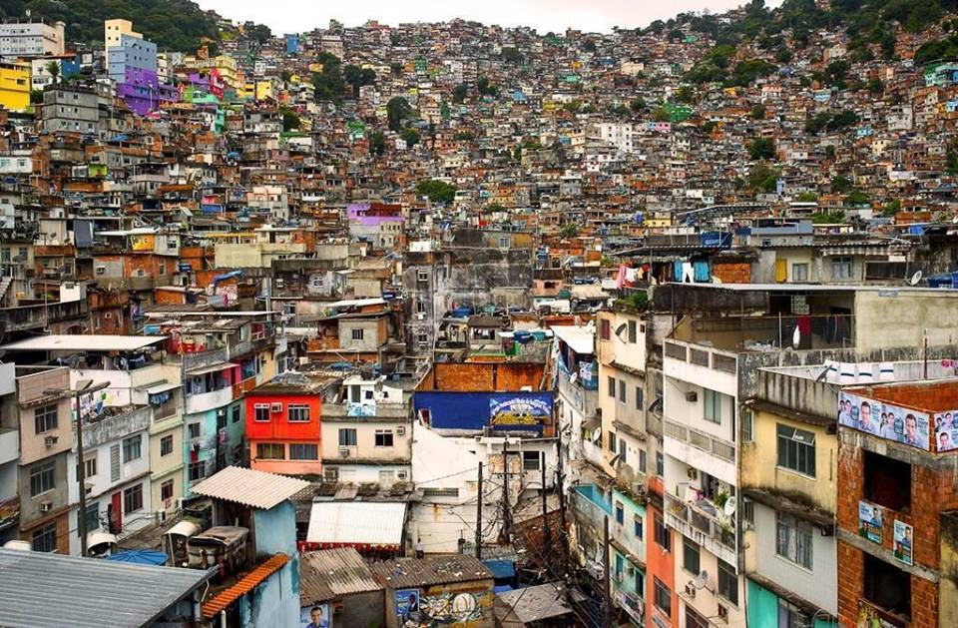

Slide 5
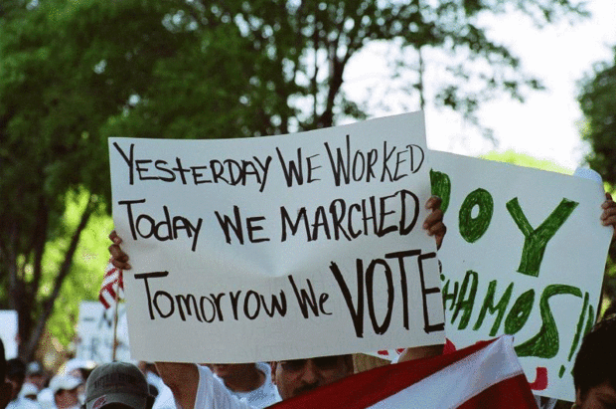
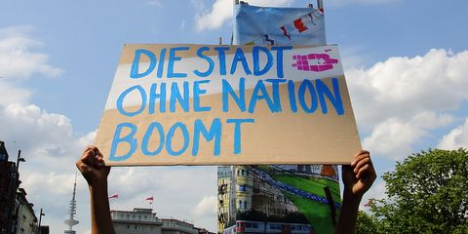
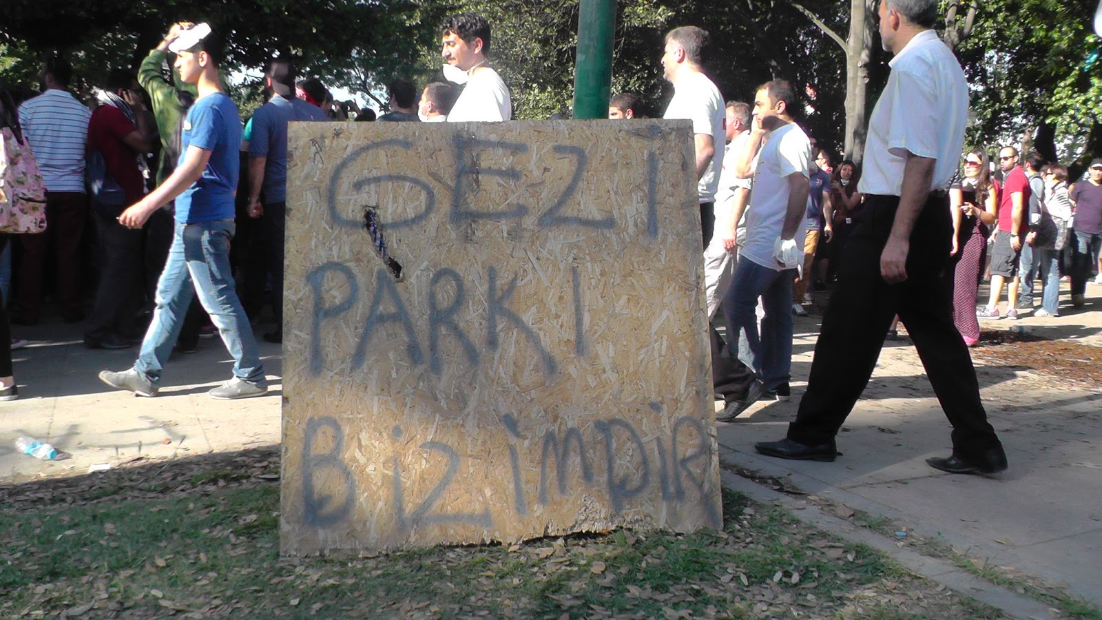

Slide 6
Urban citizenship, citizenship from below
Rise of nation states – disempowerement of cities
Globalization – strenghtening of the role of cities
Presence of non-national residents in cities claiming rights
„Right to the city“
Baubock - strengthening municipal polities - multiple local citizenship and voting rights within and across national borders

Slide 7
Migration policy making
European context vs. context of immigration countries
Ad hoc policy measures vs. more systematic adaptation of institutions to immigration
European Union (esp. European Commission) – promoting more systematic and pro-active approach to migration policymaking
State policies vs. city policies
Security perspective vs. Inclusive perspective
Control, coercion vs. empowerment of immigrants
Walls vs. Bridges (?)
The problem of coordination btn. state and local administration

Slide 8
“Integration of immigrants”
Fuzzy concept, uclear definition
Who integrates into what?
False dualism btn. „host society“ and „immigrants“ – plurality of actors – individuals, social groups and institutions
Integrated vs. unintegrated (immigrants) – stigmatizing
Umbrella term for great variety of measures
European website of integration

Slide 9
Integration policies in cities - examples
Access to services
Language access
Partnerships, mentoring – long settled residents vs. newcomers
Community work in neighbourhoods, block parties
Increasing representation of immigrants in local governments and administration (Advisory boards, commissions for immigrants)
Welcoming culture
Participation, local voting rights

Slide 10
Literature
Sassen, Saskia. 1996. „Whose City Is It? Globalization and the Formation of New Claims.“ Public Culture Winter 1996 8 (2): 205-223.
Baubock, R. 2003. „Reinventing Urban Citizenship“. Citizenship Studies, Vol. 7, No. 2, 2003
Penninx, R. et al. 2004. Citizenship in European Cities. Immigrants, Local Politics and Integration Policies. Routledge.
Anthias, Floya, Maria Kontos, Mirjana Morokvasic-Müller. 2012. "Introduction:Paradoxes of Integration". In Paradoxes of Integration: Female Migrants in Europe,in Floya Anthias, Maria Kontos, a Mirjana Morokvasic-Müller (eds.), 1–16. Springer Science & Business Media.
Gebhardt, D. 2014. Building Inclusive Cities: Challenges in the Multilevel Governance of Immigrant Integration in Europe. MPI Report: http://www.migrationpolicy.org/research/building-inclusive-cities-challenges-multilevel-governance-immigrant-integration-europe
Margie McHugh. 2014. Immigrant Civic Integration and Service Access Initiatives: City-Sized Solutions for City-Sized Needs. MPI Report: http://www.migrationpolicy.org/research/immigrant-civic-integration-and-service-access-initiatives-city-sized-solutions-city-sized

