Slide 1
Development of the concepts How the concepts of social exclusion and inclusion came into being?
SOC607
Mgr. Ivana Rapošová
Mgr. Lenka Kissová

Slide 2
Exclusion & Inclusion. Eternal Dynamics?
historic processes
exclusion as a natural way of bonding -> group identity
in-group vs. out-group, significant other vs. the Other
currently: emphasis on social cohesion
too diversified societies are not cohesive -> risk of conflict

Slide 3
From poverty to social exclusion
social inclusion/exclusion/cohesion emerging in 1970’s in France
from communitarian approach (1960’s and 1970’s) to social structure (individual/community problem -> structural disadvantagement)
from understanding marginalization in economic terms to political, social, economic and cultural dimension
part of the European agenda since 2000 -> national inclusive policies
context of V4 countries – adopting the terminology thanks to the EU integration process

Slide 4
Activity: finding a Proper definition
Instructions:
You will be working independently in a group of 3-4 students
During the activity, you can use the course materials, books, your computers, and smartphones
Do the research. Each group should find at least 5 different definitions of one of the following concepts: social inclusion, social exclusion, social cohesion, discrimination, affirmative action. If you use internet, try using Google Scholar.
Use the flipchart paper to write down the definitions and any other remarks. Write down the sources of all definitions.
Discuss in the group the pros and cons of respective definitions and decide on one which you consider the best. Provide arguments for your choice.
Introduce the definitions to your classmates and comment on them.

Slide 5
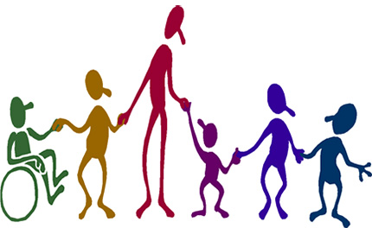
Social Inclusion & Exclusion two sides of the same coin?
a continuum instead of two poles
two dynamics often existing side by side
inclusive paradox

Slide 6
New Narratives. Do we need Them?
newly emerging narrative – from vertical understanding of disadvantagement to horizontal one
PROS – departure from economic dimension to social categories of racial/ethnic/religious identities, joined European approach
CONS – concealing social inequalities (Levitas 2005), empty European categories
In what ways do social inclusion and exclusion serve us to better capture the social reality?
In what ways they conceal social injustice coming from inequality?
What implications do they have for daily life of people?

