Slide 1
Discourses &
SOCIAL EXCLUSION/Inclusion
SOC607
Mgr. Ivana Rapošová
Mgr. Lenka Kissová

Slide 2
defining social inclusion
… is difficult
Meanings vary
Meanings are shifting
→ complex settings indicate that approaches towards social exclusion/inclusion are (country-) specific and context-dependent (history, discourse, public policies, institutions, cultural understanding of social relations, etc.)
Notes:
2

Slide 3
Variety of definitions of exclusion
“Social exclusion may be understood as an accumulation of confluent processes with successive ruptures arising from the heart of the economy, politics and society, which gradually distances and places persons, groups, communities and territories in a position of inferiority in relation to centres of power, resources and prevailing values” (Estivill 2003, p. 19)
“the dynamic process of being shut out ... from any of the social, economic, political and cultural systems which determine the social integration of a person in society” (Walker and Walker 1997, p. 8)
”lack of income and productive resources to ensure sustainable livelihoods; hunger and malnutrition; ill health; limited or lack of access to education and other basic services; increased morbidity and mortality from illness; homelessness and inadequate housing; unsafe environments and social discrimination and exclusion. It is also characterised by lack of participation in decision-making and in civil, social and cultural life.” (United Nations 1995, p. 57)
“inability to participate effectively in economic, social, political and cultural life, alienation and distance from the mainstream society” (Duffy 1995)
Notes:
3

Slide 4
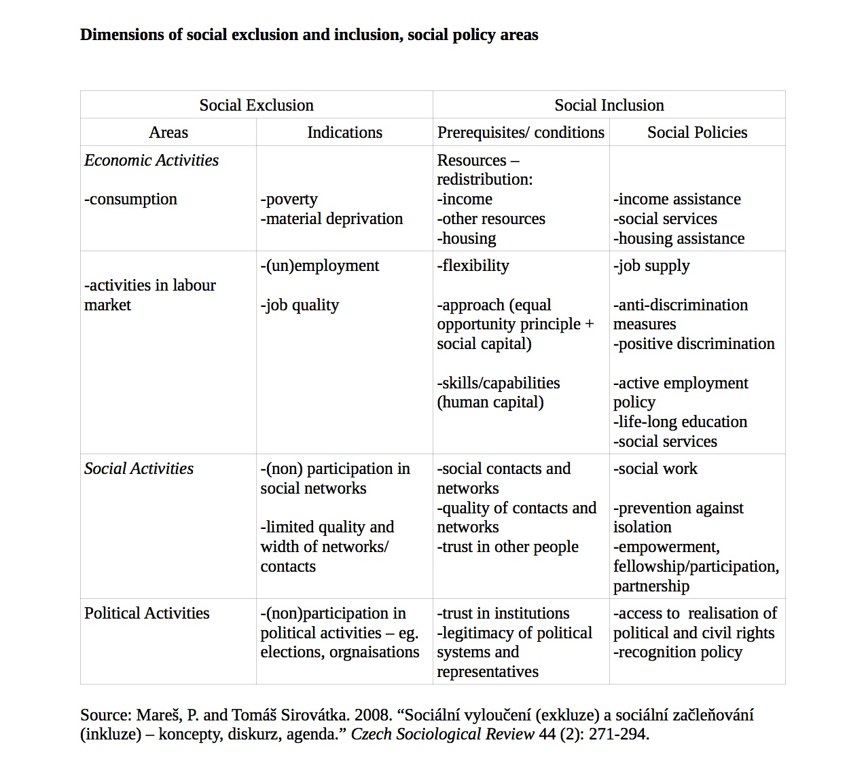

Slide 5
Dimensions of social exclusion and inclusion
Economic activities
Social activities
Political activities
...discussions might go even further…
Community
Individual
Group
Spatial
Notes:
5

Slide 6
Problematic formulation of policies
term still quite new
concept is very flexible (country, context-specific)
missing a well-developed set of indicators
clarifying the definition and the concept would undermine the flexibility of the concept
Any other potential problems?
Notes:
6

Slide 7
IMPORTANCE OF DISCOURSES
Discourse formulates the ways we look at things, we describe them, what meanings we ascribe them and thus how we act. (Levitas 2005)
- we (re)produce mental representations and meanings through discourses
- it offers us a certain perspective how we look at things
- it offers particular ways how we produce knowledge about things
- it influences the way we act
Notes:
7

Slide 8
1. redistributionist discourse (RED)
developed in British critical social policy
prime concern is poverty
critique of inequality
exclusion is contrasted with a form of citizenship calling for substantial form of redistrbution of power and wealth

Slide 9
2. MORAL UNDERCLASS DISCOURSE (MUD)
stress on moral and behavioural delinquency of excluded people
in the center there are criminals, unemployable youth, irresponsible single mothers → paid emlployment is the crucial tool of disciplination
their exclusion is a moral threat and a cultural feature
emphasises the cultural but ignores political and economic causes of exclusion
Notes:
9

Slide 10
3. SOCIAL INTEGRATIONIST DISCOURSE (SID)
central focus is on paid employment
inclusion is primary considered through paid work
reduction of social to economic exclusion/inclusion + ignoring political and cultural features/factors
doesn’t acknowledges non-market work (they’re squeezed into market or spaces around paid employment) – unpaid work is addressed from perspective of market

Slide 11
IMPORTANCE OF DISCOURSES II
Social exclusion/inclusion anchored in discourses (Levitas 2005)
→ different discourses will frame and tackle exclusion and related problems differently
They will differ in:
Who defines the insiders/outsiders
How they characterise/define boundaries (what is the crucial feature of the boundary)
How is it possible to support inclusion
How they represent relation between inclusion/exclusion and inequality
‘In a political environment the advocates of reform need to employ strategies to overcome the scepticism of others and persuade them of the importance of reform. In other words, they must create a frame that changes the collective understanding of the welfare state, because doing so ‘shapes the path’ necessary to enact reform’ (Cox, 2001: 475 in Béland 2007)
Notes:
11

