Slide 1
Climate change and geo-engineering
Modern Technologies and Conflicts
12.11.2018
Michael Myklín

Slide 2
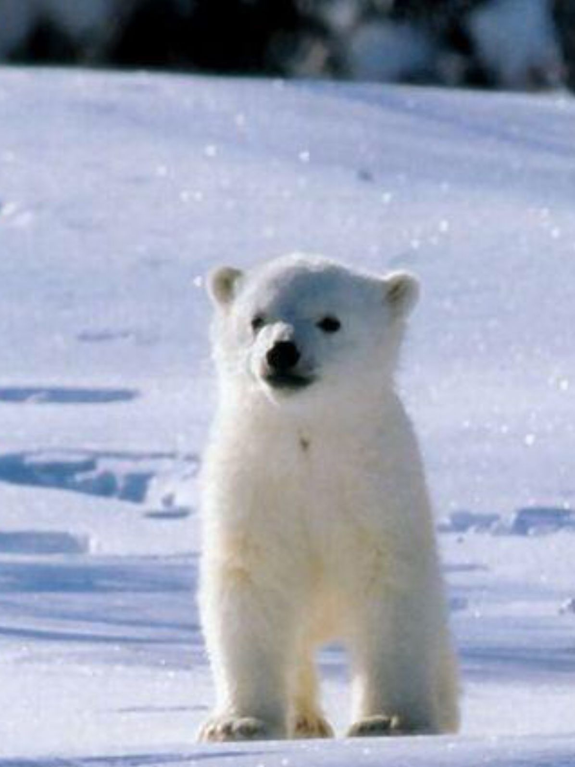
Content of lecture
Cliate change
Geo-engineering
Case study: Role of environmental factors behind the outbreak of Syrian civil war

Slide 3
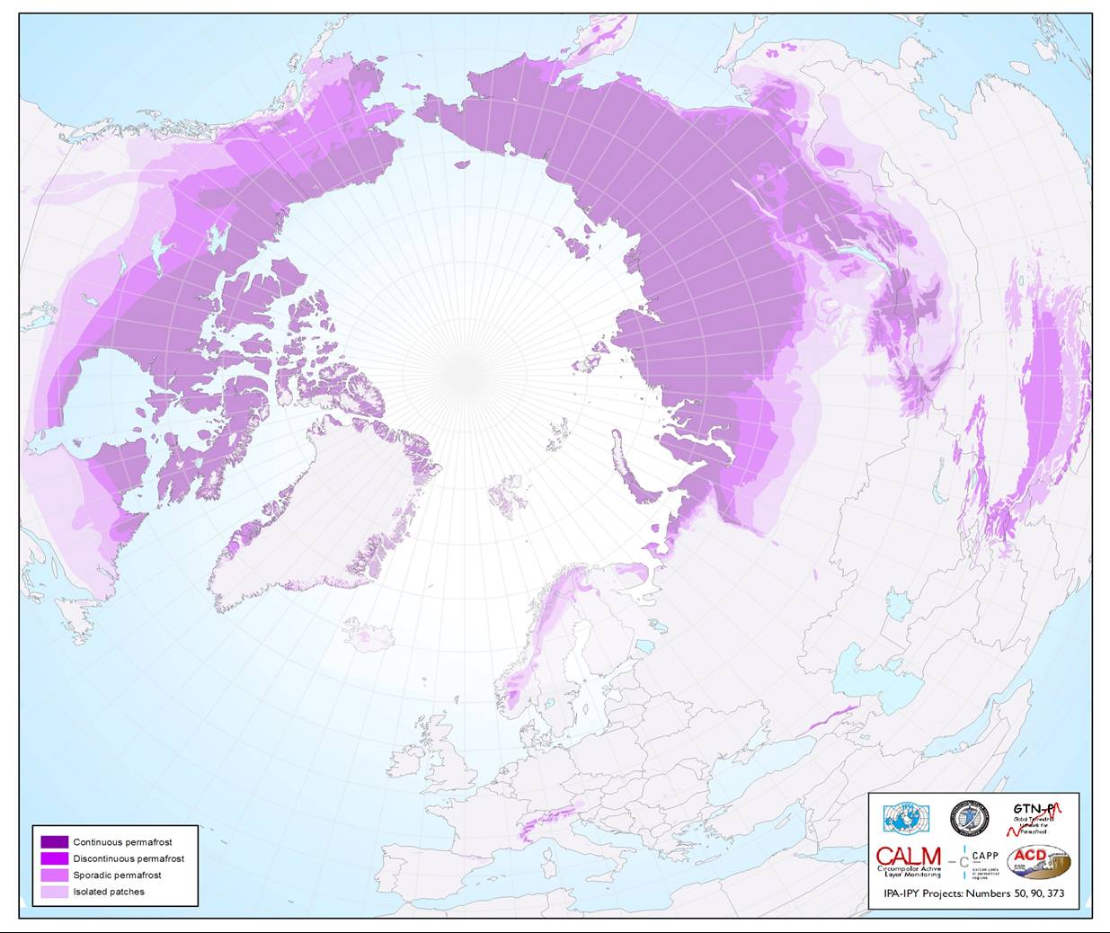
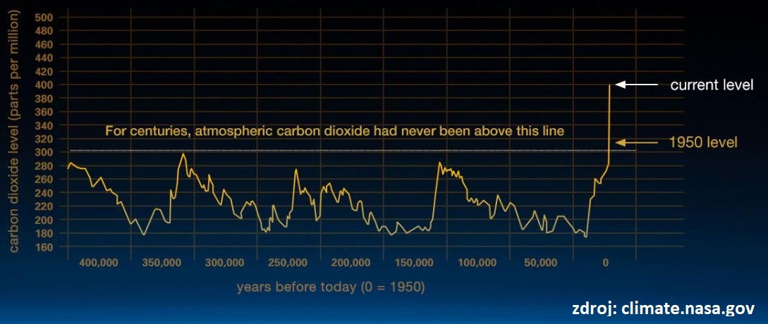
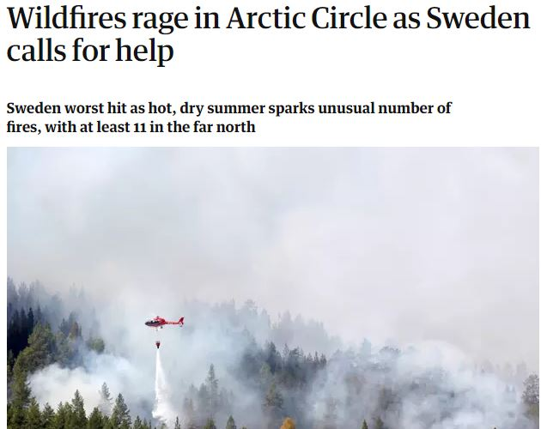
Climate change
Historical norm, but…
Ice Age
Record concetration of CO2
Negative impacts
Melting of glaciers, permafrost
More frequent weather extremes, draught
Geopolitical impacts
Positive impacts
Agriculture
Shipping

Slide 4
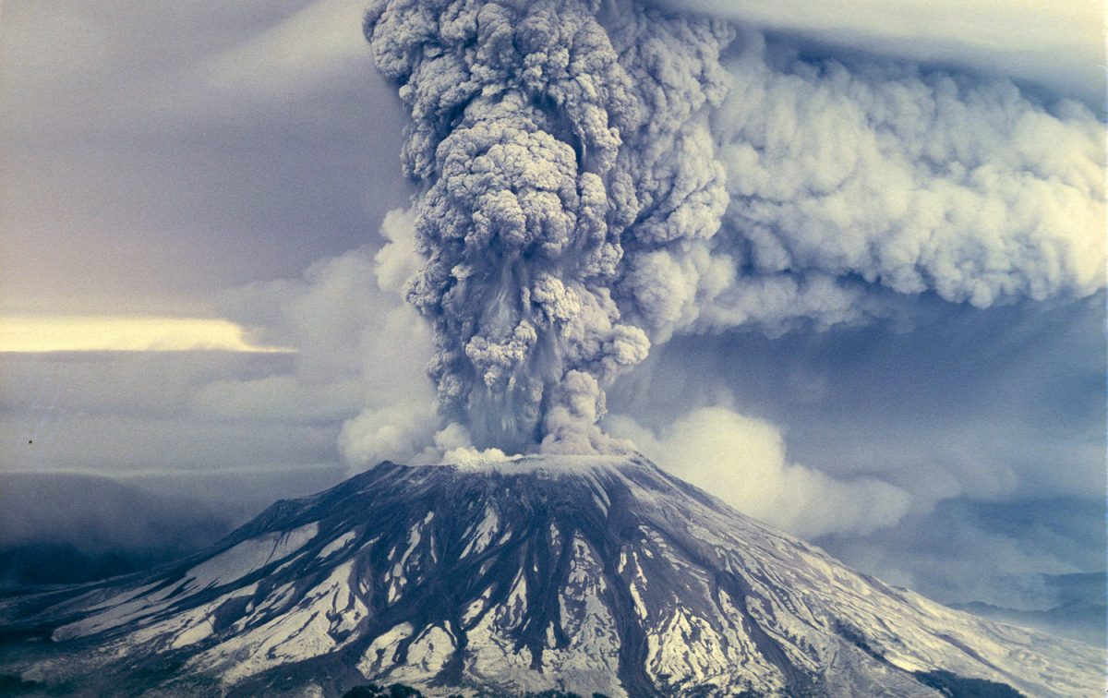
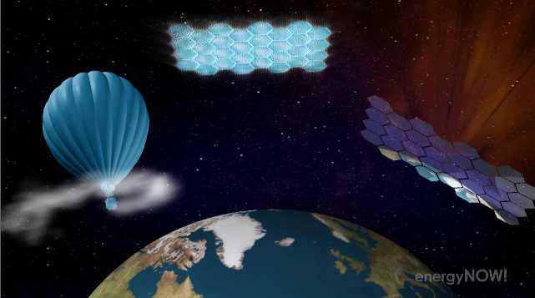
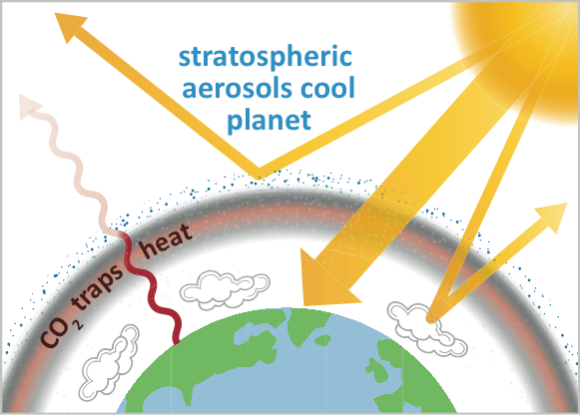
Geo-engineering
SRM – Solar Radiation Management
Stratospheric Aerosol Injection
High-tech / Low-tech
Space mirrors
The Great Green Wall of China
Carbon capture
Technical / Organic
Weather control
Source of conspiracy theories– HAARP
Nuclear holocaust☺

Slide 5
Role of environmental factors behind the outbreak of Syrian civil war
Case Study

Slide 6
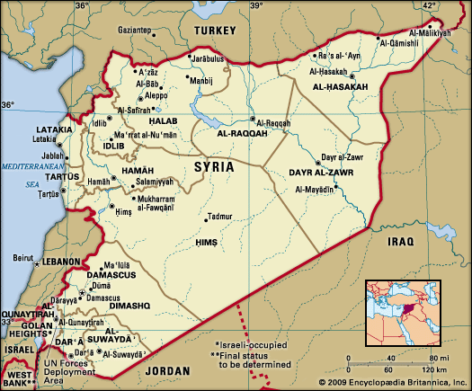
Syria – quickly and briefly
2010
Population 20,7 mil.
2018
6,2 mil. IDPs
5,6 mil. refugees in the region
(UN OCHA 2018)
Pre-war economy
Agriculture
Oil extraction
Food and textile industry

Slide 7
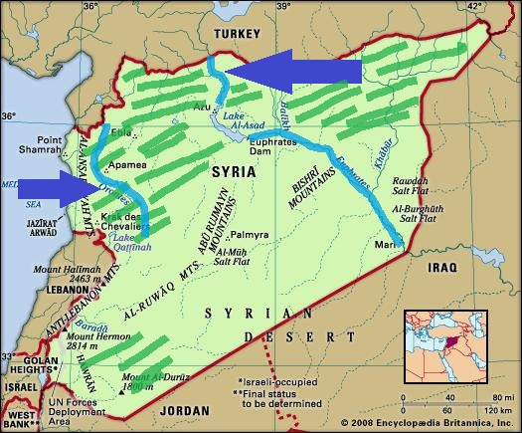
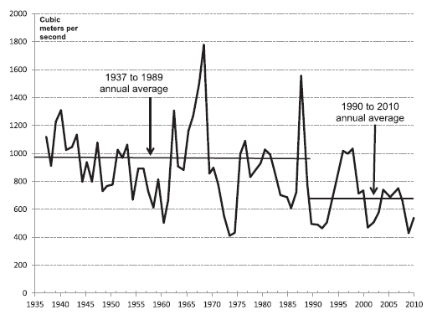
Syria – water resources and agriculture

Slide 8
Draught 2006-2010
Worst draught in the Mediterranean in 900 years? (Cook et al. 2009)
Massive reduction of rainfall
Temperature increase and reduction of rainfall during the winter months
Eastern Syria: 1,3 mil people affected, 800 thousand lost their living
Livestock reduction– decrease of livestock population by 60 %
Government´s mistakes
Selling the stockpiles of wheat
Cultivation of cotton
Ineffective method of irrigation
Regulation of well drilling

Slide 9
Impacts of draught
Is the draught direct cause behind the Syrian civil war?
Migration to the cities (Aleppo, Damascus, Hama, Homs)
Increase of unemplyement
Singificant increase of prices of food, water and fuel
Reduction of agricultural land

Slide 10
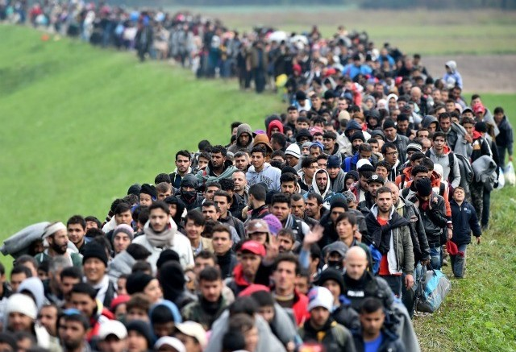
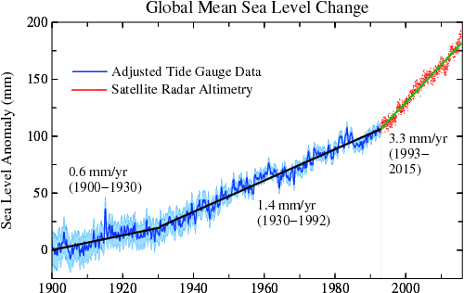
Conflict potential of climate change
Climate change
Decreasing level of ground water in China, India, USA
Loss of agricultural land
Uneconomic agriculture
Erosion
Desertification
Urbanisation
Risnig sea levels
Glaciers
Population growth

