Slide 1
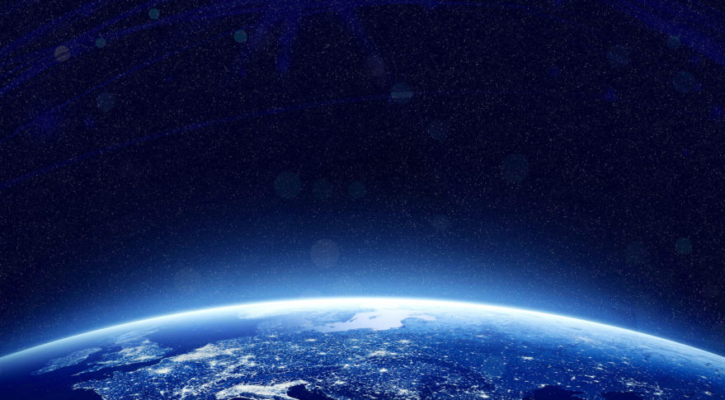
Modern Technologies and Conflicts
Space Security
3.10.2018
Marek Dvořáček

Slide 2
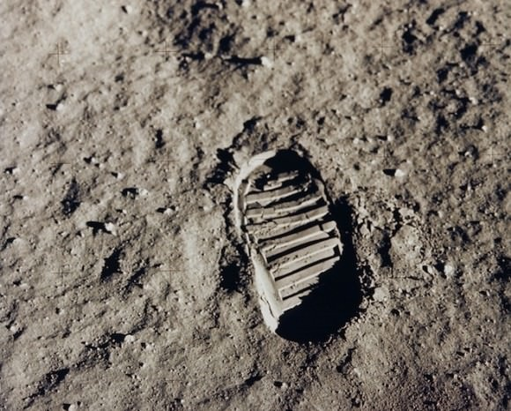

Slide 3
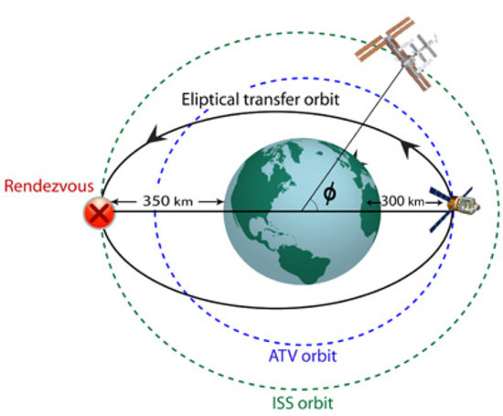
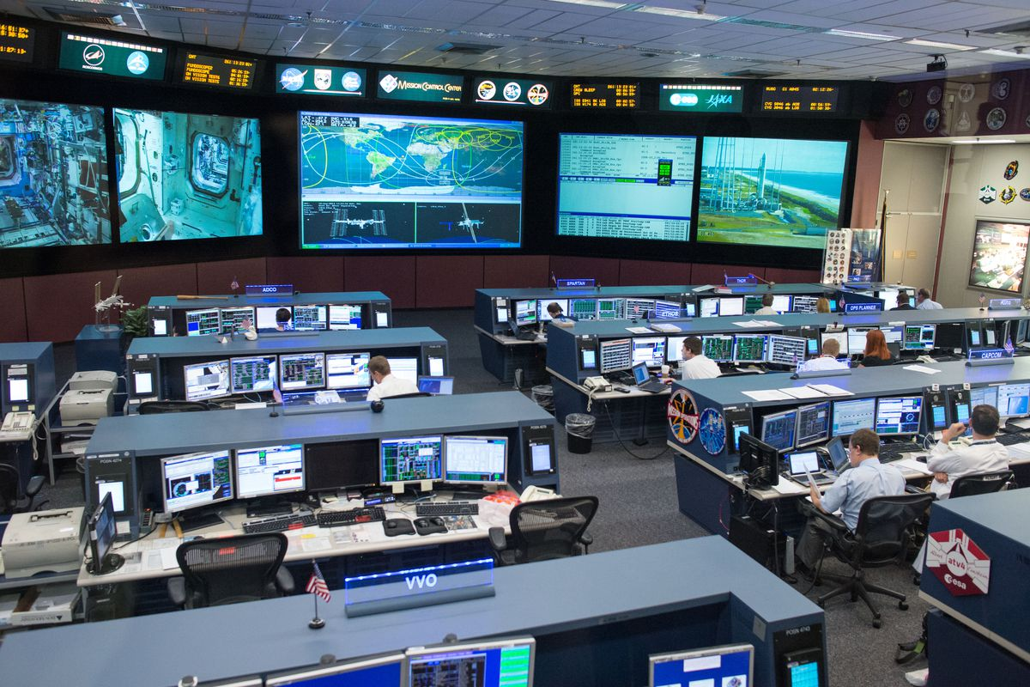
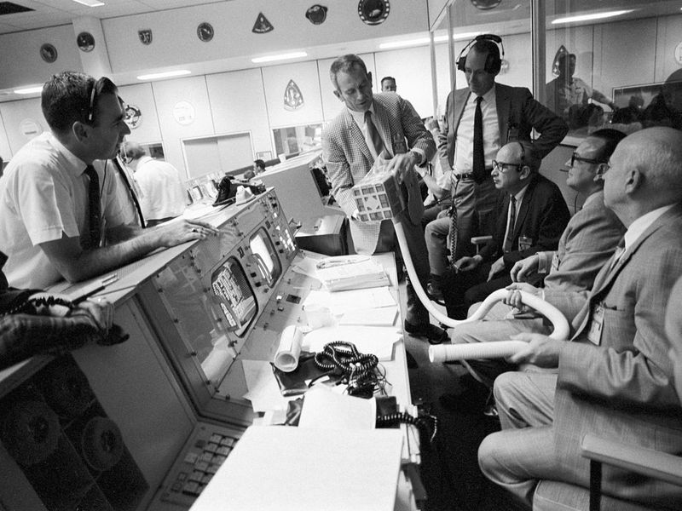

Slide 4
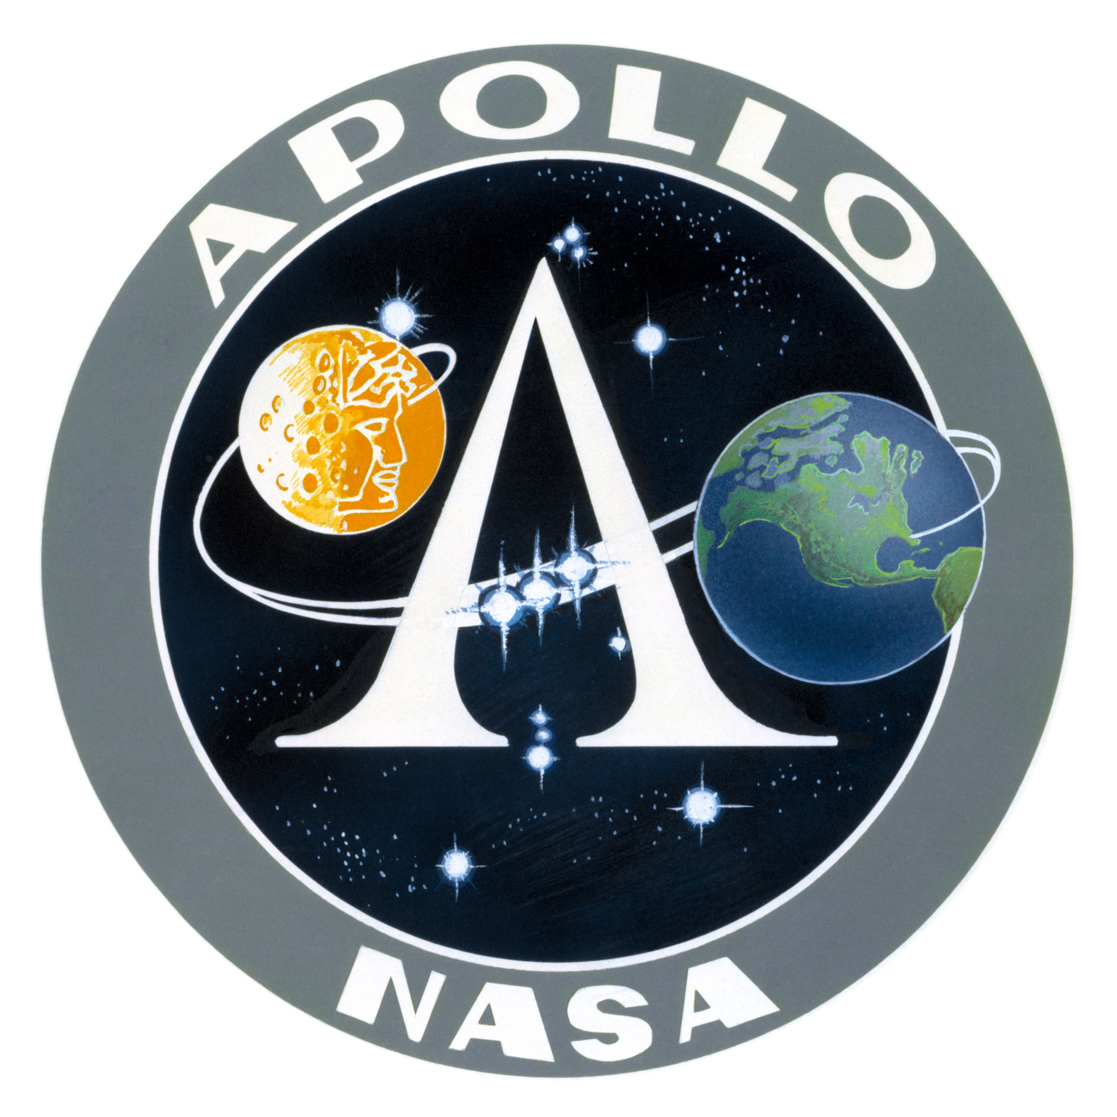
Neil Armstrong and Buzz Aldrin
Pete Conrad, Alan Bean,
Alan Shepard, Edgar Mitchell,
David Scott, James Irwin,
John Young, Charles Duke,
Eugene Cernan, Harrison Schmitt

Slide 5
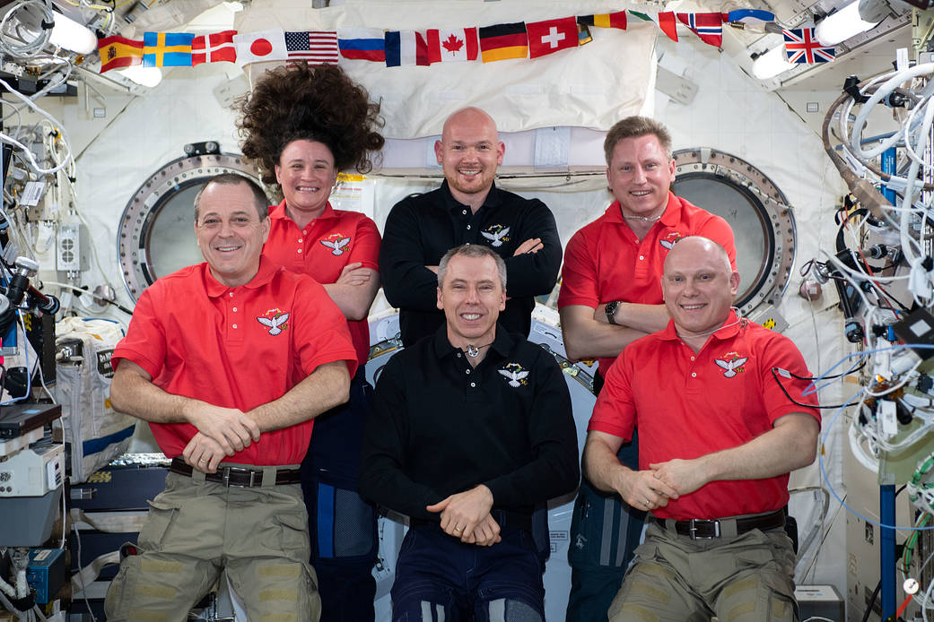

Slide 6
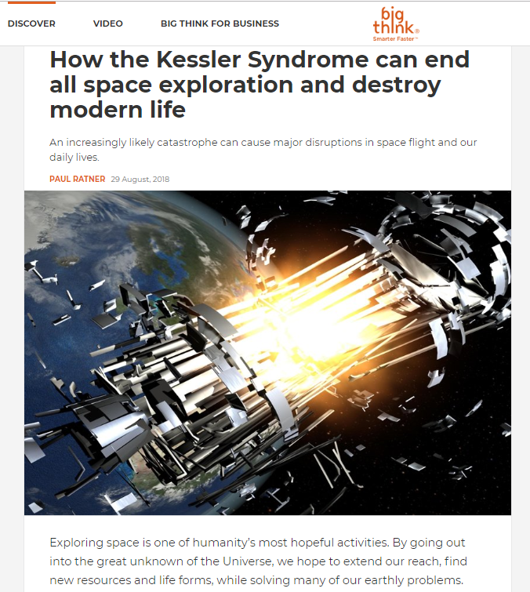
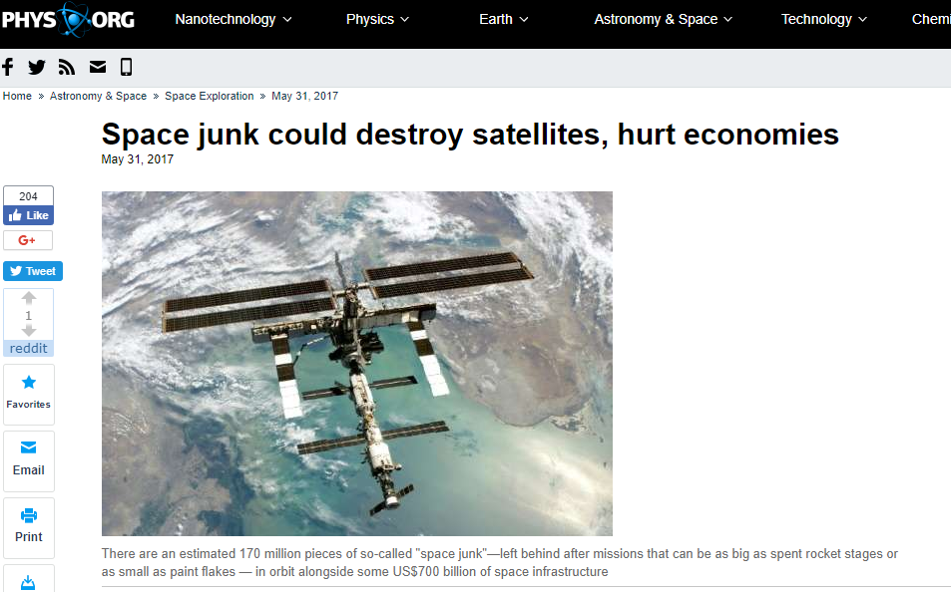
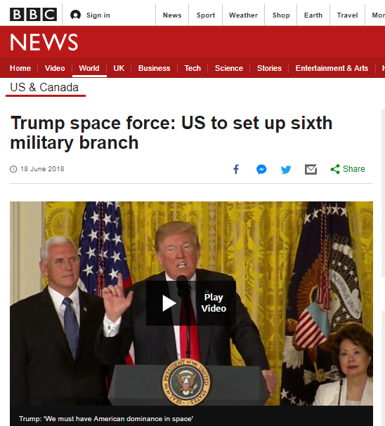
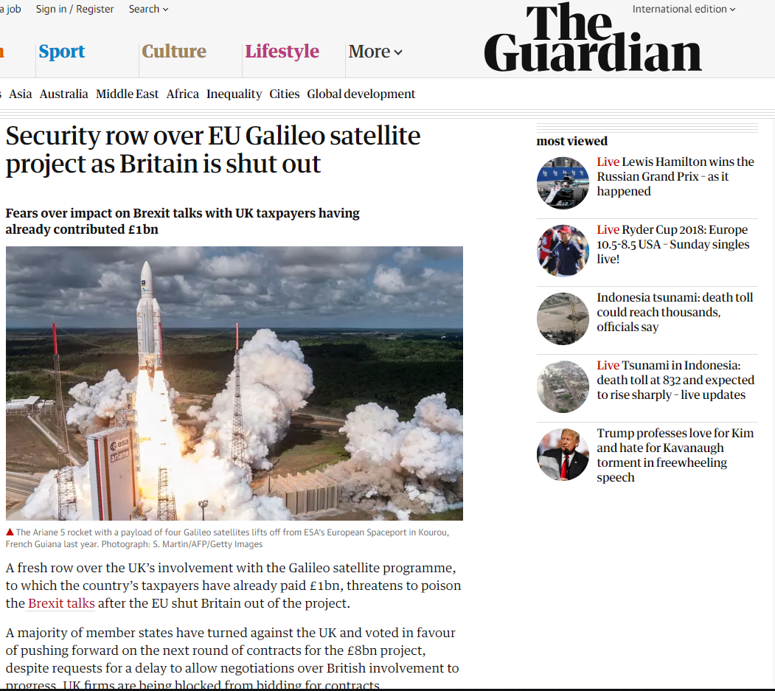

Slide 7
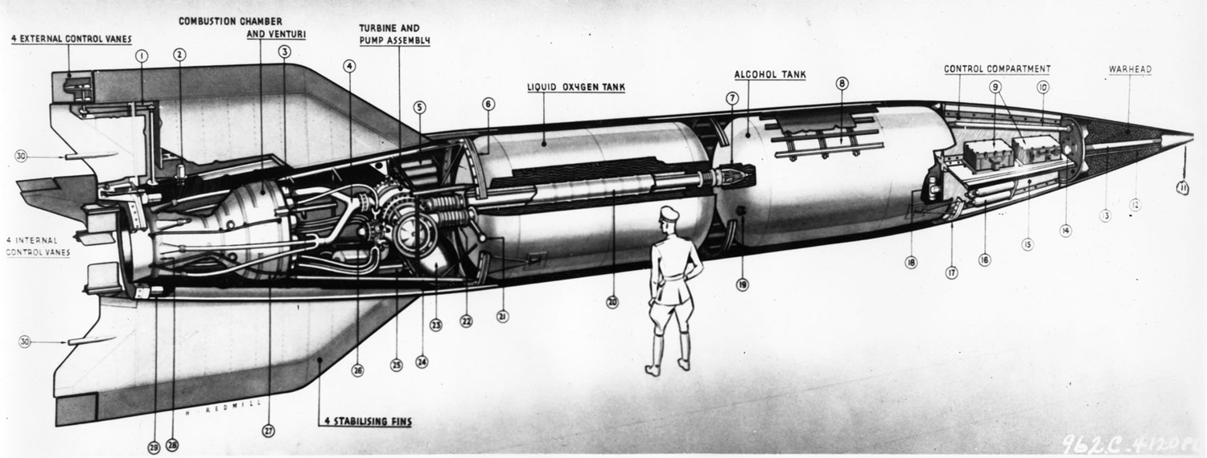
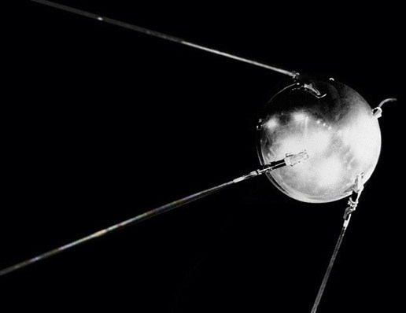
1) Outer space and Kármán line
the atmospheric boundary at the altitude of 100 km (62 miles)the highest achievable point for ordinary aviation: Aeronautics
the highest achievable point for ordinary aviation: Aeronautics
the lowest point under which the atmosphere is too dense for a spacecraft to remain on a stable orbit without a continuous pull of its drive: Astronautics
(altitude where the speed necessary to aerodynamically support the airplane's full weight equals orbital velocity (assuming wing loading of a typical airplane). In practice, supporting full weight wouldn't be necessary to maintain altitude because the curvature of the Earth adds centrifugal lift as the airplane reaches orbital speed)
2) history – 1942
- Vergeltungswaffe 2
- 1957
Sputnik-1

Slide 8
Satellites

Slide 9
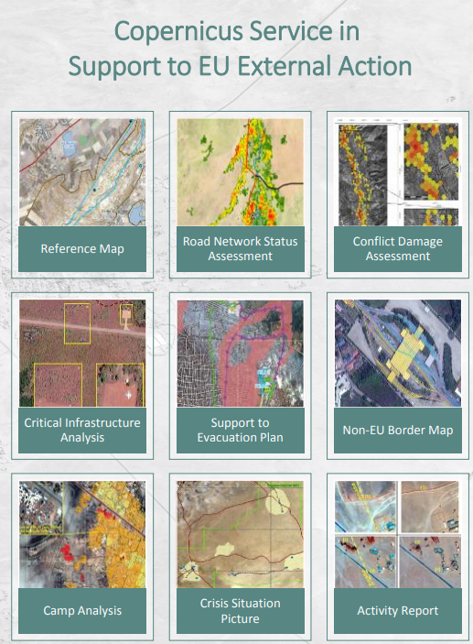
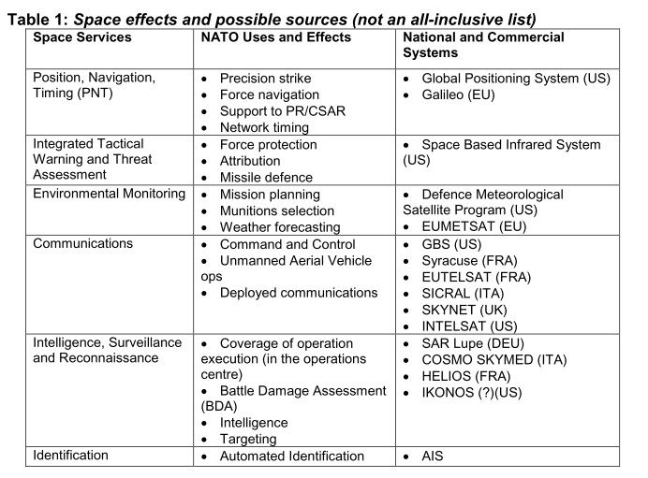
GeoInt

Slide 10
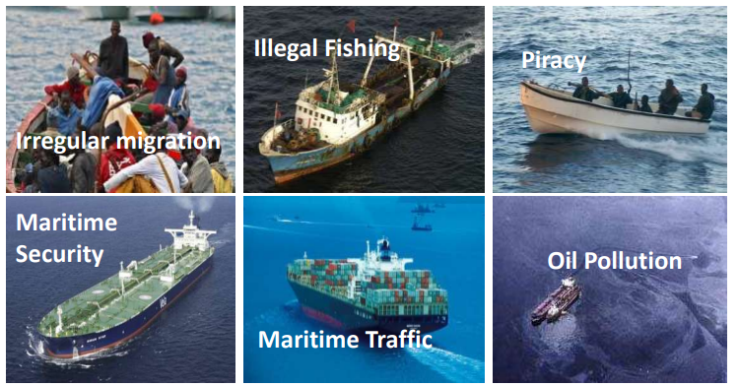

Slide 12
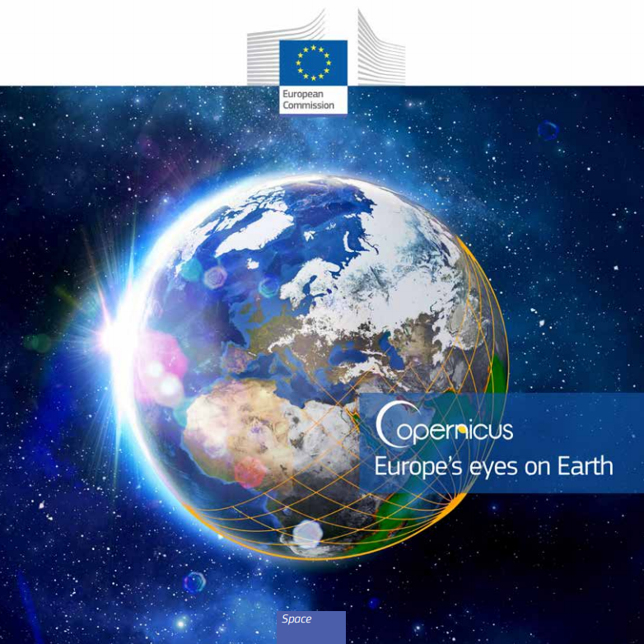
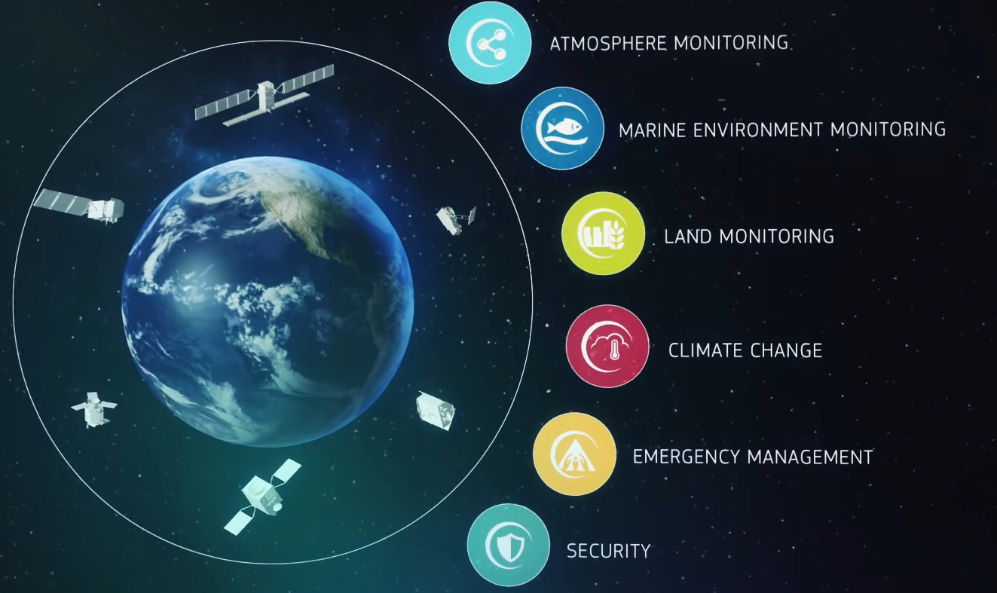
Copernicus
https://www.youtube.com/watch?v=MGJss4lDaBo

Slide 13
Support to EU External Actions (implemented in partnership with the European Union Satellite Centre and the Emergency Management Service);
Maritime surveillance (implemented in partnership with the European Maritime Safety Agency, EMSA);
Border surveillance (implemented in partnership with FRONTEX).

Slide 14
Space Security Definition:
„Secure and sustainable access to space and its use, as well as freedom from threats emanating from space.“
Definition based upon Outer Space Treaty principles (of 1967)
Outer space should remain freely sustainable for all to peaceful use now and in the future
Clay Moltz:
the ability to place and operate assets outside the Earth’s atmosphere without external interference, damage, or destruction
The three dimensions of space Security by Jean-François Mayence:

Slide 15
Three dimensions - interrelated areas
I) Outer space for security:
Satellite systems contributing to security and defence initiatives
II) Security in outer space:
Keeping space assets and infrastructure intact against natural and human risks. Maintaining sustainable development
III) Security from outer space:
Protecting humanity and the environment from natural threats and risks originating in outer space

Slide 16
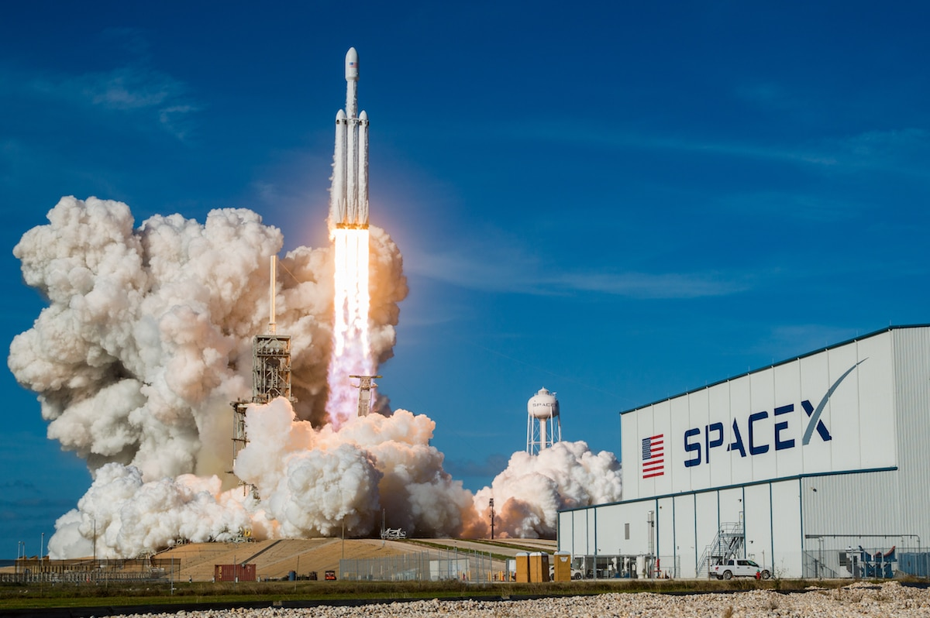
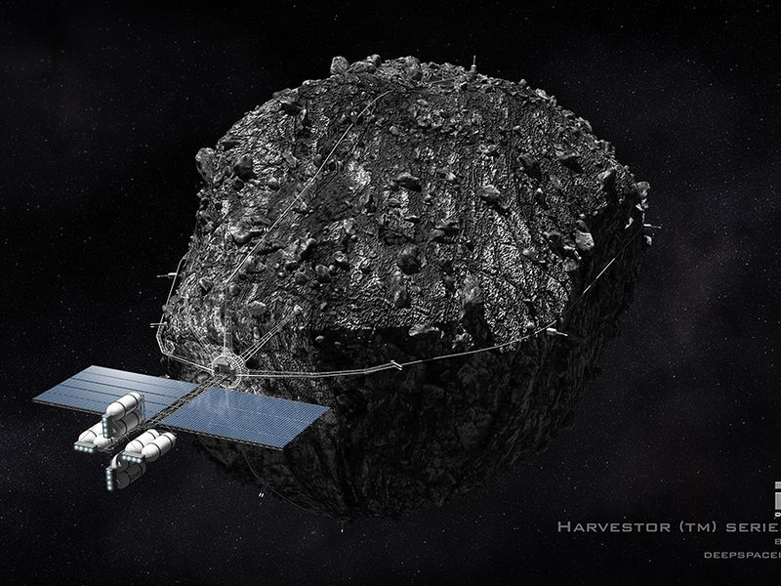
Current trends
Privatization + commercionalization
Turism
Asteroid mining?
Growing number of actors
NewSpace /
Space 4.0

Slide 17
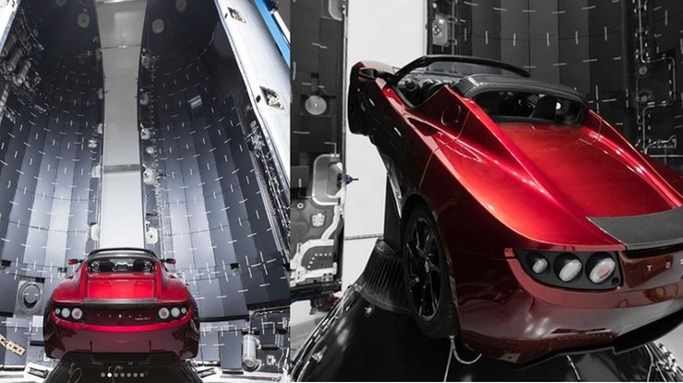

Slide 18
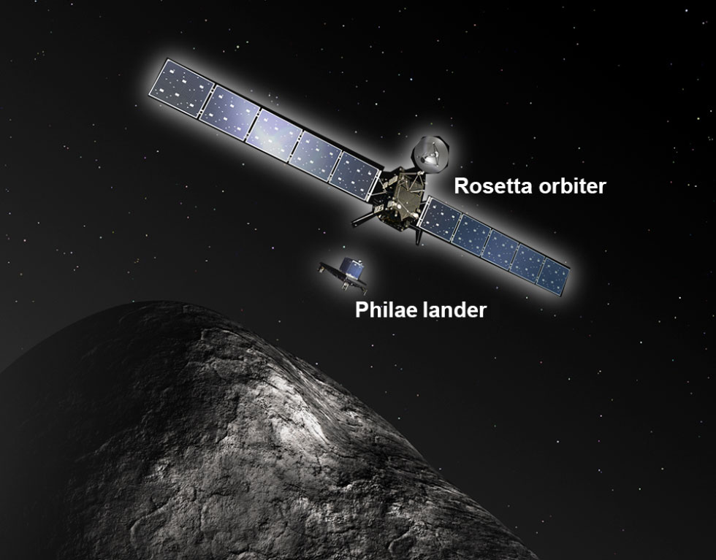
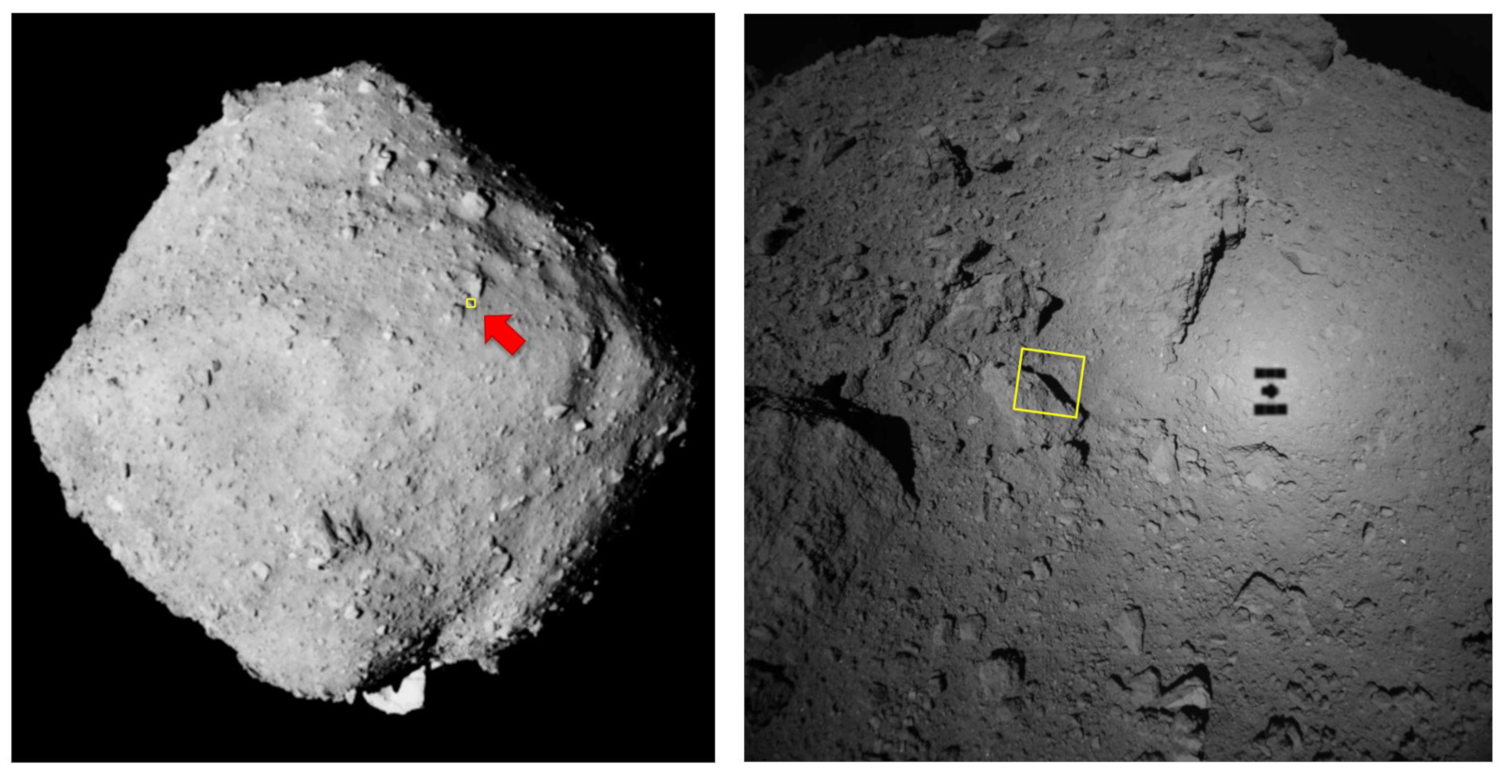
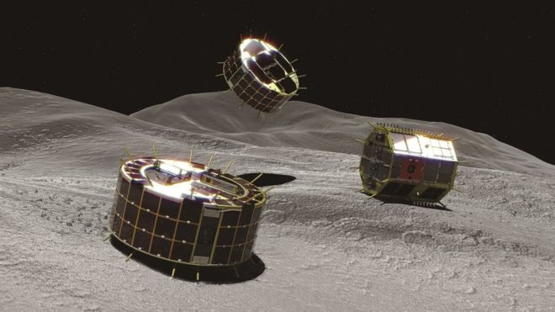

Slide 19
NewSpace
Technological progress = large amount of actors and assets
Cheaper development, production and operation of satellites and launchers
Various industrial sectors - such as IT companies, investment and media companies
New approaches, emphasis on innovation, lowering the overall price due to competition
Products are not perfect but sufficient
Priority is given to a lower price before a perfect performance, reliability and endurance
More efficient and simpler manufacturing processes
Cheaper components, 3D printing, open source software, adaptable production model

Slide 20
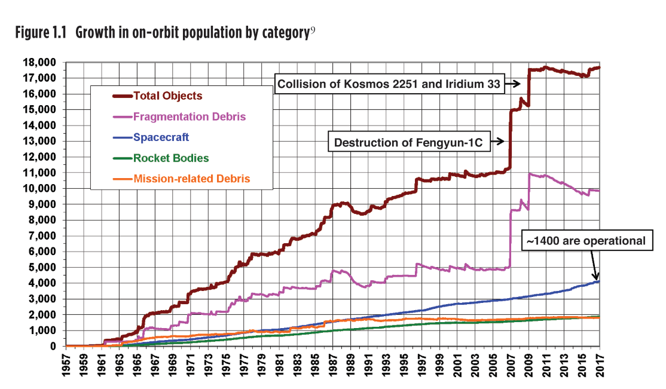
Risks and threats
1) Space debris
Kessler syndrome
2) Anti-satellite weapons
Conventional
Nuclear
Direct energy – radiofrequency, microwave and laser techniques
Jamming / disruption / destruction
3) Cyber
Only non-kinetic capabilities are actively being used in current military operations

Slide 21
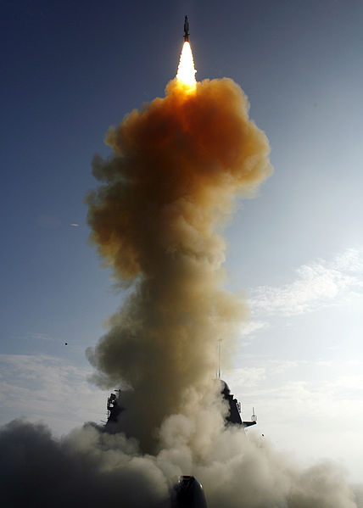
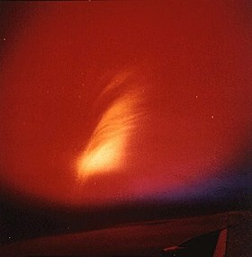
Starfish Prime SM-3 missile Fengyun-1C 1962 2008 2007

Slide 22
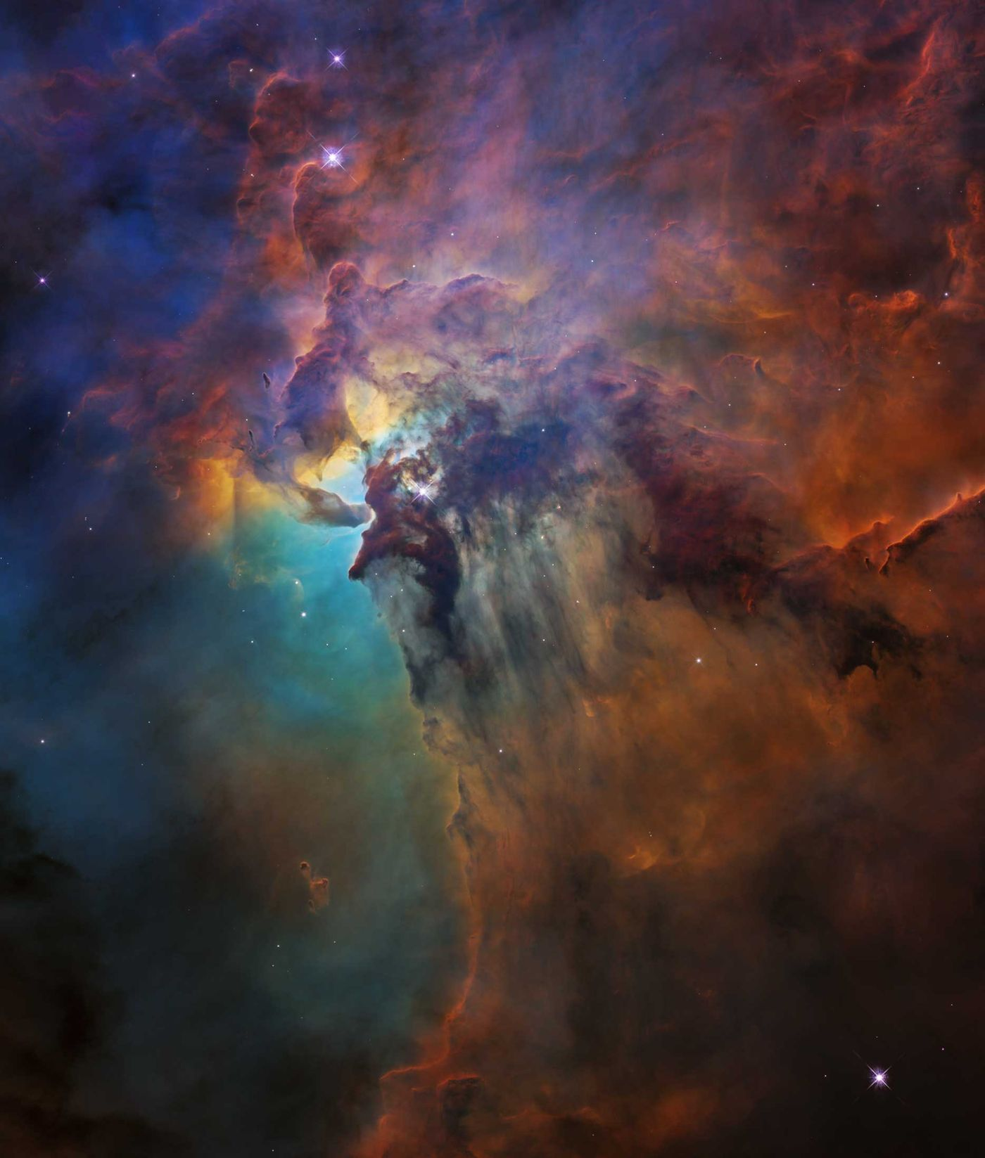
What topics to follow?
Private sector
Legal system
Miniaturization – microsatellites
Evolution of autonomous systems
Antisatellites system
Planetary Defence

Slide 23
http://spacesecurityindex.org/2018/06/
https://espi.or.at/news/public-espi-report-64-security-in-outer-space-rising-stakes-for-europe
MAYENCE, Jean-Francois. 2010. Space Security: Transatlantic Approach to Space Governance
MOLTZ, James Clay. 2011. The Politics of Space Security: Strategic Restraint and the Pursuit of National Interests
DRMOLA, Jakub a Tomas HUBIK. 2018. Kessler syndrome: System dynamics model. Space Policy. Available from: http://linkinghub.elsevier.com/retrieve/pii/S0265964617300966
http://copernicus.eu/sites/default/files/documents/Brochure/Copernicus_brochure_EN_web_Oct2017.pdf
https://www.businessinsider.com/space-race-anti-satellite-china-russia-war-us-2017-07#ampshare=http://www.businessinsider.com/space-race-anti-satellite-china-russia-war-us-2017-07
http://www.thespacereview.com/article/3331/1
https://www.ted.com/talks/will_marshall_the_mission_to_create_a_searchable_database_of_earth_s_surface
ASBECK, Frank, 2015. Policy Framework for Space Security Activities in the EU. In: Youtube.com [online]. Available from: https://www.youtube.com/watch?v=xGKdT8oYBX0
THE UK MILITARY SPACE PRIMER. 2010. An introduction to potential military uses of space. [online. Available from: https://assets.publishing.service.gov.uk/government/uploads/system/uploads/attachment_data/file/33691/SpacePrimerFinalWebVersion.pdf
SATCEN EU. 2018b. EU Satellite Centre Annual Report 2017. European Union Satellite Centre [online]. Available from: https://www.satcen.europa.eu/key_documents/EU%20SatCen%20Annual%20Report%2020175af3f893f9d71b08a8d92b9d.pdf
https://swfound.org/media/206118/swf_global_counterspace_april2018.pdf

