Slide 1
IT and the state
17. 10. 2018
Veronika Netolická
Modern technology

Slide 2
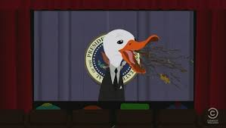
Disclaimer: Opinions presented in this lecture and the views of the author do not necessarily follow the views of the employer

Slide 3
In general
Specific
Behavior
Activities
Purpose

Slide 4
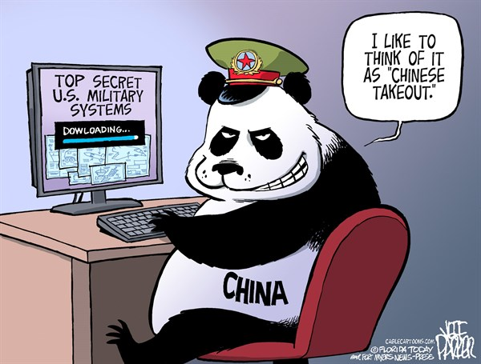
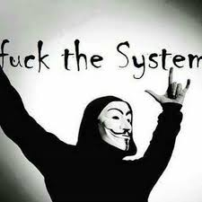


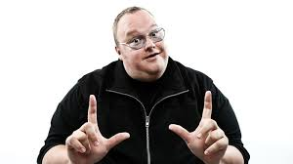
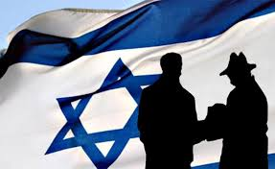
Ideology
Individuals State
Profit
Hacktivism Militia Cyberterrorisms
Espionage
Sabotage
Financial crime
Stolen identity

Slide 5
Triad of cyber security
CIA
Confidentiality
Integrity
Availability

Slide 6
Main state activities in cyberspace
Espionage
Sabotage
Censure
Information war/propaganda
Demonstration of power
Support of conventional attack

Slide 7
Cyber espionage vs. Sabotage
Espionage
Obtaining strategically sensitive or strategically important information from individuals or organizations by using or targeting IT means. It is used most often in the context of obtaining a political, economic or military supremacy.
Sabotage
Deliberate action aimed at weakening a polity or corporation through subversion, obstruction, disruption or destruction. In a workplace setting, sabotage is the conscious withdrawal of efficiency generally directed at causing some change in workplace conditions.

Slide 8
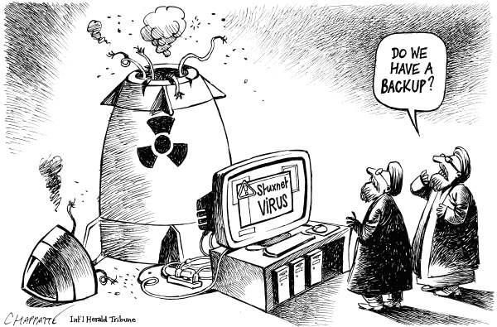
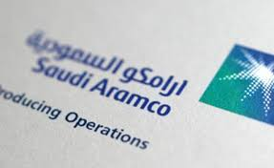

Cases

Slide 9
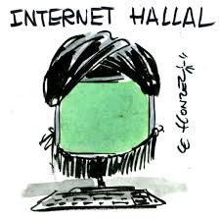
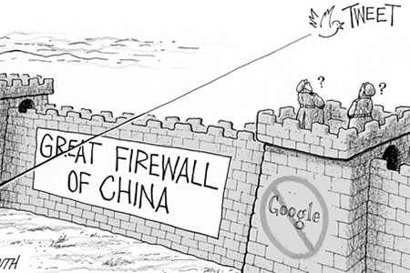
Censure
Commonly link with non-democratic regime
Halal internet vs. forbidden applications
Using different ways from residents

Slide 10
Demonstration of power
Estonia (2007) and Latvia (2008)
Similar modus operandi (DDoS, defacement and malware)
Russian Federation – absence of direct evidence
Estonia - due to the removal of the bronze statue of an unknown Soviet soldier
for RF symbol of freedom vs. symbol of occupation
Latvia – main reasons: law about non-acceptance Nazi and Soviet symbols, planning of American antimissile defense

Slide 11
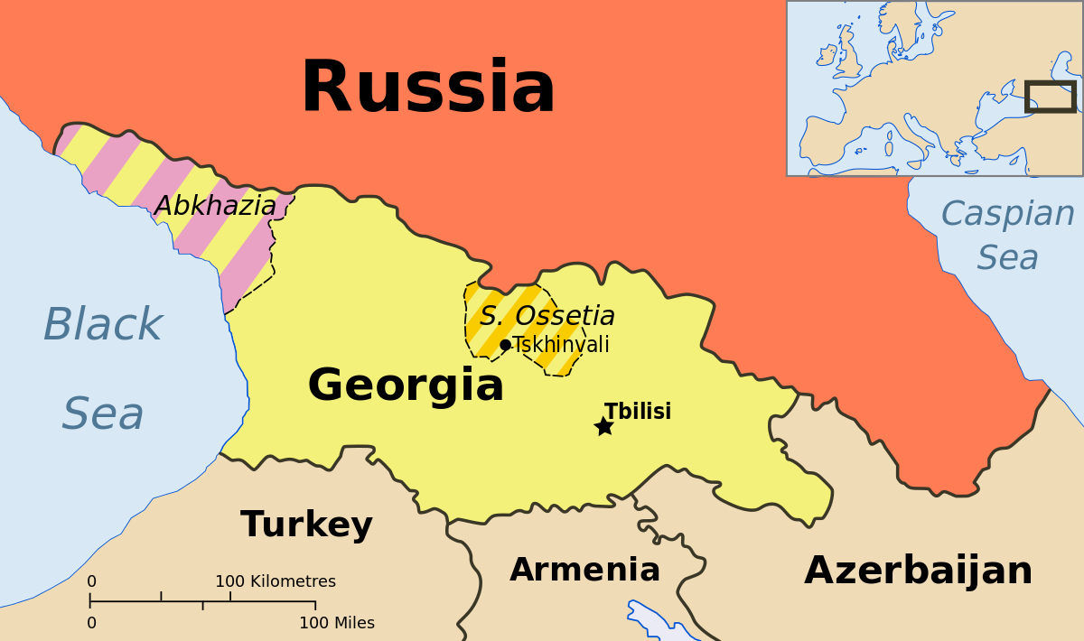
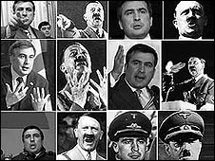
Support conventional attack
Georgia (2008)
In the background of a five-day war
Target: destroying of active communication and information
Methods: defacement, DoS, DDoS, malware
Patriotic hacking (nationalistic mode in society)
Russian Business Network
Attacks also on RF

Slide 12

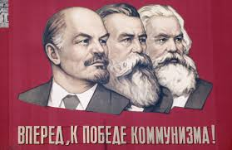

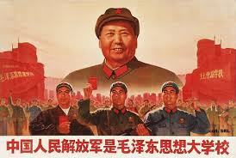
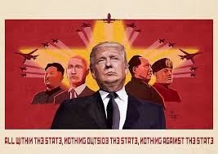
Information war/ propaganda

Slide 13
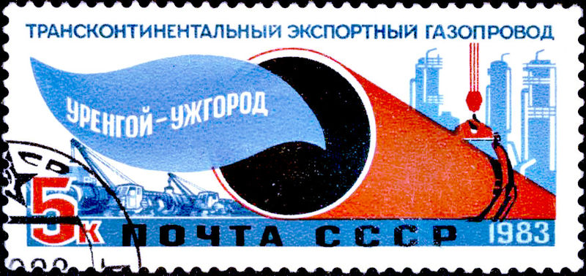
Demystification ???
1982: trans-siberian sabotage

Slide 14
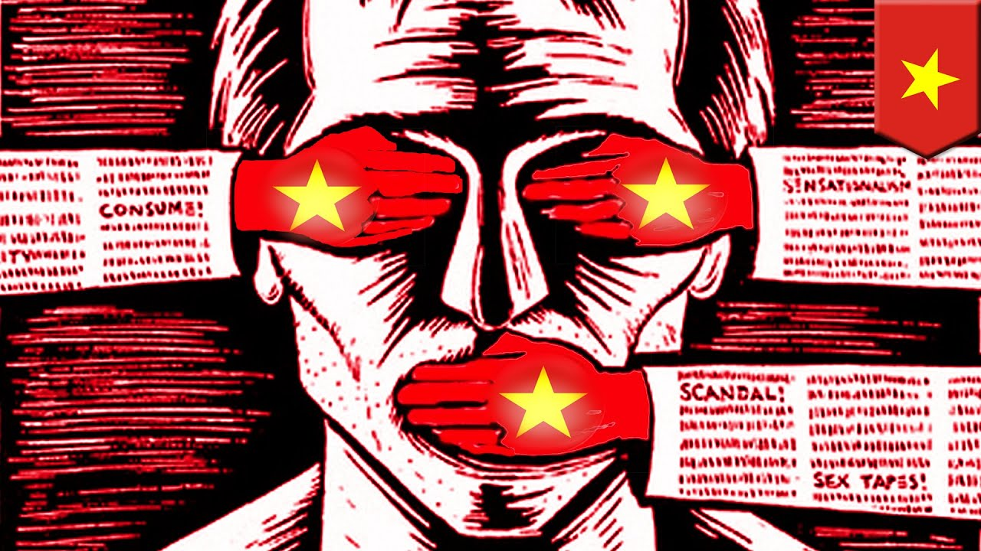
Case study – Việt Nam

Slide 15
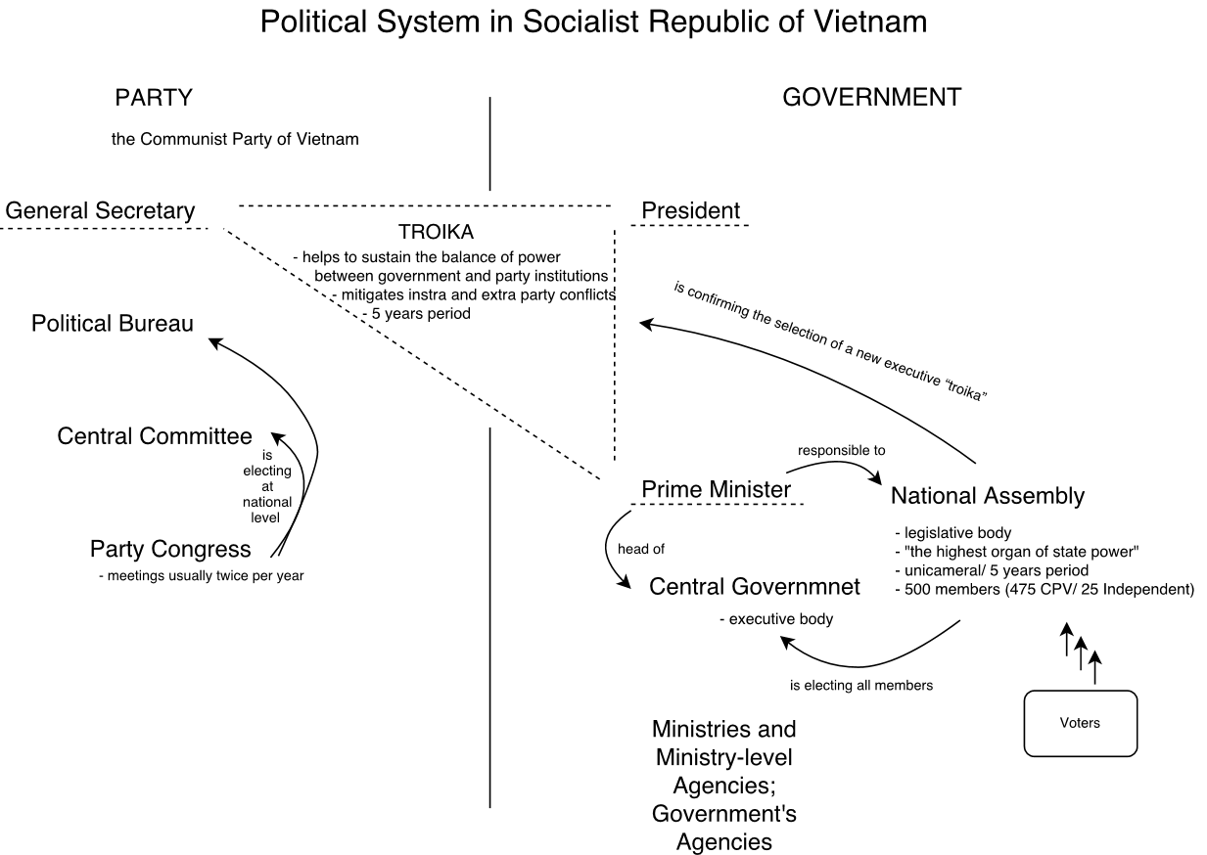

Political and historical background I.
one-party system state represented by the Communist Party of Vietnam (CPV)
moves to market-oriented socialism
1994 – domain .vn has been registered
1997 - system administration VNPT
Telecommunication - Vittel

Slide 16
Political and historical background II.
The Government formed the National Internet Steering Board
penetration rate of 66,3 percent
only companies that are state-owned can operate as Internet access service providers or Internet exchange providers

Slide 17
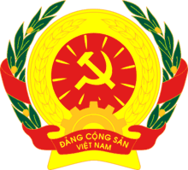
Place of cyberspace today
The continuation of the rule CPV
Internet as a place for foreign investments
Manipulation of information

Slide 18
Important actors
The Ministry of Information and Communication
Authority for regulation, publication (newspapers) and telecommunication, IT,…
the Authority of Information Security
the Vietnam Computer Emergency Response Team (VNCERT)
The Ministry of Public Security
New Cyber Security Law
The Ministry of National Defense
the Cyber Space Operations Command (January2018) „help with the state surveillance for protection of the state sovereignty“
Unit/Force 47 (10 000 members)

Slide 19
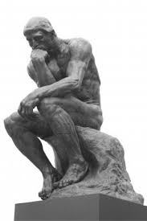
Surveillance I.
Freedom House (2018) - Net Freedom Status: not free
Internet as a tool of destabilization for CPV
Article 69 of the Constitution of the Socialistic Republic of Vietnam (1992)
x
Article 79, 88 and 258 of the Penal Code (1999)
Article 331 of the Criminal Code (2015)

Slide 20
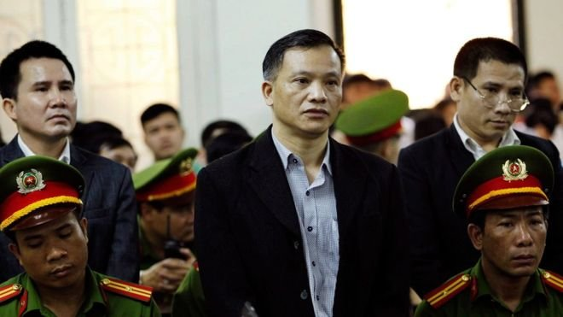
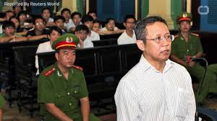
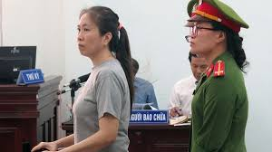
Surveillance II.
„propagandistic activities against CPV“
„threaten of democratic freedoms and the interests of the state“
„providing activities damaging the state administration“
Result:
- In 2017 - arresting 21 bloggers and activists
- Penalties 9 - 15 years

Slide 21
Surveillance III.
Using applications such as Facebook and Instagram in Vietnam is possible (it The Governmnet si able to block these networks in key moments in recent years – for example May 2016)
Removing „toxic“ content form YouTube and Facebook

Slide 22
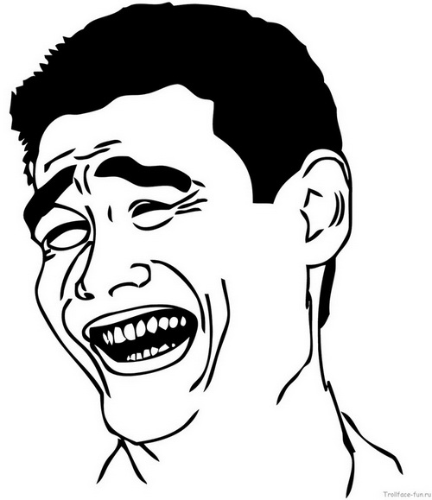
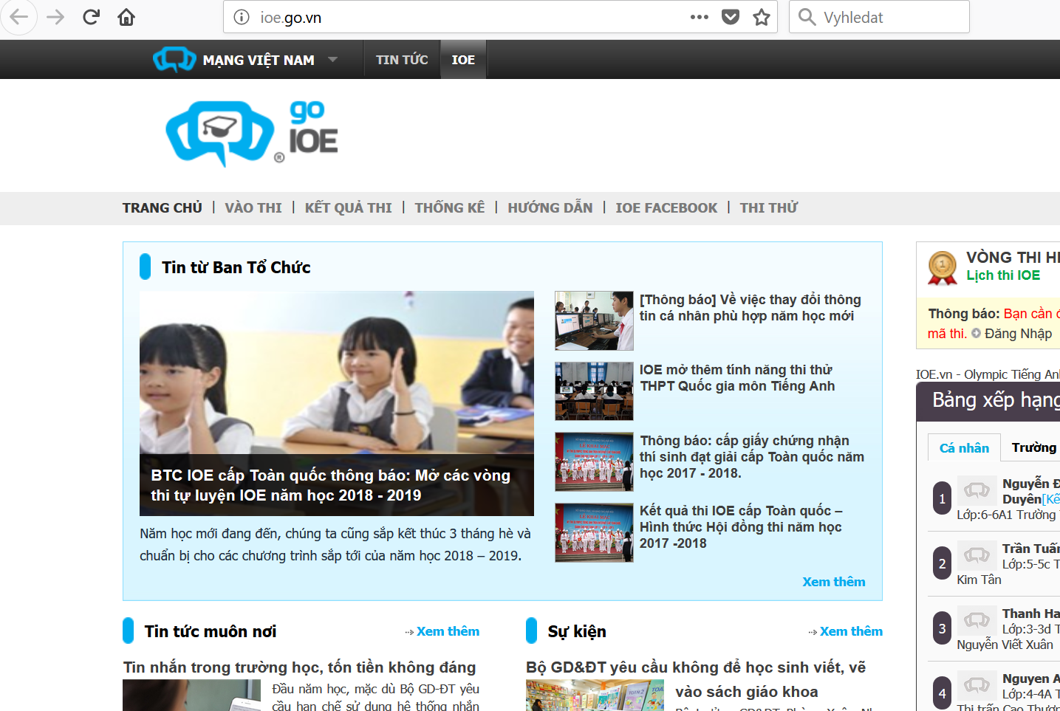
Go.vn

Slide 23
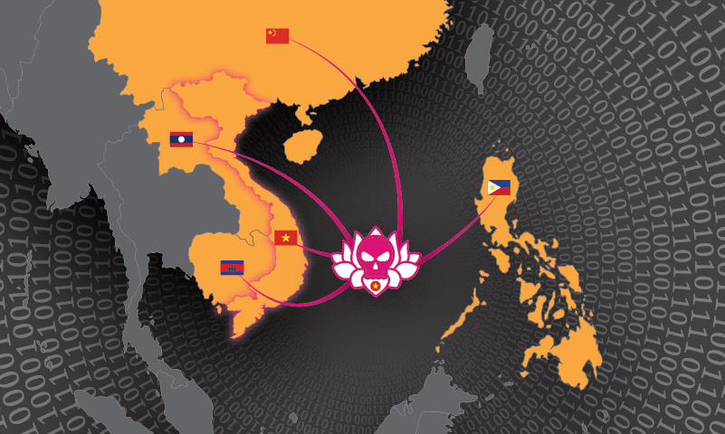
Cyber campaigns
APT32 (the OceanLotus Group -APT-C-00)
the most sophisticated groups of its kind in the region
since 2012
activities are associated with attacks targeting the Association of Southeast Asian Nations (ASEAN), human rights organisations, civil society organisations and also organisations across multiple industries and foreign governments, dissidents, and journalists
Until now, it has not been possible to associate the group cyberespionage activity with the Vietnamese government directly, but…
Other actors in region
Chinese 1937CN Team
Group from North Korea (APT37)

Slide 24
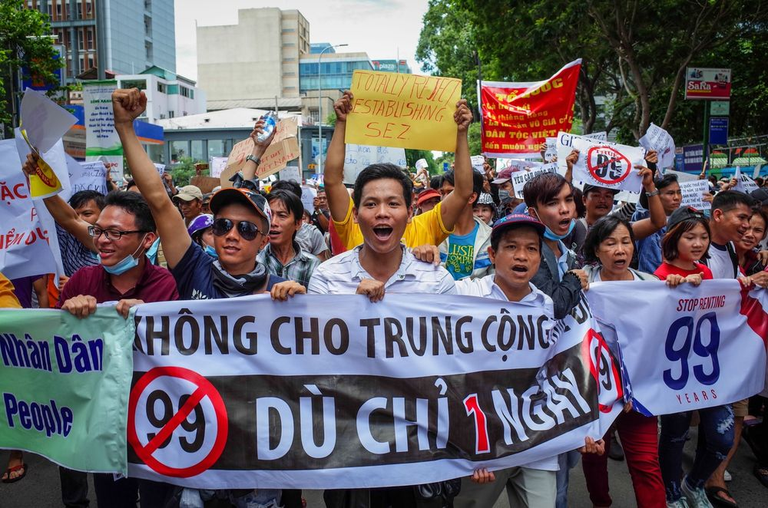
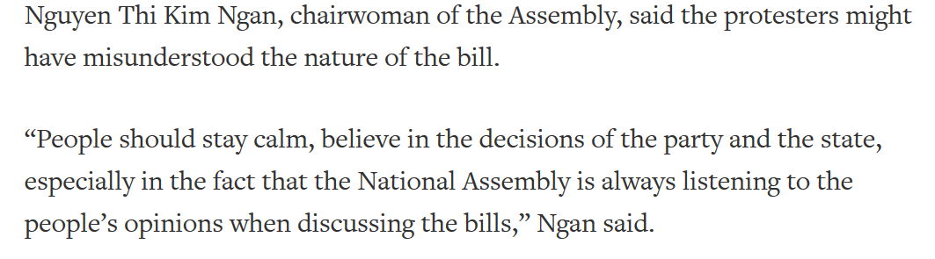
Current situation
The Cyber Security Law
-protests from public (restrictions on freedom of expression)
-protests from members of government (economic limitations)
-conclusion – The dragon is here
Efficiency: 1.1.2019
Accepted: 12.6

Slide 25
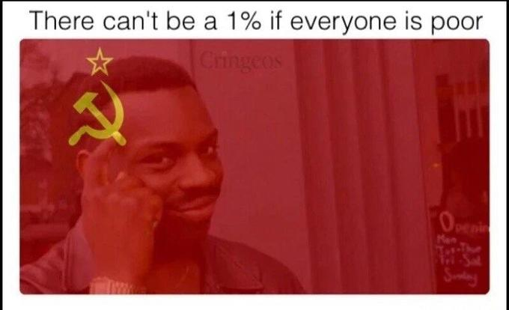
Conclusion
Vietnam does not focus on the survival of state as such, but the state is here symbolised by the regime

Slide 26
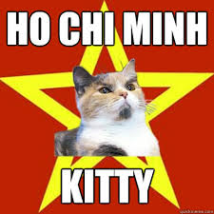

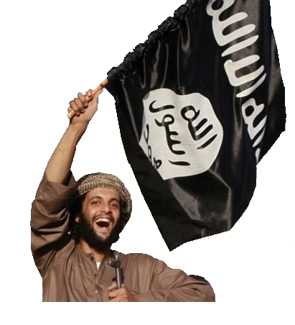
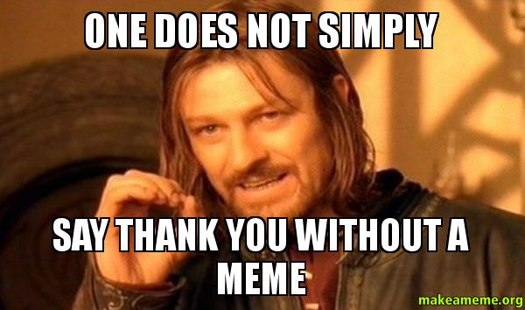

cảm ơn
v.netolicka@nukib.cz

