Slide 1
Cybersecurity
Part 2: Non-state actors
27.11. 2018
Jakub Drmola

Slide 2
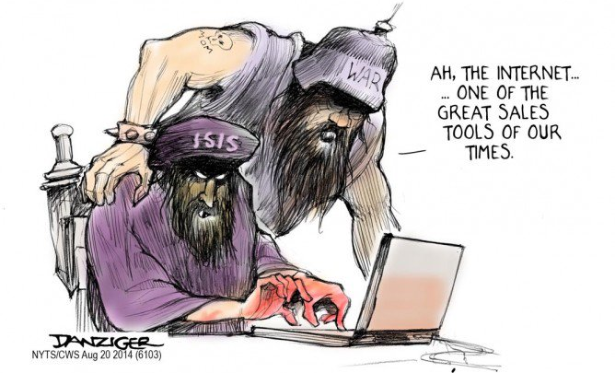
Cybeterrorism

Slide 3
What is terrorism?
extortion?
using threats and fear to get stuff?
logic of terrorism

Slide 4
victims
violence
fear
demands
attackers
audience

Slide 5
Typical features
violence, damage, fear
goal and representation
publicity
repeatability, campaign
symbolism, spectacle

Slide 6
Challenges
poor understanding among media and politicians
getting better only very slowly
rare overlap of politics and IT

Slide 7
Cyberterrorism is…
massive differences of opinion:
“terrorists on the internet”
recruitment, guides, propaganda, communication, planning
physical attacks on data infrastructure

Slide 12
History
first ideas towards the end of the Cold War
quick growth in 90s (+ Y2K)
explosion (figurative) after 9/11

Slide 19
Cases?
Queensland “cyberterror”, 2000
StuxNet, 2010
Lodz, 2008
Anonymous and LulzSec?
Estonia 2007 and Georgia 2008?
Siberian pipeline and mafia boss

Slide 20
Reality
imagined and unfulfilled concept
“nothing is happening”
not really true, things are happening all the time, but it is not cyberterrorism
why?
required combination of skills, motivation, resources
its too hard to match effectiveness of real terrorism

Slide 21
Future of cyberterrorism
Would we recognize it? What should it look like?

Slide 23
Hacktivism

Slide 25
Hacktivism
disrupting networks, misusing systems
support ideology, political goal, etc.
political activism adapted to the internet in 21st century

Slide 32
Brief history
roots towards the end of Cold War
hacktivism started from hackers
not from political activism
going all the way back to the counterculture
universities, corporations

Slide 34
Present?
rise since 2008
major force since 2010
covers all strains of politics and ideologies
Anonymous iconic
reality is much muddier

Slide 37
Anonymous
who are they?
where they came from?
why?
what do they want?
why the mask?

Slide 40
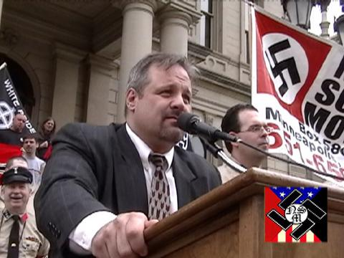

Slide 41
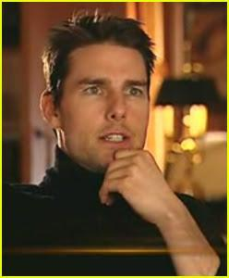
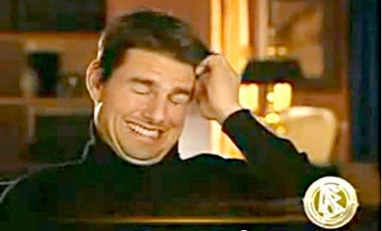
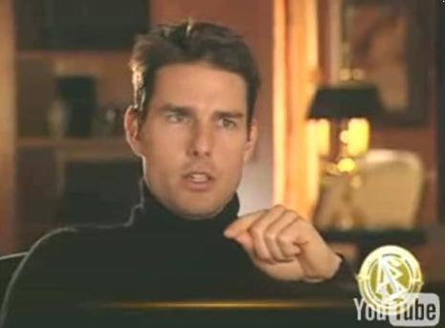

Slide 44
Videos
Scientology Tom Cruise video
https://www.youtube.com/watch?v=UFBZ_uAbxS0
Chanology declaration
http://www.youtube.com/watch?v=JCbKv9yiLiQ
11/11/11
http://www.youtube.com/watch?v=bUm5seVCpf4
We are Legion trailer
http://www.youtube.com/watch?v=gn9-80ObGA8
We are Legion excerpt
https://youtu.be/3SsLGPaYjvM?t=23m5s

Slide 47
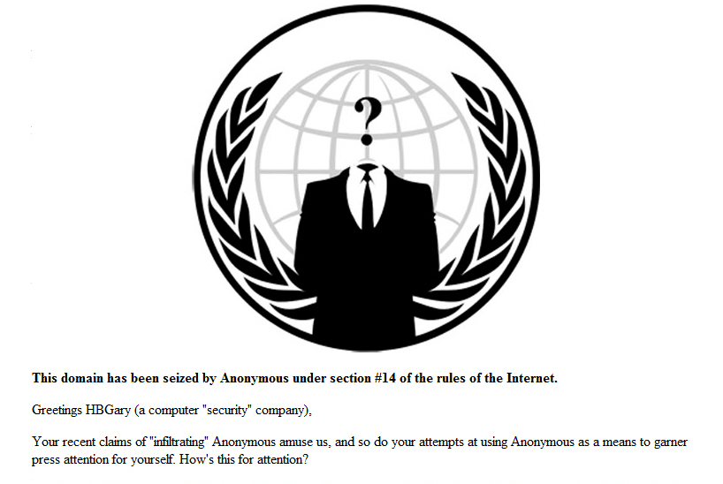

Slide 49
http://pastebin.com/HZtH523f

Slide 50
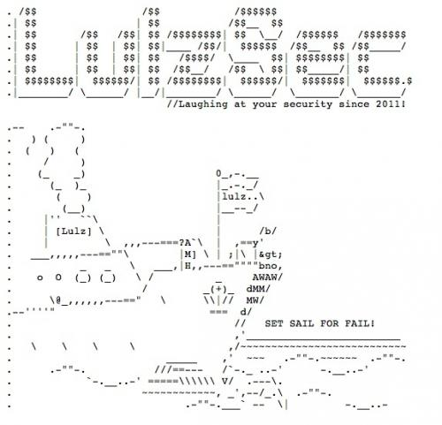

Slide 51
Pulling out all the stops
Sony
Arab spring
AntiSec
Vigilantism
against ultra-right, children porn
Stratfor
MegaUpload, ACTA
arrests
Syria, DPRK, Ukraine

Slide 52
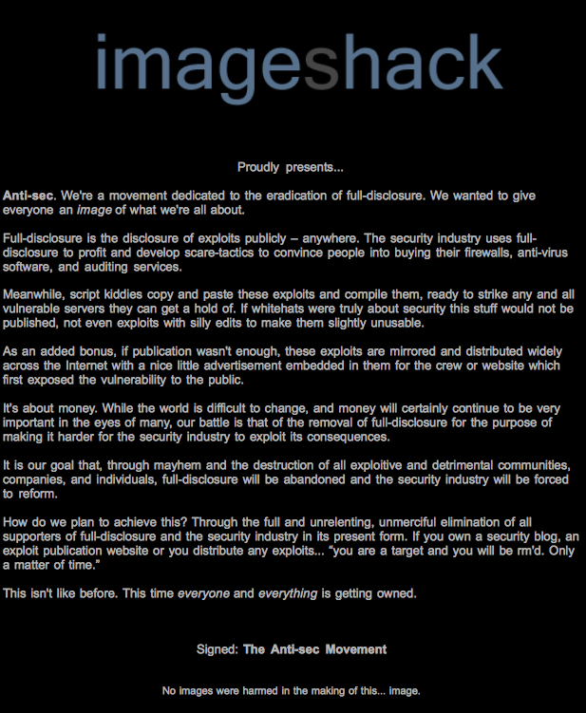

Slide 54
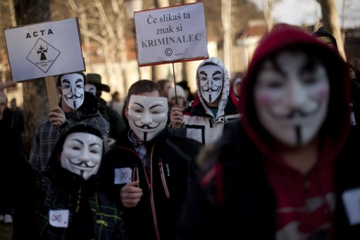

Slide 55
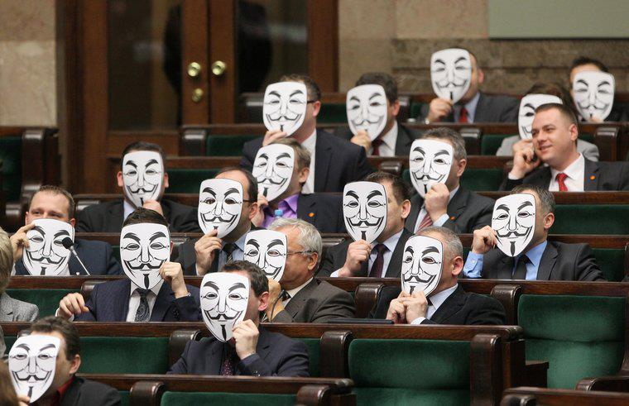

Slide 57
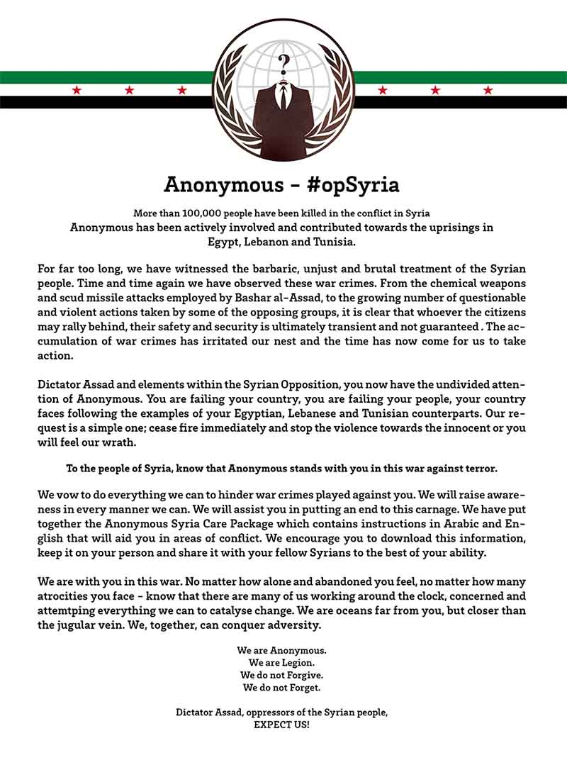

Slide 58
The spectrum of hacktivism
can be for anything
nationalistic
anarchistic
religious
vigilantism
ecological
dominant form is hybrid leftwing anarchism (Anonymous)

Slide 59
How dangerous is it?
compared to other threats, hacktivism is not especially dangerous
attacks are usually short
and more importantly – public!
hacktivism can also act as „immunization“

Slide 60
Structure and organization
not hierarchical
„adhocracy“
loose network structure
often even individual or separate groups in conflict with one another (see th3j35t3r)

Slide 61
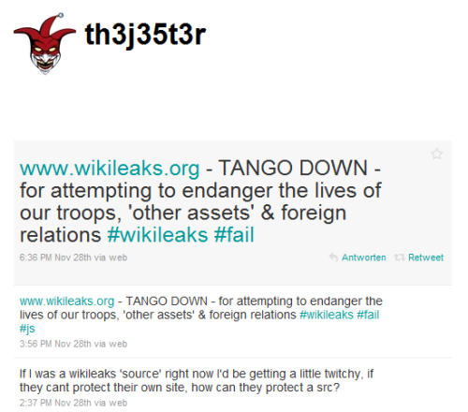

Slide 62
Targets
concept of „ops“
target selection is based on reactions and opportunities
therefore at least partially predictable

Slide 63
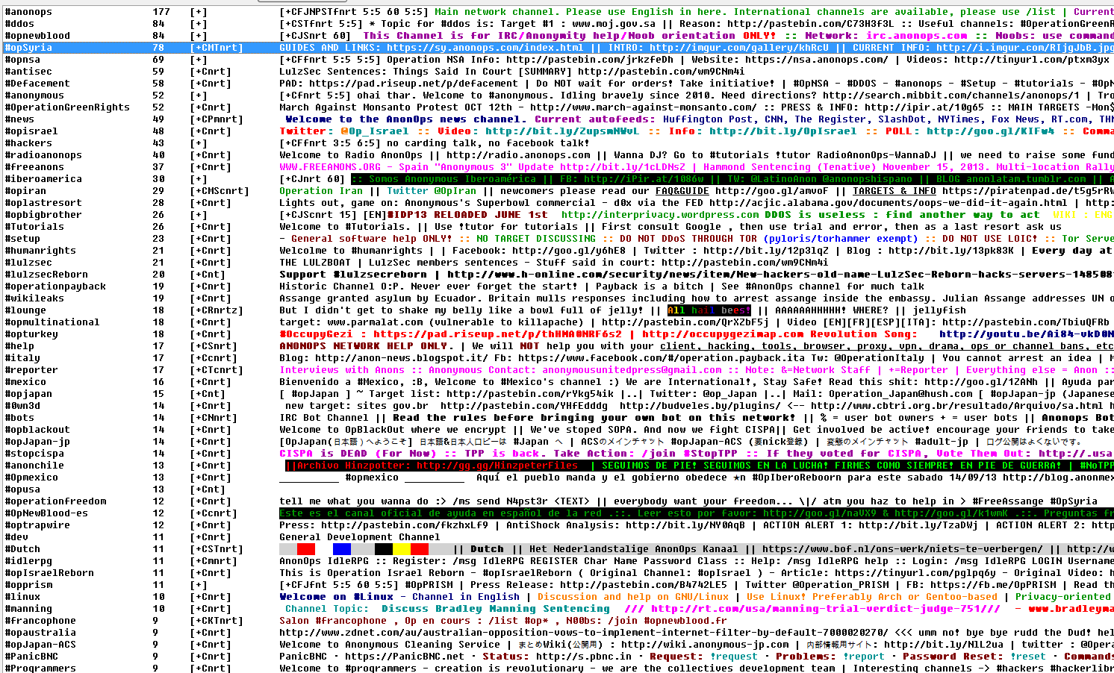

Slide 64
Tools and Methods
DDoS
botnets or LOIC and its derivatives (deniable?)
defacement
dox
communication and propaganda
twitter, youtube, facebook, blogs, IRC

Slide 65
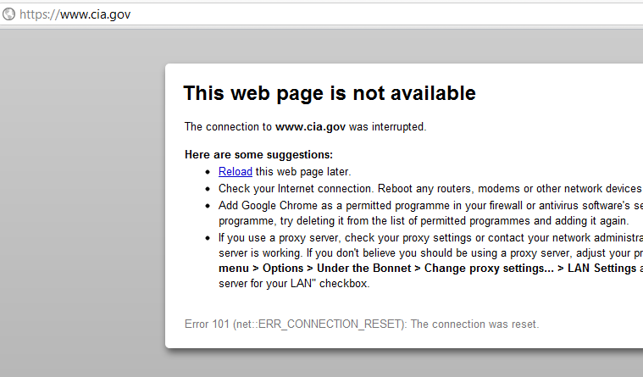

Slide 67
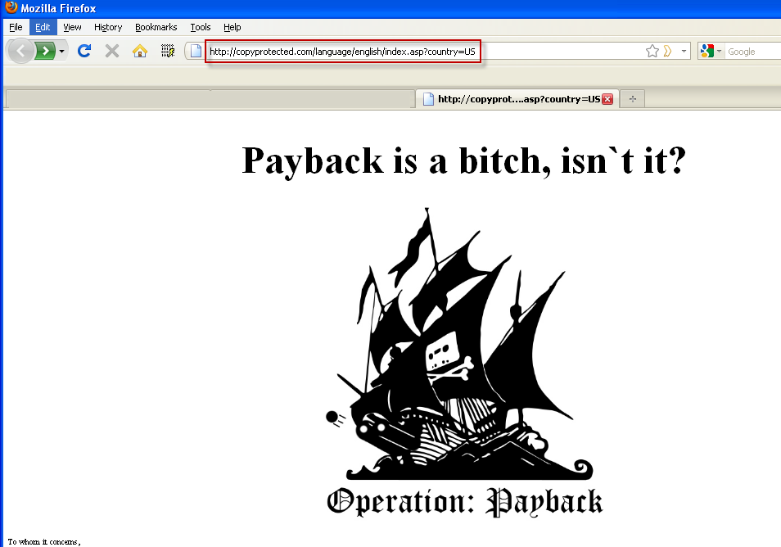

Slide 68
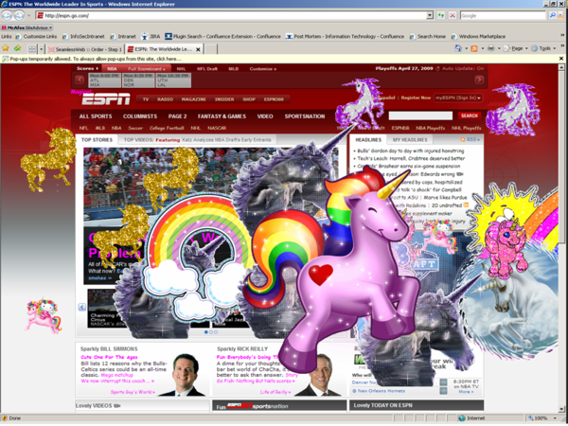

Slide 69
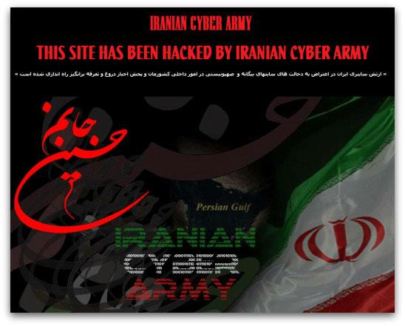

Slide 70
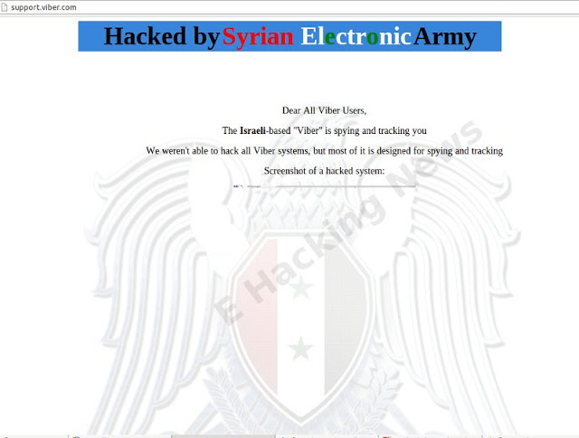

Slide 71
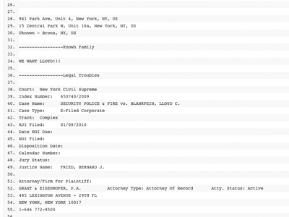

Slide 72
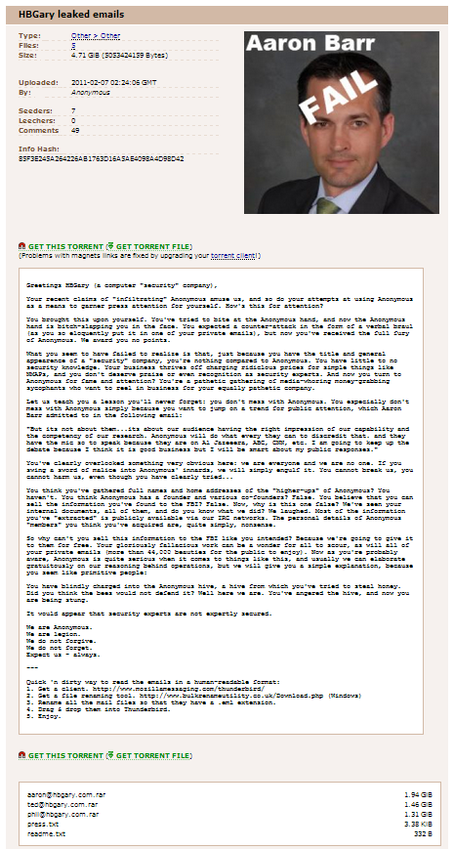

Slide 73
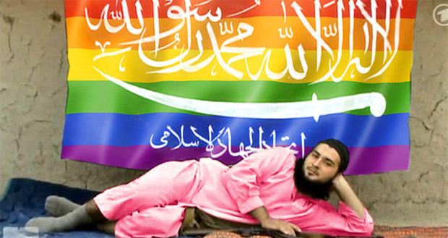

Slide 74
Future?
depends on three main pillars
people
who perform the attacks
tools
to perform the attacks with
causes
what are the attacks for
new cybermilitias and patriotic hackers?

Slide 76
