Slide 1
Conceptualization of information warfare
Petra Vejvodová
9 October 2018

Slide 2
Why is information important in conflict?

Slide 3
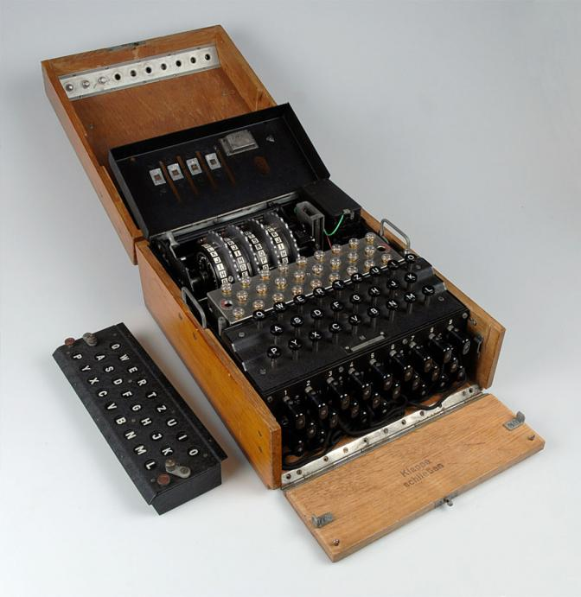
Information warfare
Information is not a new component to conflict
Information about the enemy crucial for all sides of any conflict
Deception
For centuries, cryptography has been used to
hide and reveal messages (Enigma)

Slide 4
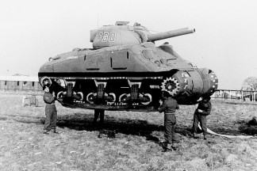
Day D – operation Bodyguard
Code name for 2WW military deception employed by the Allied nations during the 1944 Normandy landing
To mislead the German high command as for the location of the invasion (Normandy vs. Pas de Calais)
Fictional army and fake vehicles
Fake radio broadcasting
Double agents giving wrong
information to the Nazis
https://www.youtube.com/watch?v=a3w9pmvpyDM
https://www.youtube.com/watch?v=dlRFs1C4l0Q

Slide 5
Operation Infektion
Code name for operation of USSR against the US during CW
First half of 1980s
Case of AIDS showed up - opportunity for KGB agents to blame Americans
US ministry of defence blamed that it developed the virus and it spreads it among people

Slide 6
Gulf War in 1990s
George Bush administration has learnt lessons from the Vietnam War about the importance of public support and controlled discourse during the crisis
TV coverage portrayed all U.S. policy actions and U.S. military intervention in an extremely positive light
In October 1990, a 15-year old Kuwaiti girl testified that she witnessed Iraqi soldiers removing fifteen new-borns from incubators in Al-Adan Hospital in Kuwait City and had seen them left to die on the floor of the hospital

Slide 7
Information Warfare
The information age, however, has developed in extraordinary improvements in collection, storage, analysis, and transmission of information
Tofflers talk about third wave of warfare (Revolution in Military Affairs) – information is crucial, information win battles (since1970s improvement in technical means)
Agrarian Industrial Information
Bows Submarines Computers
Arrows Tanks Satellites
Swords Planes Communication
Guns Misseles Smart weapons

Slide 8
Information warfare
Libicki (1995): information warfare as a conflict involving the protection, manipulation, degradation and denial of information
Any action to deny, exploit, corrupt, or destroy the enemy`s information and its functions, protecting ourselves against those actions, and exploiting our own military information functions
Information as a weapon and target

Slide 9
What constitutes Information Warfare?
Psychological Operations
Electronic Warfare
Physical Destruction
Intelligence Warfare
Economic information warfare

Slide 10
US vs. Russian approach towards IW
The US military focus tends to favor technology – electronic warfare, cyberwarfare + tool during military operations
The U.S. Joint Chiefs of Staff define information operations as “the integrated employment, during military operations, of information-related capabilities in concert with other lines of operation, to influence, disrupt, corrupt, or usurp the decision of adversaries and potential adversaries while protecting our own.” (Teyloure Ring, 2015)
Russia uses much broader term including psyops and propaganda
Russian understanding of information warfare: “influencing the consciousness of the masses as part of the rivalry between the different civilizational systems adopted by different countries in the information space by use of special means to control information resources as ‘information weapons.’”. (Teyloure Ring, 2015)

Slide 11
Gerasimov doctrine (2013, Russia)

Slide 12
Case of Russian information warfare
IW as geopolitical tool of influencing internal state affairs
Combination of tried and tested tools of influence with a new modern technology and capabilities
Adaptation the principles of subversion to the internet age
New investments cover three main areas:
1) Both internally and externally focused media with a substantial online presence (e.g. RT),
2) Use of social media and online forums as a force multiplier to ensure Russian narrative achieve broad reach and penetration (trolls),
3) Language skills, in order to engage with target audience in their own language.

Slide 13
Russian IW: media
Investments in human capabilites – recruitment of staff for online media, journalists
Coordination of messaging with centralized direction
RT, Sputnik (national branches in European countries)
Spring 2014: annexation of Crimea - media in Europe were „buying“ what Russian media outlets were selling (Western media were reporting Russian disinformation as a fact)

Slide 14
Russian IW: media
Pro-Russian and anti-EU/NATO narratives
Fueling existing tensions by manipulation (emotions)
Dissemination of fake news (Lisa case)
Dissemination of alternative realities
„Trust nobody“, „Everybody lies“
political apathy or radicalisation (→far right parties)

Slide 15
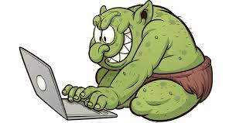
Russian IW: trolls
Spreading false information, polarizing the debate at social networks and forums, targeting emotions
https://www.youtube.com/watch?v=6CjR82EYwBc

