Slide 1
The Amphibious Project
Reflections on sustainability and ethics through a project of choreography – the Pond Ballet
Hans-Jørgen Wallin Weihe
H-J.Wallin.Weihe@inn.no
The Inland University of Applied Sciences

Slide 2
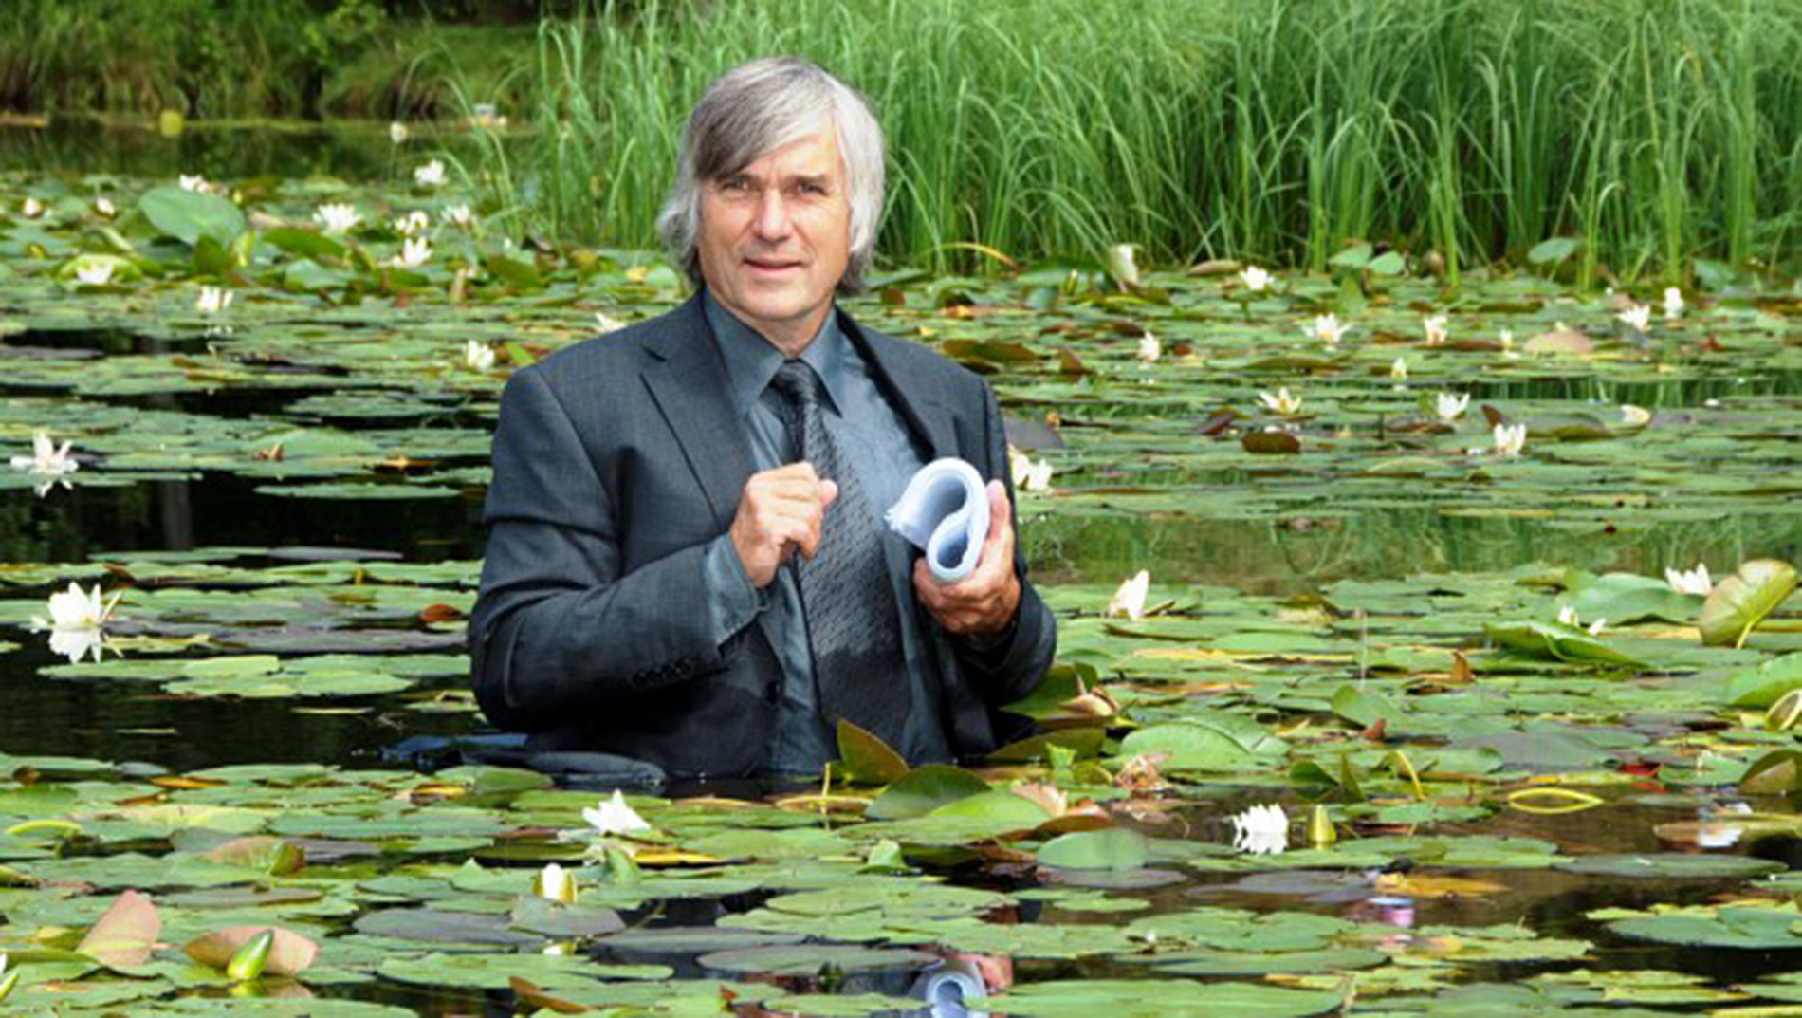
Linked questions
These themes will centre on following linked core questions: 1) How may a situated attention to the rhythms and tensions between continental and oceanographic islands provide a model for the choreographic strategizing and production of the project? 2) Who, what and where is included and/or left out in the pond? Can other living beings be considered as voluntary participants and have critical participative voices, including children? 3) What kinds of narrative expressions are produced by gaze and conversation, in spatio-temporal experiences of moving through littoral landscapes? How might they be documented, apportioned and projected into the future when connected to 'passages'? 4) What is the hope,

Slide 3
AMPHIBIOUS TRILOGIES
Project leader: Professor of choreography Amanda Steggell The Oslo Academy of Dance , in collaboration with Andrew Morrison, Director of the Centre for Design Research, Oslo School of Architecture and Design and Hans-Jørgen Wallin Weihe, Professor of Social Work, Lillehammer University College.

Slide 4
Dancers Choreographers connected to
Britain
Germany
Iran
Korea
Norway
Rumania
The Netherlands
USA

Slide 5
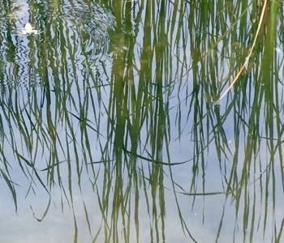

Slide 6
Thresholds (aims and goals)
AMPHIBIOUS TRILOGIES is a journey-based research approach to choreography that inhabits littoral zones (where land and water meet), design fictioning and sociology. The aim for choreography is to not be an ‘island’, nor restricted to its own ‘pond’ of legacies and dance performance centric views, nor contained in a specific route or ‘passage’ of production or performance. Instead, the main goal is to artistically explore amphibious spaces via an extended choreography of related littorial, limbic and liminal conditions, environments and articulations.

Slide 7
Thematics
Three thematics will be investigated and developed through fieldwork in correlating environments. These are: 1) 'Island': seasons, rhythms and im/migration. Oriented towards adults from without to within (Europe), 2) 'Pond': A constructed environment in the natural landscape. (Margins, memberships and immigrant populations, under represented societal participants. May be conveyed/ oriented towards children from around Europe), and 3) 'Passage': Narratives concerning rites of passage; passage between island and pond. (Mapping, platform for mobile collaborative narrative; participation on the move. Oriented towards journeying across far north European seas).

Slide 8
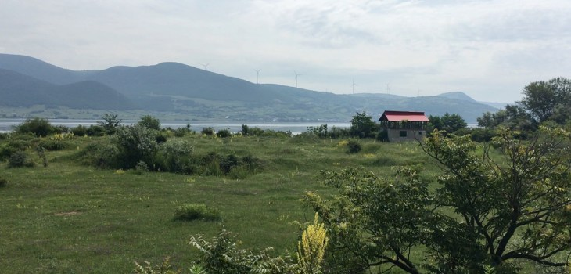
Banat Rumania – Fieldwork in the Czech minority community – one of many minorities living in the mountainous areas Rumanian side of Danube

Slide 9
Vardø Finnmark – an architectural project of rehabilitation of old buildings
Vardø is Norway’s easternmost city and the only city in Europe in the Arctic climate zone, north Norway’s oldest city, the northernmost fortified city of the world, Finnmark’s oldest fishing village and Pomor trading capital. Vardø is also one of Norway’s oldest cities, with city status from 1789.
Vardø municipality, the gate to the northeast passage and to the Barents Sea, had 2104 inhabitants per. 2017, and an area of 596 km2. The municipality consists of the town of Kiberg on the mainland, and the town of Vardø on the island, which has a mainland connection through the 2.8 km tunnel, northern Europe’s first subsea tunnel.

Slide 10
Vardø Restored
The process of development and emergence. This research seminar led into a series of events in Vardø during the week. The programme is underpinned by the Vardø Restored project and leads towards opening our new design, landscape, educational and research arenas for future collaboration and inquiry.

Slide 11
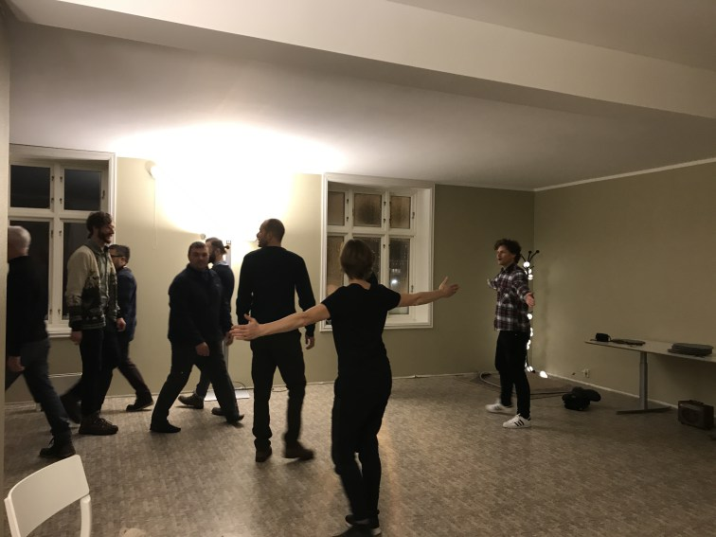
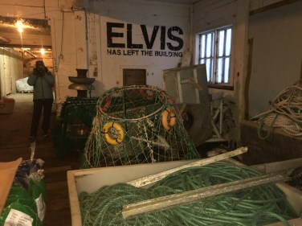
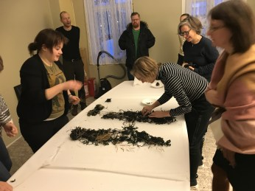
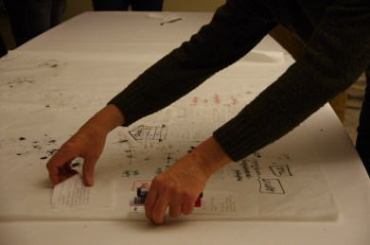
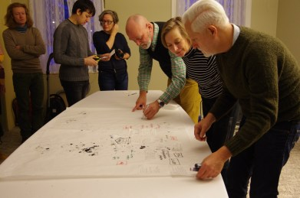
Vardø restored
Location data
Vardø is Norway’s easternmost city and the only city in Europe in the Arctic climate zone, north Norway’s oldest city, the northernmost fortified city of the world, Finnmark’s oldest fishing village and Pomor trading capital. Vardø is also one of Norway’s oldest cities, with city status from 1789.
Vardø municipality, the gate to the northeast passage and to the Barents Sea, had 2104 inhabitants per. 2017, and an area of 596 km2. The municipality consists of the town of Kiberg on the mainland, and the town of Vardø on the island, which has a mainland connection through the 2.8 km tunnel, northern Europe’s first subsea tunnel.
FieldworkJuly 26, 2016In "Fieldwork"
Dark IslandsApril 2, 2018In "Field notes"
Movements. Island and pondApril 26, 2018In "Field notes"
Elastic conversations 2
Amphibious Trilogies – Future Moves
Seminar workshops
Recent Posts
Movements. Island and pond
Dark Islands
Amphibious Trilogies – Future Moves
Archives
Archives

Slide 12
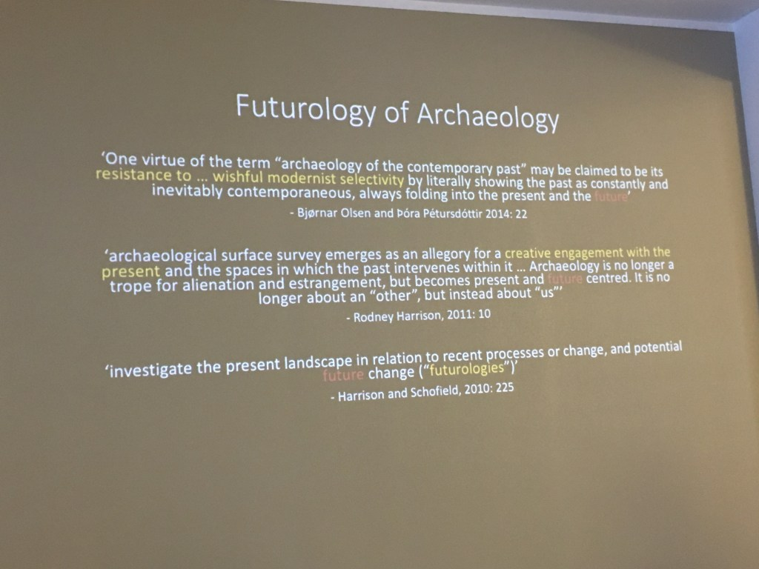
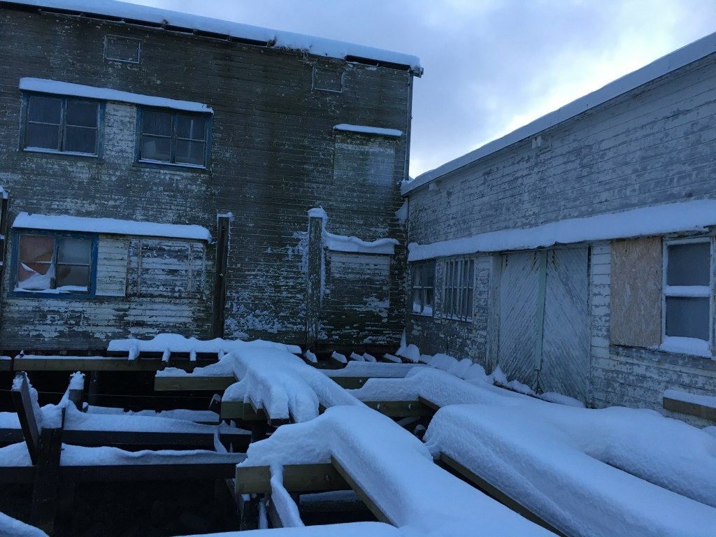

Slide 13
What could happen if we 'move', 'think' and 'do' amphibiously?
Boats and immigrants to Europe. Climate change and the melting of the arctic oceans. This artistic research project tests the limits of contemporary choreography and the power of contingency, in art based perceptions and projections of the future that address the significance of given and new knowledge of the sea.

Slide 14
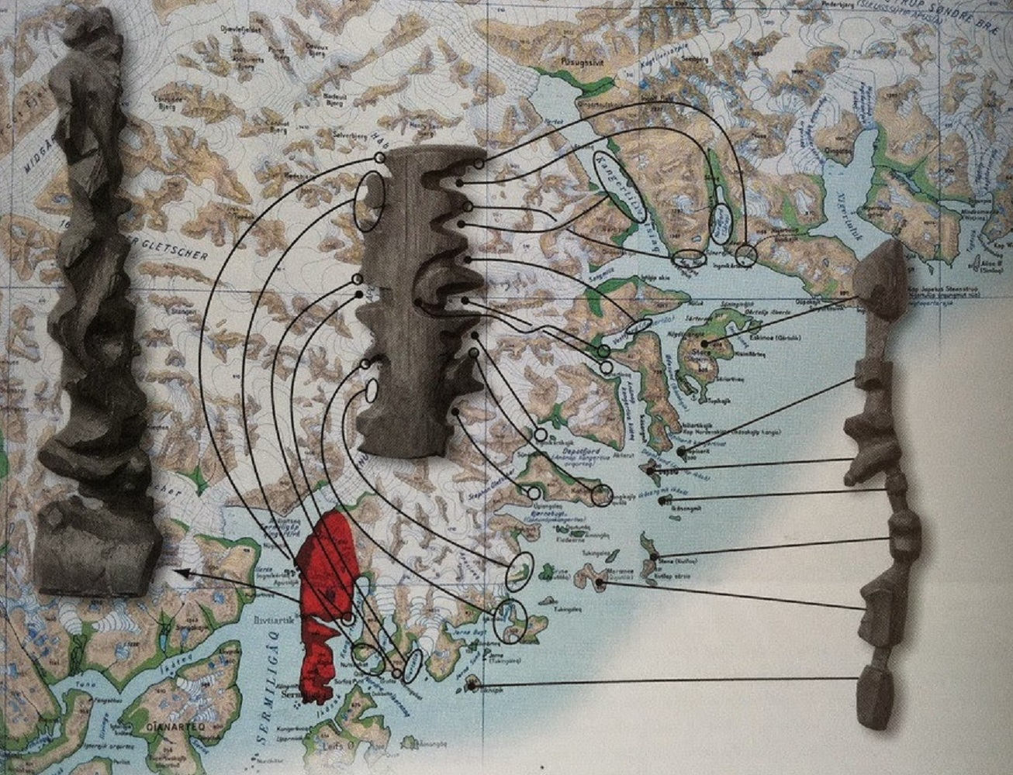
Greek Islands along the Coast of Turkey
A major gate-way to Europe

Slide 15
Subsidiary aims
The subsidiary aims are a) to explore the configurations of habitat, inhabitation, migration and mobility through three intersecting thematics that address links between place, agents and movement between the land and the sea, and b) to trace, track, document and distribute the indeterminate, emergent and slippery trajectories garnered through the project to make accessible these shifts between land and sea.

Slide 16
Linked questions
These themes will centre on following linked core questions: 1) How may a situated attention to the rhythms and tensions between continental and oceanographic islands provide a model for the choreographic strategizing and production of the project? 2) Who, what and where is included and/or left out in the pond? Can other living beings be considered as voluntary participants and have critical participative voices, including children? 3) What kinds of narrative expressions are produced by gaze and conversation, in spatio-temporal experiences of moving through littoral landscapes? How might they be documented, apportioned and projected into the future when connected to 'passages'? 4) What is the hope, happiness and the trauma of the pond and the sea?

