Slide 1
The Roseto Mystery Hans-Jørgen Wallin Weihe H-J.Wallin.Weihe@inn.no 0047 900 17623 The Inland University of Applied sciences Lillehammer Norway
Roseto Valfortore is souteast of Rome in the Appennine foothills and the Roseto village in Pennsylvania in USA

Slide 2
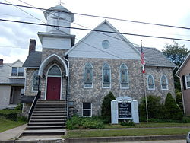
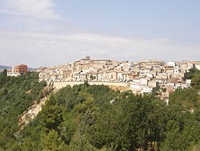
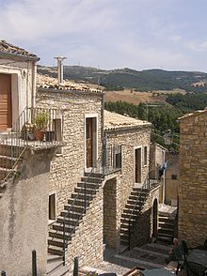
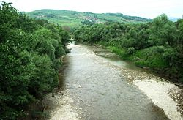
The Roseto Villages
Stone houses in Roseto Valfortore.
Roseto Presbyterian Church

Slide 3
The Italian village Roseto Valfortore
Medivial village organized around a large central square
Marble quarries
Cultivating terrased fields in the valley below
Poverty
Low education many illiterate
1882 11 Rosetans immigrated to the USA
Started to work in stone quarries near Bangor in Pennsylvania
Large immigration continued in 1894 a total of 1.200 immigrated
The built a small town called Roseto

Slide 4
The USA village of Roseto
A village with immigrants from the same geographical area in Italy (Roseto Valfortore) Population around 2000
In the 1950s it was found that the life expectancy of the village was 10 years higher than people living in other villages/towns in the area
Medical investigations in the village found that there were few heart attacks in the village while heart attacks were epidemic in the USA
No one under 55 had died of heart attack or showed sign of heart disease
For those over 55 the rate of heart disease was half of the US average

Slide 5
The dead -ends
People from the same region in Italy ( the same genetics) had the same high rate of heart disease as the rest of the population.
People living in neighbour towns/ villages of silair size and similair economical structure/same kind of work had the same high rate of heart disease as the rest of the population.
The people of Roseto had the same diet as other Americans
The people in Roseto smoked as much as other Americans and if any difference they ate more unhealthy stuff (sweets, fat etc and they used unhealthy cooking lard and not the healthier olive oil that they used in Italy)

Slide 6
The town itself
Many three generational families
Strong social bonds
Active family life and communal life
Strong identity in local culture
Strong attachment to the land, to the community and to the values represented by the church
Strong sense of community
The unifying and calming effect of the church
The only explanation of the low rates of heart disease was the community of Roseto

Slide 7
References
Bianco, Carla (1974).The Two Rosetos. Bloomington: Indiana University Press.
Bruhn, John G. & Wolf, Stewart (1993). The Power of Clan: The Influence of Human Relations on Heart Disease. New Brunswic, New Jersey: Transaction Publishers.
Bruhn, John G. & Wolf, Stewart (1979). The Roseto Story. Norman, Oklahoma: University of Oklahoma Press.
Gladwell, Malcolm (2008). Outliers. The Story of Sucess. London: Penguin Books.

