Slide 1
The limits of my language means the limits of my world.
Ludwig Wittgenstein

Slide 2
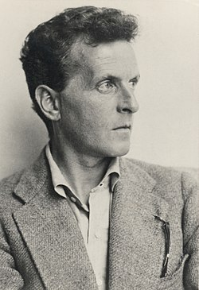

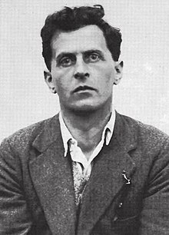
Ludwig Wittgenstein 1889 – 1951
Austrian Cambridge philosopher i periods Skjolden in Norway 1913 to last time 1951

Slide 3
Human subjectivity
«A desert-mountain environment (or any landscape, for that matter) plays a central role in constructing human subjectivity, including the way one envisions the holy. The place where we live tells us who we are — how we relate to other people, to the larger world around us, even to God. Meaningful participation in any environment requires our learning certain «gestures of approach» or disciplines of interpretation that make entry possible. All these are matters essential to the analysis of any spirituality.(-)This intimate connection between spirit and place is hard to grasp for those of us living in a post-Enlightenment technological society. Landscape and spirituality are not, for us, inevitably interwoven.» (Belden C. Lane, The Solace of Fierce Landscapes: Exploring Desert and Mountain Spirituality. New York: Oxford University Press, 1998, p.9)

Slide 4
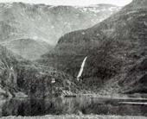
On Skjolden -
«I can’t imagine that I could have worked anywhere as I do here. It’s the quiet and, perhaps, the wonderful scenery; I mean its quiet seriousness.» (LW, 1936)

Slide 5
“To imagine a language is to imagine a form of life.”
Ludwig Wittgenstein

Slide 6
“What can be shown, cannot be said.”
Ludwig Wittgenstein

Slide 7
“At the core of all well-founded belief lies belief that is unfounded.”
Ludwig Wittgenstein

Slide 8
Whereof one cannot speak, thereof one must be silent.
Ludwig Wittgenstein

Slide 9
Nothing is so difficult as not deceiving oneself.
Ludwig Wittgenstein

Slide 10
“Whereof one cannot speak, thereof one must be silent.”
Ludwig Wittgenstein

Slide 11
“Only describe, don't explain.”
Ludwig Wittgenstein

Slide 12
“Don't for heaven's sake, be afraid of talking nonsense! But you must pay attention to your nonsense.”
Ludwig Wittgenstein

