Slide 1
Zemědělství a hospodářský rozvoj – historická lekce
Rozvoj 2018

Slide 2
 | Ireland | England
1841 | ??? | 13.66
1961 | 2.82 | 41.16
2017 | 4.79 | 55.62

Slide 3
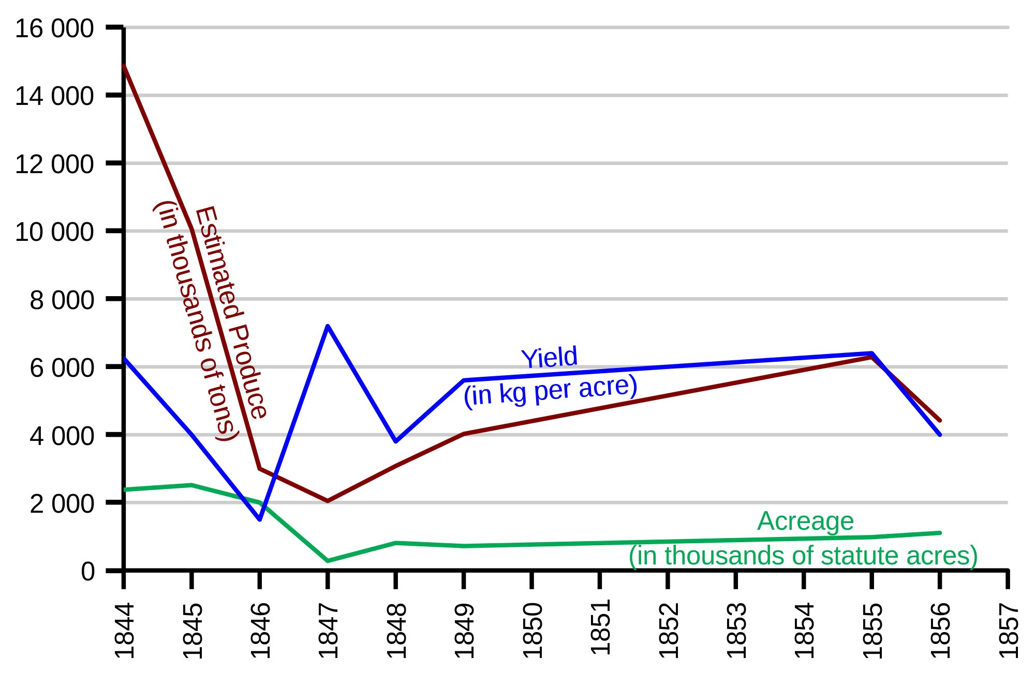

Slide 4
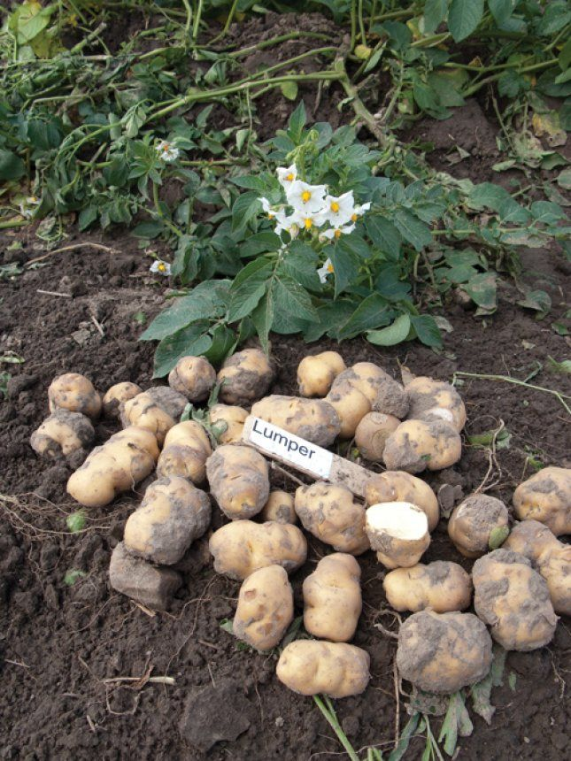

Slide 5
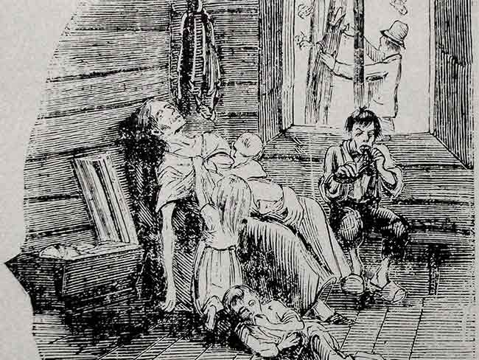

Slide 6
 | Exporty | HNP | Průmysl | Zemědělství | Populace
Obchodní politiky – Evropa
Protekcionizmus: 1830-1844/1846 | 3,5 | 1,7 | 2,7 | 0,8 | 0,6
Britský liberalizmus: 1844/1846-1858/1860 | 6,0 | 1,5 | 2,3 | 0,9 | 0,7
Evropský liberalizmus: 1858/1860-1877/1879 | 3,8 | 1,7 | 1,8 | 0,5 | 0,8
Nástup protekcionizmu: 1877/1879–1890/1892 | 2,9 | 1,2 | 2,2 | 0,9 | 0,9
Protekcionizmus: 1890/1892-1913 | 3,5 | 2,4 | 3,2 | 1,8 | 1,0
Hospodářská období - kontinentální Evropa
Období růstu: 1829/1831–1868/1870 | 4,3 | 1,8 | 2,0 | 1,0 | 0,7
Deprese: 1868/1870–1891/1893 | 2,9 | 1,0 | 2,0 | 0,8 | 0,9
Období rychlého růstu: 1891/1893-1911/1913 | 4,0 | 2,6 | 3,8 | 1,5 | 1,1

Slide 7
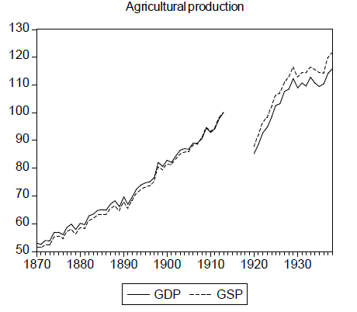

Slide 8
Wheat - world price
(1996 GBP)

Slide 9
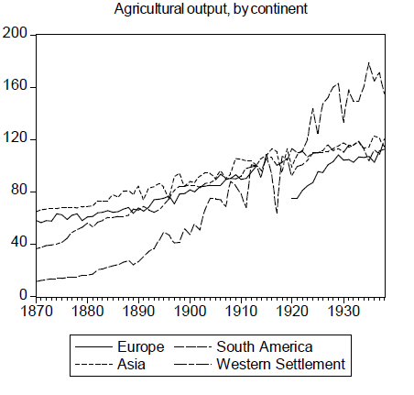

Slide 10
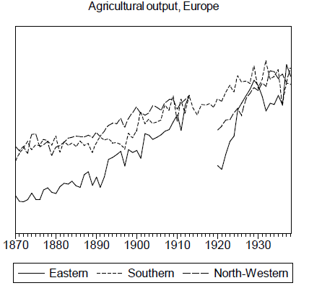

Slide 11
Wheat production – average yield
 | tons/ha
CS | 1.50
Europe | 1.26
US | 0.98
Canada | 1.34
Australia | 0.80
Argentina | 0.66
Poland | 1.24
Hungary | 1.26
Romania | 1.29
Bulgaria | 1.06
Serbia | 0.88

Slide 12
Agriculture in EE
 | employed 1920 (%) | GDP 1920 (%) | GDP 1938 (%) | exports 1938 (%) | 1930s yields as % of E | land per tractor | surplus labor WE tech
CSR | 28 | 33 | 23.2 | 72in | 113 | 920 | +5
POL | 72 | - | 39.0 | 28.5 | 74 | 8400 | 51
HUN | 56 | 41.8 | 36.5 | 55.3 | 85 | 830 | 22
BUL | 80 | 71.4 | 63.3 | 31.4 | 74 | 1430 | 53
YUG | 79 | 58 | 53.6 | 49.7 | 70 | 3430 | 61
ROM | 78 | 60.2 | 53.2 | 33.8 | 63 | 2490 | 51

Slide 13
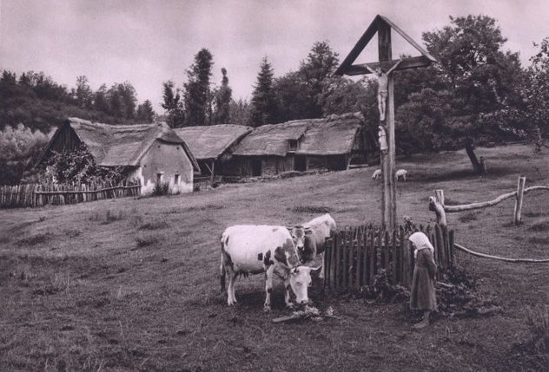

Slide 14
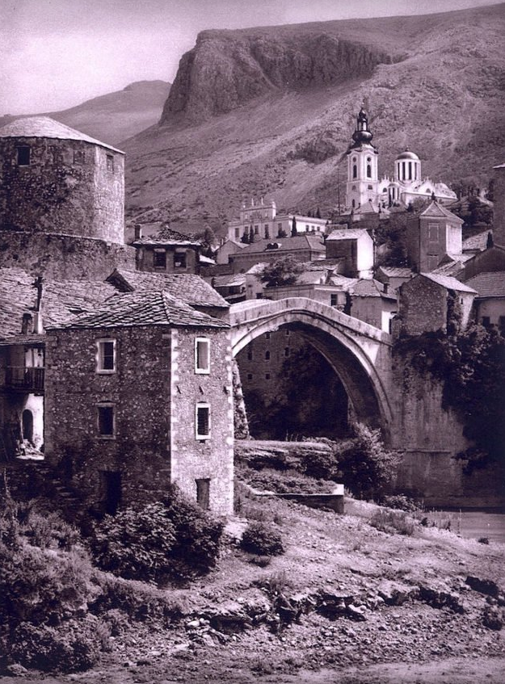

Slide 15
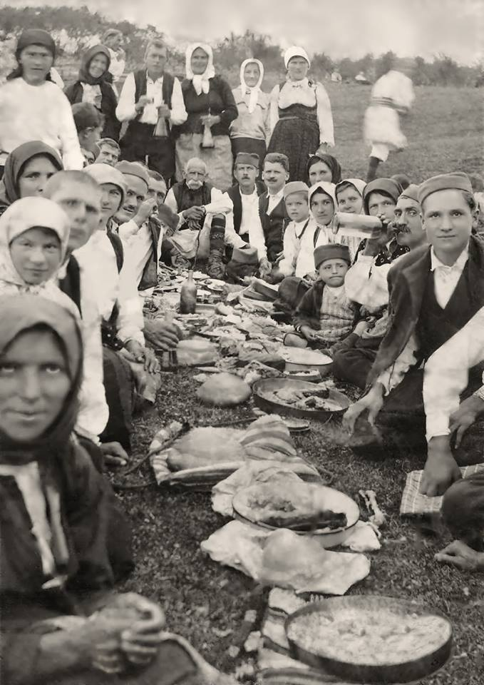

Slide 16
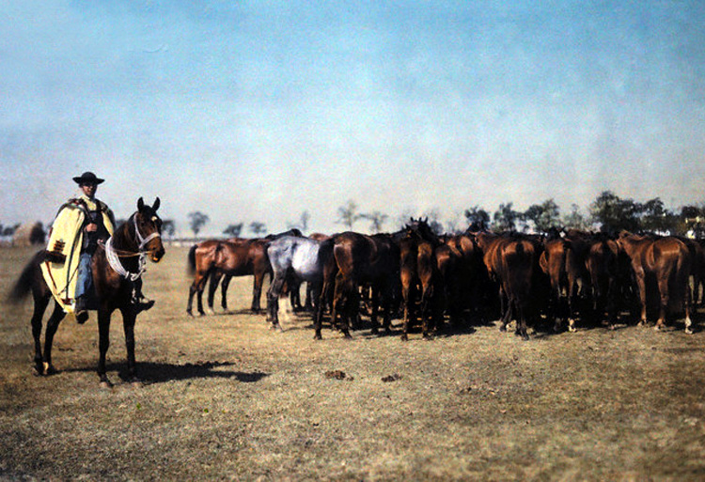

Slide 17
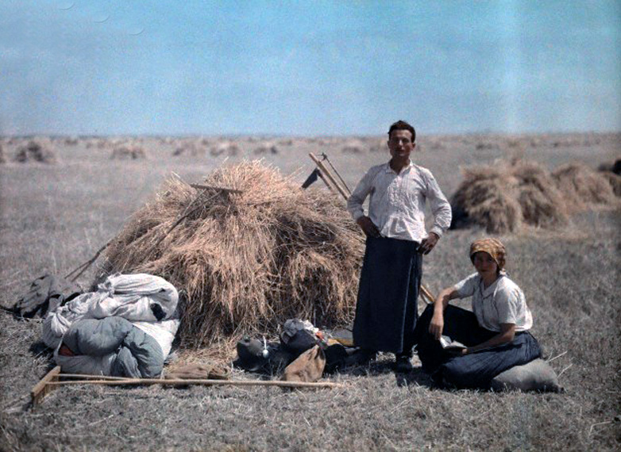

Slide 18
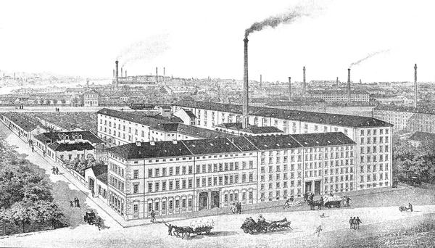

Slide 19
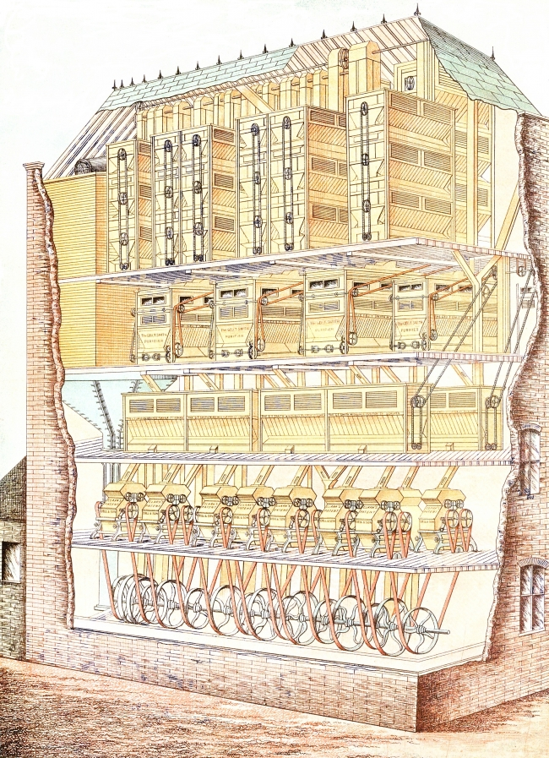

Slide 20
Redistribution as a result of CSR 1925-26 tariff –
wheat and wheat flour (bill. mill. of CSK; thous. of tons)
 | 1924 | 1926 | 1927 | 1929
domestic producers´ revenue (bil. CSK) (without tariff in parentes) | 1.949 | 2.390 (2.063) | 2.549 (2.202) | 2.083 (0.897)
foreign producer´s revenue (bil. CSK) | 1.082 | 0.703 (1.091) | 1.361 (1.220) | 0.126 (1.615)
consumption (thous.tons) | 1,562,322 | 1,412,362 | 1,649,783 | 1.598.236
consumers expenses (bil. CSK) | 3.031 | 3.093 | 3.910 | 2.829
extra producers´ surplus (mil. CSK) | - | 319.8 | 320.9 | 268.0
consumers´ loss (mil. CSK) | - | 454.5 | 495.4 | 496.2
government revenue (mil. CSK) | - | 96.3 | 172.3 | 126.4
dead weight loss (mil. CSK) | - | 38.5 | 2.2 | 101.6

Slide 21
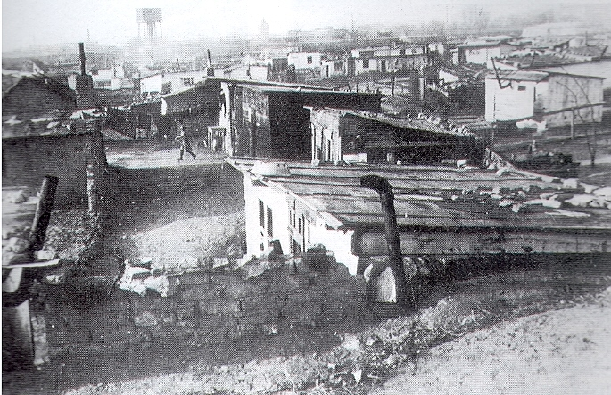

Slide 22
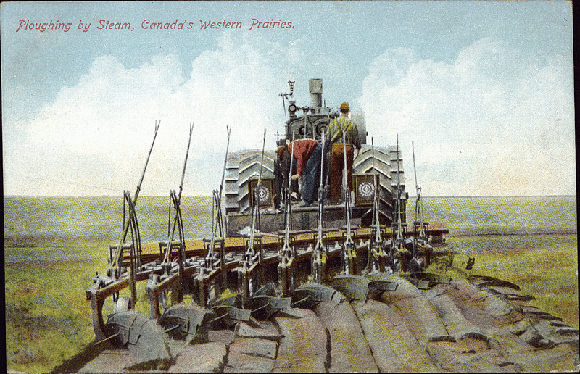

Slide 23
