Slide 1
International security - ire107
Fall 2018
Security terms and theories
dr. Martin Chovančík
dr. Petr Suchý
dr. Maya Hadar

Slide 2
Starting discussion
Form a group of 3-4
Discuss question
Present answer
Is security survival?
Is security absolute or relational?
Is state/national security paramount?
How do we know we’re (not) secure? Who decides?
Who improves or damages security (which actors)?
What makes us most insecure? (WMD, or climate, or race, or conflict?)
Notes:
Security survival – prevention/mitigation of threats to values (survival plus – freedom from and to)
Security either absolute – commodity or relational (Russia threat or not a threat?)
State security, who is the referent object – people in groups? State because not nation, but political unit even from within?
Goes both up and down, groups, societies, human race
I am not secure – threat and security agendas, fear-mongering
No way to establish common priorities (WMD, or climate, or race, or conflict?)
UN panel on threats – healthcare?
Life expectancy 86 japan – 34 Zimbabwe

Slide 3
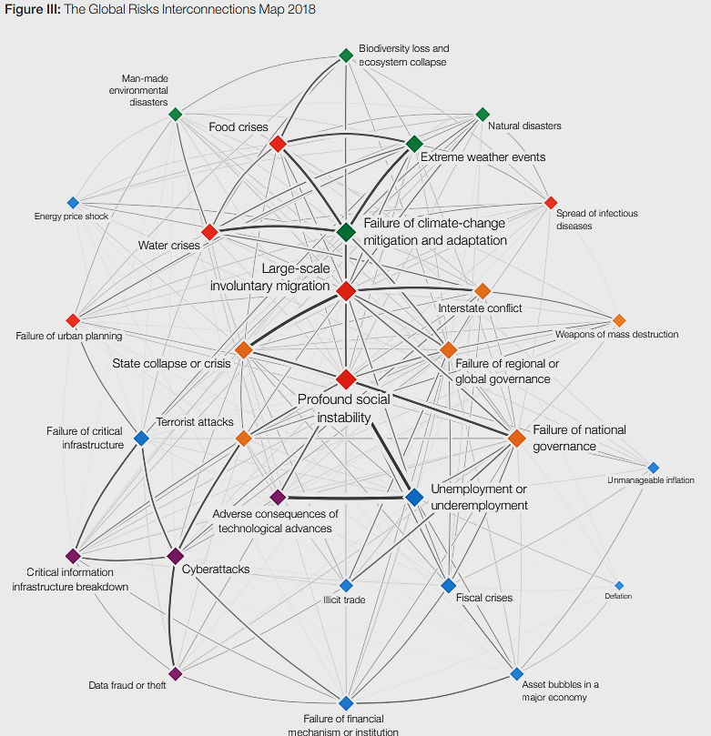
Global risks
World Economic Forum
The Global Risks Report 2018 13th Edition
http://www3.weforum.org/docs/WEF_GRR18_Report.pdf

Slide 5
security
security is survival plus
while survival is easier to define the plus is not
depending on the level of analysis (read Singer) survival will consist of:
a degree of sovereignty, independence, and territorial integrity
the prevention/mitigation of threats to values
freedom from (persecution)
and freedom to (pursue happiness)
Global
International
National
Individual

Slide 6
threat
Cold War
dual threat to state security – physical and ideological
dual as source – internal and external
oriented at military
Collective defense
Current
societal and environmental threats
previous are present, but less important
Collective security
primary phenomenon endangering values
severity corresponds to how core the value is
national security threat as an action or sequence of events that (Ullman 1983):
1) threatens drastically and over a relatively brief span of time to degrade the quality of life for the inhabitants of a state; or
2) threatens significantly to narrow the range of policy choices available to the government of a state or to private non-governmental entities (persons, groups, corporations) within the state
ever broadening list with varying weights of impact
Notes:
In collective Security, threat is not known in advance
In Collective Defence, threat is known in advance
In Collective Security enemy is not known in advance
In Collective Defence enemy is known in advance
Collective Security is global in nature
Collective Defence is regional and continental

Slide 7
Security challenge
Is it just a threat?
technically a synonym, but used to underline collective security and increase the standing of remote but shared threats
often “soft security”:
i.e.: contagions, environmental degradation, migration, antibiotic resistance, drought, ageing populations, and many others growing in importance due to globalization
does not have to name an adversary

Slide 8
vulnerability
the level AND area-specific weakness/exposure to threats
susceptibility to threat, being exposed, or sensitive to STRESSORS in a particular area and at a particular level
follows the logic of security challenges and discourse is guided away from military and national security vulnerabilities, to more societal and environmental definitions
What is a structural vulnerability assessment?
from physical exposure: presence and density of the people, habitat, networks, goods and services in risk zones, physical military or civilian infrastructure
to concepts of resilience: societal capacity to retain values and recover from attacks negative influence

Slide 9
Risk
Is a risk negative or positive?
likelihood of occurrence
“Uncertainty arises when the future is unknown but no actual probabilities (objective or subjective) are attached to alternative outcomes. Risk arises when specific numerical probabilities are attached to alternative outcomes”(Llewllyn 1996:744)
probability of a loss coupled with our evaluation of its size and significance
What is a risk appetite?
Risk management
just weigh the risk of climate change against the risk of economic downturn if policies are applied
How aggressively?
How “risky” is it to stall?
Broadest equation:
Impact
Threat
Vulnerability
RISK

Slide 10
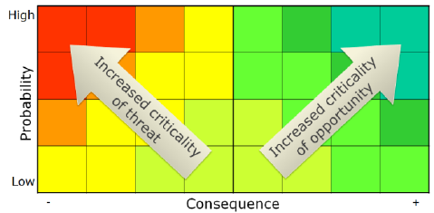
Risk assessment matrix

Slide 11
referent
referent or referent object
entity whose security is to be assured
national security – state
human security – individual
broadening category – regions, communities, minorities, institutions, etc.
all require actorness: i.e. the ability to take decisions as a social actor

Slide 12
structure
the context which allows for and limits the actions of actors
our context is international
the structure of the system is perceived differently, depending on paradigm:
realism, neorealism, liberalism, neoliberalism, Marxism, constructivism
the departing assumption dictates that since global governance is lacking: the international system is subject to varying degrees of anarchy
Unipolarity
Bipolarity
Multipolarity
Market structure
Interdependence
Dialectical materialism
World-systems core-periphery
World society
….

Slide 13
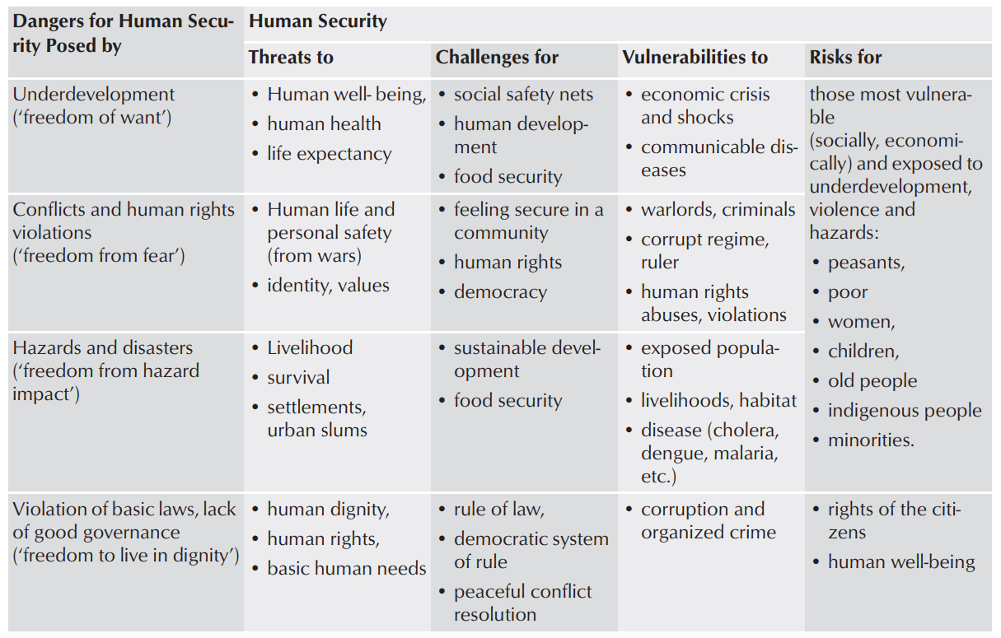
threat
Brauch 2011: 101
Concepts of Security Threats, Challenges, Vulnerabilities and Risks

Slide 14
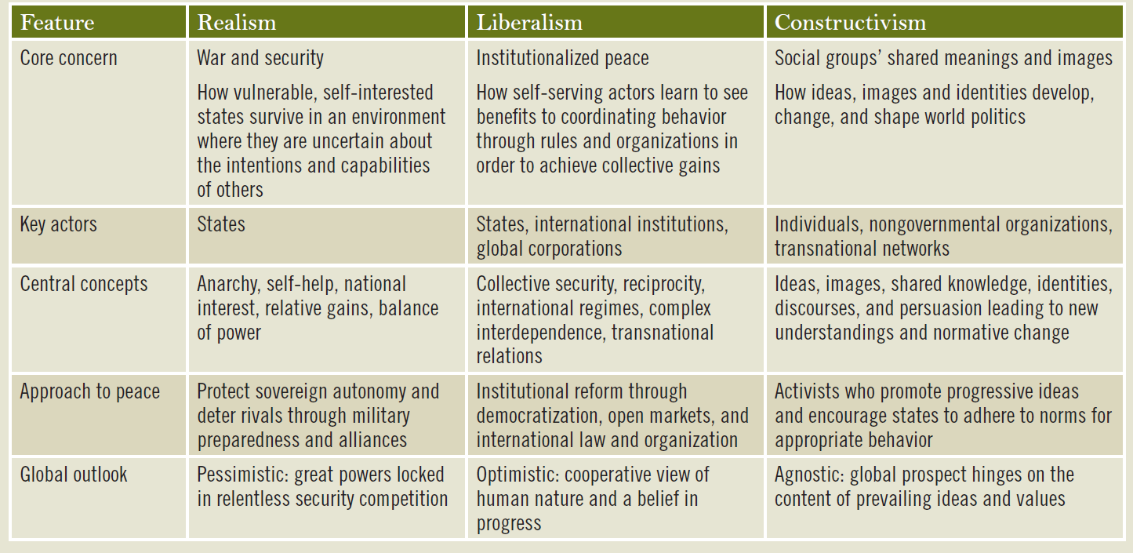
Paradigms (Kegley – Shannon 2011:47)
Notes:
REALISM:
Conflict is intrinsic to IR
Balance –internal arming, external alliances
Zero sum game
Bandwagoning – allying oneself with much stronger state despite value difference
Offensive realism, defensive realism
Liberalism:
Conflict as aberration in IR
Still anarchy – but mediated by institutions
Interdependence: a relation of mutual, typically,
asymmetrical dependence that, when disrupted,
brings significant costs and constraints to both
parties.
Constructivism:
Not same standing, not IR theory
Weak - allows causal explanations and objective knowledge
or strong
PLANTING YOUR FLAG
Regulatory rules – activities don’t depend on them – road traffic
Constitutive rules – activities are made of them – chess
Discourse – institutionalized use of language / Framing – shared interpretative scheme

Slide 15
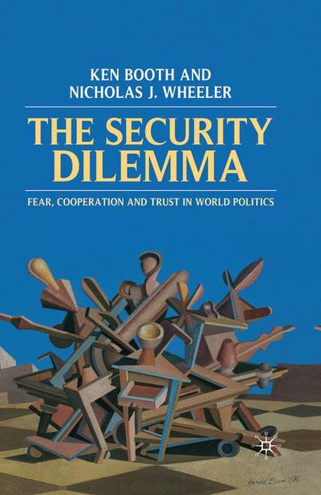
Uncertainty and the Security dilemma
2 level dilemma
not to be confused with security spiral (although often used in its lieu)
1st level dilemma – a dilemma of interpretation intentions, capabilities, and signals of others
occurs under the inescapable and unresolvable uncertainty between defensive and offensive acts
How can we know our adversary’s steps are aiming to change the status quo rather than safeguarding it?
2nd level dilemma – a dilemma of choosing the appropriate response to not reinforce the 1st level dilemma
if 1st dilemma is evaluated incorrectly may send a strong signal to the opposite effect
misplaced trust may lead to ruin, while deterring a benign act may result in escalation (security paradox)

Slide 16
Dealing with uncertainty
Fatalist logic (realism and neorealism)
is the idea that security competition can never be escaped in international politics. Human nature and the condition of international anarchy determine that humans will live in an essentially conflictual world.
Mitigator logic (liberalism and neoliberalism)
is the idea that security competition can be ameliorated or dampened down for a time, but never eliminated. Here, notions of regimes and societies are key, blunting the worst features of anarchy
Transcender logic (constructivism)
is the idea that human society is self-constitutive, not determined. Humans have agency, as individuals and groups, and so human society can seek to become what it chooses to be, though inherited structural constraints will always be powerful. A global community of peace and trust is in principle possible if in practice it currently looks improbable.
Booth and Wheeler 2008:143.

Slide 17
The broadening of security
Hard security
Soft security
primarily external existential threats
response military deterrence, threat, or use
response capacity is delimited geographically
realist-based and measured in terms of power
predominantly zero-sum
response requires other than military force, collaboration cooperation, prevention
response capacity and action is delimited by issue rather than geography
more liberal and measured in terms of coverage and progress
primarily internal, or transborder, or global threats
predominantly non-zero sum
Current mainstream approach COMBINES and EVOLVES
Constituting broadly out of 2 domains which overlap

Slide 18
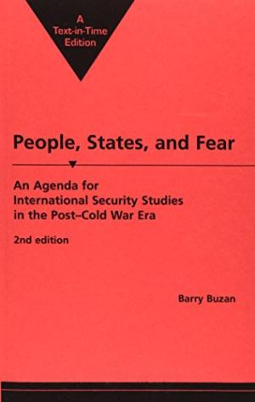
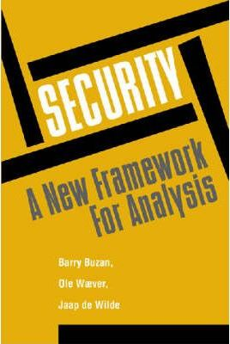
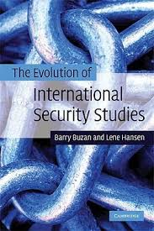
Evolution of security – through the eyes of barry buzan
1983 1991 1997 2009
Notes:
no “essence”, no universal feature of security
a self-referential practice

Slide 19
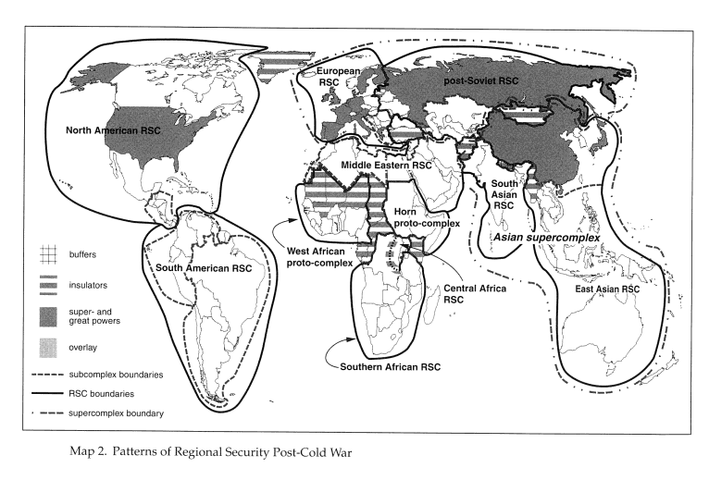
Mainstream security
Regional security complexes as ecosystems of security
Currently defined in 5 sectors:
Military
state-centric; involve use of force; existential
Political
regime orientated, ideological in nature
Economic
acceptable level of stability
Societal
coping with differences in identity and culture
Environmental
climate and ecology orientated issues
at 3 different levels: individuals, states, and international system
Notes:
SECURITY COMPLEXES
“...set of units whose major processes of securitization, desecuritization, or both, are so interlinked that their security problems cannot be reasonably analyzed apart from one another

Slide 20
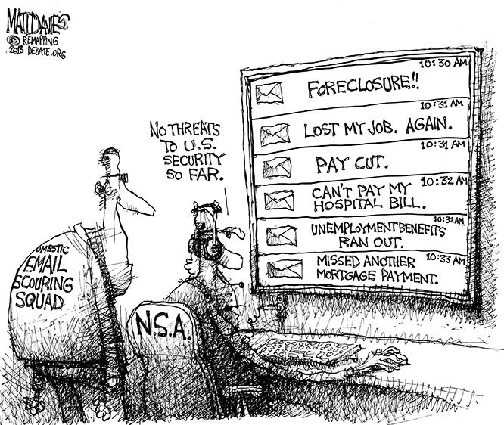
Securitization in ir
Making something more secure?
rather making something that was not a threat before (although existed) into a threat in the political arena
by introducing an issue in the security discourse it becomes a threat
step up from politicization – the act of making something a political issue
once an issue is securitized it is subject to special treatment and security responses may apply
constant process broadening our definition of security

Slide 21
Securitization
Securitization act:
(1) claims that a referent object is existentially threatened
(2) demands the right to take extraordinary countermeasures to deal with that the threat
(3) convinces an audience that rule-breaking behavior to counter the threat is justified
Ole Weaver and Barry Buzan
followed by many iterations and revisions

