Slide 1
Introduction to macroeconomics
Vladan Hodulak
This powerpoint serves as a study material for the students of the course Introduction to economics (MEB435) at FSS MU in Fall 2018. Using this presentation for other purposes without consent of the author is prohibited.

Slide 2
Definition
Macroeconomics – a study of the aggregate outcomes of human economic behavior.
Issues of macroeconomics – employment, output, inflation, international context.
Goal of macroeconomics – using the available economic resources (including labor) to its full potential.
Challenge of macroeconomics
  How to maintain full employment but at the same time achieve price stability.
  How to encourage economic growth?

Slide 3
MMT approach
Places monetary arrangements at the center of the analysis.
Currency regimes and their consequences for the government economic policy
  Fixed (currency board, gold standard) vs floating exchange rates
At the aggregate level, total spending equals total income and total output.
The sectoral balance approach
  Analyzes the behavior and interactions of the main economic sectors.
  A deficit in one sector must be offset by surpluses in the others.
  The sum of the sectoral balances nets to zero.

Slide 4
MMT approach
The role of the government
Fiscal balance
  fiscal deficit occurs when its spending exceeds its taxation revenue
  fiscal surplus occurs when government spending is less than its taxation revenue
Fallacy of composition
  Errors in logic that arise when we infer that something, which is true at the individual level, is also true at the aggregate level.
  Government vs household financial constrains.
  Outcomes of government vs household increase in saving on the economy.

Slide 5
Tools of macroeconomic policy
Fiscal policy
  is represented by the spending and taxation choices made by the government.
  is one of the major means by which the government seeks to influence overall spending in the economy and achieve its aims.
Monetary policy
  usually the responsibility of the Central Bank
  setting of a short-term policy target interest rate
  operating the interbank clearing mechanism acting as lender of last resort (to stop bank runs)
  regulating and supervising the banks.
Consolidated government sector

Slide 6
National accounts
Gross Domestic Product (GDP) - the measure of all currently produced final goods and services evaluated at market prices.
Limits of GDP
  Unpaid work (housework, raising children, small farmers etc.), black market
  GDP and economic well-being
  Inequality
Alternatives to GDP -> HDI
Country comparisons
  GDP per capita × total GDP
  Purchasing power parity (PPP) × nominal (at market exchange rate)

Slide 7
Components of GDP
Consumption (C)
  Domestic consumption by households of goods and services.
Investment (I)
  Capital investment by firms, inventory investment by firms, and real estate investment by households.
  Investment expenditure increases the productive capacity of the economy and expands what we think of as potential GDP.
Government spending (G)
  Government purchases of final goods and services (government transfer payments are not included).
Net Exports (NX or X - M)
  Exports (X) are goods and services sold abroad; imports (M) are goods and services produced abroad for domestic use.

Slide 8
Ways to measure GDP
Expenditure approach
  the sum of final expenditures on goods and services measured in current market prices.
  Y = C + I + G + (X − M)
Production approach
  This approach measures gross value added.
  Value added in the production = gross value of output – value of intermediate consumption, which has been summed over all stages of production.
Income approach
  Sum of primary incomes distributed by resident producers of goods and services.
  This method adds together the producers’ incomes that firms pay in exchange for their services, namely wages for labor, interest for capital, rent for land and profit for capitalists.

Slide 9
GDP versus GNP
GDP is the total value of goods and services produced within a nation regardless of the ownership of the firm producing them.
GNP (Gross National Product) is the total value of goods and services produced by residents of the nation regardless of the location of the production
Measuring Gross National Income (GNI)
  the perspective of what can be done with income (Y): an individual can consume (C) it, pay taxes (T), or save it (S)
  Y = C + S + T = GDP = C + I + G + NX

Slide 10
GDP Growth and The Price Deflator
Measuring economic growth
  The growth of GDP over time
  The GDP is measured at current prices (nominal GDP)
  Problems with rising prices
“Deflate” GDP - to correct our measure for the change in prices to get an idea of real economic growth.
Example:
  GDP₂₀₀₂ = P₂₀₀₂ × Q₂₀₀₂
  GDP₂₀₁₅ = P₂₀₁₅ × Q₂₀₁₅
  We always calculate ‘real GDP’ over time in terms of a base year.
  RGDP₂₀₁₅ = P₂₀₀₂ × Q₂₀₁₅
Problems with the method

Slide 11
Measuring CPI inflation
CPI: An index based on the cost of a fixed basket of consumer goods and services.
  Consumer goods and services, and their respective quantities (weights).
  It is assumed that the chosen basket of goods and services is representative of the purchases made by a typical household.
  Base year.
Rate of growth of the CPI index
  The growth rate of the CPI measures the rate of inflation (if positive) or deflation (if negative).
Other indexes.

Slide 12
Measuring National Inequality
Gini Coefficient – measures the distribution of income in the population.
The Lorenz Curve plots the share of total income received (vertical axis) by the lowest X per cent of income earners (horizontal axis).
The 45-degree line shows the case of perfect equality.
A Gini Coefficient of zero means that income is perfectly equally distributed as the economy is lying on the Line of Equality.
Alternatively, a Gini coefficient of one means that income is perfectly unequally distributed (that is, one person has all the income).

Slide 13
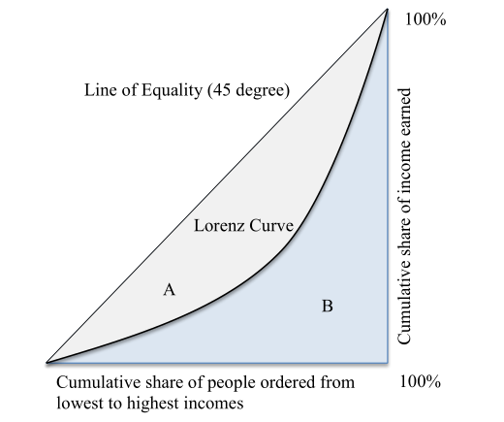
The Lorenz curve

Slide 14
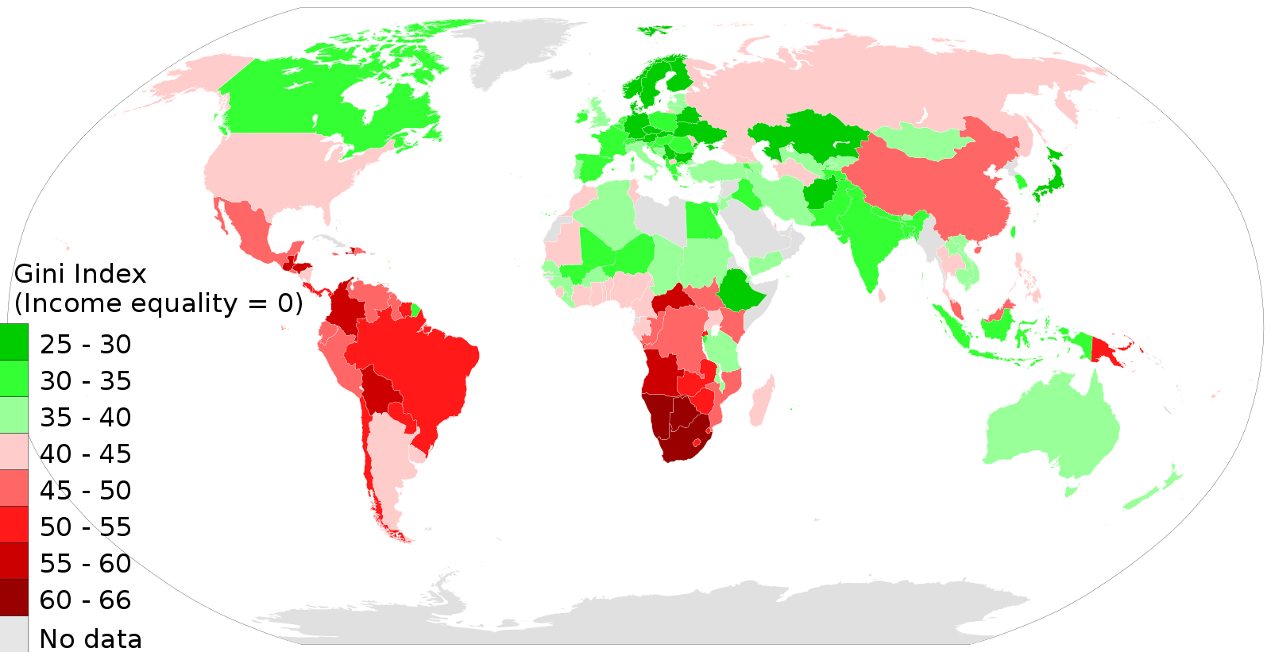
Gini coefficient in the world
Source: M Tracy Hunter

Slide 15
Sectoral balances perspective
The most basic macroeconomics rule is that one person’s spending is another person’s income.
The sectoral balances approach helps us to understand the relations among the spending and income balances of the households, firms, government, and foreign sectors of the economy.
The sectoral balances must sum to zero.
A flow is measured as a certain quantity that is spent per unit of time.
A stock is measured at a point in time and is the product of prior, relevant flows.

Slide 16
The Sectoral Balances View of the National Accounts
Identity – a formula that is true by definition
GDP ≡ C + I + G + (X – M)
When these components of spending are summed, they equal aggregate demand for goods and services in a particular period.
Macroeconomic policy aims at influencing the individual components of GDP.
Net external income flow (FNI) - we have to add this to get the total sum of financial flows between the domestic economy and the external sector.
GNP ≡ C + I + G + (X – M) + FNI

Slide 17
The Sectoral Balances View of the National Accounts
(GNP – C – T) – I ≡ (G – T) + (X – M + FNI)
(GNP – C – T) – I - overall saving of the private domestic sector or private domestic financial balance.
(G – T) is the government financial balance.
(X – M + FNI) is the external financial balance or Current Account Balance (CAB)
The private domestic financial balance equals the sum of the government financial balance plus the current account balance.
It is impossible for all sectors to accumulate net financial wealth by running surpluses.

Slide 18
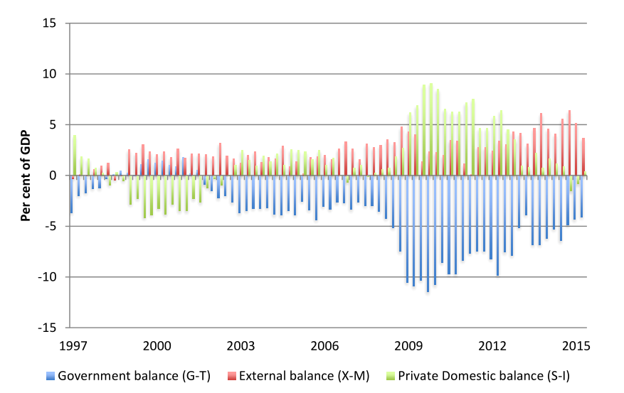
UK sectoral balances, 1997 to 2014

Slide 19
Important remarks
One’s financial asset is another’s financial liability.
Inside vs outside sector wealth.
Real assets
Examples of economic behavior (theory, causal relationships)
  The response of consumption to a change in income is called the Marginal Propensity to Consume (MPC). It is normally hypothesised that the MPC will be less than one, so that the residual of disposable income not consumed will be positive. That constitutes saving.
  Automatic stabilizers – net government expenditure higher when national income is lower and vice versa.
  Lower interest rates should lead to higher investment which should in turn increase output.
  We will talk more about these in the next lecture.

