Slide 1
Money and finance
Vladan Hodulak
This powerpoint serves as a study material for the students of the course Introduction to economics (MEB435) at FSS MU in Fall 2018. Using this presentation for other purposes without consent of the author is prohibited.

Slide 2
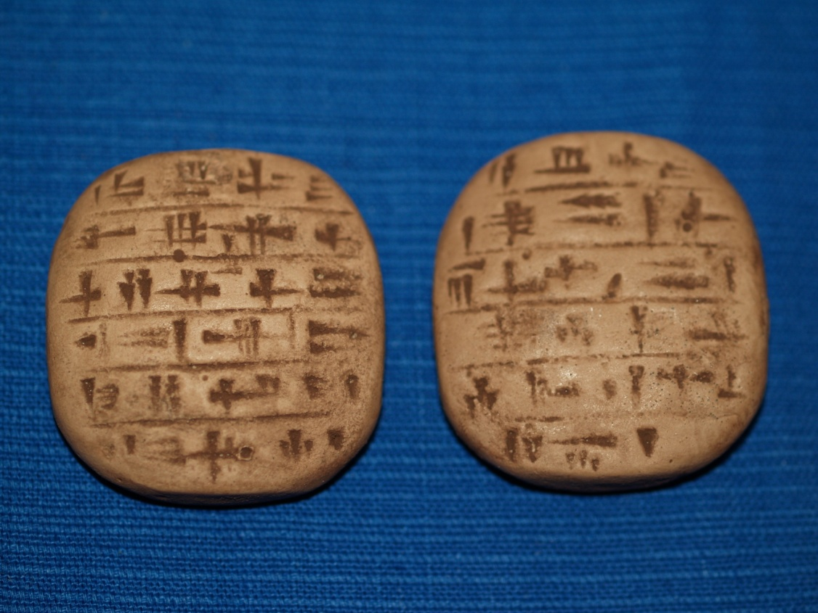
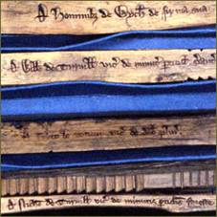

Slide 3
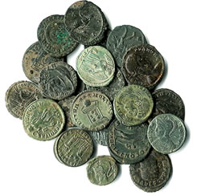
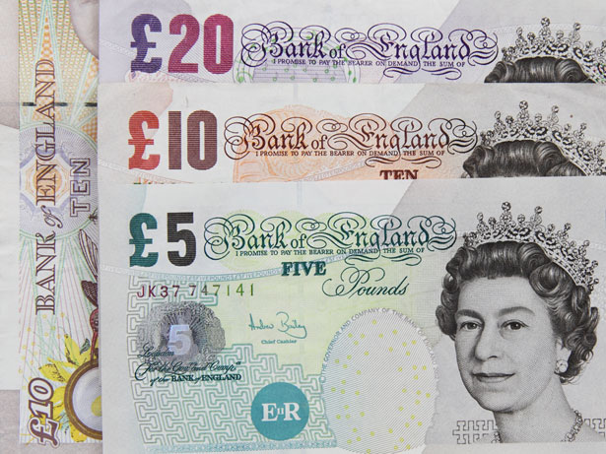
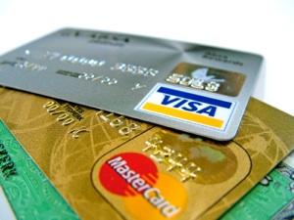

Slide 4
Essential questions about money
What is money?
How is money produced?
How does it get/lose value?

Slide 5
The standard economic story (metallist)
With this theory, money is first and foremost a means of exchange, its other functions (unit of account and store of value) are secondary
A. Smith, C. Menger
Problems of rational actors engaged in economic exchange
  Double coincidence of wants
Type of an evolutionary explanation – increasing effectiveness of the economic exchange
  Precious metals (gold, silver) were selected due to their properties, particularly their high exchangeability
  Paper and later electronic money were introduced as a transaction cost saving device, originally they were to represent the „real money“ deposited in vaults
Barter -> money -> credit
Problems with the standard approach (internal inconsistency, role of the state, historical facts)

Slide 6
State/credit theory of money
Money is firstly a unit of account for recording debts
It is an IOU and is created when an IOU is issued
Its value depends on the credibility of the promise
Money is an institution – a generalized and formalized type of an obligation (debt)
Anyone can issue money (obligations) and almost anything can represent it (cattle, salt, wood, paper)
The crucial problem is: How to make people accept it? How to make it generally recognized? (only then a generalized means of exchange is possible)
Hierarchy of money (government > banks > firms > households)
Problems (role of the private sector, legitimacy issues)

Slide 7
Essence of money
What is money?
  measure of value (unit of account)
  It’s vital to differentiate between money of account and money things (what represents money)
  A tool for economic coordiantion (technology)
  People coordinate their economic behavior in various ways, the most common in-group coordination mechanism is some form of credit -> money usually measures debts (credits)
  credit -> money (-> barter)
How is money produced?
  By issuing an IOU (× destruction of money)
How does it get/lose value?
  Money vs wealth
  Credibility × quantity theory of money (but it’s complicated)
  M × V = P × Q

Slide 8
Money and states
A state is able to determine its money (unit of account) once it enforces taxes/fees in it
Governments use money to mobilize resources for public purpose
Money is accepted for several reasons: trust, habit, authority, but the ultimate reason is power
The fact that a state issues its money and declares that it will accept it back in the form of taxes is an expression of power (+legal tender)
Governments can buy anything that is for sale in its currency and is in theory able to overbid anyone
Money has distributional consequences and is therefore prone to be abused for political gains
Debtor × creditor interests

Slide 9
Modern money
Usually one state – one currency rule
Governments owing in their own currency can’t be forced to go bankrupt but they can decide to do so
Fallacy of composition – what is true for a part (an individual) doesn’t have to be true for the whole
  Individuals × states
  Expenditure = income
Governments are for historical and political reasons limited in their power to exploit their monetary systems
Most money today is issued by private commercial banks
  Exogenous money – money multiplier
  Endogenous money – credit creation ex-nihilo

Slide 10
Limits of domestic monetary power
Political and institutional constraints
  Central bank independence
  Deficit limit
  Debt ceiling
  Limited money supply (metal standard, currency peg)
Inflation and real constraints (output level)
International constraints
  Balance of payments constraints
  Debt in a foreign currency

Slide 11
International constraints
Balance of payments (flow)
  Accounting accord of all monetary transactions between a country and the rest of the world
  The sum of all accounts has to be equal 0 by definition
Composition (IMF × USA!)
  Current account – trade + factor income
  Financial (capital) account (including the reserve account) – net change of ownership of international assets
  Balancing item (statistical errors)
Relations between individual accounts
Net international investment position (stock)
  Accumulated CA, asset price changes, currency moves

Slide 12
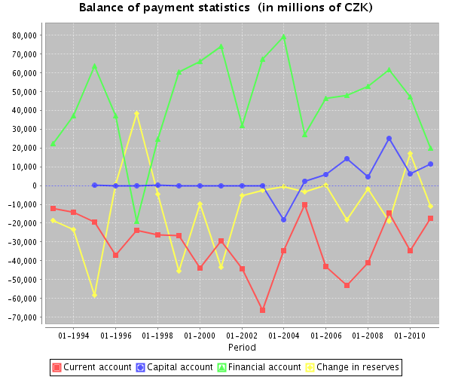
Source: The Czech National Bank

Slide 13
Source: The Czech National Bank

Slide 14
Net international investment position (% of GDP in 2014)
Switzerland | 119,6 | United States | -39,7
Japan | 74,8 | Slovakia | -70
Germany | 36,4 | Spain | -94,5
China | 17,1 | Ireland | -106,7
Russia | 16,7 | Portugal | -111,6
CZ | -35,6 | Greece | -121,9
Source: IMF

Slide 15
Balance of payments adjustment
Most countries can’t run CA deficits for prolonged periods of time
Relationship to government deficits and debts
Balancing mechanisms
  Exchange rate adjustment
  Internal prices adjustment
  Various others (debt forgiving, war, emigration)
Adjustment cost
  Transitional cost
  Continuing cost

Slide 16
Monetary power
Аutonomy × influence
Power to delay
  Liquidity
  Borrowing capacity
  Special cases
Power to deflect
  Sensitivity (openness)
  Vulnerability (adaptability)
Who adjusts?
  Deficit × surplus countries
Distributional consequences

