Slide 1
Intifada
A Crisis of Confidence

Slide 2
Background
It was a Palestinian uprising against the Israeli occupation of the West Bank and Gaza, which lasted from December 1987 until 1991 (Madrid Conference)
  some date its conclusion to 1993, with the signing of the Oslo Accords
Lockman, Zachary; Beinin, Joel, eds. (1989). Intifada: The Palestinian Uprising Against Israeli Occupation
Nami Nasrallah, 'The First and Second Palestinian intifadas,' in David Newman, Joel Peters (eds.) Routledge Handbook on the Israeli-Palestinian Conflict, Routledge, 2013, pp.56–67, p.56
economic integration and increasing Israeli settlements such that the Jewish settler population in the West Bank alone nearly doubled from 35,000 in 1984 to 64,000 in 1988, reaching 130,000 by the mid nineties
Morris, Benny (2001). Righteous Victims: A History of the Zionist-Arab Conflict, 1881-2001. Vintage. p. 567.

Slide 3
Background
The uprising began on 9 December,^{[7]} in the Jabalia refugee camp after an Israeli Defense Forces' (IDF) truck collided with a civilian car, killing four Palestinians.^{[8][9][10]} In the wake of the incident, a protest movement arose, involving a two-fold strategy of resistance and civil disobedience,^{[11]} consisting of general strikes, boycotts of Israeli Civil Administration institutions in the Gaza Strip and the West Bank, an economic boycott consisting of refusal to work in Israeli settlements on Israeli products, refusal to pay taxes, refusal to drive Palestinian cars with Israeli licenses, graffiti, barricading,^{[12][13]} and widespread throwing of stones and Molotov cocktails at the IDF and its infrastructure within the Palestinian territories. Israel, deploying some 80,000 soldiers and initially firing live rounds, killed a large number of Palestinians.

Slide 4
The Intifada was not initiated by any single individual or organization. Local leadership came from groups and organizations affiliated with the PLO that operated within the Occupied Territories; Fatah, the Popular Front, the Democratic Front and the Palestine Communist Party.
The Israeli Labor Party's Yitzhak Rabin, the then Defense Minister, added deportations in August 1985 to Israel's "Iron Fist" policy of cracking down on Palestinian nationalism.
  Helena Cobban, 'The PLO and the Intifada', in Robert Owen Freedman, (ed.) The Intifada: its impact on Israel, the Arab World, and the superpowers, University Press of Florida, 1991 pp.70-106, pp.94-5.'must be considered as an essential part of the backdrop against which the intifada germinated'.(p.95)

Slide 5
Israeli Policy

Slide 6
Crisis
International condemnation
Israel ‘lost’ the moral high ground.
  no longer the victim
    nazi-comparison begins
    anti-Israeli sentiment spreads

Slide 7
Outcomes
The Intifada was recognized as an occasion where the Palestinians acted cohesively and independently of their leadership or assistance of neighbouring Arab states
The Intifada broke the image of Jerusalem as a united Israeli city.
The success of the Intifada gave Arafat and his followers the confidence they needed to moderate their political programme: At the meeting of the Palestine National Council in Algiers in mid-November 1988, Arafat won a majority for the historic decision to recognise Israel's legitimacy; to accept all the relevant UN resolutions going back to 29 November 1947; and to adopt the principle of a two-state solution.

Slide 8
Outcomes
Jordan severed its residual administrative and financial ties to the West Bank in the face of sweeping popular support for the PLO
"Iron Fist" policy, Israel's deteriorating international image, Jordan cutting legal and administrative ties to the West Bank, and the U.S.'s recognition of the PLO as the representative of the Palestinian people forced Rabin to seek an end to the violence though negotiation and dialogue with the PLO

Slide 9
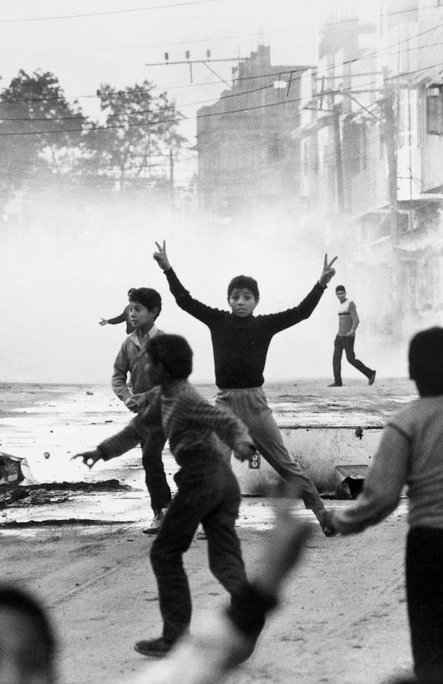
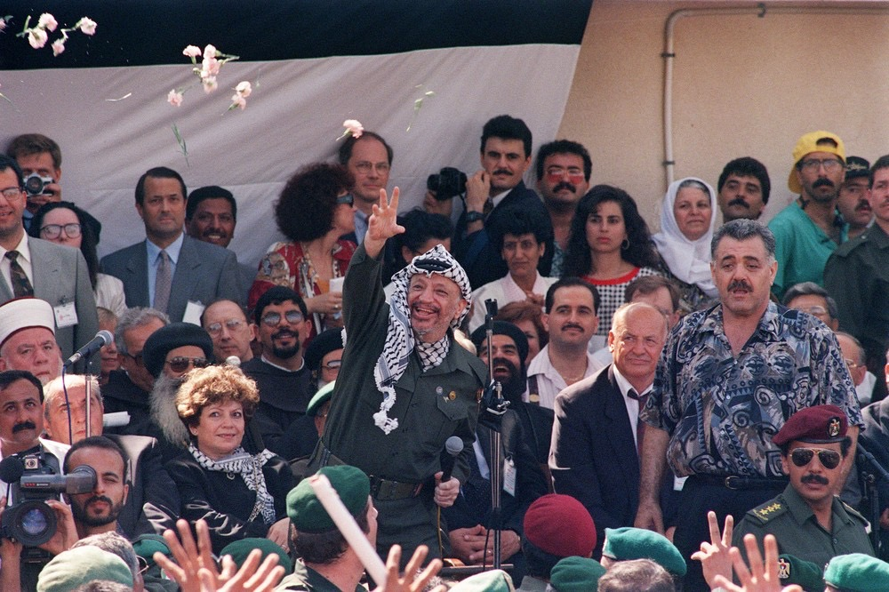
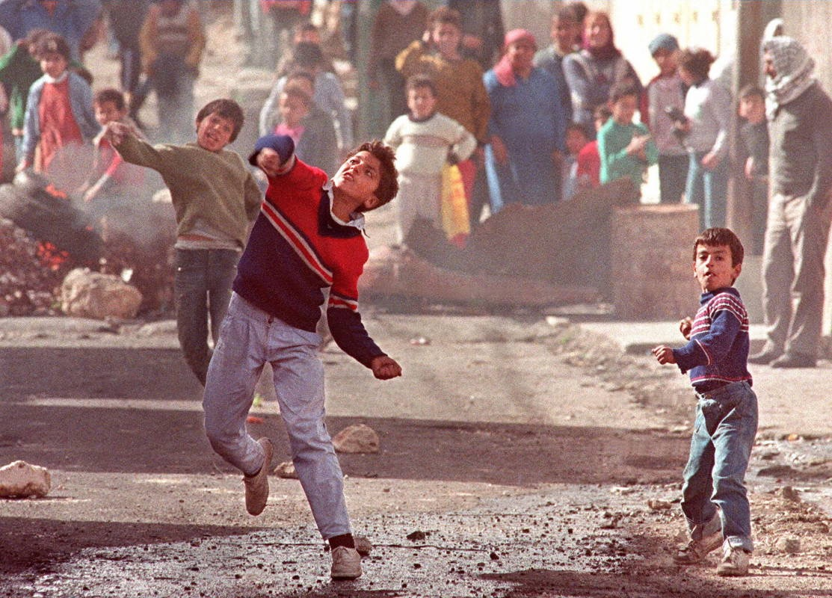

Slide 10
