Slide 1
„CTT“ package
Simona Galbavá (459829)
Kateřina Kožmínová (460195)

Slide 2
disattenuated.cor()
korekce proti zeslabení nereliabilitou
disattenuated.cor(r.xy,c(r.xx,r.yy))
# r.xy=0.6, r.xx=0.7,r.yy=0.8
disattenuated.cor(0.6,c(0.7,0.8))
[,1]
[1,] 0.8017837

Slide 3
spearman.brown()
spearman.brown(r.xx, input = 2, n.or.r = "n")
#old reliability is 0.82, if we want a new measure to be 0.9, the new test length is
> spearman.brown(0.82, input = 0.9, n.or.r = "r")
$`n.new`
[1] 1.97561
#old reliability is 0.82, if the measure is shortened to half length, the reliability of new test is
> spearman.brown(0.82, input = 0.5, n.or.r = "n")
$`r.new`
[1] 0.6949153

Slide 4
splitHalf()
„psych“ package
> splitHalf(ODdata)
Split half reliabilities
Call: splitHalf(r = ODdata)
Maximum split half reliability (lambda 4) = 0.9
Guttman lambda 6 = 0.86
Average split half reliability = 0.82
Guttman lambda 3 (alpha) = 0.82
Minimum split half reliability (beta) = 0.58
Average interitem r = 0.2 with median = 0.18

Slide 5
lowerCor()
„psych“ package

Slide 6
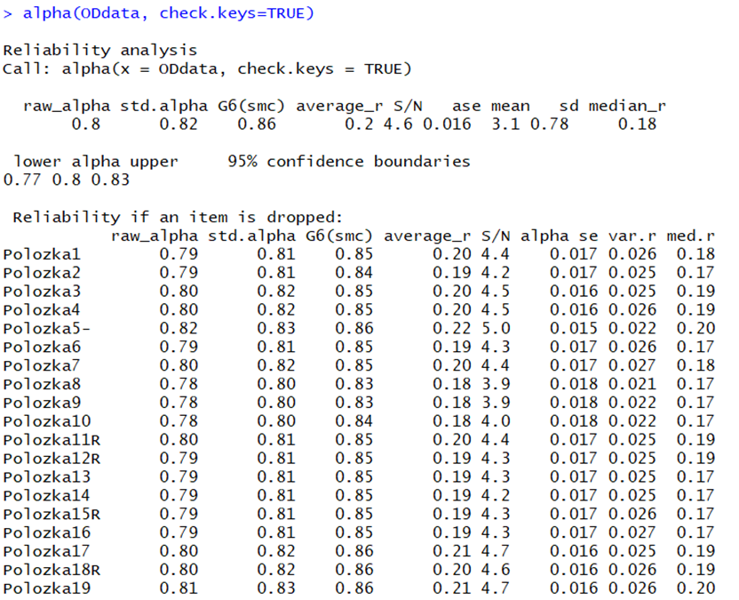
alpha()
„psych“ package
alpha(data, check.keys =T)
std.alpha – méně zkreslený odhad
(zešikmené položky, různé škály)

Slide 7
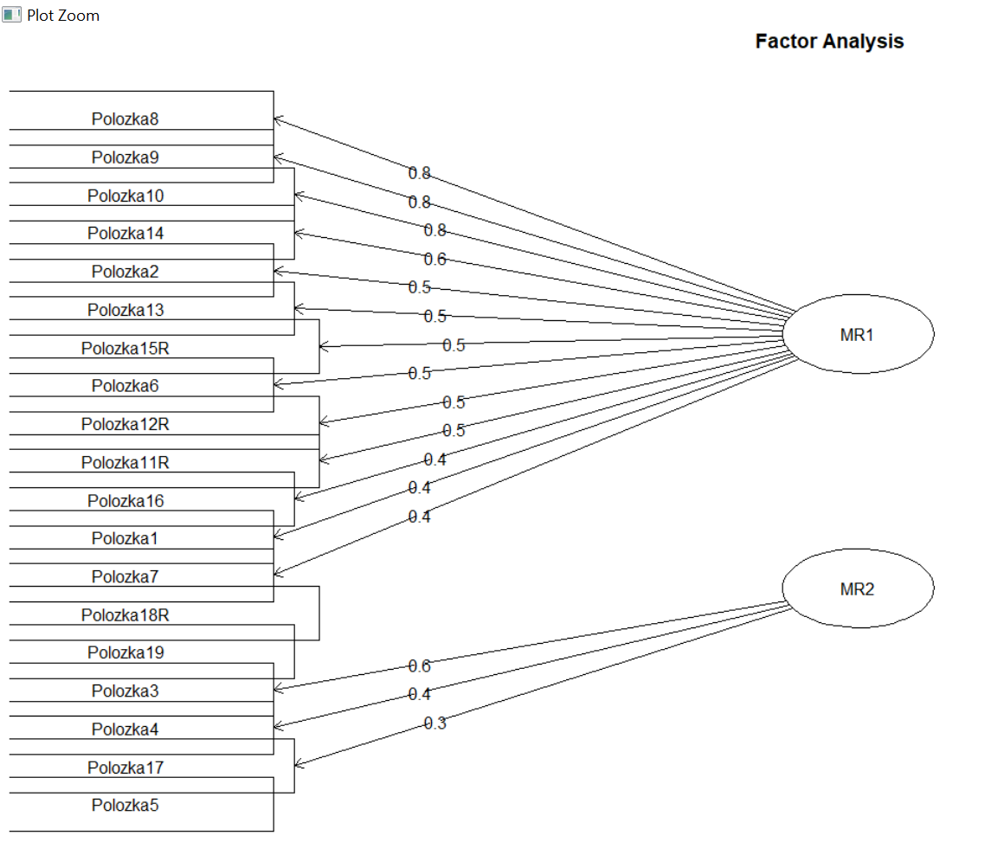
Další funkce - psych
EFA_model <- fa(ODdata, nfactors = 2, rotate = "oblimin")
EFA_model$loadings
Faktorové náboje položek
fa.diagram(EFA_model)
Path diagrams
describe(ODdata)
Statistiky položek
AUC(c(TP,FP,FN,TN))
Specificita, senzitivita

