Slide 1
Nežádoucí negativní dopady psychoterapie, vedlejší účinky
Přiblížení výzkumu Centra pro výzkum psychoterapie Katedry psychologie FSS MU
Kontakt: prof. Z. Vybíral; vybiral@fss.muni.cz
© Zbyněk Vybíral, Faculty of Social Studies, Masaryk University, 2017 –

Slide 2
The past

Slide 3
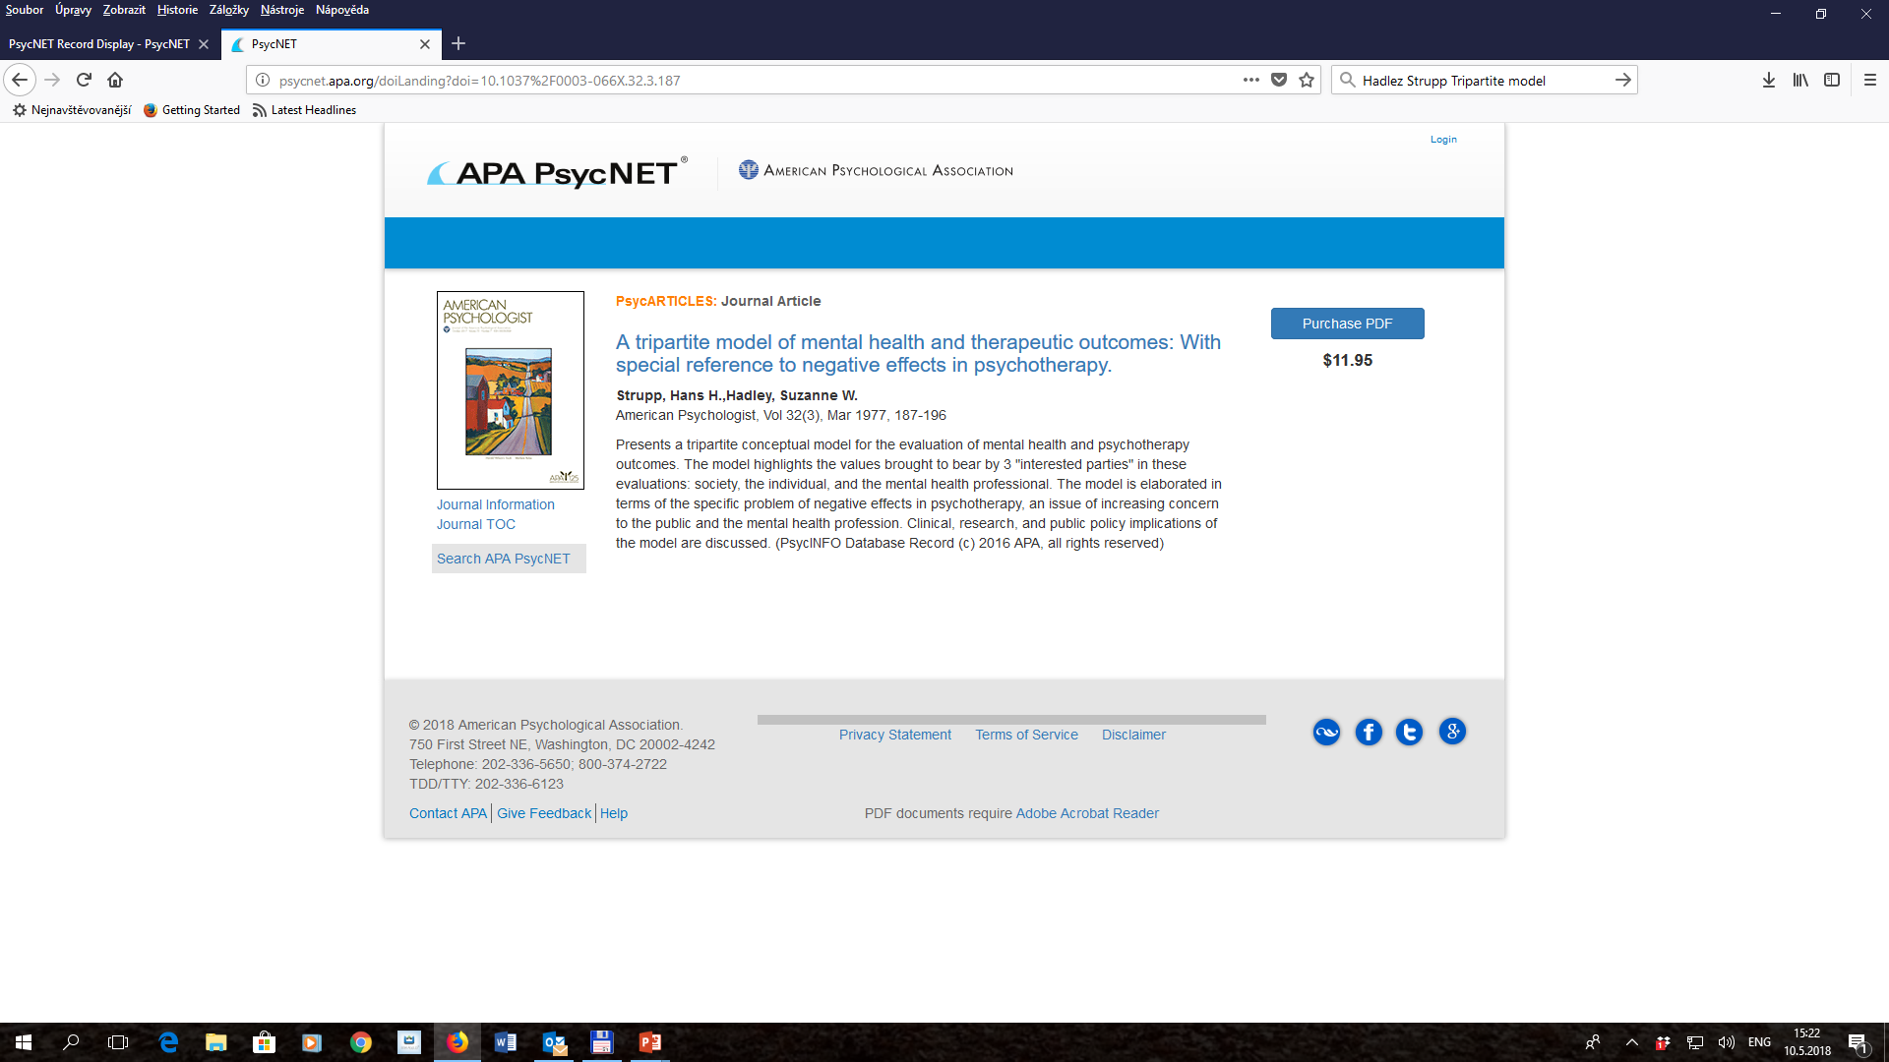

Slide 4
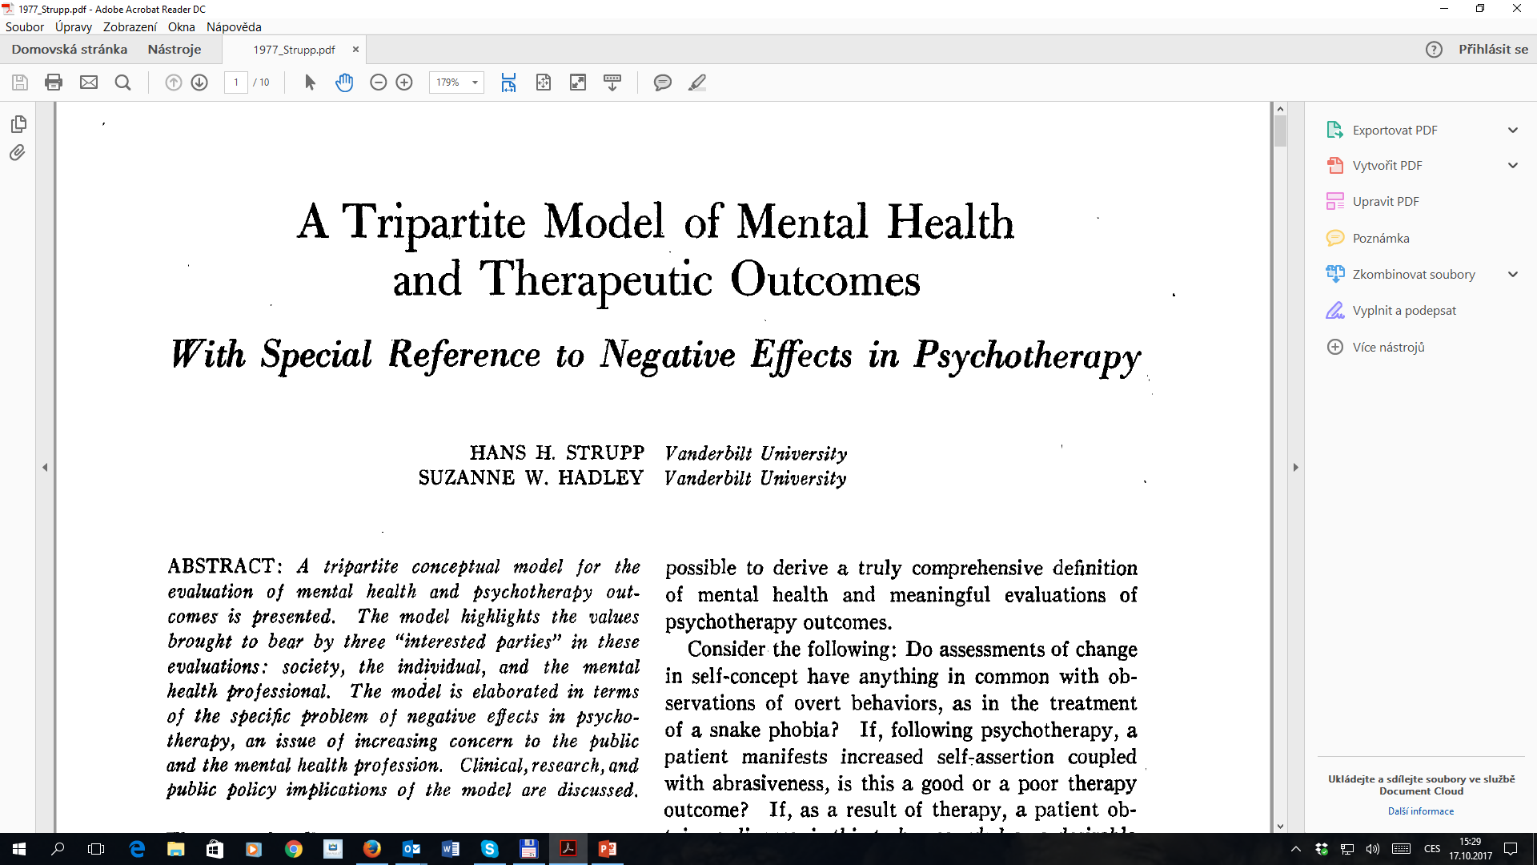

Slide 5
When Things Get Worse
The Problem of Negative Effects in Psychotherapy
Hans H. Strupp; Suzanne W. Hadley and Beverly Gomes-Schwartz
This text confronts the disturbing reality of patients getting worse while in treatment. With an awareness of society's legitimate right to question what psychotherapy does and how it does it, this book discusses the complex problems of when psychotherapy fails at its intent.
Jason Aronson, Inc., pages 366, paperback, July 1977

Slide 6
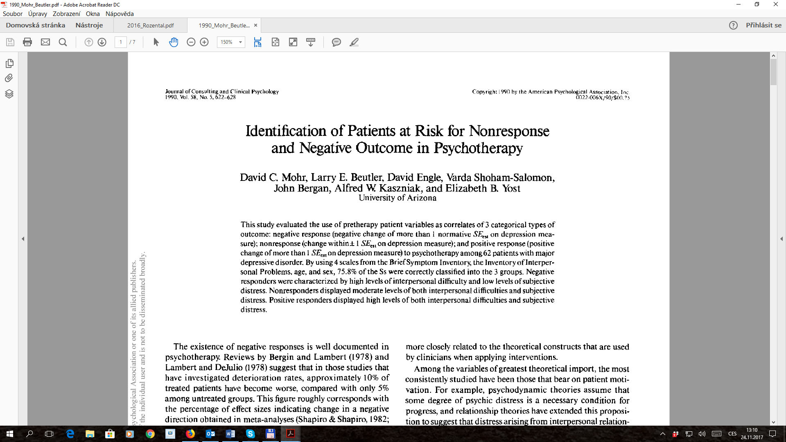

Slide 7
2012 – 2014
First summarizing reviews
NE from clinicians’ perspectives
First tools (questionnaires) for clients’ feedback

Slide 8
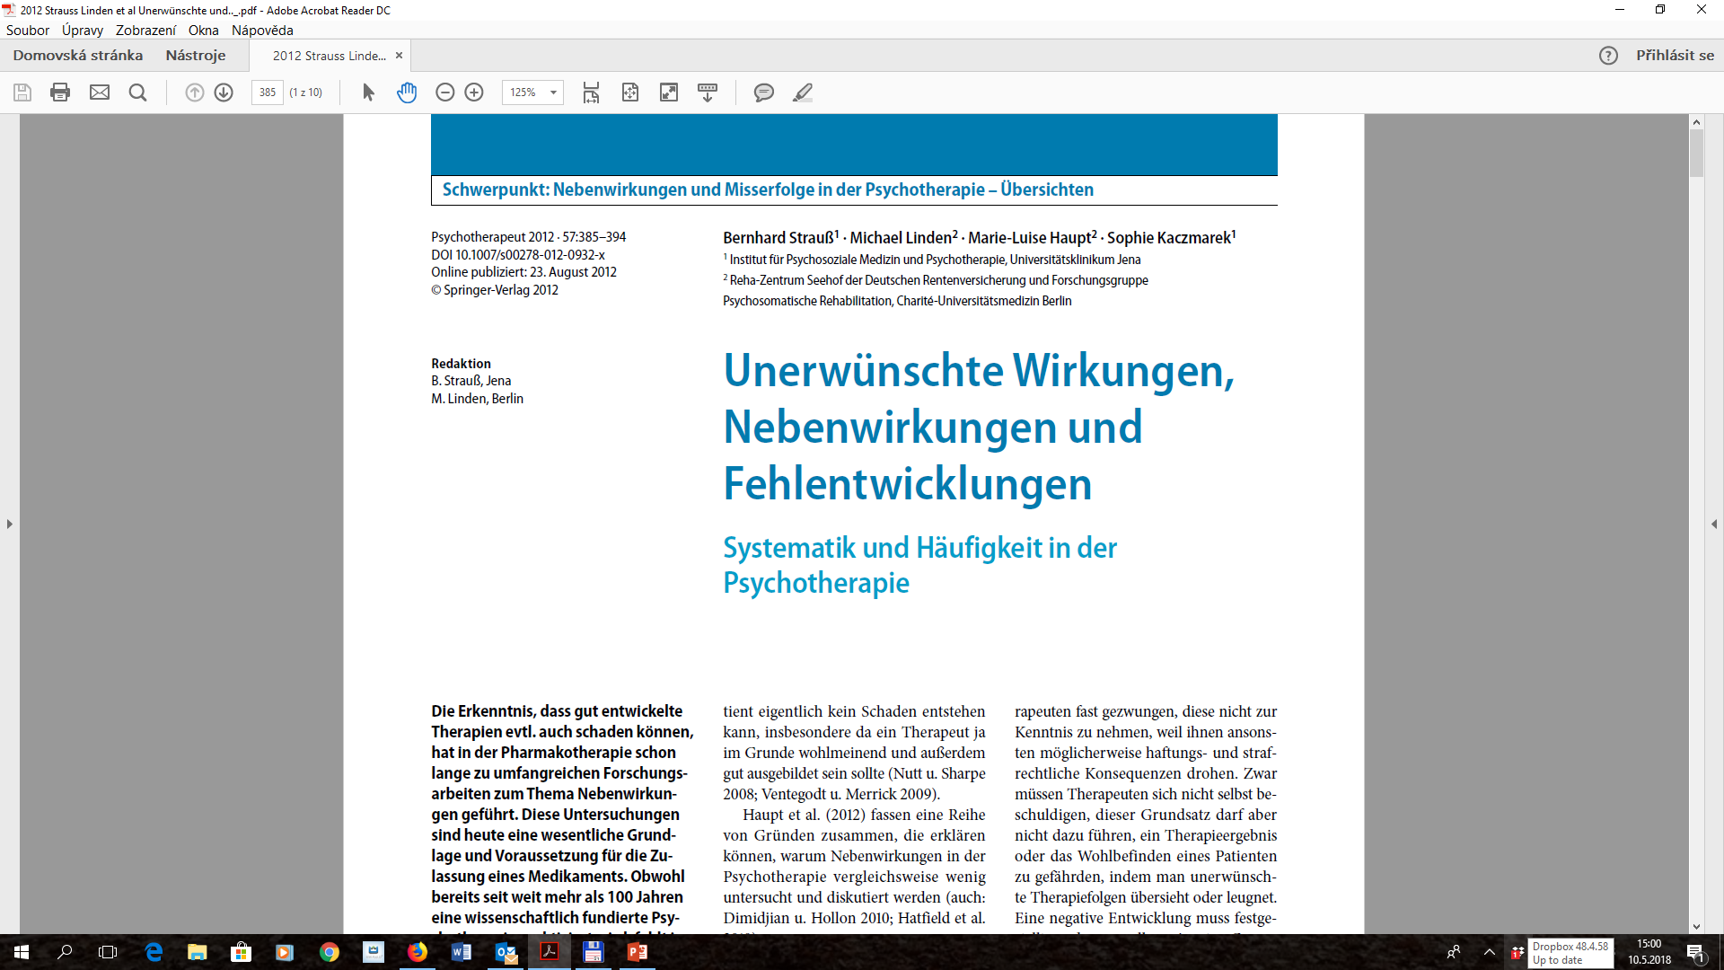

Slide 9
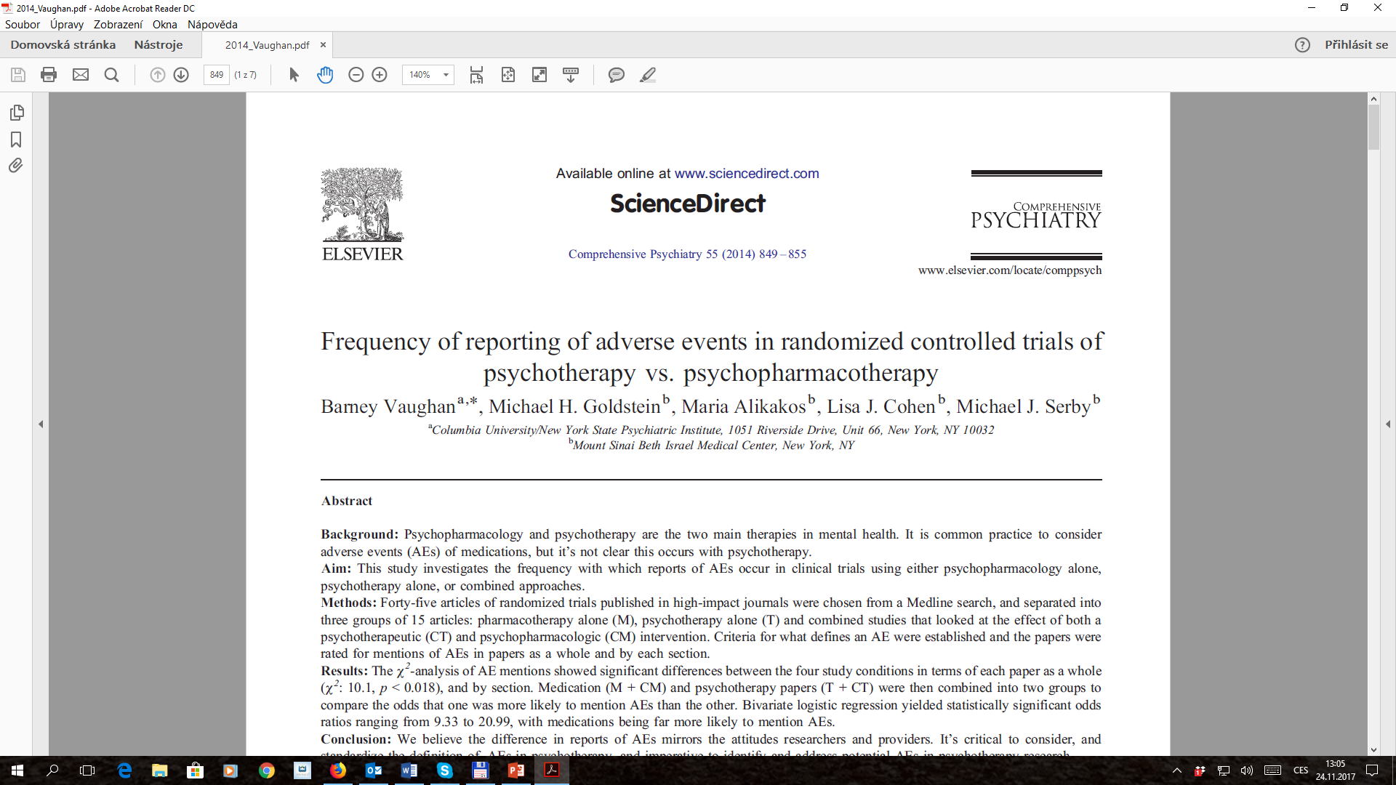

Slide 10
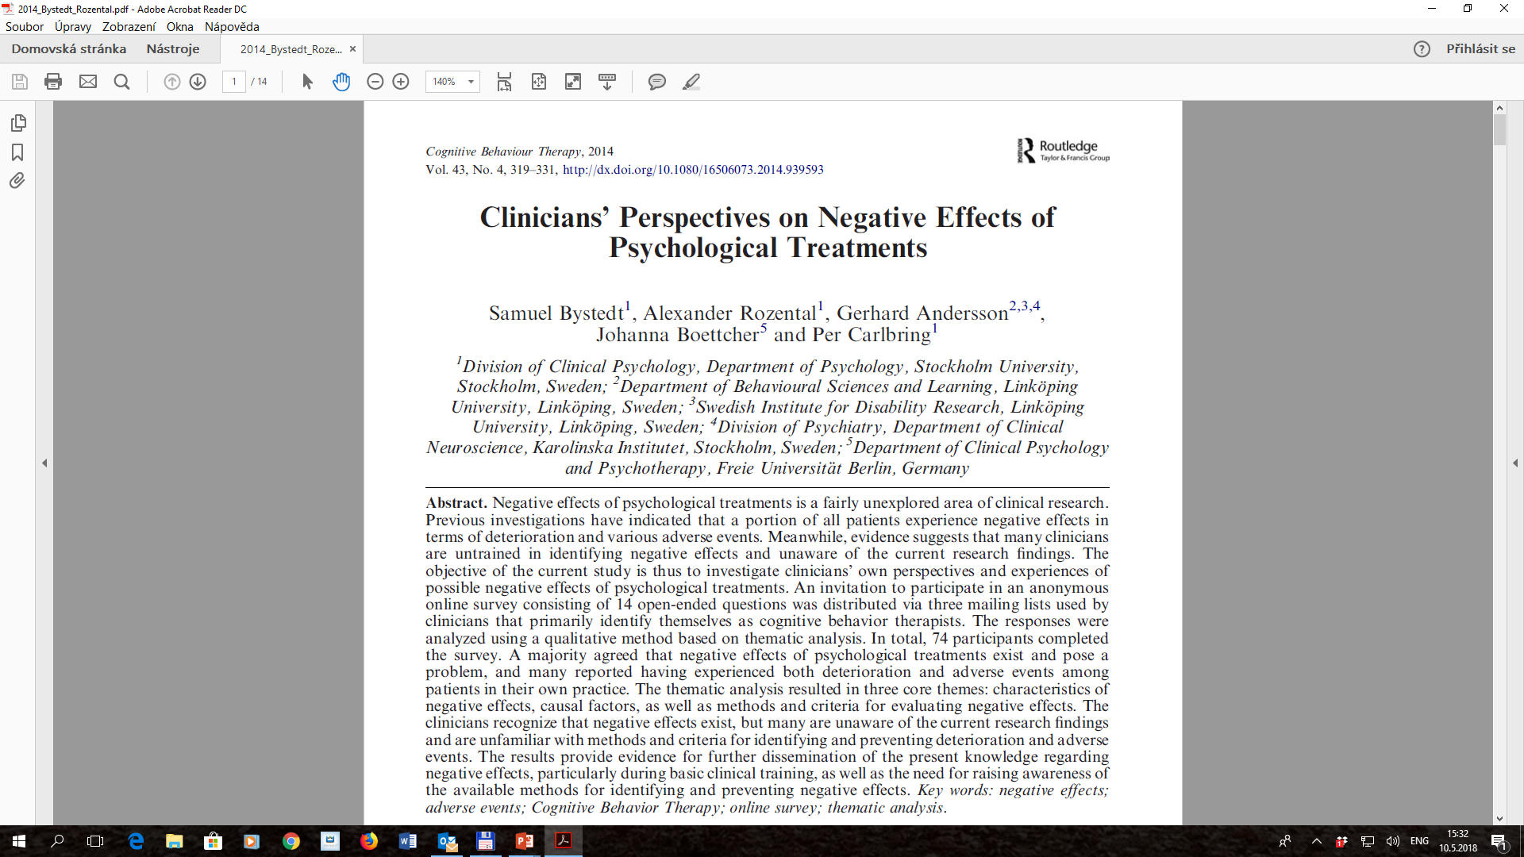

Slide 12
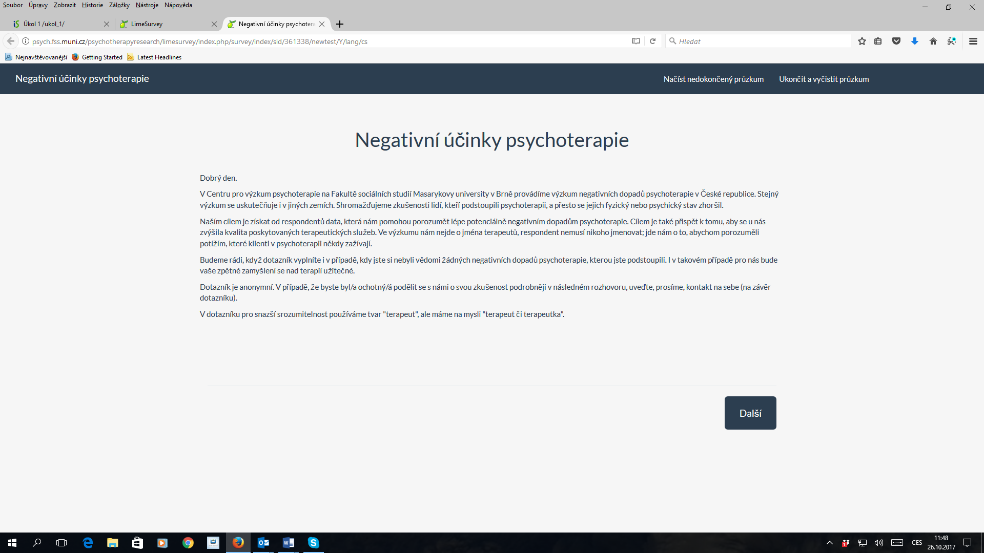

Slide 13
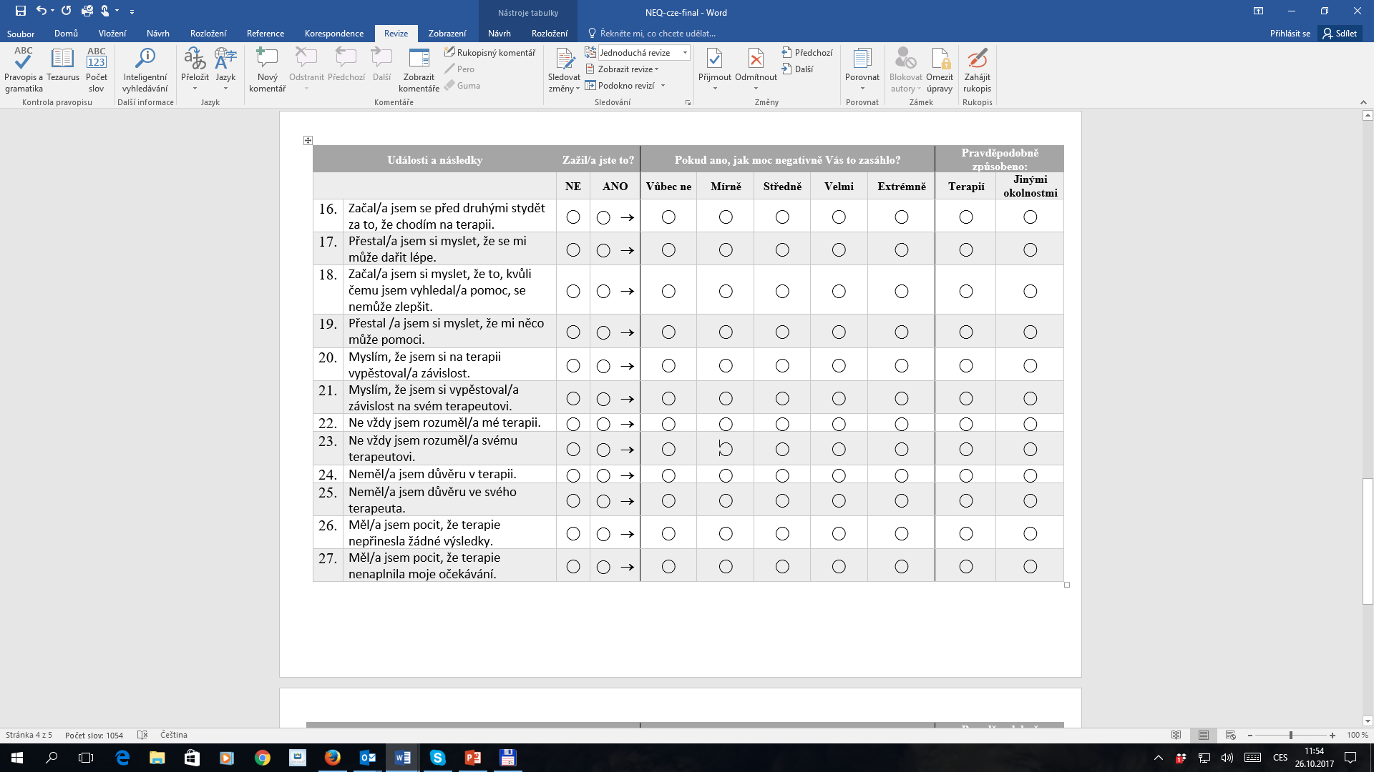

Slide 14
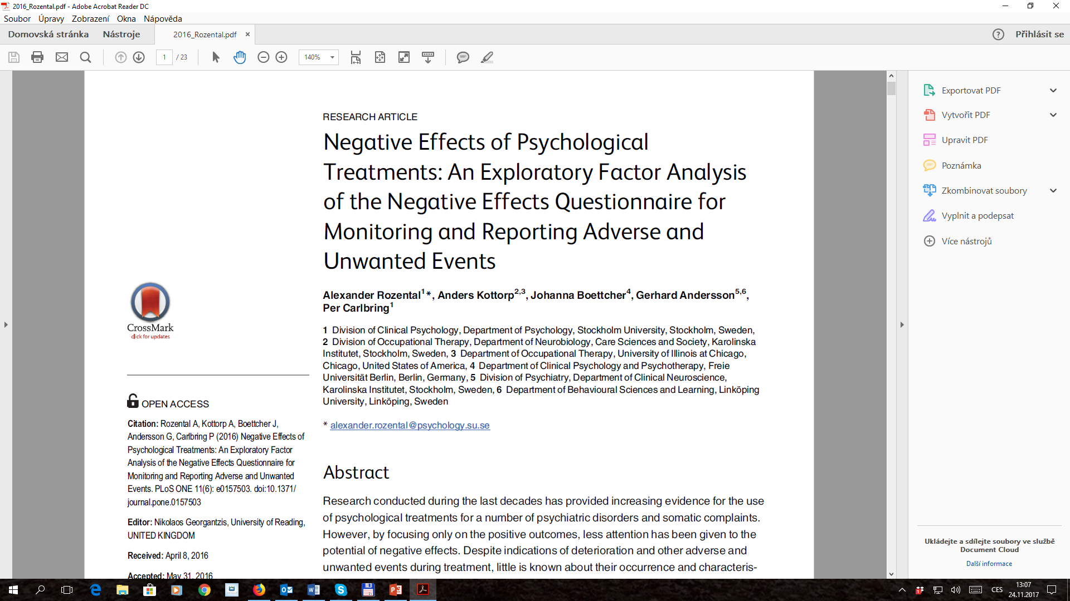
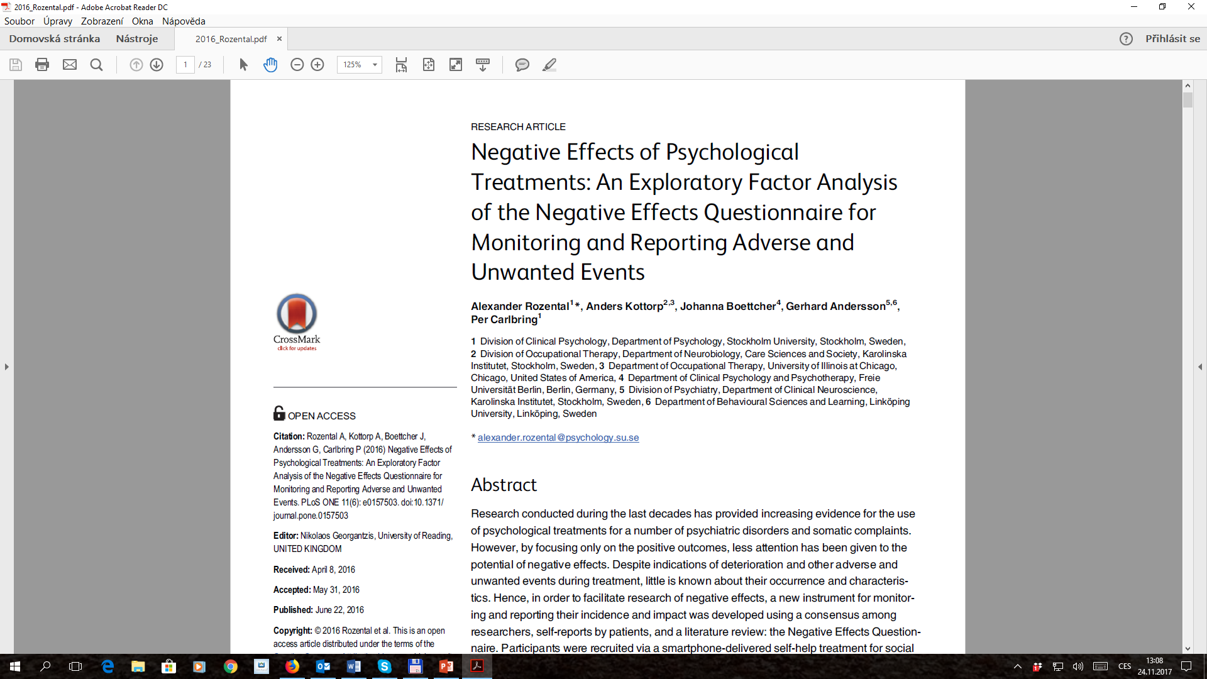
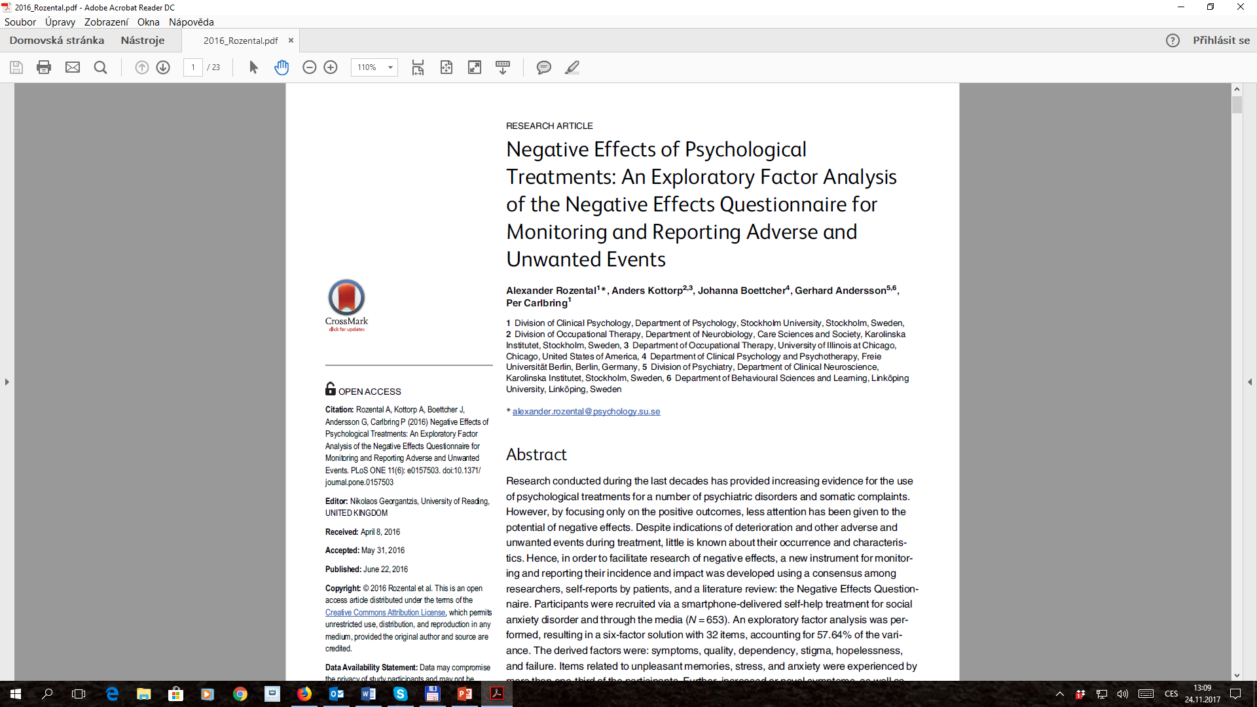

Slide 15
2015 –
More specialized focus
Further tools (questionnaires) & first research outcomes
First analyses of clients’ experiences
Research of therapists’ contribution continues

Slide 16
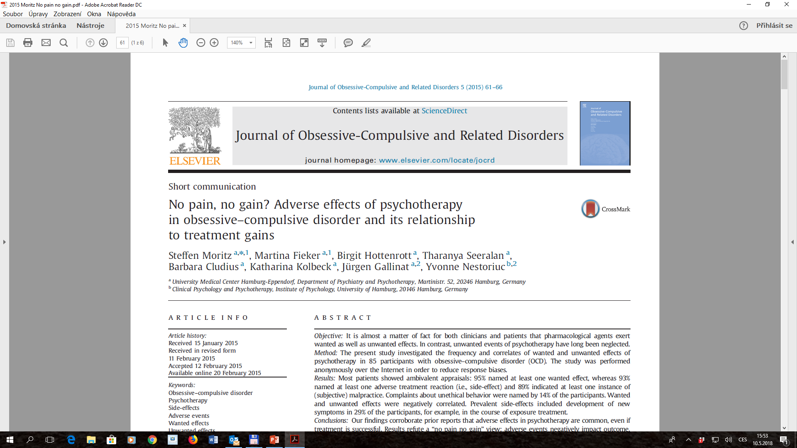

Slide 18
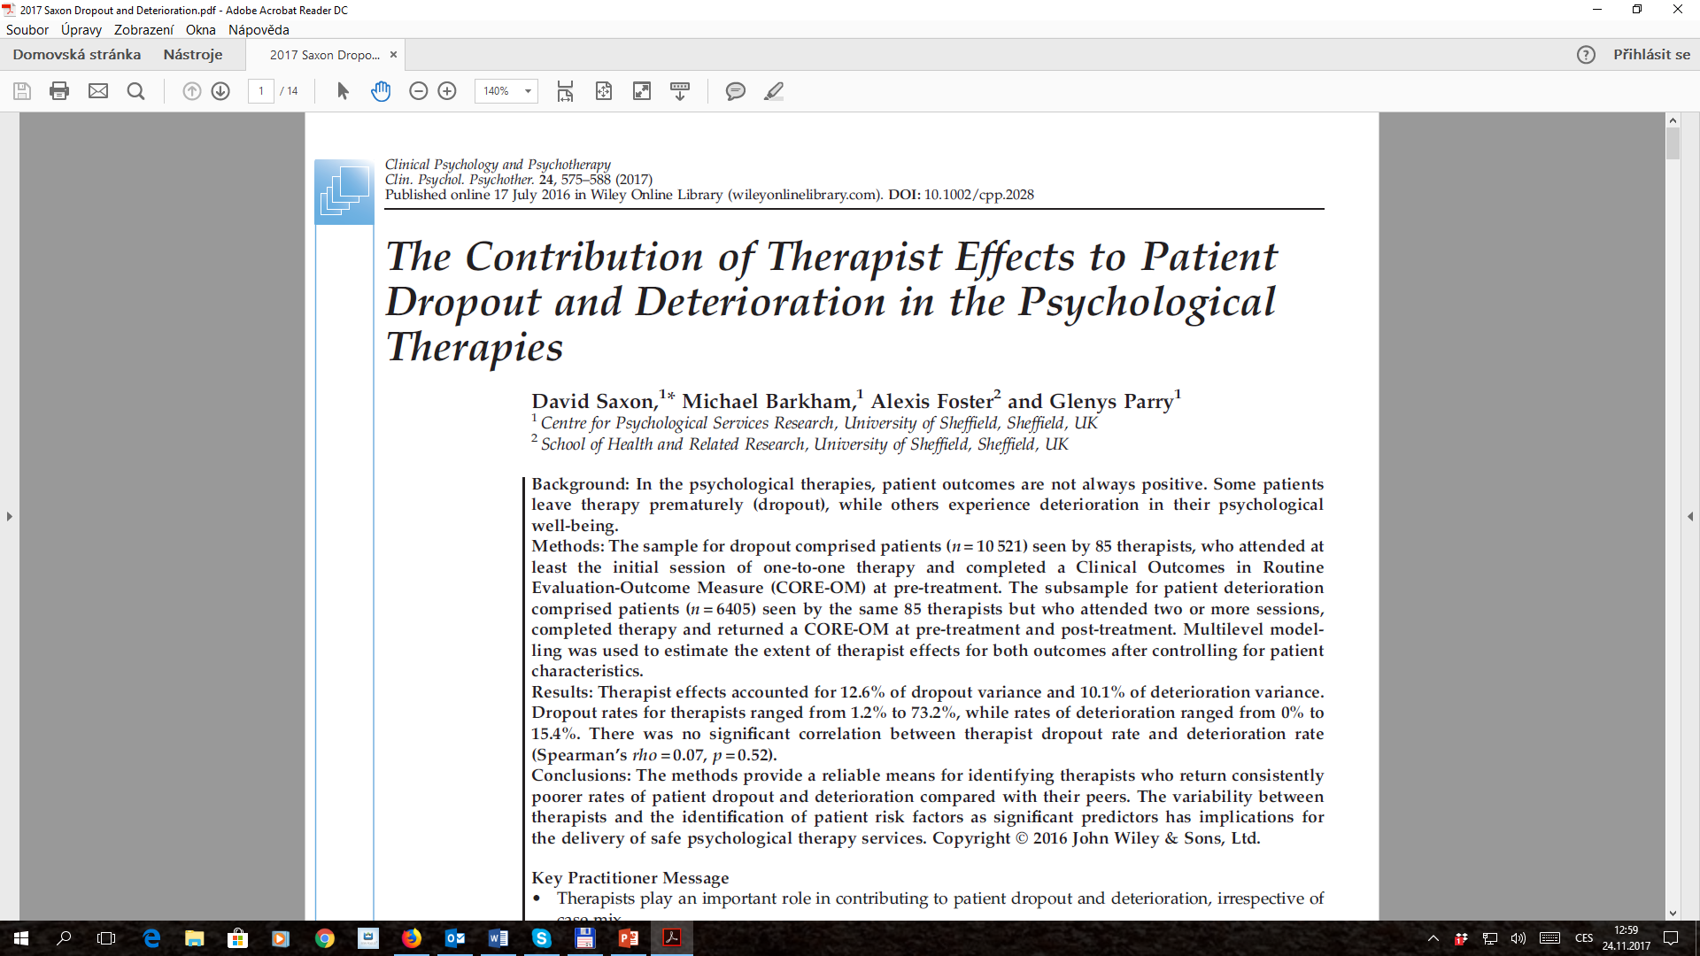

Slide 19
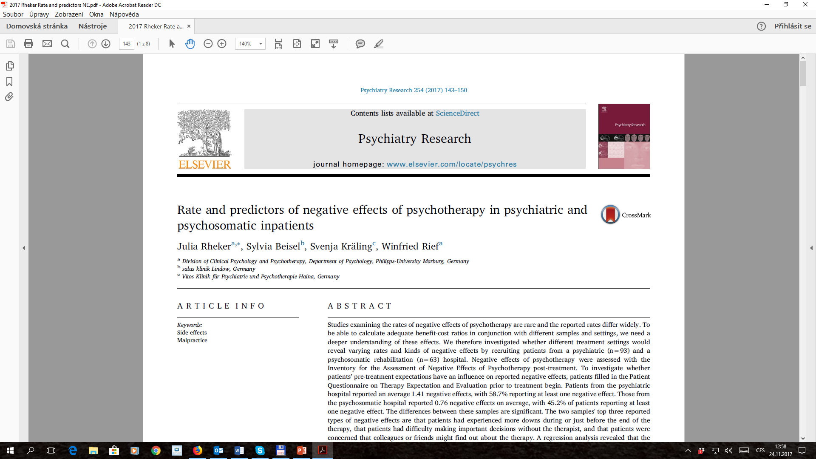

Slide 20
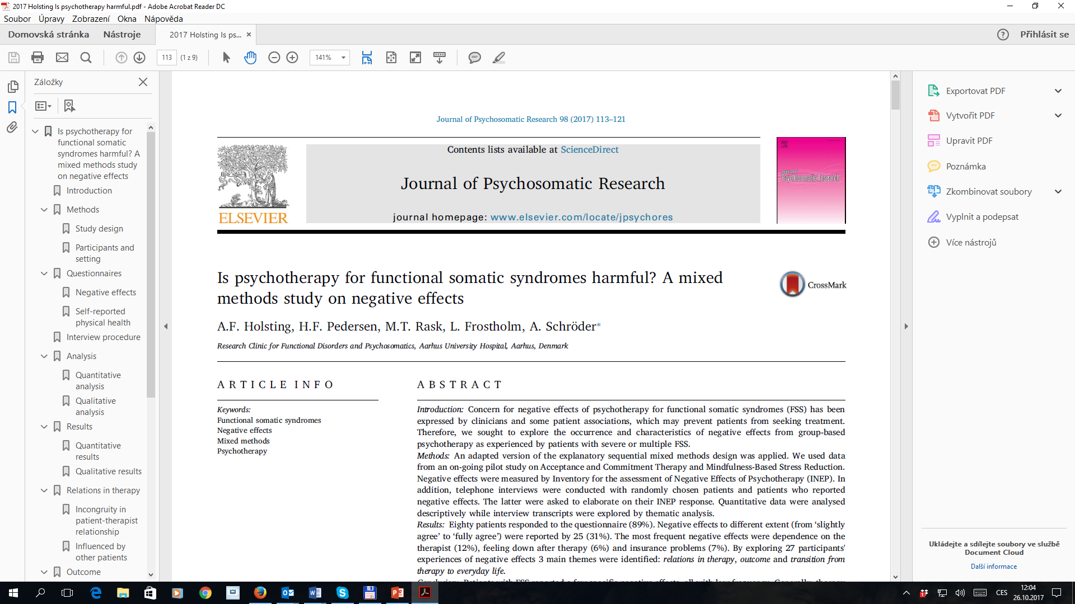

Slide 21
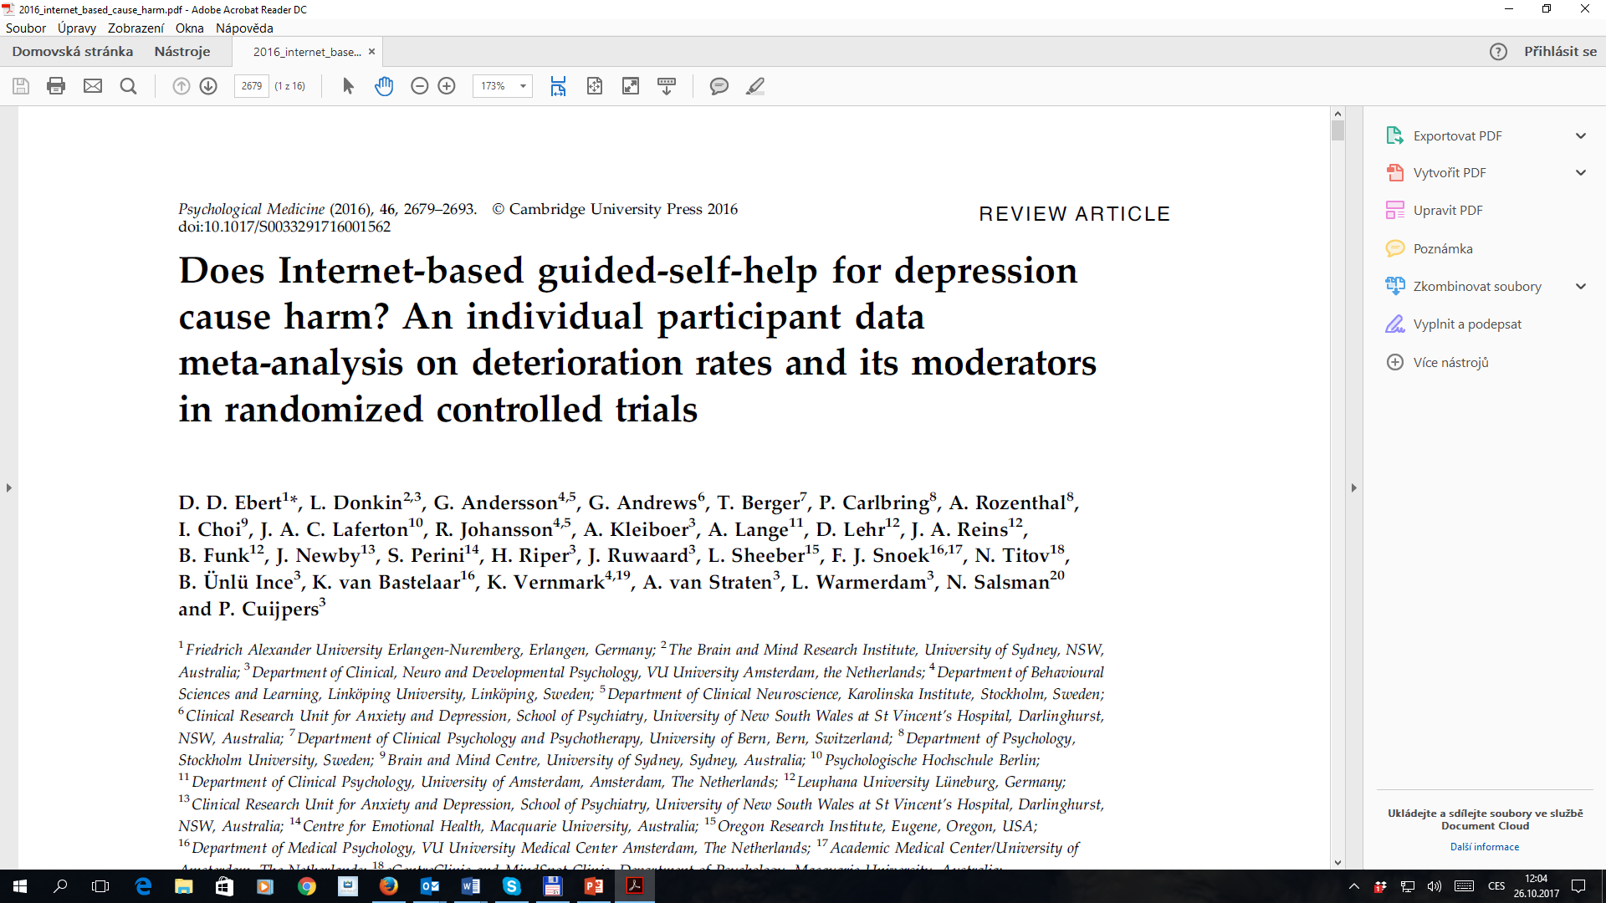

Slide 23
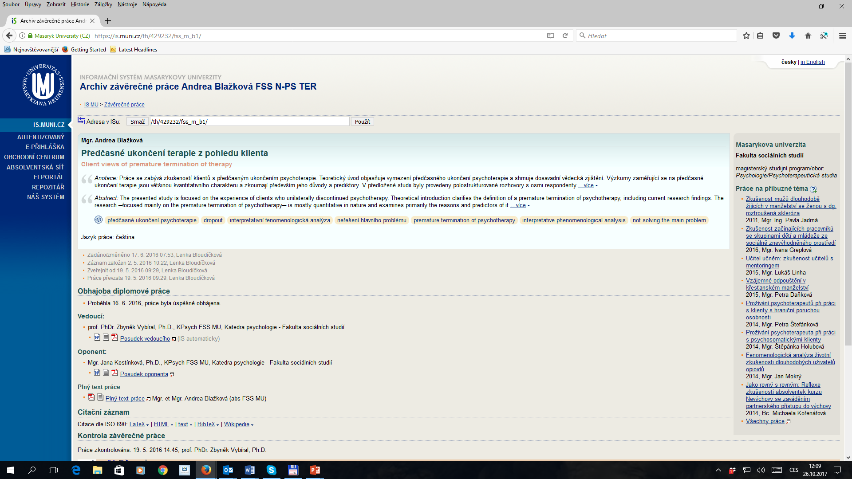

Slide 24
Současnost

Slide 25
