Slide 1
Meta-analysis of neuroimaging data
Martin Jáni
Selected Topics in Contemporary Neuroscience

Slide 2
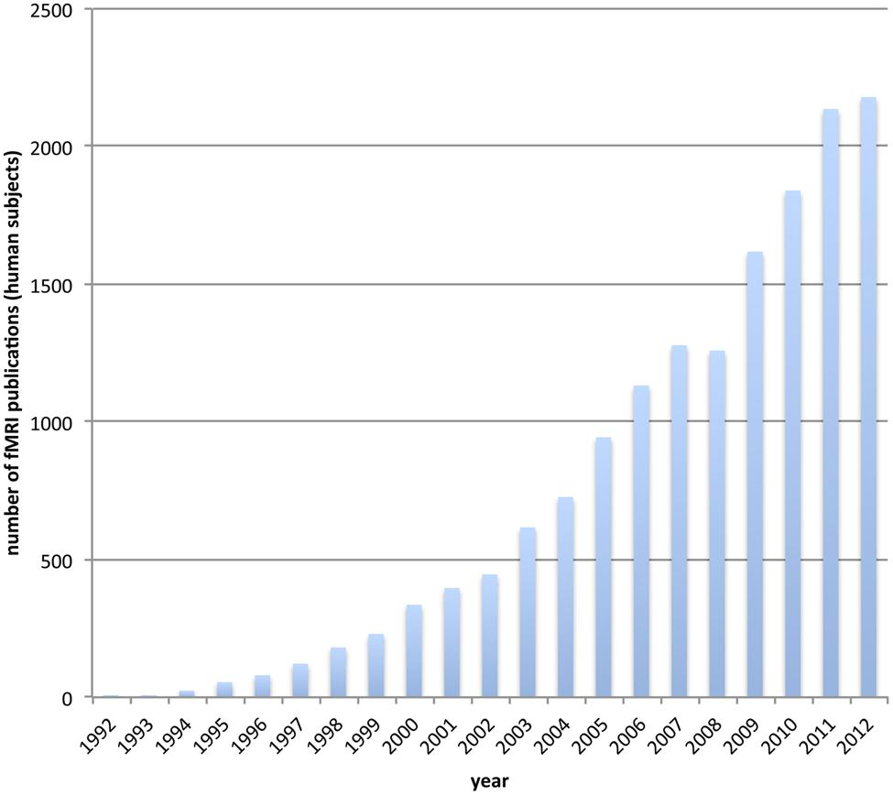
[Stelzer et al., 2014]

Slide 3


Slide 4
why and what?
need for comprehensive summary
meta-analysis = quantitative review
1 study represents 1 subject
units of measurement = summary statistics (effect sizes)
standard IMRaD structure

Slide 5

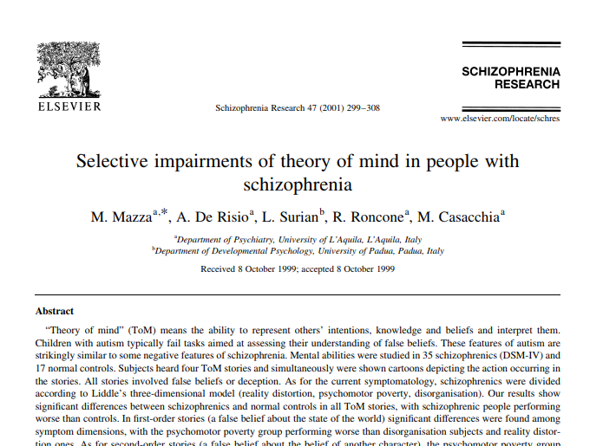
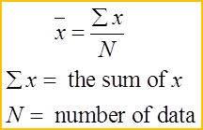
t-statistic
p value

Slide 6

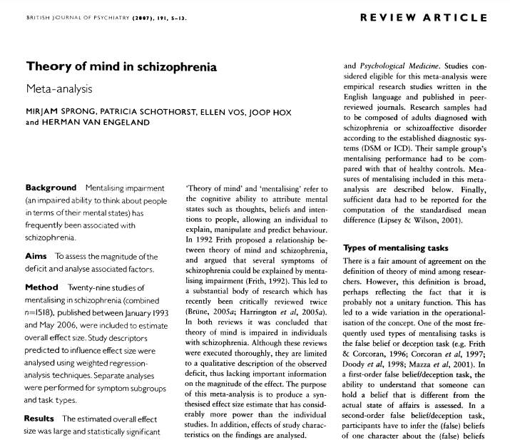

Slide 7

The use of Effect sizes
difference in means / pooled standard deviation
  Cohen's d
  Glass' Δ
  Hedges’ g
comparable with other studies
unit of measure is lost
less straightforward

Slide 8
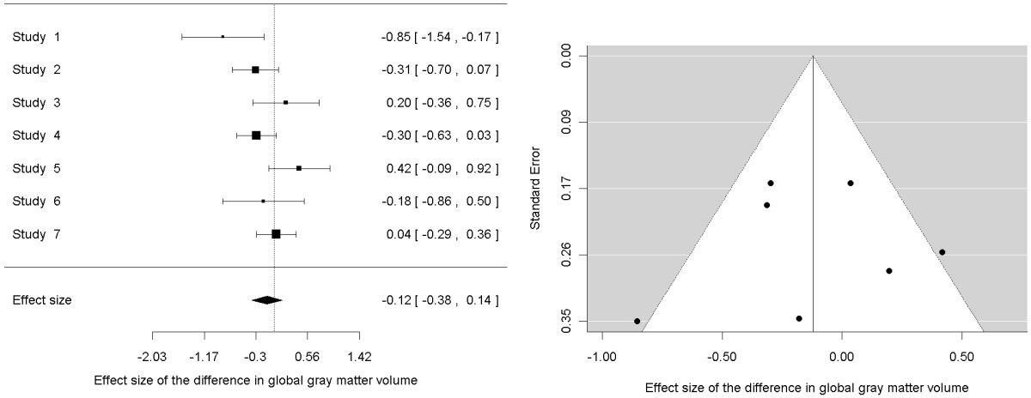
Publication bias
Forest plot
Funnel plot
[Radua and Mataix-Cols, 2012]

Slide 9
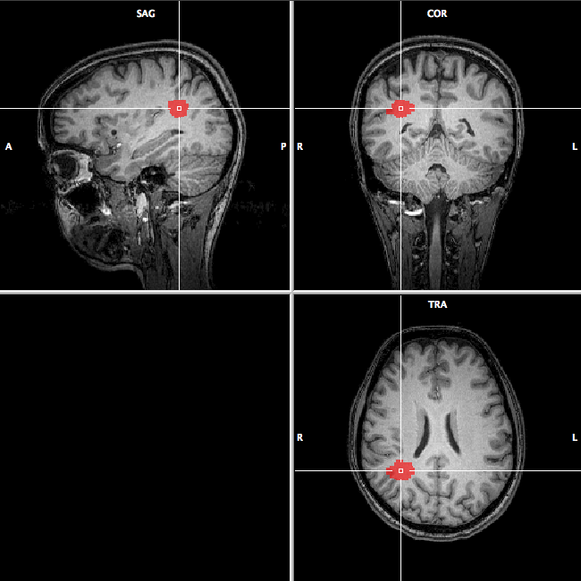
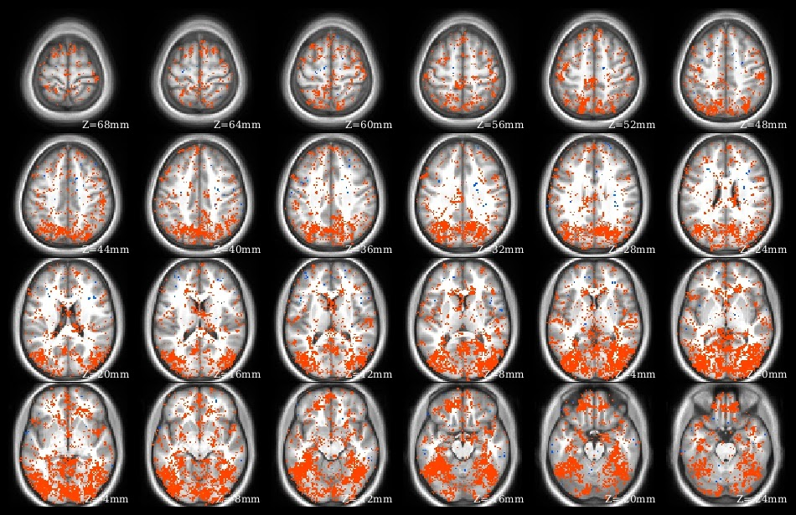
Region of interest-based meta-analyses
Voxel-based meta-analyses

Slide 10
Region of interest-based meta-analyses
set of different meta-analyses for every ROI
selective = some regions more studied than others
a priori hypotheses influence selection of ROI
strong publication bias

Slide 11
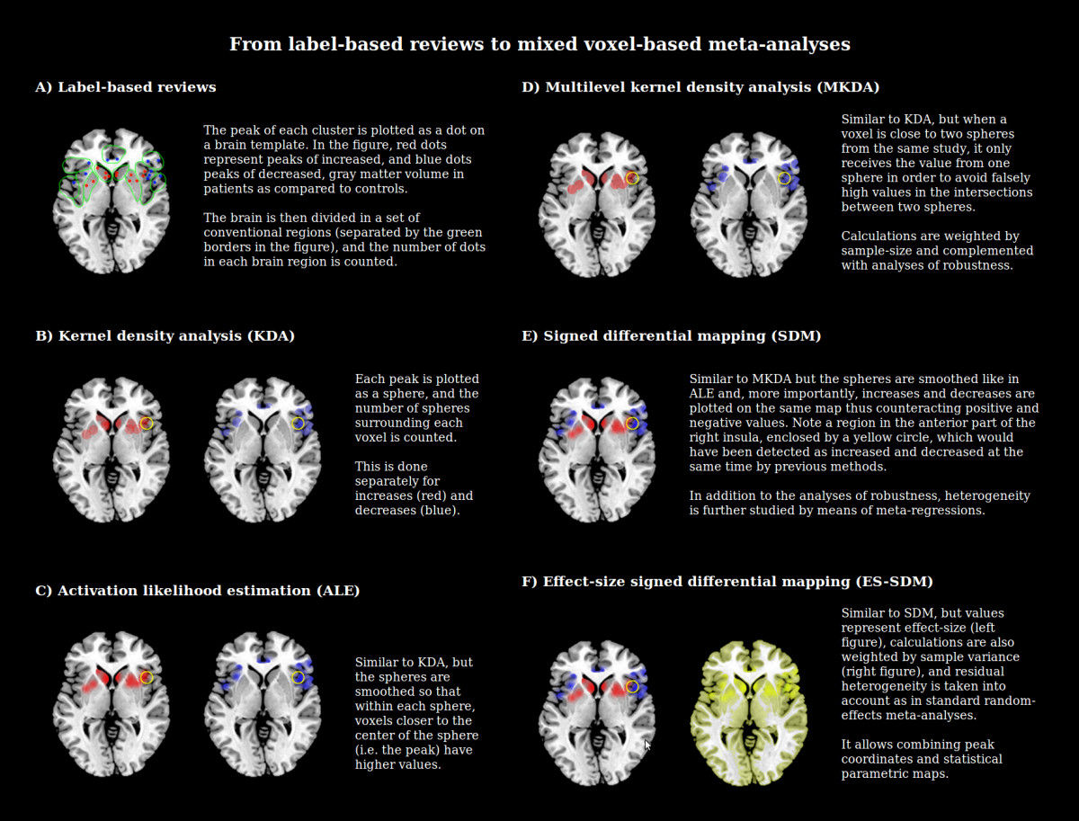
Label-based reviews
peak of a cluster plotted as a dot
number of dots count in each region
  increase
  decrease
  borders of conventional regions
drawbacks: no weighting, loss of information, selective
[Radua and Mataix-Cols, 2012]

Slide 12
Voxel-based meta-analyses
Image-based meta-analyses
Coordinate-based meta-analyses
Mixed image- and coordinate-based meta-analyses

Slide 13
Voxel-based meta-analyses
Image-based meta-analyses
Coordinate-based meta-analyses
Mixed image- and coordinate-based meta-analyses

Slide 14
Image-based meta-analyses
use of parametric maps
meta-analysis for each voxel
multiple-comparisons problem
hard to find (contacting authors)

Slide 15
Voxel-based meta-analyses
Image-based meta-analyses
Coordinate-based meta-analyses
Mixed image- and coordinate-based meta-analyses

Slide 16
Coordinate-based meta-analyses
Kanske et al. 2015

Slide 17
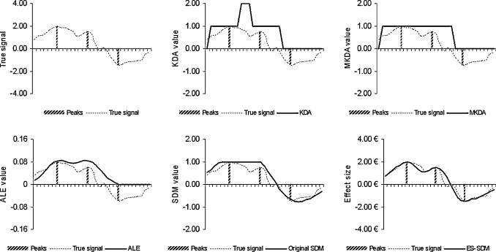
Kernel density analysis (KDA)
peak as a sphere
number of spheres surrounding each voxel are counted
  increase
  decrease
[Radua and Mataix-Cols, 2012]

Slide 18
Multilevel kernel density (MKDA)
similar to KDA
voxel close to two spheres from one study counts as one
avoids false high values at intersections
weighted by sample size
robustness analysis
[Radua and Mataix-Cols, 2012]

Slide 19
Activation likelihood estimation (ALE)
peak as a smoothed sphere (Gaussian Kernel at FWHM)
higher value for voxels closer to the center of the sphere (peak)
  increase
  decrease
[Radua and Mataix-Cols, 2012]

Slide 20
Signed differential mapping (SDM)
smoothed spheres like in ALE
weighted by sample size, robustness analysis like MKDA
combines positive and negative values
adds heterogeneity analysis
[Radua and Mataix-Cols, 2012]

Slide 21
Effect size-Signed differential mapping
(ES-SDM)
similar to SDM, but values are effect sizes
weighted by variance (right)
random effects model
combination of peaks and statistical parametric maps
[Radua and Mataix-Cols, 2012]

Slide 22
Voxel-based meta-analyses
[Radua et al., 2012]

Slide 23
Voxel-based meta-analyses
Image-based meta-analyses
Coordinate-based meta-analyses
Mixed image- and coordinate-based meta-analyses

Slide 24
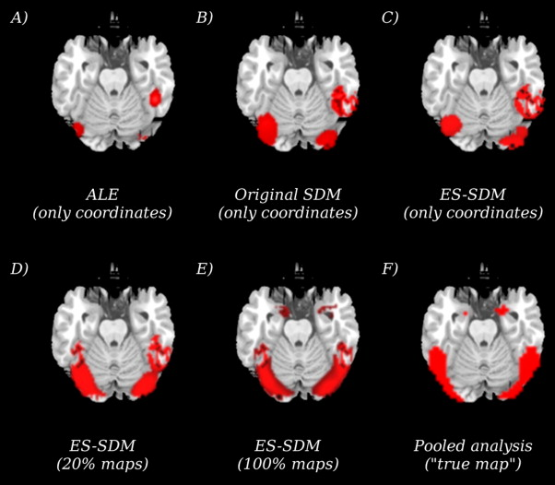
Mixed image- and coordinate-based meta-analyses
[Radua et al., 2012]

Slide 25
Summary
Meta-analysis is a quantitative systematic review
Pretty accessible and valuable research to do
Different approaches and methods
ROI based and Voxel based

Slide 26
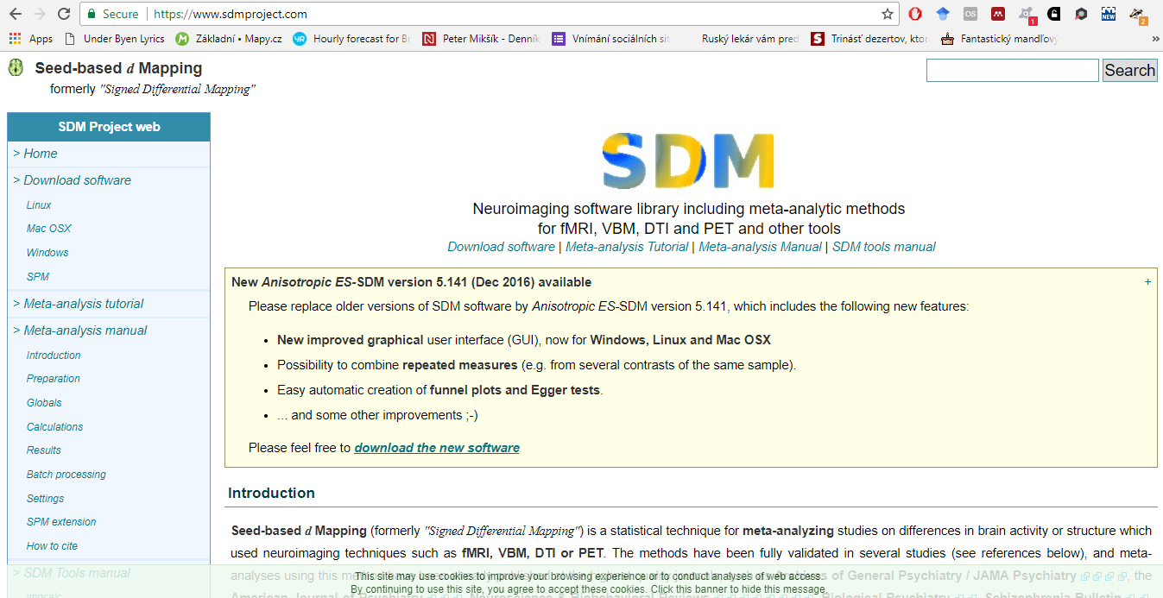
Example: SDM
www.sdmproject.com

Slide 27
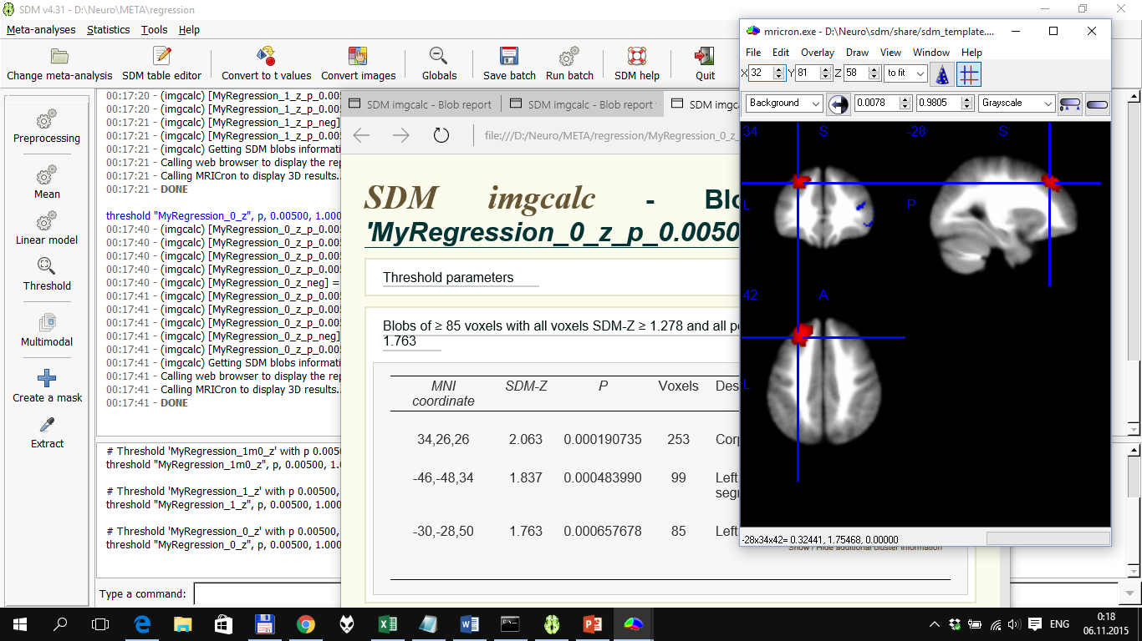
Example: SDM
research question
data collection
formatting
preprocessing
model estimation
results
www.sdmproject.com

Slide 28
Example: SDM
research question
data collection
formatting
preprocessing
model estimation
results
consistent task/process
choose contrasts

Slide 29
Example: SDM
research question
data collection
formatting
preprocessing
model estimation
results
similar to systematic review
search in databases
selection of papers
1 study as 1 subject
contact authors for missing data

Slide 30
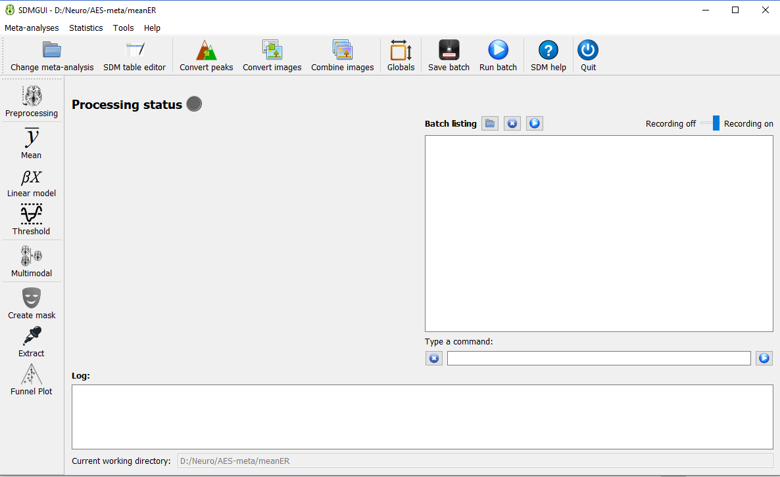
Example: SDM
research question
data collection
formatting
preprocessing
model estimation
results

Slide 31
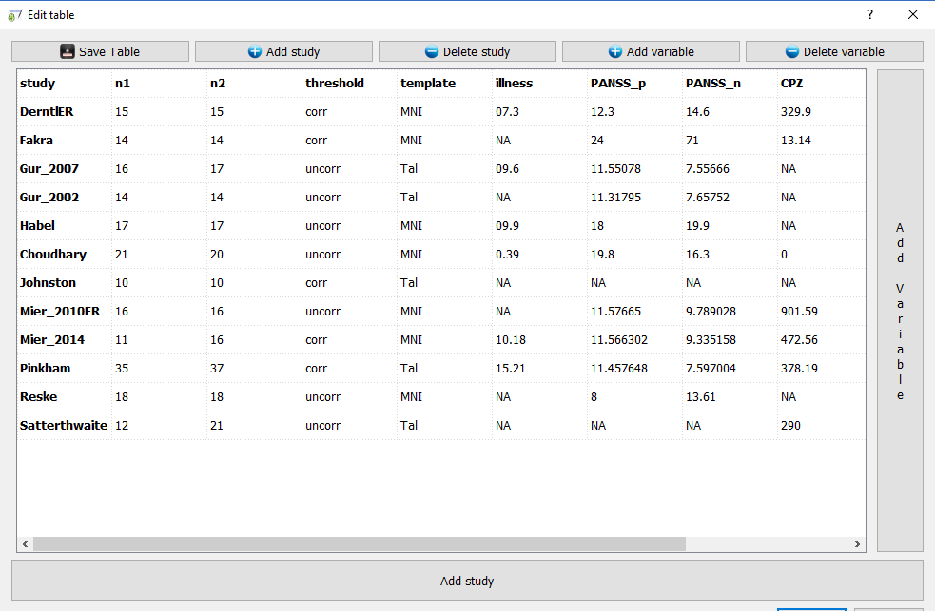
Example: SDM
research question
data collection
formatting
preprocessing
model estimation
results

Slide 32
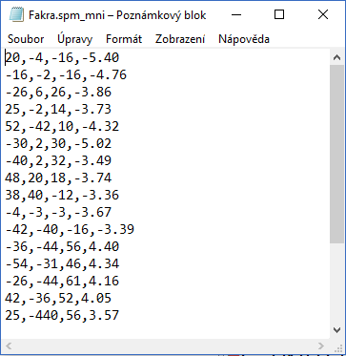
Example: SDM
research question
data collection
formatting
preprocessing
model estimation
results

Slide 33
Example: SDM
research question
data collection
formatting
preprocessing
model estimation
results
convert coordinate peaks to estimate parametric maps
optionally include original parametric maps
creates
  parametric maps of effect sizes
  heterogeneity maps

Slide 34
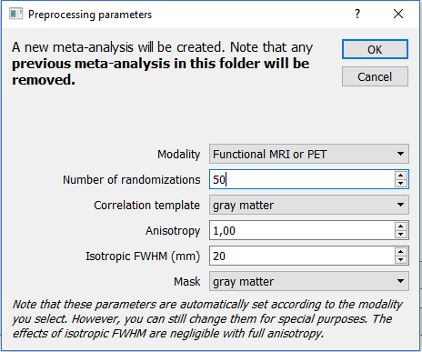
Example: SDM
research question
data collection
formatting
preprocessing
model estimation
results
modality: VBM, fMRI, PET, DTI
template: GM, WM, FA, CSF

Slide 35
Example: SDM
research question
data collection
formatting
preprocessing
model estimation
results
estimate mean
linear model
  compare groups
  meta-regression
multimodal meta-analysis

Slide 36
Example: SDM
research question
data collection
formatting
preprocessing
model estimation
results
threshold results
extract peaks (seed)
funnel plot

Slide 37
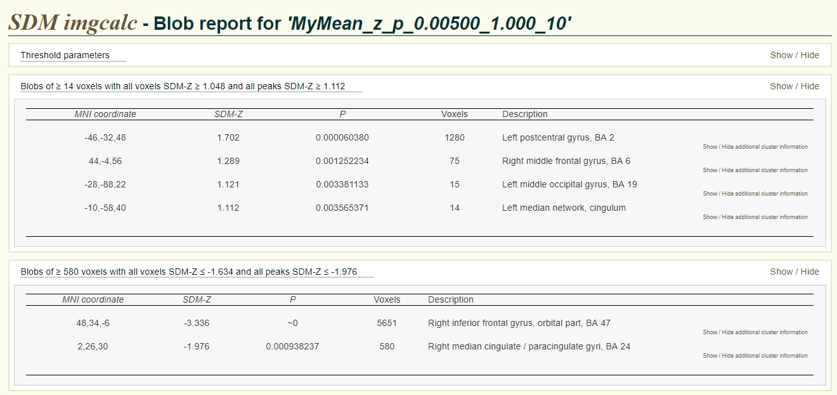
Example: SDM
research question
data collection
formatting
preprocessing
model estimation
results
threshold results
create mask
extract peaks
funnel plot

Slide 38
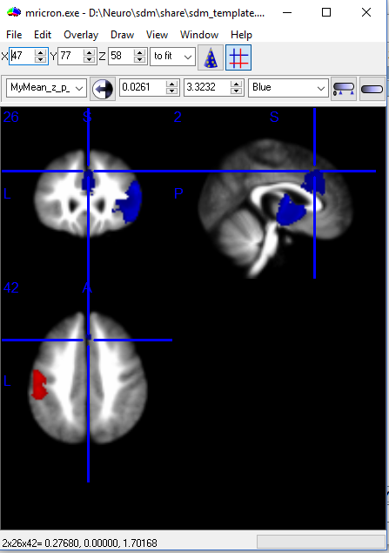
Example: SDM
research question
data collection
formatting
preprocessing
model estimation
results
threshold results
create mask
extract peaks
funnel plot

Slide 39
Databases
sets of original data (eg raw scanned images)
BRAINNet (http://www.brainnet.net)
fMRI Data Center (http://www.fmridc.org)
OpenfMRI (http://www.openfmri.org)
summary statistics from the studies included in one meta-analysis (mean and SD of ROI volumes)
Bipolar Disorder Neuroimaging Database (http://www.bipolardatabase.org)
Major Depressive Disorder Neuroimaging Database (http://www.depressiondatabase.org)
Peak-coordinate databases from SDM meta-analyses (http://www.sdmproject.com/database)
sets of summary statistics of virtually all published studies
BrainMap (http://www.brainmap.org)
NeuroSynth (http://www.neurosynth.org)

Slide 40
Thank you for your attention

Slide 41
literature
Kanske P, Schönfelder S, Forneck J, Wessa M (2015): Impaired regulation of emotion: neural correlates of reappraisal and distraction in bipolar disorder and unaffected relatives. Transl Psychiatry 5:e497. http://www.nature.com/doifinder/10.1038/tp.2014.137.
Radua J, Mataix-Cols D, Phillips ML, El-Hage W, Kronhaus DM, Cardoner N, Surguladze S (2012): A new meta-analytic method for neuroimaging studies that combines reported peak coordinates and statistical parametric maps. Eur Psychiatry 27:605–11. http://www.sciencedirect.com/science/article/pii/S0924933811000733.
Radua J, Mataix-Cols D (2009): Voxel-wise meta-analysis of grey matter changes in obsessive–compulsive disorder. Br J Psychiatry 195:393–402. http://bjp.rcpsych.org/content/195/5/393.abstract.
Radua J, Mataix-Cols D (2012): Meta-analytic methods for neuroimaging data explained. Biol Mood Anxiety Disord 2:6. http://biolmoodanxietydisord.biomedcentral.com/articles/10.1186/2045-5380-2-6.
Stelzer J, Lohmann G, Mueller K, Buschmann T, Turner R (2014): Deficient approaches to human neuroimaging. Front Hum Neurosci 8:1–16. http://journal.frontiersin.org/article/10.3389/fnhum.2014.00462/abstract.

