Slide 1
Inhibition in neuroscience

Slide 2
Outline

Slide 3
At the neural level
Tuning responses of excitatory networks
Stabilize network activity levels (feedback)
Avoid saturation

Slide 5
Ernst Mach

Slide 6
Mach bands Das, Krishanu. (2017).

Slide 8
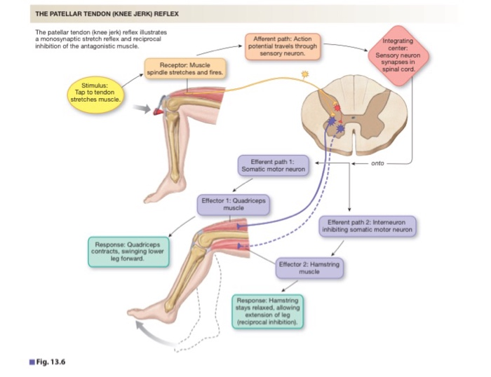

Slide 9
Brain areas (8)
Phantom limbs
Notes:
PFC is also sensitive to estrogens

Slide 10
Inhibition in depression

Slide 11
Tourette’s syndrome

Slide 12
Effects of Stress on DM
OCD

Slide 13
Inhibition in everyday life

Slide 14
The social “you” is an inhibited “you”
Notes:
The differences however disappear after 100 trials, women take longer to adopt the long-term advantageous solution.

Slide 15
Sidewalk waltz

Slide 16
Jamming Avoidance Response

Slide 17
Say the same thing
Short demo

Slide 18
What’s going on?
Schematic of shared perspectives/representations. A and C´s perspectives overlap only partially. As the overlap grows, as in A and B’s case, A’s own perspective becomes a better and less effortful model of their partner’s perspective.

Slide 19
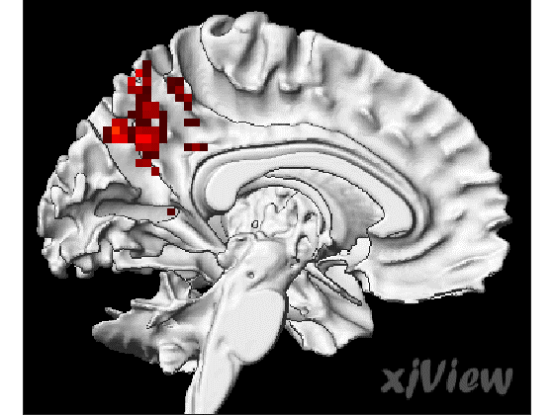

Slide 20
Earworms

Slide 21
Take away message
It’s possible to observe the differences in the response to stress in men and women in decision making, however, the contributions of the gonadal steroid hormones are rather complex and we’ll need a lot of brainpower to get to the bottom of this

Slide 22
References
Das, Krishanu. (2017). Role of Pre-embedded Associated Memory in Generation of Optical Illusions. 3. 37-49.

