Slide 1
PERSUASIVE TECHNIQUES used in media
Session 3 – media literacy
Robert Helán
31 October 2018

Slide 2
What do you think LOGOS – ETHOS – PATHOS mean?

Slide 3
LOGOS – ETHOS - PATHOS

Slide 4
LOGOS
“LOGIC”
Theoretical language
Facts and statistics
Logical arguments

Slide 5
ethos
“credibility”
Language appropriate for the audience
Demonstration of expertise
Fair/unbiased talk

Slide 6
pathos
“emotion”
Emotion evoking examples
Stories of emotional events
Meaningful language

Slide 7
THE STRUCTURE OF EACH TECHNIQUE
DEFINITION
“EXAMPLE”
THE EFFECT THIS HAS ON THE audience

Slide 8
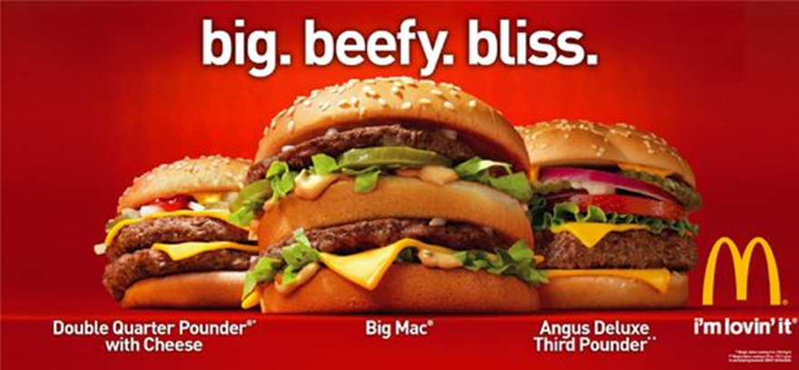

Slide 9
Alliteration (pathos)
Repetitions of sounds
“BIG. BEEFY. BLISS.”
DRAWS ATTENTION, NICE TO READ AND LISTEN TO

Slide 10
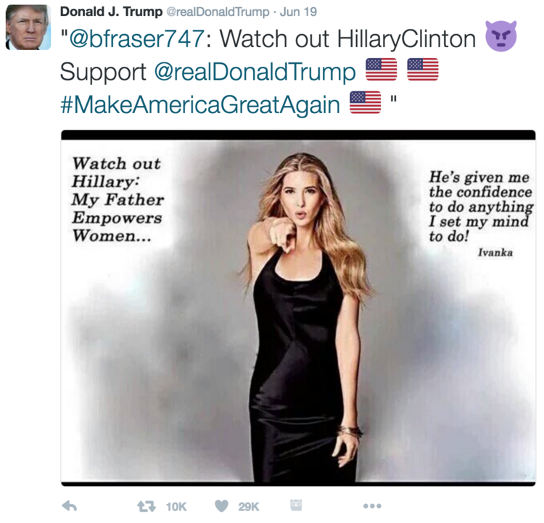

Slide 11
ANECDOTE (pathos)
Personal, emotional, story
“HE’s given me the confidence to do anything I set my mind to do!” (ivanka)
encourages the reader to show emotion and see the topic as more related to them

Slide 13
Appeal to authority (ethos)
Words from experts
“#1 brand recommended by dentists”
Positions the audience as a learner, with someone knowledgeable explaining things

Slide 14
“Terrorism is like an angry dog, if you poke a dog it will bite.”
“This shameful tragedy will haunt the community for years to come”

Slide 15
Appeal to common sense/emotions (pathos)
Refers to things everybody would agree to
“Terrorism is like an angry dog, if you poke a dog it will bite.” “This shameful tragedy will haunt the community for years to come”
Makes a complex argument seem simple and easy to decide on, usually by comparing it to something more simple, the use of adjectives („shameful“) for effect

Slide 17
ALLUSIONS TO TIME (pathos)
CREATES A SENSE OF URGENCY
“donate blood now”
Encouraging the reader to prioritize that issue over other issues, requires immediate action

Slide 19
CALL TO ACTION (pathos)
A REQUEST OR DEMAND FOR THE READER TO TAKE ACTION
“CALL TO DONATE“
ALTERING THE READER’S BEHAVIOUR – THE READER FEELS EMPOWERED

Slide 21
COLLOQUIAL LANGUAGE (pathos)
INFORMAL LANGUAGE – CREATES A CASUAL TONE
“O.M.G.!”
CREATES A BOND BETWEEN THE READER AND WRITER, WRITER BRINGS HIM/HERSELF DOWN TO THE SAME LEVEL AS THE READER

Slide 22
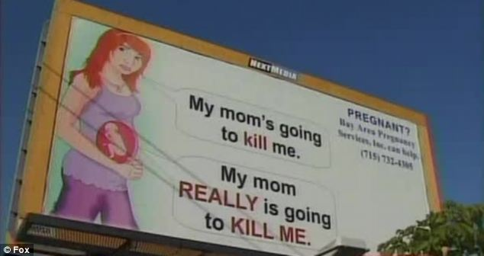

Slide 23
EMOTIVE LANGUAGE (pathos)
WORDS/PHRASES THAT CHANGE THE FEEL OF A SENTENCE
“MY MOM REALLY IS GOING TO KILL ME.”
DECREASES THE READER’S RATIONAL RESPONSE, ENCOURAGES READERS TO REACT INSTINCTIVELY

Slide 24
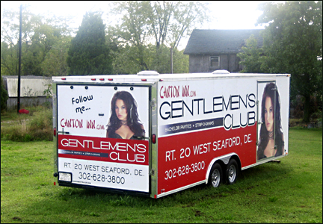

Slide 25
EUPHEMISMS (ethos/Pathos)
POLITE OR SOFTENING PHRASES USED IN REPLACEMENT OF UNPLEASANT WORDS
“GENTLEMEN’S CLUB”
TO MAKE AN IDEA SEEM KINDER THAN IT ACTUALLY IS (E.G. DIE = PASS AWAY)

Slide 27
GRAPHS (ethos/logos)
DEMONSTRATE WRITER CREDIBILITY provide evidence
“US UNEMPLOYMENT RATE”
CAN PERSUADE READERS OF THE WRITER’S POINT OF VIEW, can be tricky if they don‘t start at 0, demonstrate research

Slide 28
“RIDING YOUR BIKE TO WORK HAS MANY BENEFITS FOR THE INDIVIDUAL AND THE COMMUNITY:
IT REDUCES TRAFFIC,
IMPROVES YOUR HEALTH AND PROTECTS THE ENVIRONMENT.”

Slide 29
LISTING (logos)
A LIST OF THE BENEFITS OR DETRIMENTS
“RIDING YOUR BIKE TO WORK HAS MANY BENEFITS FOR THE INDIVIDUAL AND THE COMMUNITY: IT REDUCES TRAFFIC, IMPROVES YOUR HEALTH AND PROTECTS THE ENVIRONMENT.”
THE WRITER PROVIDES MULTIPLE ARGUMENTS TO SWAY THE READER

Slide 31
COMPARISON (pathos)
SIMILE – SENTENCES WITH “LIKE” OR “AS…AS”
“SKIN CREAM…FOR SKIN AS SMOOTH AS A PEACH”
GIVES THE READER A SENSE OF WHAT SOMETHING IS LIKE, EVEN IF IT IS FOREIGN TO THEM

Slide 32
“IT HURTS THE INDIVIDUAL,
IT HURTS THE ECONOMY AND
IT HURTS THE COUNTRY AS A WHOLE”

Slide 33
REPETITION (pathos)
REPETITION OF WORDS OR PHRASES AND IDEAS
“SALE, SALE, SALE” “IT HURTS THE INDIVIDUAL, IT HURTS THE ECONOMY AND IT HURTS THE COUNTRY AS A WHOLE”
CREATES EMPHASIS AND IS MEMORABLE

Slide 34
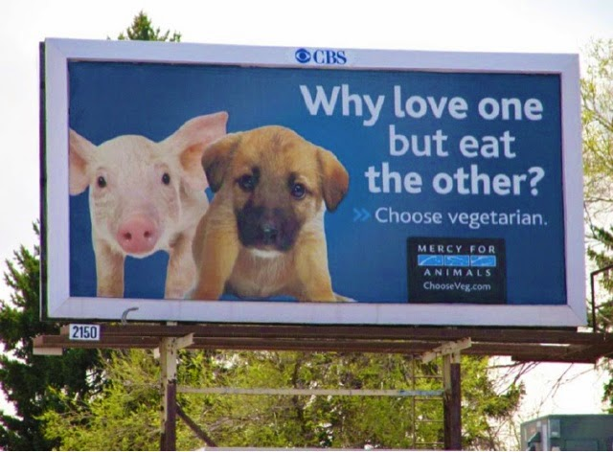

Slide 35
RHETORICAL QUESTION (pathos/logos)
STATEMENTS WITH QUESTION MARKS – THE ANSWER IS IMPLIED BY WHAT IS BEING ASKED
“WHY LOVE ONE BUT EAT THE OTHER?”
MAKES THE READER VIEW AN ALTERNATIVE ANSWER TO THE ISSUE, APPEARs ILLOGICAL OR AGAINST COMMON SENSE

Slide 36
“When the factories close down, when the workers go back home to their families without a pay slip in their pockets, when the price of living goes up and the quality of life goes down, where will the Government be to help? Nowhere. Just like always.”

Slide 37
SENTENCE STRUCTURE (logos)
The use of SHORT, SHARP SENTENCES after long complex sentences
“When the factories close down, when the workers go back home to their families without a pay slip in their pockets, when the price of living goes up and the quality of life goes down, where will the Government be to help? Nowhere. Just like always.”
particularly short sentences can be used by the writer to draw emphasis to what is being said because of the change in rhythm that they create

Slide 38
“The three main arguments for vegetarianism are (1) the human health benefits, (2) environmental sustainability, and (3) moral standards in relation to how we treat animals.”

Slide 39
SIGNPOSTING (logos)
Signposting is a way that a writer or speaker outlines their arguments.
“The three main arguments for vegetarianism are (1) the human health benefits, (2) environmental sustainability, and (3) moral standards in relation to how we treat animals.”
This can make the style of a piece appear more logical and assist the reader in following the line of argumentation.

Slide 40
“The Minister for Tertiary Education was earlier quoted saying “investment in our universities should be in the top three current national priorities”. ”

Slide 41
QUOTES (ethos)
Quotes and references to authorities are often used in conjunction with statistics, because they have the same overall effects.
“The Minister for Tertiary Education was earlier quoted saying “investment in our universities should be in the top three current national priorities”. ”
The source of the quote is particularly important - as a reader is less likely to be persuaded by a quote when the speaker is not an expert

Slide 43
METAPHOR (pathos)
a comparison that describes one thing in terms of another
“LIGHT BEER”
This technique can be used to reinforce a point without repetition and the imagery created can often really stick in a reader’s head.

Slide 44
“We should all take action on climate change to save our world for future generations”
“We can‘t let them cross our borders and infiltrate our country.“

Slide 45
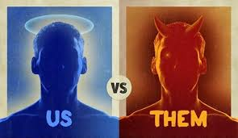
INCLUSIVE LANGUAGE
Terms such as ‘our’, ‘us’, and ‘we’ are used (‘us‘ VS. ‘THEM‘)
“We should all take action on climate change to save our world for future generations” “We can‘t let them cross our borders and infiltrate our country.“
makeS the reader feel like part of a group or inspired to take collective action

Slide 46
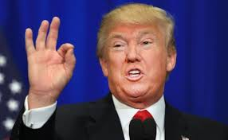
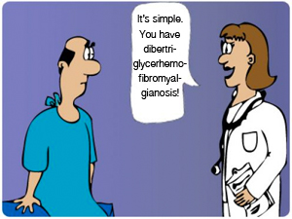
“It’s gonna be huge!” Donald Trump’s speech

Slide 47
Body language – ethos
Donald trump‘s colloquial language – ethos
medical jargon – ethos
Case studies – logos

Slide 48
Persuasion triangle

Slide 49
sources
https://sites.google.com/site/buchanangovernment/persuasive-writing/ethos-pathos-logos
http://wiki.engageeducation.org.au/english/language-analysis/persuasive-techniques-2/
http://sixminutes.dlugan.com/
http://www.virtualspeechcoach.com/
https://www.speakingprocentral.com/
https://www.ethos3.com/

