Slide 1
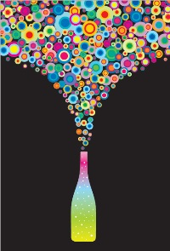
WHY
STUDY
VISUALS?

Slide 2
Visual Communication takes many forms:
  Gestures
  Facial Expressions
  Color
  Objects
  Signs & symbols
  It’s all around us

Slide 3
What is Visual Literacy?
The ability to:
Interpret
Appreciate
Use
Create
IMAGES… in ways that advance
critical thinking, understanding,
decision making, and effective communication.

Slide 4
Why is Visual Literacy Important?
MORE visuals today
Pictures and images are more likely to be remembered than words
Humans are visually wired:
It takes less than 1/10 of a second to process visuals (to recognize and take away meaning)

Slide 5
Beginning with cave drawings, stories have been told through images.

Slide 6
Research tells us these early images document a specific culture and its everyday reality.

Slide 7
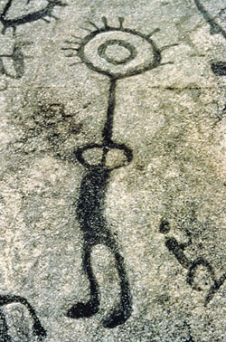
Sometimes the imagery is not easy to “read”

Slide 8
Images became pictograms – the basis of pictorial alphabets that communicated with symbols that were meaningful to early societies.
Notes:
Images became pictograms – the basis of pictorial alphabets that communicated with symbols that were meaningful to early societies.

Slide 9
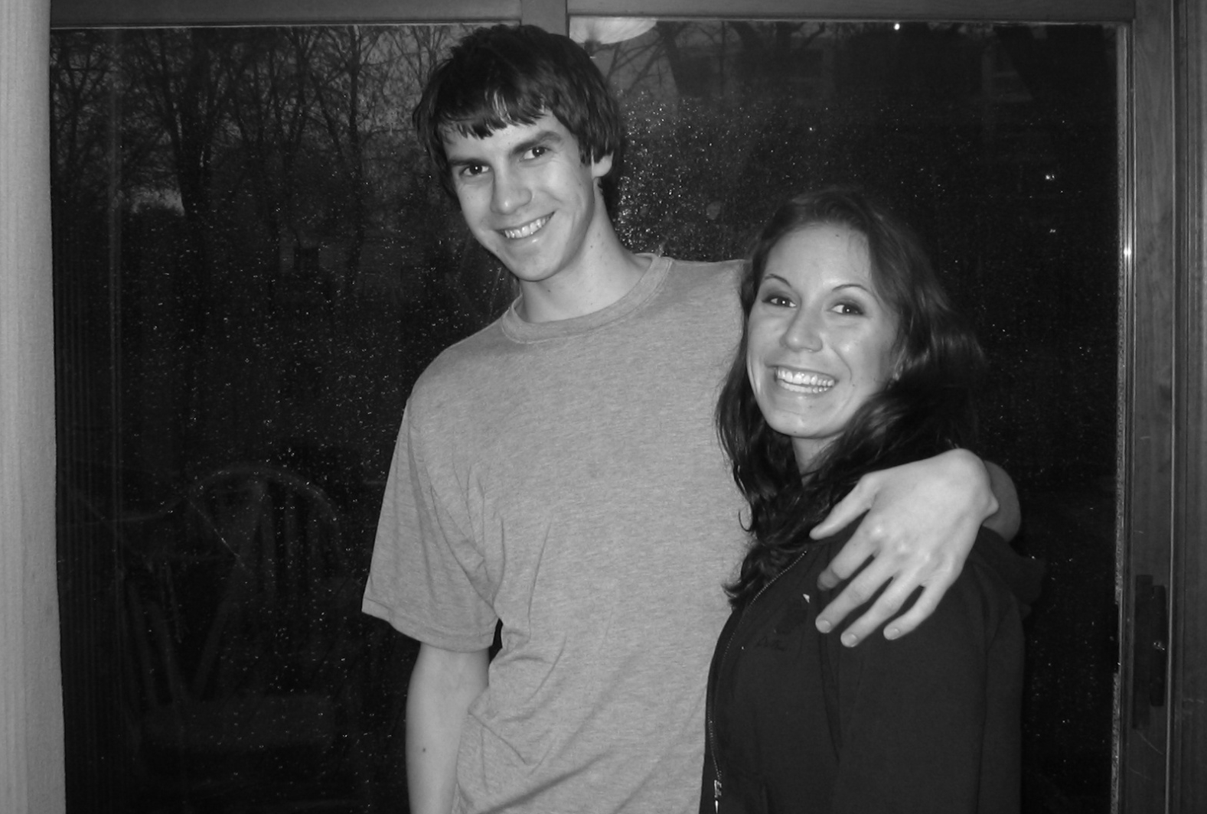
You may be most familiar with personal photos and the multiple purposes they serve – to document family ceremonies and gatherings, passages into different life stages, or merely slices of life that typically present normal and idealized situations and relationships.

Slide 10
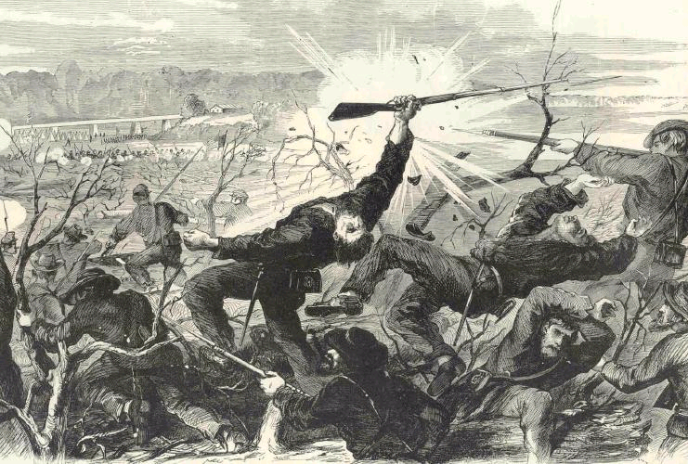
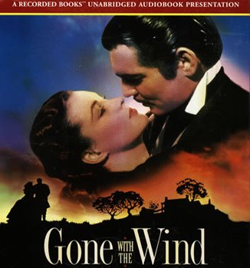
Visuals also document – or at least represent -- a certain view of the past.

Slide 11
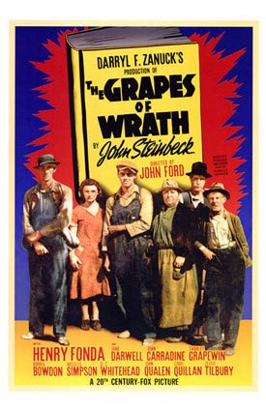
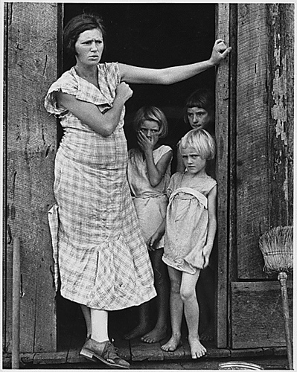
Visual images tell stories not just of a point in time, but of a specific culture.

Slide 12
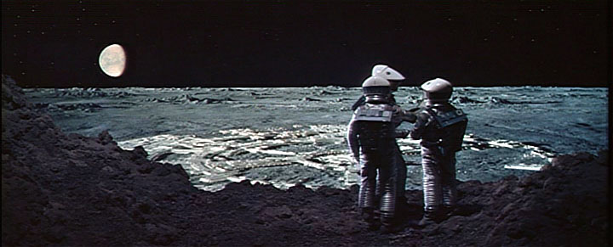
And with technology, they simulate the future.

Slide 13
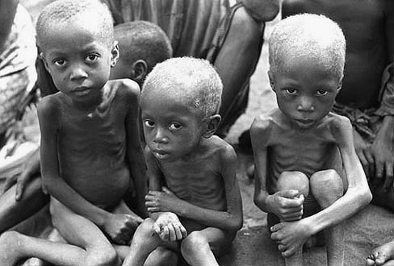
Visuals may provoke ethical concerns.

Slide 14

Or, they be purely artistic. . . or perhaps, “elevator music” for the eyes

Slide 15
Brain processes 3 types of visual messages
1. MENTAL: dreams, thoughts, fantasies
2. DIRECT: those seen without media intervention
3. MEDIATED: those seen through some medium— movie, TV, computer, mobile…

Slide 16
The most powerful, meaningful, and culturally important messages are those that combine words and pictures equally and respectfully.

Slide 17
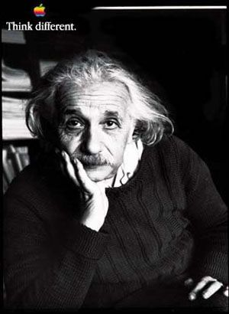
  Some advertising does that well.

Slide 18
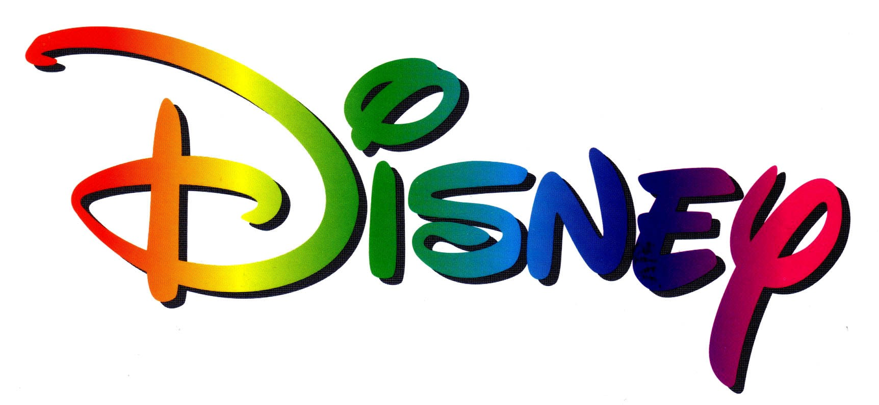

  Also Logos…

Slide 19

Why so some images attract you? What becomes evident in this image that wasn’t at first glance?

Slide 20
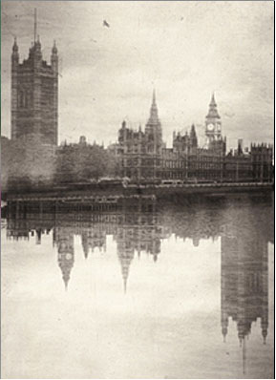
Study pictures and ads wherever you find them.
Do you think each image is good or bad?
Are they truthful?
Is this one?

Slide 21
MORE …
ON VISUAL SENSE-MAKING, ADVERTISING CREATIVE,
HOW YOU “SEE” ADS,
VISUAL CULTURE JAMMING, AND PR IMAGES…ON NOV. 14

