Slide 1
MEDIA BIAS 101
Robert helán
Media literacy course

Slide 2
Why is media bias an important topic?
Its potential effects on society, particularly when it comes to the people making informed decisions about issues that affect them the most

Slide 3
Types of media bias
Bias by omission
Leaving one side out of an article, or a series of articles over a period of time
Ignoring facts that disprove/support liberal or conservative claims
See if both conservative and liberal perspectives are included

Slide 4
Types of media bias
Bias by selection of sources
Including more sources that support one view over another
Also when reporters say “experts believe”, “observers say”, “most people believe”
Check political perspective of those quoted as experts, also an equal number of experts should come from both sides

Slide 5
Types of media bias
Bias by story selection
A pattern of highlighting news stories that coincide with the agenda of either THE Left or RIGHT, IGNORING STORIES THAT COINCIDE WITH THE OPPOSING VIEW
CHECK BOTH CONSERVATIVE AND LIBERAL SIDES OF A SPECIFIC ISSUE

Slide 6
Types of media bias
Bias by PLACEMENT
HOW IMPORTANT THE EDITOR CONSIDERS A SPECIFIC STORY
WHERE ON A WEBSITE/NEWSPAPER A STORY OR EVENT IS LOCATED
OBSERVE WHERE A MEDIA OUTLET PLACES POLITICAL STORIES

Slide 7
Types of media bias
Bias by LABELING
Two types:
Labeling conservative politicians as “ultra-conservative”, “far right” and liberal politicians as “ultra-liberal”, “far left”
Describing a person/group with positive labels such as “an expert”, “independent consumer group” without mentioning their political perspectives

Slide 8
Types of media bias
Bias by spin
only one interpretation of an event to the exclusion of the other
It can include tone: a reporter’s subjective comments about objective facts, making one side’s ideological perspective look better that the other
Observe which interpretation of an event a news story matches (liberal or conservative)

Slide 9
Example 1: Which bias?
the day after President Trump was inaugurated there was the largest woman’s protest march in history. On almost all left leaning media sites this was the lead story. However, on the right biased Fox News it was buried at the bottom of the page, with many smaller news items getting more attention than this story.
Bias by omission

Slide 10

Example 2: Which bias?
BIAS BY LABELING

Slide 11
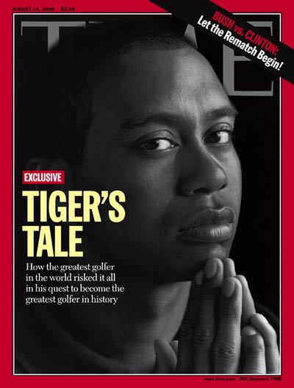
Example 3: Which bias?
BIAS BY PLACEMENT

Slide 12
Critical questions to ask to balance bias

Slide 13
Who are the sources and what are their perspectives?
Unnamed sources
Only well-educated
Only those who speak English well
Liberal or conservatives

Slide 14
Are significant questions left unasked or unanswered? Is the political, social, economic, or historical context missing?
First Coverage of a crisis – social and political causes are seldom examined
What will be remembered is what we first saw or heard
Usually later on, many questions and criticisms are raised

Slide 15
Do quotes seem abridged or out of context?
The new York times on U.s. church worker, held in captivity by Salvadoran military:
“I don’t think I suffered.”
In reality, she said (according to newsday):
“I don’t think I have suffered as terribly as the thousands of Salvadorans have suffered here.”

Slide 16
Does coverage seem to offer a partial or selective history of events?
Presidential Elections in panama: references to returning panama to “democracy”, “last elected president”
in reality: he was instituted in and removed from office – fraudulent elections

Slide 17
Are exaggerated or rhetorical claims reported uncritically without journalistic scrutiny?
Loaded words such as “terrorist” vs. “freedom-fighters”
They should alert us to ideological point of view
The most misused word Is “democracy” – there is a variety of democratic ways

Slide 18
What stories or events are not covered?
Brazil’s presidential elections were not covered in us media
Covered are those countries in which there are American troops
Third world countries make the news only if there are coups or earthquakes

Slide 19
conclusion
No one can form opinions from stories that are not covered
Therefore, alternative sources of news are important
Be a critical reader – read between the lines
Asking the right questions is the first step towards making informed decisions

Slide 20
High quality sources
https://www.allsides.com/unbiased-balanced-news
https://fair.org/
https://mediabiasfactcheck.com/

