Slide 1
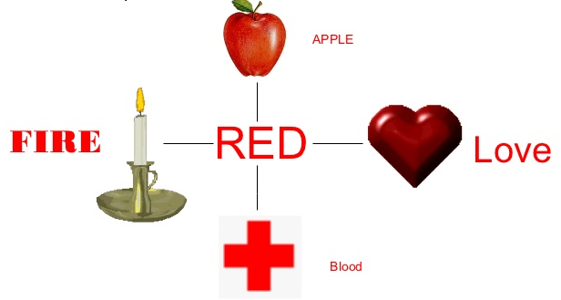
SEMIOTICS
Part Two

Slide 2
Terms Review
SIGN
SIGNIFIER + SIGNIFIED
DENOTATION
CONNOTATION
ICON, INDEX, SYMBOL
GESTALT
TROPES (OR “CODES”)

Slide 3


SIGNIFIER:
SIGNIFIED: “Okay”
SIGN
Notes:
Paul Saussure

Slide 4

Heart
Denotation + Connotation
Denotations
Organ
Muscle
Connotations
Love
Care

Slide 5
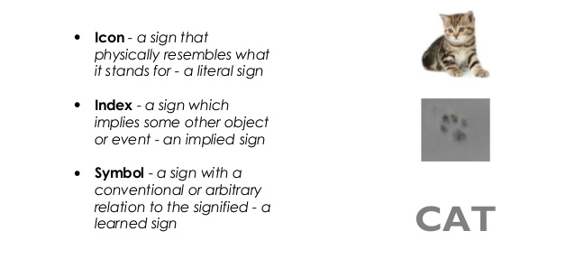
Icon, Index, Symbol

Slide 6
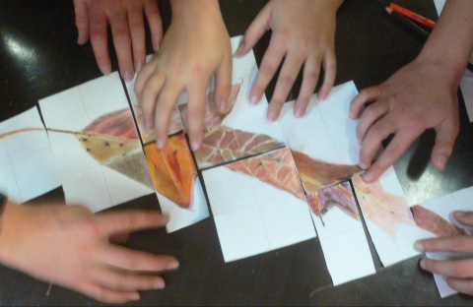
GESTALT
Principles of Visual Perception
“The whole is different from the sum of its parts.”

Slide 7
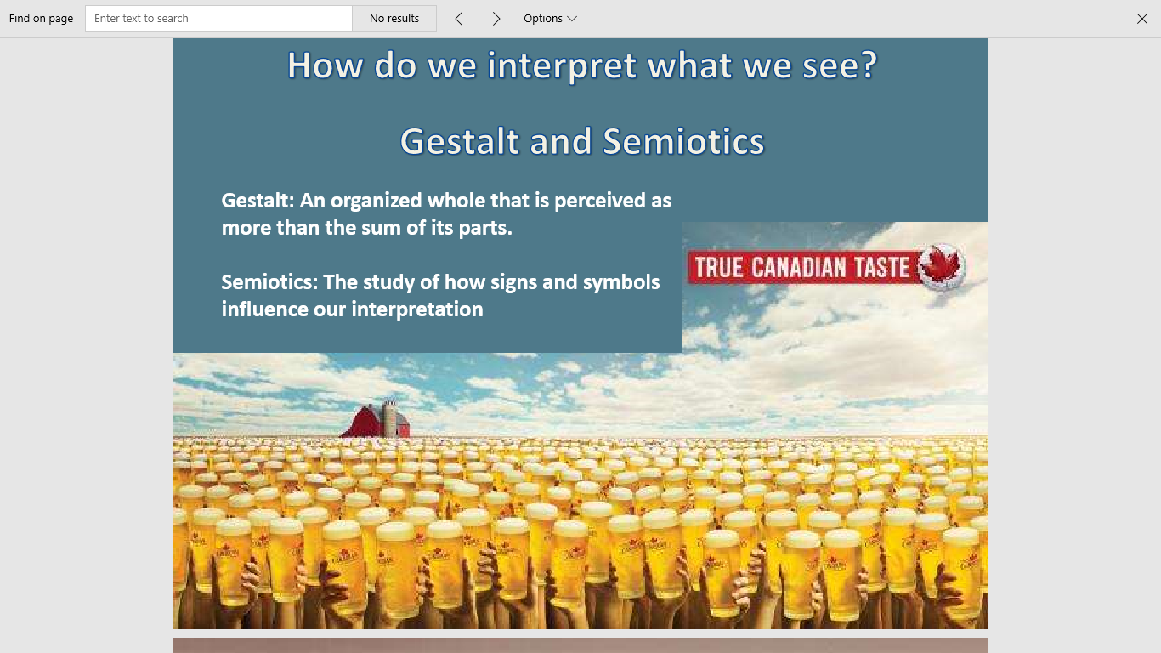

Slide 8
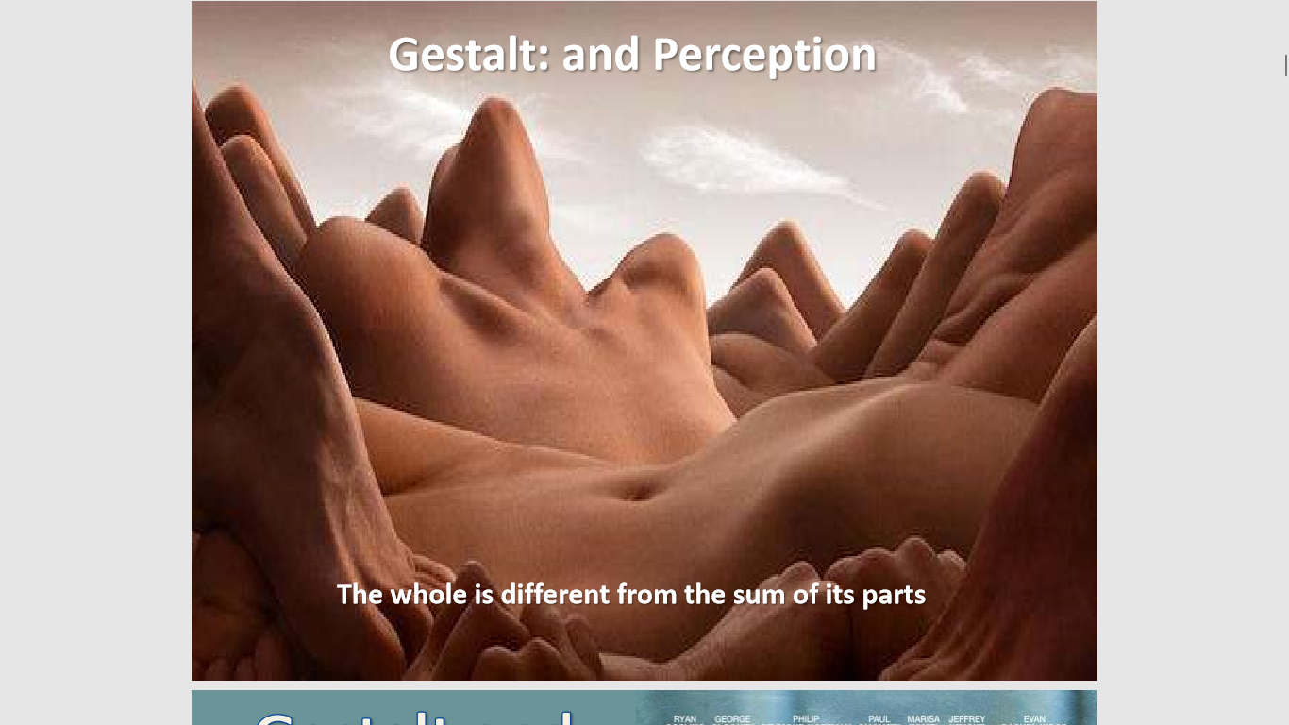

Slide 9
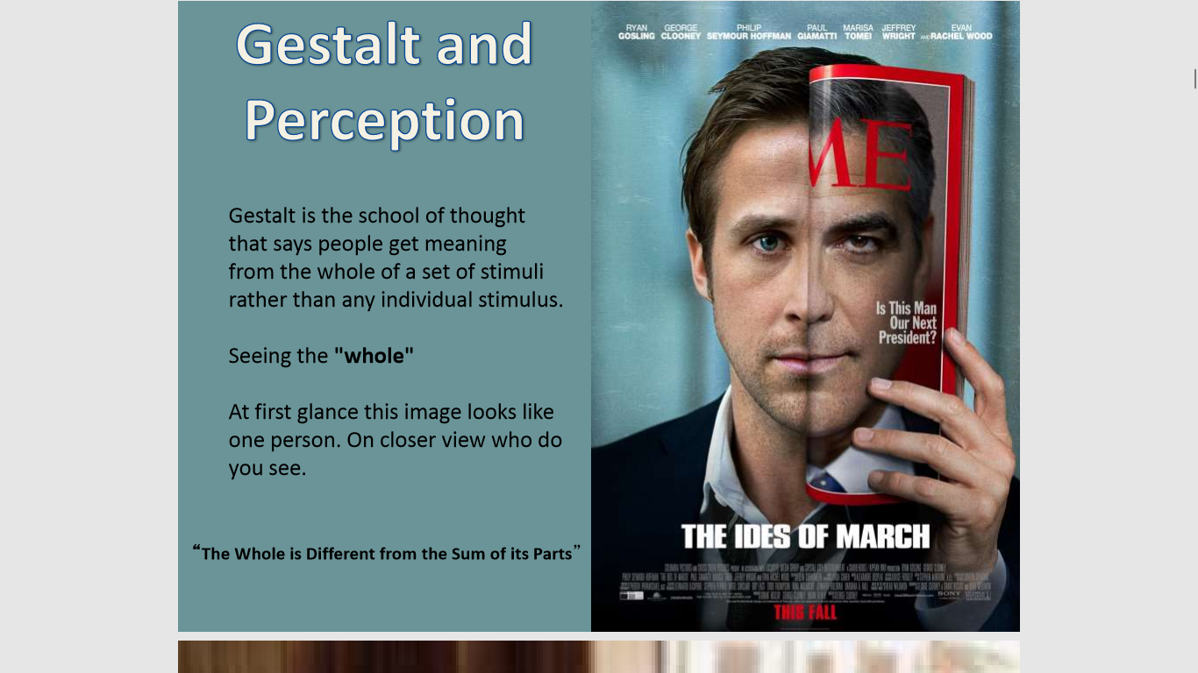

Slide 10
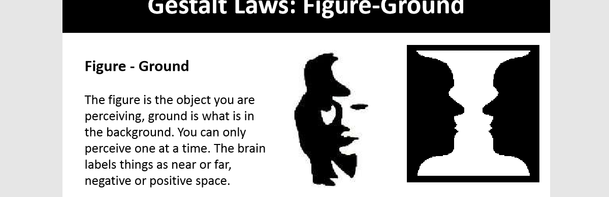


Slide 11
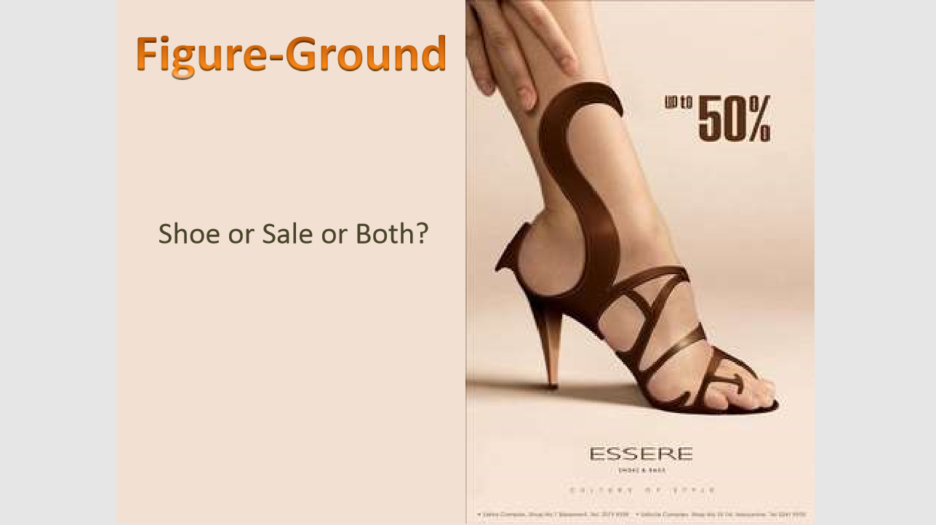

Slide 12
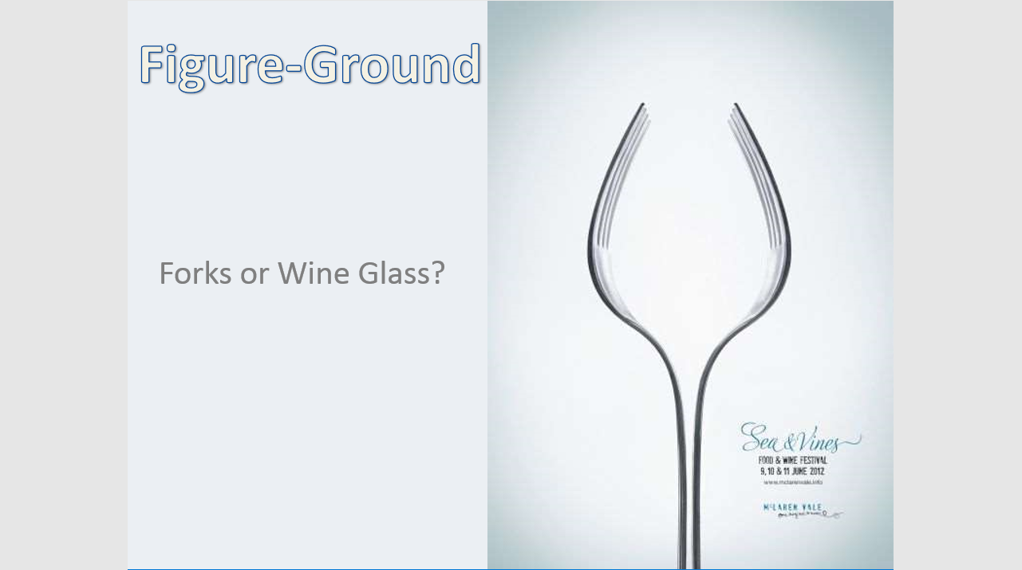

Slide 13
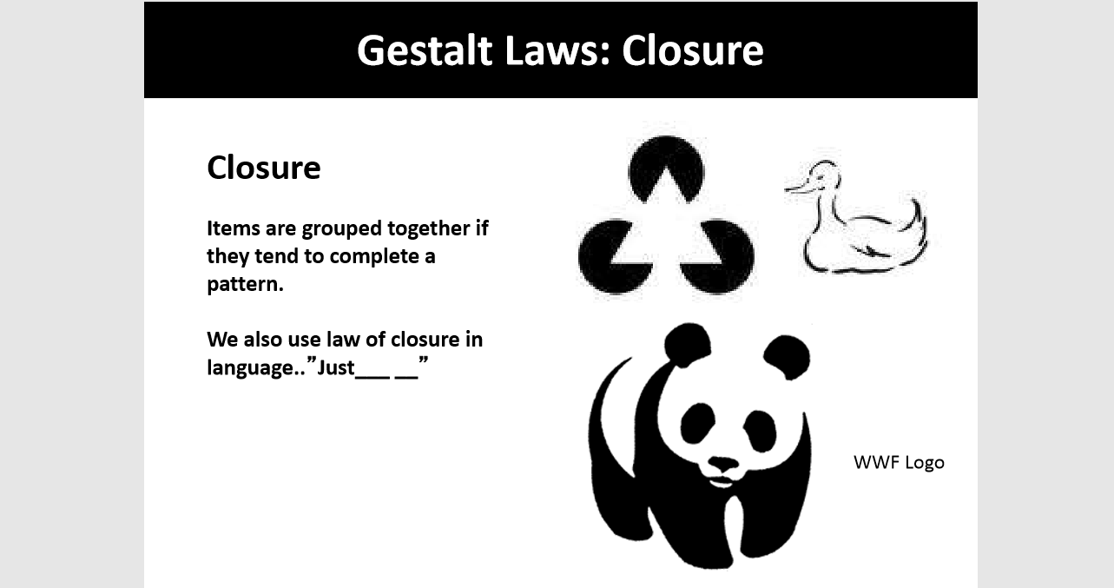

Slide 14
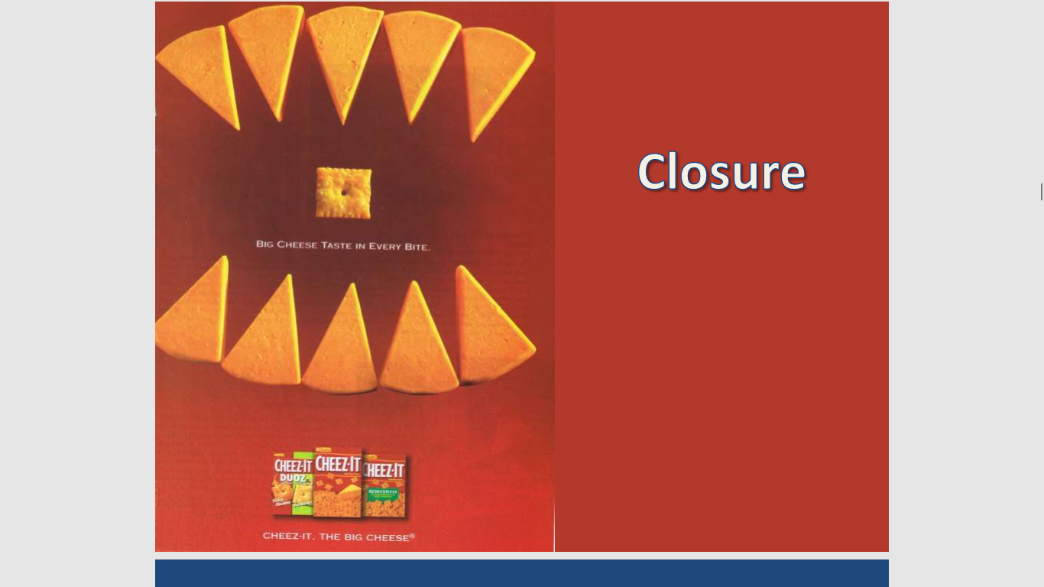

Slide 15
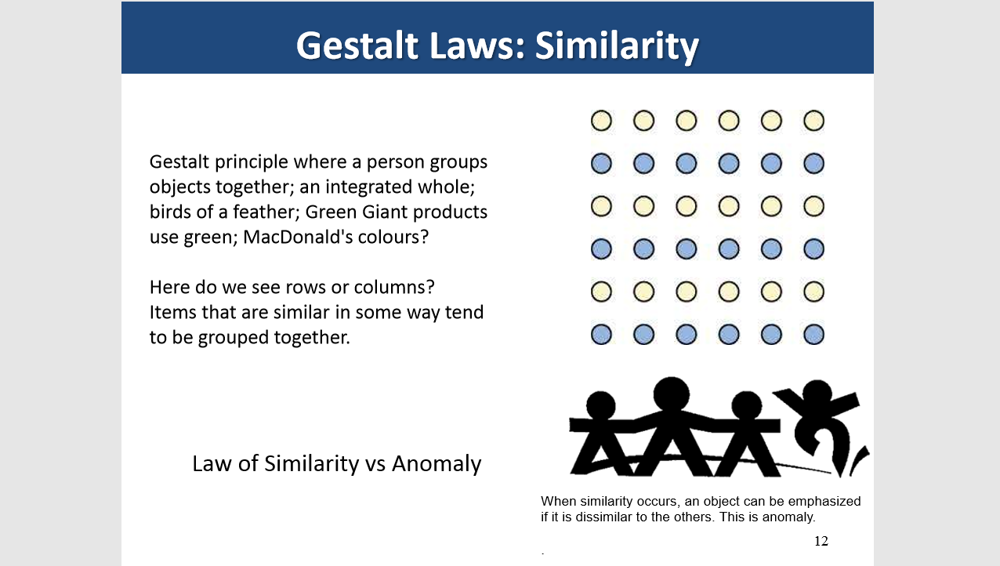

Slide 16
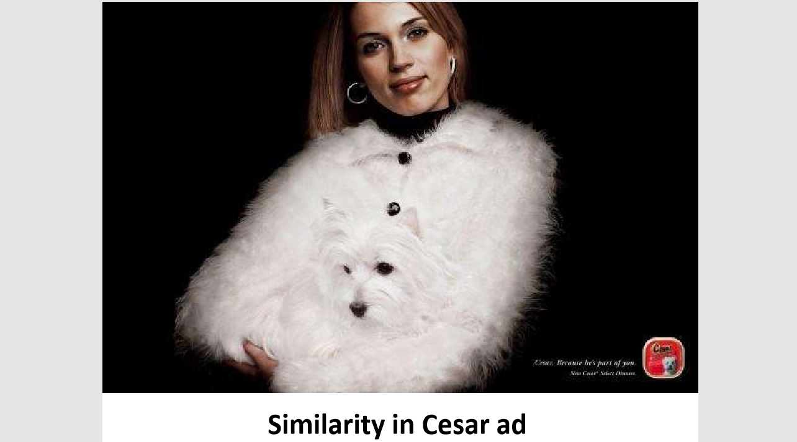

Slide 17
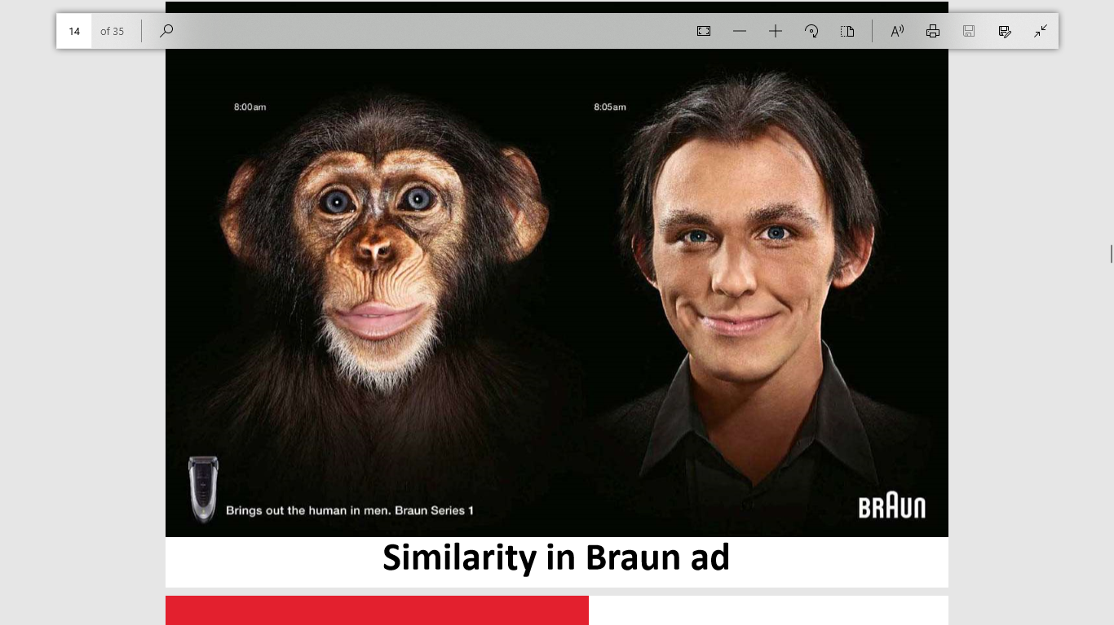

Slide 18


Proximity

Slide 19
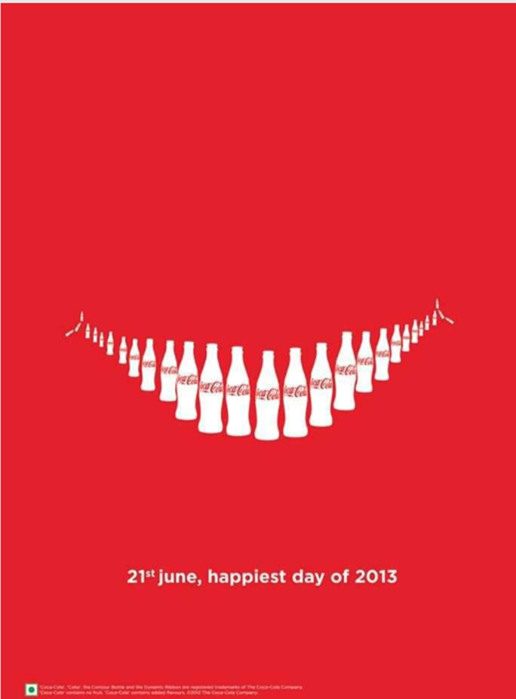
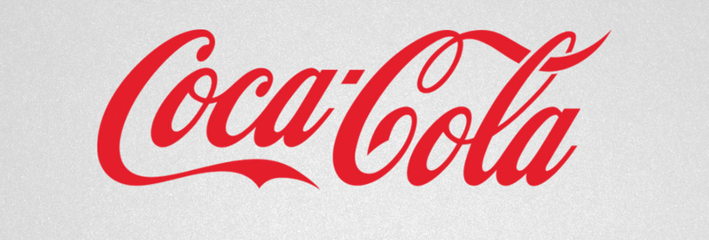
Continuity
Our eyes follow a line naturally so when we see an object, we are automatically compelled to move through it.

Slide 20
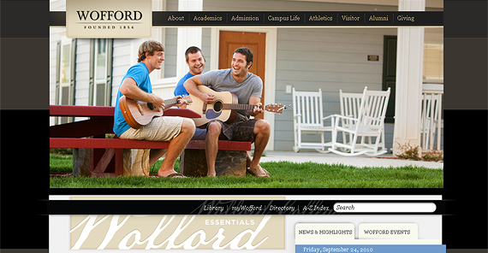

IDEAL and REAL
Visual messaging may link the “promise” or the “desired experience” with the real product, service or event. For example, universities:
IDEAL: REAL:

Slide 21
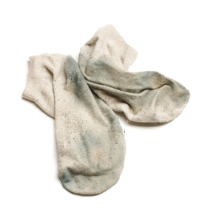
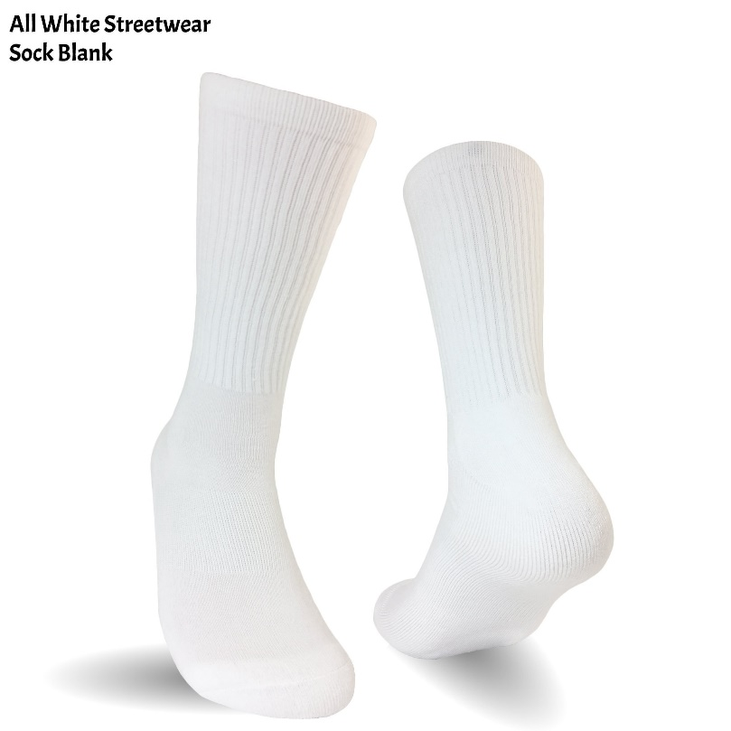
GIVEN and NEW
Think of this visual message as an example of Gestalt “continuation.” Our eye naturally moves from left to right, arriving at some resolution or unexpected ending (new knowledge). Think of “new” as “result” or “better”
GIVEN: NEW:

Slide 22

TROPES
(or CODES)
A common pattern, theme, or motif within a genre … or a society
(dark skies in war films)

Slide 23
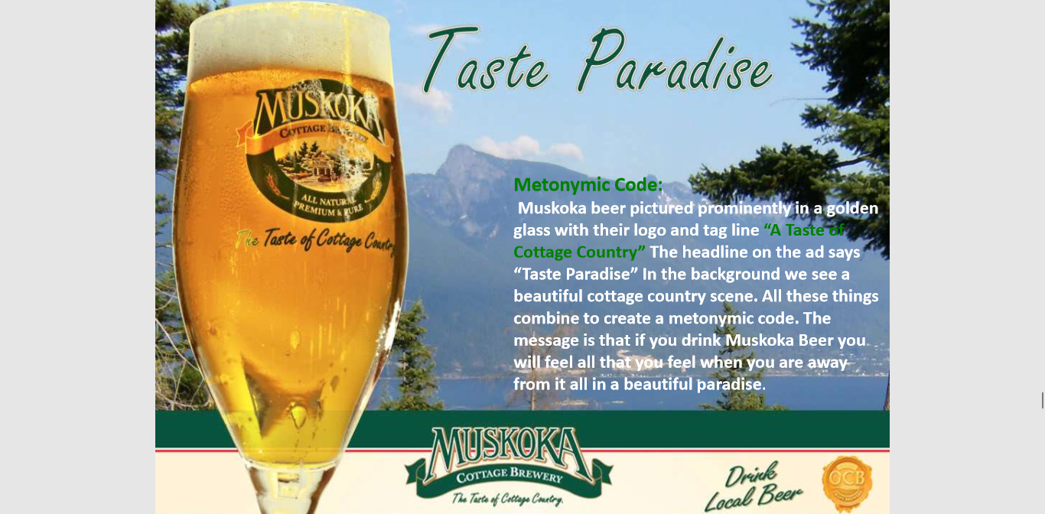
ADS are often guided by cultural codes:
Beer + “Nature”

Slide 24
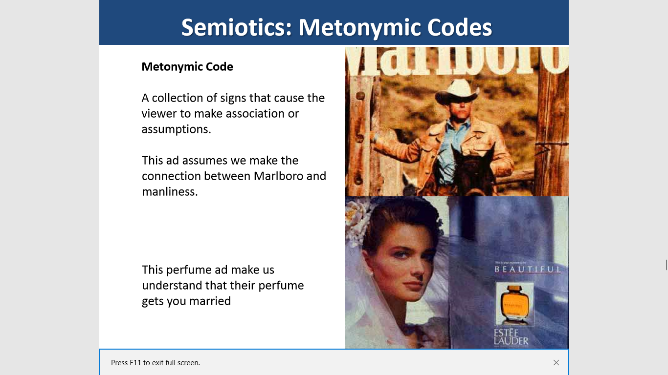
Cigarettes + “Manliness”
Perfume + “Romance”

Slide 25
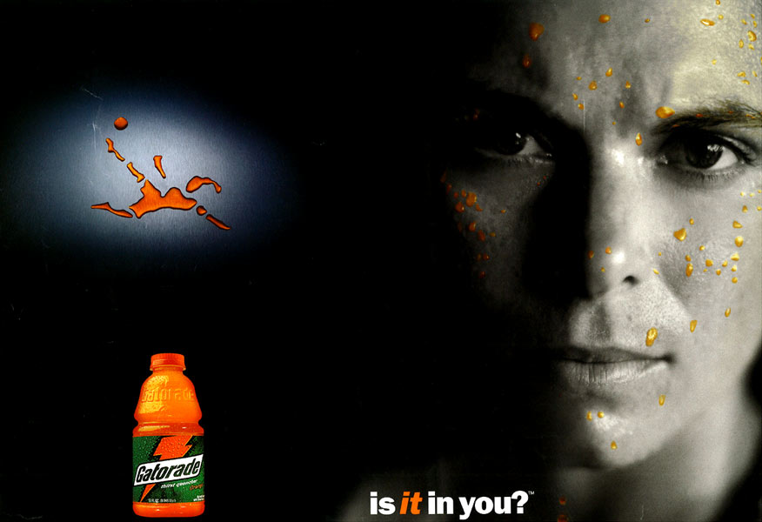
Youth Culture Category Codes, such as “Personal”

Slide 26
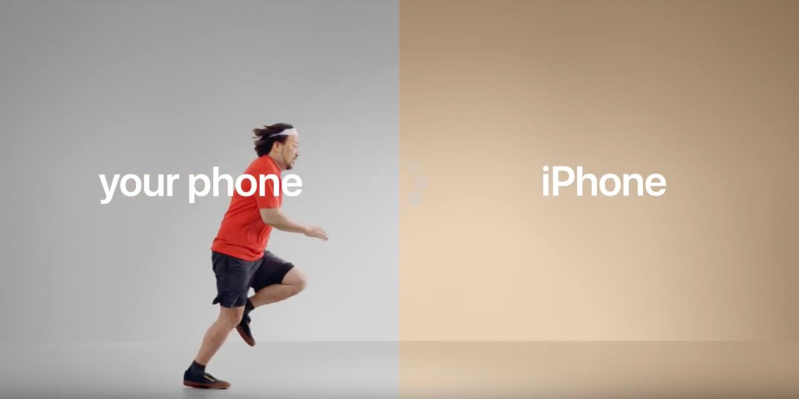

Slide 27
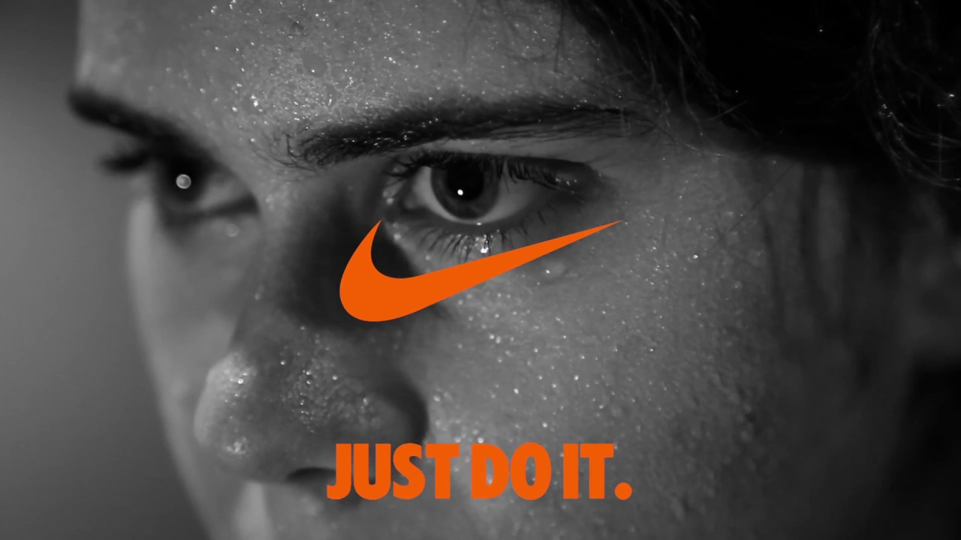

Slide 28
HILOBROW
SEMIOVOX

Slide 29
Sources for images
HUGH KRETSCHMER
PICTURE OF THE YEAR INTERNATIONAL
PULITZER PRIZE-WINNING PHOTOS
WORLD PRESS PHOTOS

