Slide 1
Introduction to Statistics and SPSS
Methodology of Conflict and Democracy Studies
November 25

Slide 2
Aim of this lecture
Variables and their categories
Population and sample
Hypotheses and null hypotheses
Statistical significance
Introduction to SPSS
How to make your own variables

Slide 3
Logic of Statistics
Deductive logic of research
What we do:
Derive hypotheses from the theory
Define variables and operationalize our concepts
Collect the data
Test the hypotheses using statistical models
Provide interpretation and decide whether our hypotheses hold or not
This all requires more than just few cases

Slide 4
Variables
Measurable items that change their values
Number of cars on highways, maximum daily temperature, local turnout in elections
Independent (predictor) and dependent (outcome) variables
Main tool for testing hypotheses

Slide 5
Levels of Measurement
Completely different categorization of variables than IV and DV
Categorical:
Nominal
Ordinal
Continuous:
Interval
Ratio

Slide 6
Nominal Variables
Their values cannot be ordered in a logical way
Names of towns, names of streets, telephone numbers, colors, species of animals, numbers of players
Binary variables – nominal variable with just two values
Someone is employed or he/she is not employed
Citizen either voted in election or did not vote
You either came to this lecture or you did not

Slide 7
Ordinal Variables
Their values can be ranked in a logical way however we cannot tell exact differences between the values
School grades, Olympic medals, military ranks, age groups
Ordinal variables tell us more than nominal variables (ordering values) but less than interval and ratio variables

Slide 8
Interval and Ratio Variables
Interval:
We can order the values and we know the differences
Equal intervals on a scale represent equal differences
Temperature in Celsius
Ratio:
Same as interval but ratios of values are meaningful
They have to contain a true zero
Distance in kilometers, time in seconds
In SPSS interval and ratio variables are under the same label (scale)

Slide 9
Continuous or Discrete?
Continuous (interval, ratio) variables can be either:
Continuous
Discrete
Depends whether the values can take any values on a scale
Success rate in a test (in %)
Number of kids in families

Slide 10
 | Nominal | Ordinal | Scale (interval, ratio)
Can we logically order the values? | No | No | Yes
Do we know differences between the values? | No | Yes | Yes
Continuous or discrete | Discrete | Discrete | Continuous / discrete

Slide 11
Population and Sample
Population:
Includes all possible subjects of a dataset
All towns of a country, all students of a university
Sample:
Includes only part of the cases and it is subset of the population
Important feature – representativeness
1000 people in a survey
Many ways of selection – random and non-random

Slide 12
Population and Sample
Working with population data:
You have data for the whole population
Your findings apply to the whole population
Working with sample data:
You have data for the sample only
Your aim is to apply the findings to the whole population
Nobody cares if 53 per cent of 1,000 survey respondents support Brexit but whether 53 per cent of UK population has this opinion

Slide 13
Hypotheses
Logical conjecture about the nature of relationships between two or more variables expressed in the form of a testable statement (O’Leary 2004)
“Higher unemployment leads to higher frustration of the society”
Null hypotheses:
Statement about absence of any relationship between independent and dependent variable
Every hypotheses has its null hypotheses
In statistics, all operations test the null hypotheses
After testing null hypotheses hold or they are dismissed (what gives support to our hypotheses)

Slide 14
Statistical Significance
Working with samples is always connected with some sampling error
Statistical significance allows to estimate whether the found effects are not only random and they can be applied to the whole population
Levels of significance: 95 %, 99 %, 99.9 %
Significance and hypotheses testing:
If a result is significant, we reject the null hypothesis and we gain confidence in our own hypotheses
If a result is not significant, we hold the null hypothesis and we thus we have no support for our own hypothesis

Slide 15
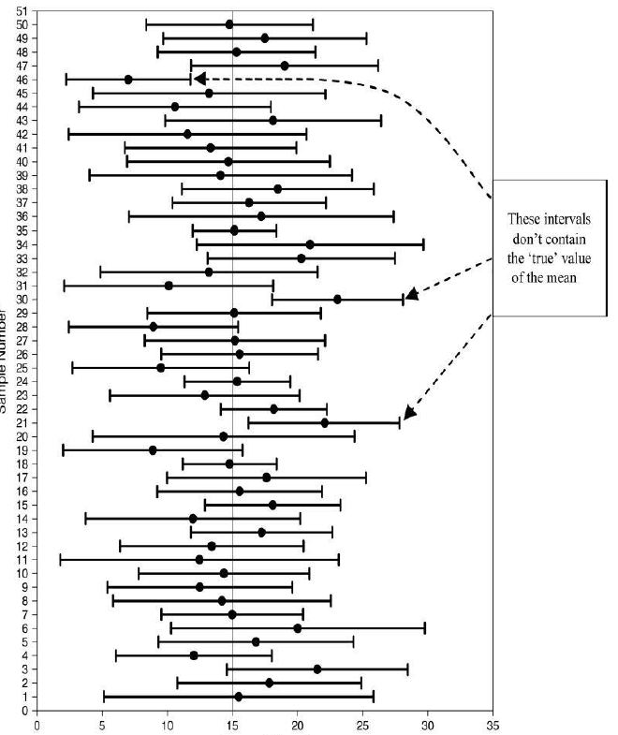

Slide 16
Statistical Significance
A statistically significant effect does not necessarily mean that it is also important and meaningful
A finding that a new medicine reduces body temperature of the patient by 0.01 °C (significant at 99.9 %)
A finding that a new medicine reduces body temperature of the patient by 1 °C (significant at 99.9 %)
Zrazky12062010

Slide 17
Descriptive Statistics
Basic measures to summarize the characteristics of your data
Various types:
Central tendencies – mean, median, modus
Dispersion – standard deviation, variance, minimum, maximum
Not all descriptives are suitable for all types of variables
We use them to describe and explore your data

Slide 18
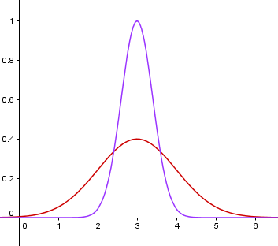

Slide 19
 | Variable | Mean | Std. Dev. | Minimum | Maximum
Reelection | Nominal | 0.75 | 0.43 | 0 | 1
Number of grants | Scale | 1.33 | 1.52 | 0 | 10
Grant in election year | Nominal | 0.36 | 0.48 | 0 | 1
Incumbent terms | Scale | 2.19 | 1.21 | 1 | 6
Unemployment | Scale | 19.41 | 13.15 | 0.00 | 94.94
Number of challengers | Scale | 2.18 | 1.38 | 1 | 7
Grants in EUR (per capita) | Scale | 77.74 | 209.62 | 0.00 | 5,331.82
Mayor from governing party | Nominal | 0.41 | 0.49 | 0 | 1

Slide 20
How to Obtain Descriptives in SPSS
Analyze > Descriptive Statistics > Frequencies
Move variables of interest to the right
In ‘Statistics’ choose all measures you require

Slide 21
