Slide 1
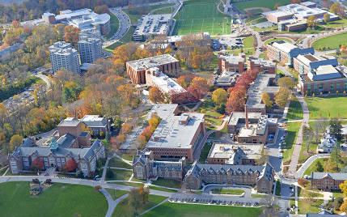
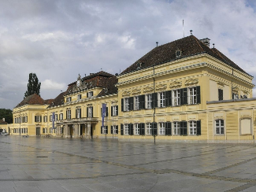
Biophysical Resources and Socio-economic systems ENSb1302
Brian D. Fath, Ph.D. – bfath@towson.edu
Professor, Department of Biological Sciences, Towson University, Baltimore, Maryland, USA
Senior Research Scholar, International Institute for Applied Systems Analysis, Laxenburg, Austria

Slide 2
ENSb1302: Syllabus highlights
Course Description:
This course deals with the relationships between human society and natural ecosystems as they relate to the sustainability of both. Relevant scientific, socio-economic, and ethical issues will be addressed in connection to current events such as global climate change, energy, conservation, agriculture, and cities.
Grade evaluation (points available):
Presentation (50), Reflections/Homework (50), Participation (50), Paper (100), Final Exam (150) = Total (400)

Slide 3
Schedule
Thursday 26. 9., 10:00–11:40, room nr. P31
Lecture 1: Systems thinking, system diagrams, systems analysis
Ecological Systems Thinking: Orr, Niccolucci, Bastianoni
Thursday 10. 10. 10:00–11:40, room nr. P31
Lecture 2: Ecosystems, Succession, Dynamics, Complex systems cycle (Holling)
Ecosystems: Fath
Succession: Pandolfi
Thursday 17. 10. 12:00–13:40, room nr. P52
Lecture 3: Human population
Human Population Growth: Goujon
Thursday 24. 10. 12:00–13:40, room nr. P52
PAPER TOPIC DUE
Lecture 4: Agriculture
Agriculture Systems: Andrén, Kätterer
Organic Farming: Nielsen
Thursday 31. 10. 10:00–11:40, room nr. P31
Lecture 5: Energy basis for socio-ecological development: from solar to fossil fuels back to solar
Water-Energy-Food-Ecosystems Nexus: Bidoglio, Vanham, Bouraoui, Barchiesi
Thursday 7. 11. 10:00–11:40, room nr. P31
Lecture 6: Global Climate Change
Greenhouse Gases Formation and Emission: Barbera, Vymazal, Maucieri
Thursday 14. 11. 10:00–11:40, room nr. P31
Lecture 7: Sustainability and Sustainable Development Goals
System Sustainability: Pulselli
The Sustainable Development Goals: Gigliotti, Schmidt-Traub, Bastianoni
Thursday 21. 11. 10:00–11:40, room nr. P31 - Tuesday 26.11., 10.00 - 11.40, room nr. U35
Lecture 8: Ecological Economics and Ecosystem Services
Ecological Economics 1: Costanza
Ecological Economics 2: Costanza
Thursday 28. 11. 10:00–11:40, room nr. P31,
Lecture 9: Urban systems
Urban Systems: Elmqvist, Alfsen, Colding
Thursday 5. 12. 12:00–13:40, room nr. P52
Lecture 10: Student presentations, summary and future research directions
specific readings from Encyclopedia of Ecology, 2nd Edition, 2019, Fath (editor), Elsevier

Slide 4
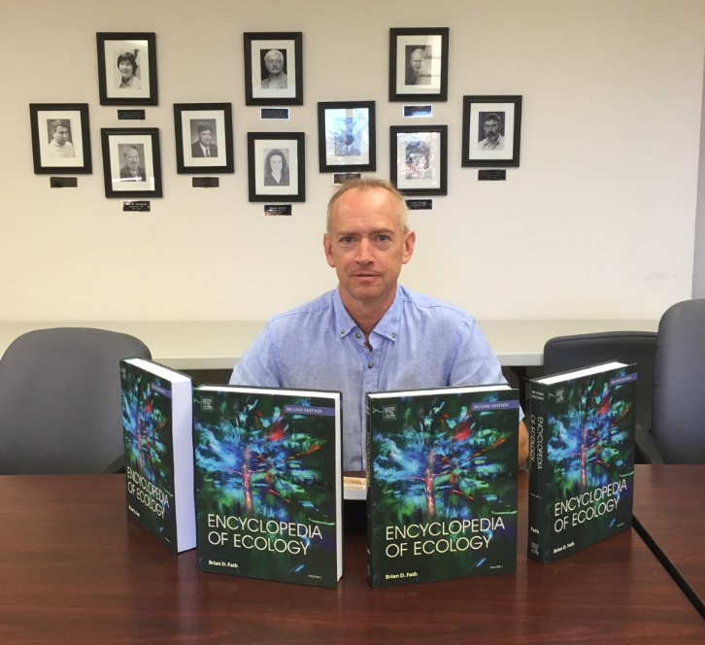
Schedule
Thursday 26. 9., 10:00–11:40, room nr. P31
Lecture 1: Systems thinking, system diagrams, systems analysis
Ecological Systems Thinking: Orr, Niccolucci, Bastianoni
Thursday 10. 10. 10:00–11:40, room nr. P31
Lecture 2: Ecosystems, Succession, Dynamics, Complex systems cycle (Holling)
Ecosystems: Fath
Succession: Pandolfi
Thursday 17. 10. 12:00–13:40, room nr. P52
Lecture 3: Human population
Human Population Growth: Goujon
Thursday 24. 10. 12:00–13:40, room nr. P52
Lecture 4: Agriculture
Agriculture Systems: Andrén, Kätterer
Organic Farming: Nielsen
Thursday 31. 10. 10:00–11:40, room nr. P31
Lecture 5: Energy basis for socio-ecological development: from solar to fossil fuels back to solar
Water-Energy-Food-Ecosystems Nexus: Bidoglio, Vanham, Bouraoui, Barchiesi
Thursday 7. 11. 10:00–11:40, room nr. P31
Lecture 6: Global Climate Change
Greenhouse Gases Formation and Emission: Barbera, Vymazal, Maucieri
Thursday 14. 11. 10:00–11:40, room nr. P31
Lecture 7: Sustainability and Sustainable Development Goals
System Sustainability: Pulselli
The Sustainable Development Goals: Gigliotti, Schmidt-Traub, Bastianoni
Thursday 21. 11. 10:00–11:40, room nr. P31 - Tuesday 26.11., 10.00 - 11.40, room nr. U35
Lecture 8: Ecological Economics and Ecosystem Services
Ecological Economics 1: Costanza
Ecological Economics 2: Costanza
Thursday 28. 11. 10:00–11:40, room nr. P31,
Lecture 9: Urban systems
Urban Systems: Elmqvist, Alfsen, Colding
Thursday 5. 12. 12:00–13:40, room nr. P52
Lecture 10: Student presentations, summary and future research directions

Slide 5
What are some the ways humans have impacted the environment?

Slide 6
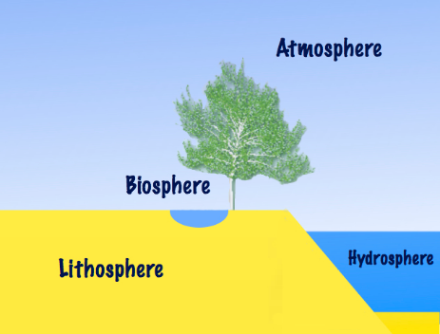
Earth’s environment can be partitioned into four+one spheres
Atmosphere
Lithosphere
Hydrosphere
Biosphere
Noosphere (sphere of human thought; nous – Greek for mind) also called anthroposphere

Slide 7
How are ways that you depend on the environment?
Homework – identify 1 mineral element that is used in the making of your smart phone, describe where it comes from and the extraction methods to get it. What happens to it at the end of the product life?

Slide 8
Systems Perspective
See how things are connected and interrelated
Complex – many parts, many interactions
Adaptive – respond and change
Systems – set of parts interacting together to function as a whole

Slide 9
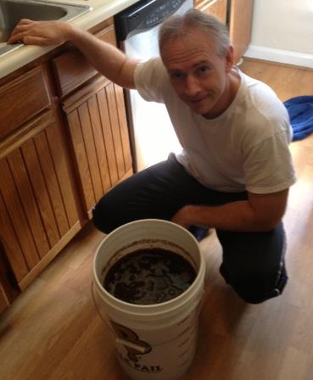
Systems Theory
“…is, strictly speaking, not a theory of systems, but of system-environment distinctions.” Moeller 2006, p. 40
system
Environment
“If you want to make an apple pie from scratch,
first you must make a universe.” -- Carl Sagan

Slide 10
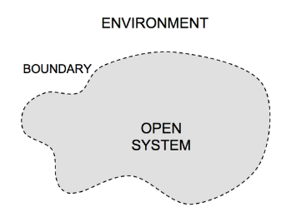
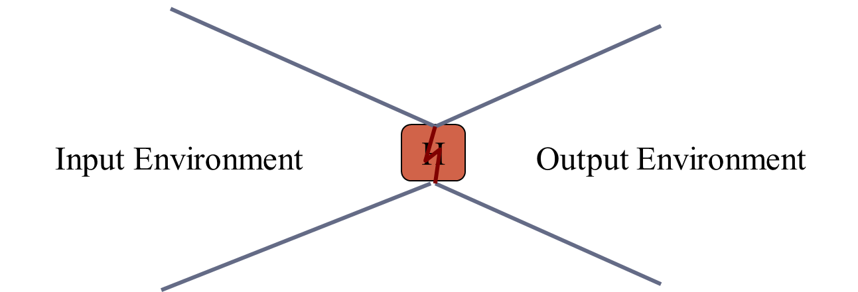
System boundaries
What is part of your question and what is not?
How you determine this first part largely determines the answers the question
Every system is a process

Slide 11
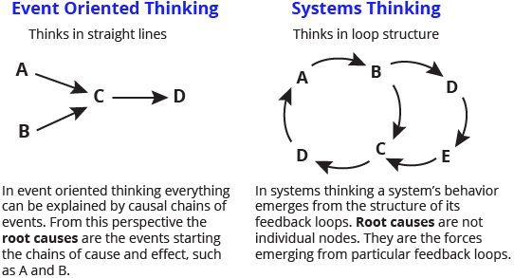
Systems Perspective
www.thwink.org/sustain/glossary/EventOrientedThinking.htm

Slide 12
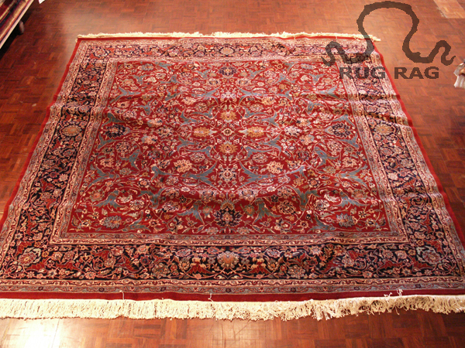
Problems arise when we don’t see systems, relations, and connectivity…

Slide 13
Pest management example
Conventional response to crop pest is spraying pesticide designed to kill that insect. Imagine a perfect pesticide that kills all target insects and which has no side effects on air, water, or soil.
Is using this pesticide likely to make the farmer better off?
Representing the thinking used by those applying the pesticides would look like this:
Unfortunately, often crop damage gets worse in following years and the pesticide that seemed so effective does not help.

Slide 14
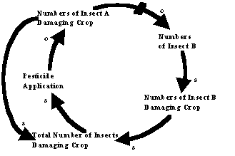
E.g., the pest was controlling another insect population, either by predation or competition. The effective pesticide eliminates the control that those insects were applying on the population of the other insects. Then non-target insect populations explode and cause more damage than the insects killed by the pesticide.

Slide 15
In other words, the action intended to solve the problem actually makes it worse because unintended side effects change the system & end up exacerbating the problem.

Slide 16
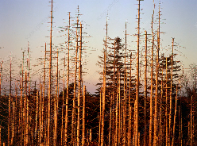
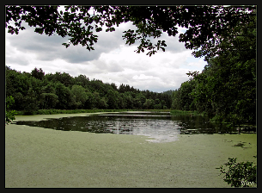
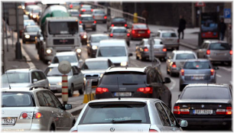
Unintended consequences
Acid precipitation/rain
Ozone depletion
Eutrophication
Global climate change
Automobile dependency
…
All of today’s major environmental problems emerge from yesterday’s solutions.

Slide 17
Key systems concepts
Input-Output models
Feedback
Time lags
Exponential growth
Irreversibility

Slide 18
6 key themes how biophysical human systems interact
Human Population
Sustainability
Global Perspective
Urban Systems
People and Nature
Science and Values

Slide 19
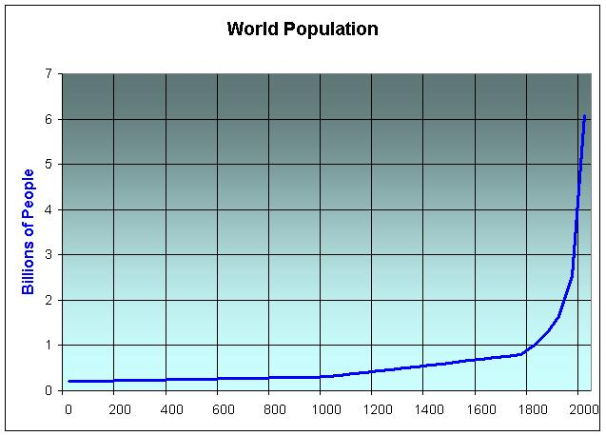
Human Population
World 7,732,909,210

Slide 20
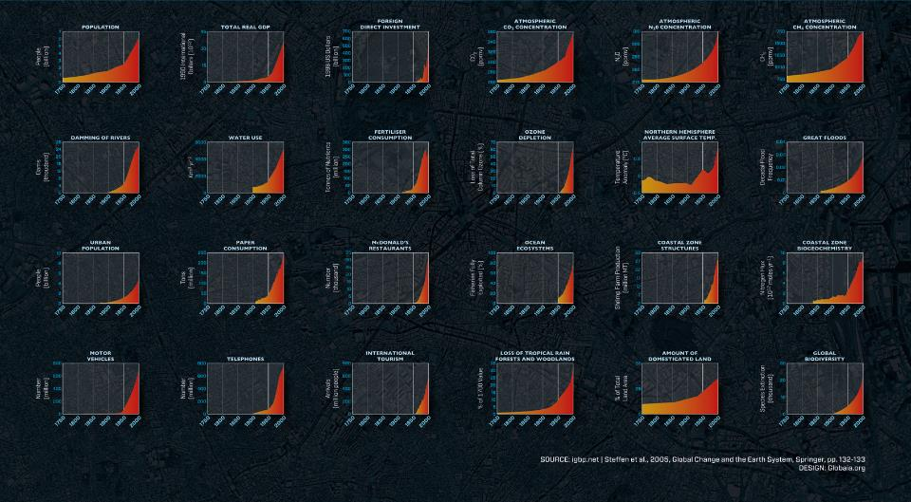
Great Acceleration

Slide 21
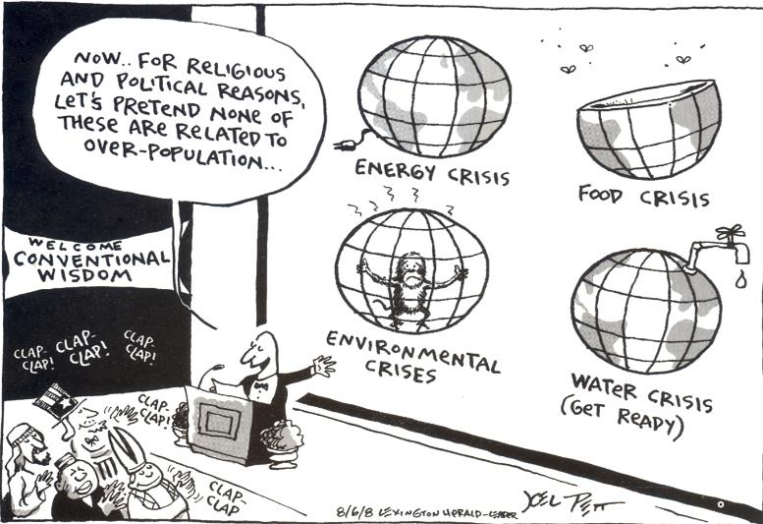

Slide 22
2) Sustainability – the capacity to endure
Resource Harvest
continuous supply for an unlimited or specified amount of time
Ecosystem
able to maintain its functions
Economy
maintains its level of activity in spite of its use of environmental resources
Development
“ensure that humanity meets the needs of the present without compromising the ability of future generations to meet their own needs.” Gro Harlem Brundtland, 1986

Slide 23
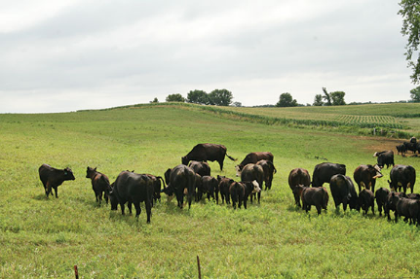
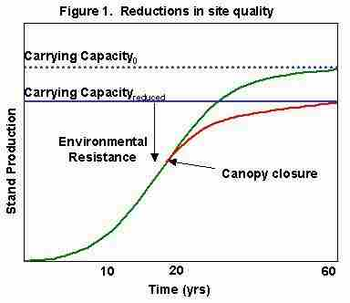
Carrying Capacity
max number of individuals of a species that can be sustained by an environment without decreasing the capacity of the environment to sustain that same amount in the future.

Slide 24
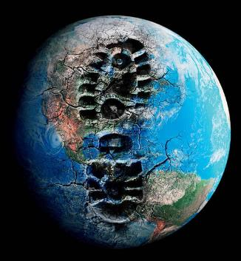
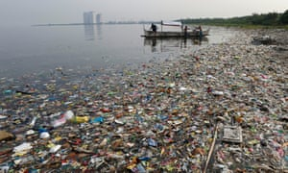
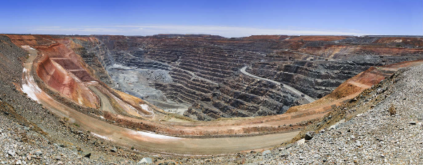
3) Global Perspective
Civilization can change the entire planet’s environment
Spaceship earth

Slide 25
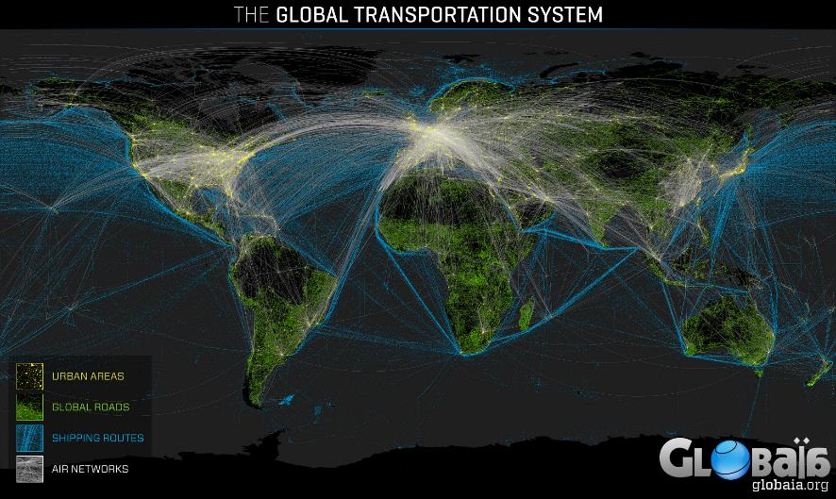
Anthropocene - term to denote the present time interval, in which human activities profoundly impact geology and ecosystems.

Slide 26
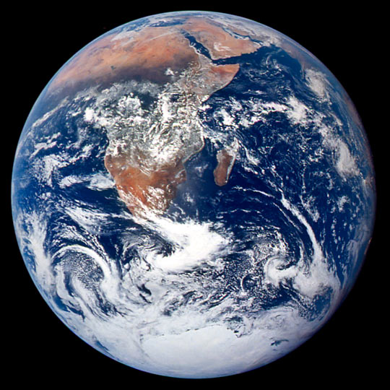
Blue Marble
Dec. 7, 1972 – Apollo 17

Slide 27
4) Urban places
In developed countries 75% of population live in urban areas and 25% in rural areas; in developing countries about 40% are urban
Globally about 54% in urban areas; it is expected that 70% of world population will be urban by 2050
Environmental organizations have often focused on wilderness, endangered species, and natural resources. Although they remain important, more emphasis on urban areas is needed

Slide 28
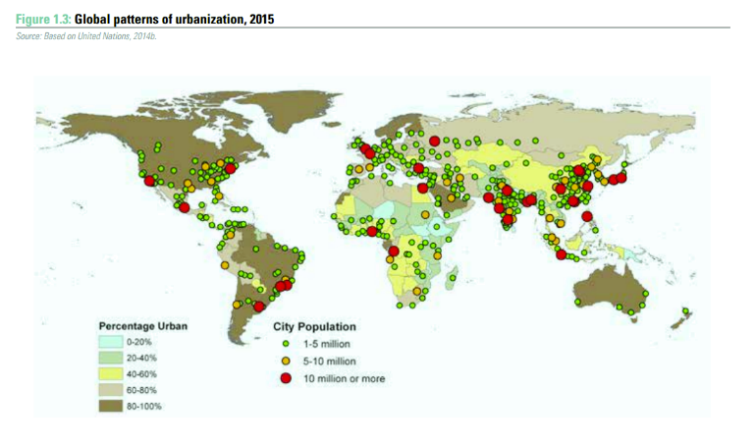

Slide 29
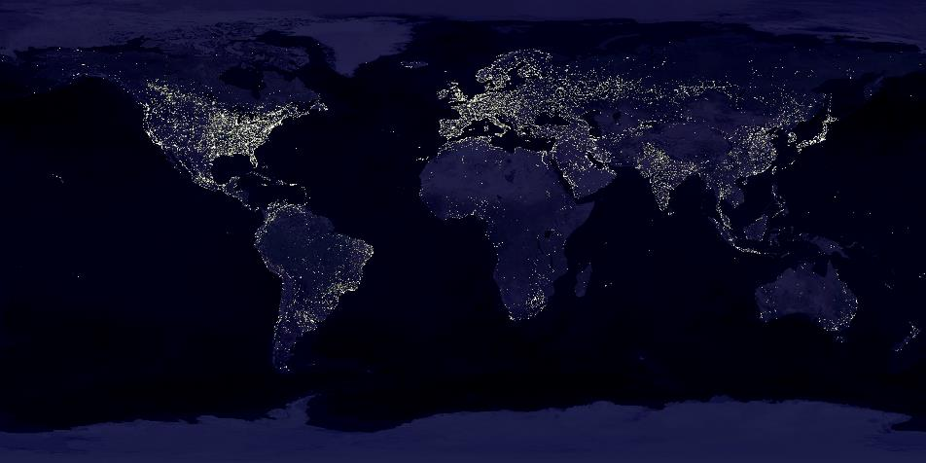
Anthropocene – urban perspective

Slide 30
5) People and Nature
Principle of Environmental Unity –
Everything affects everything else
Things we get from nature: Ecosystem Services
Unintended consequences – today’s problems were yesterday’s solutions

Slide 31
6) Science and Values
Science is process of discovery
Science is one way of looking at the world
Scientists rely on critical thinking

Slide 32
Placing value on the environment
Utilitarian – survival or economic
Ecological – essential to larger life support systems
Aesthetic – our appreciation of nature’s beauty
Moral – environment has a right to exist
Notes:
Does Nature have rights?

Slide 33
Environmental Ethics 1970s
Why a new code of ethics?
New effects on nature
New knowledge about nature
Expanding moral concern
People-people relations
People-group relations
People-nature relations
Land Ethic – A thing is right when it tends to preserve the integrity, stability, and beauty of the biotic community. It is wrong when it tends otherwise (Aldo Leopold, 1949).

Slide 34
Human Ecology
Humans are part of the biosphere;
We are living organisms like other animals in many respects, but
we have an advanced social organization, and
the ability to extract and use energy and resources that characterizes us and our impacts on the planet.
That does not make us independent from the environment though

Slide 35
Tracing the chain of effects through ecosystems and human society
anticipate the long-range environmental consequences of human actions
avoid disastrous surprises from the environment
generate ideas for dealing with environmental problems; and, in general
maintain a liveable and sustainable relationship with the environment.

Slide 36
Are you hungry?
Pick a food of your choice and draw a system diagram of how it interacts with you and the environment

Slide 37
Understanding SYSTEMS!
A set of components or parts that function together to act as a whole

