Slide 1
Human Population
Three stages based on energy acquisition
Progress in reducing suffering
Period of acceleration

Slide 2
Learning Objectives
There can be no long-term solution to environmental problems unless human population stops growing
What controls the rate of growth?
How many people can the Earth sustain?
The rapid increase in human population occurred with no change in the MAXIMUM lifetime of an individual
Birth rates have declined faster in countries with a high standard of living than in countries with low standard of living

Slide 3
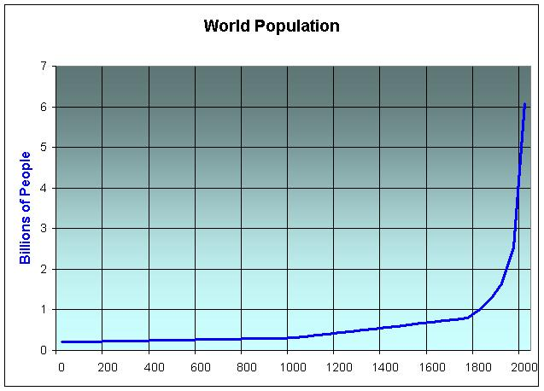
Human Population
World 7,679,302,210

Slide 4
Growth rate = Birth rate – Death rate
Population
Birth/year
Death/year
Crude Growth Rate = Crude Birth Rate – Crude Death Rate
Crude = # Per 1000

Slide 5
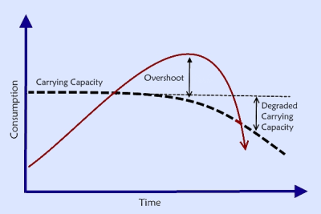
Zero Population Growth
Population is stable
Number of births = number of deaths
In overshoot, if births go up, then deaths go up (war, famine, plague)

Slide 6

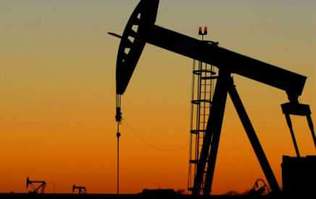
Stages of Civilization:
Hunter Gatherer (>10,000 YA)
Agriculture (10,000YA – present)
Wheat (emmer and einkorn), barley
Sheep and goats
Cattle and pigs
Draught animals (6000YA)
Industrial Revolution (1800 – present) drawdown of stored solar capital to utilize higher energy densities from geologic input

Slide 7
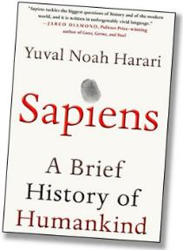
Rapid rise of Homo sapiens
[It was] only in the last 100,000 years—with the rise of Homo sapiens—that man jumped to the top of the food chain....Other animals at the top of the pyramid, such as lions and sharks, evolved into the position very gradually, over millions of years. This enabled the ecosystem to develop checks and balances that prevent lions and sharks from wreaking too much havoc.
....In contrast, humankind ascended to the top so quickly that the ecosystem was not given time to adjust. Moreover, humans themselves failed to adjust.
www.motherjones.com/kevin-drum/2016/02/nice-paragraph-about-why-humans-are-so-damn-paranoid

Slide 8
Stages of civilization and how it affects population
Hunter Gatherer – Home sapiens emerged 250,000 and until ~10,000 years ago food was based on gathering “sunlight energy” in plants and animals from the ecosystem. Population was low and growth was low
Rise of Agriculture – 10,000 years ago until present. Humans domesticated plants and animals for more stable and predictable food supply – gathering “sunlight energy” that they had control over. Population growth increased, and population increased steadily but slowly.
Fossil Fuel Age (Industrial Revolution) 1800-present. Use of concentrated “stored solar energy” for plowing, irrigation, fertilizer, transportation, storage, processing, preparation, made food more available. Population growth increased and population exploded. Fewer people needed to engage in farming allowed additional specializations in medicine, technology, industry, etc., etc., etc.

Slide 9
Human Population
World 7,679,302,210

Slide 10
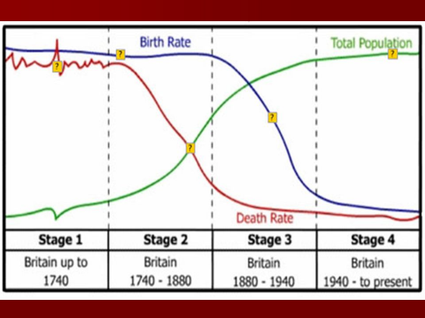
Demographic Transition
50/1000
10/1000

Slide 11
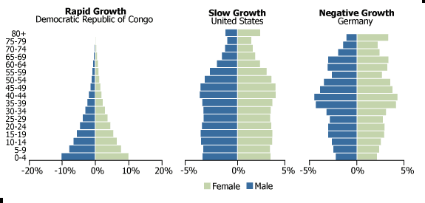
Age structure
Pyramid, column, inverted pyramid, column with a bulge

Slide 12
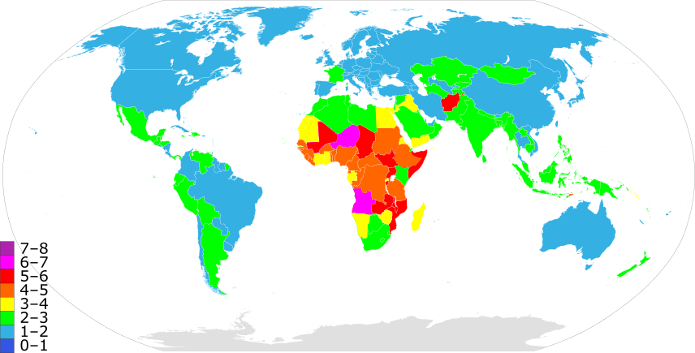
Fertility Rate - average number of children that would be born to a woman over her lifetime
2018 CIA Factbook

Slide 13
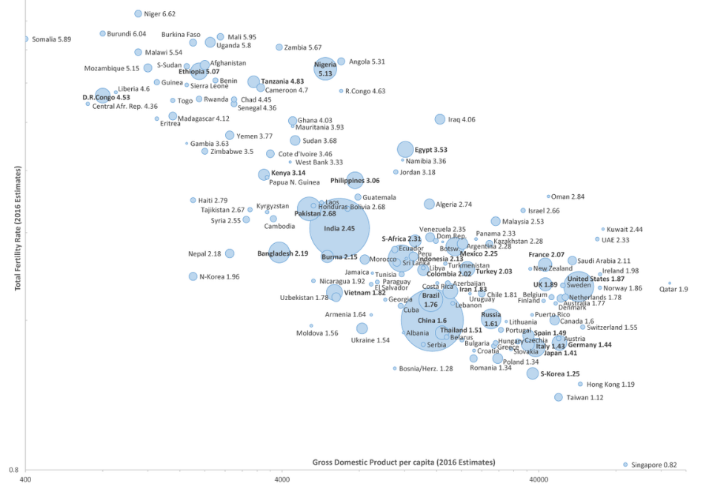
Fertility versus GDP

Slide 14
How many people can the Earth support? Limiting factors
Food supply
Land and soil resources – almost all usable agricultural land is being cultivated – each year more soil is lost to erosion than is formed
Water resources – less than 3% of all water is suitable for drinking and irrigation. Underground reservoirs are being depleted
Population Density – people per area
Energy resources and Technology – How much each person uses (mainly energy resources)
1 American = 35 Indians = 140 Bangladeshi

Slide 15
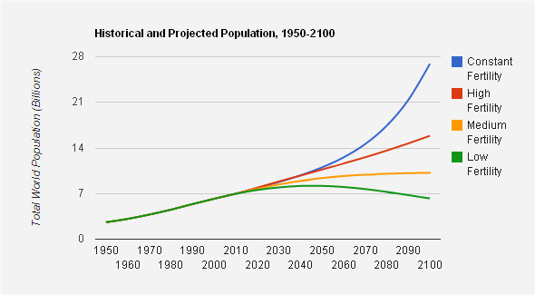
United Nations Population projections

Slide 16
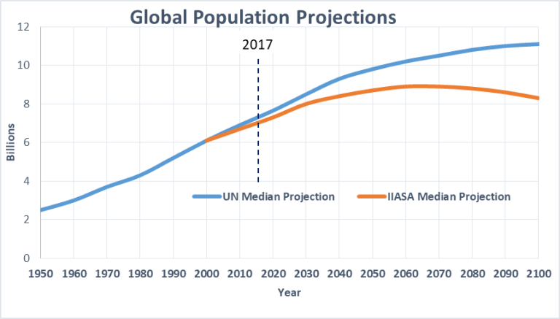
World Population projections

Slide 17
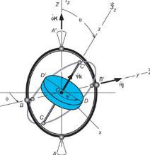

Progress
Change
Dynamics
Development
Modification
Process
Transformation
Do all these terms have the same implication?

Slide 18

Is the direction always “better”?
Is something lost when something else is gained?
What change leads to destruction?
Who decides what is a gain or a loss?
Does it depend on who gains and loses?

Slide 19
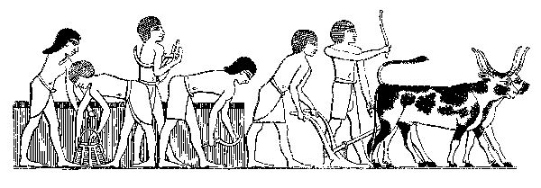
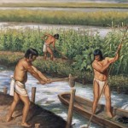
When human societies first evolved as a significant part of the systems of nature, man had to adapt to the food and fuel energy flows available to him, developing the now-familiar patterns of human culture.
The energy source was sunlight which is spread out so evenly that it is not directly available to man until after some has been concentrated and much has been necessarily lost by the plants and animals.

Slide 20
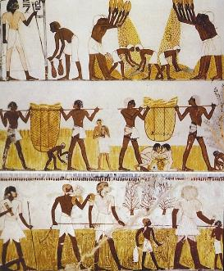
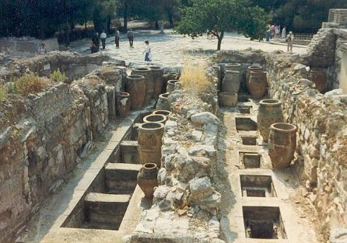
Societies that were able to survive had to gather food and distribute energies within the social system for their successful continuance, and they developed the group organization necessary for these purposes.
Ethics, folkways, mores, religious teachings, and social psychology guided the individual in his participation in the group and provided means for using energy sources effectively.

Slide 21
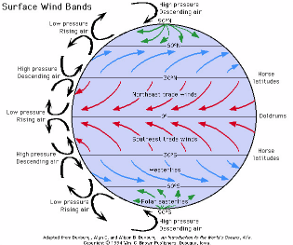
Two main energy flows
Solar energy driving photosynthesis
About one-half of the solar energy is in wavelengths incapable of directly driving photosynthesis and is absorbed as heat.
  This creates temperature gradients across the globe driving the great wind and water current systems of the earth.
  This giant heat engine contributes to P-R by bringing raw materials (rain, fertilizer) more rapidly to sites of production.

Slide 22

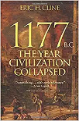
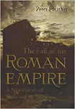

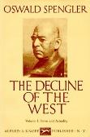


Growth and decay of civilizations has been well studied
Babylonian (Mesopotamian): 3200 – 2200 BC
Egyptian: 2900BC-1680 BC
Mexican (Mayan-Aztec): 160 AD – 960 AD
Classical (Apollinian): 1100 BC – 300 BC
Western: 900 AD – 1800 AD
Typical pattern is deforestation, erosion, flooding, siltation, saltation
→ soil degradation leads to declining agricultural productivity
All systems show signs of complex growth and DECAY dynamics

Slide 23
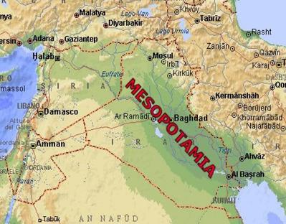
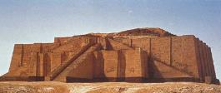
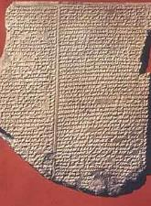
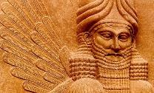
Babylonian (Mesopotamian): 3200 – 2200 BC
Cities, monumental architecture, wide use of metals, writing.
“Within 1000 of emergence of settled communities, villages were abandoned as soil erosion caused by deforestation resulted in badly damaged landscape, declining crop yields and eventually inability to grow enough food” (p. 43).

Slide 24
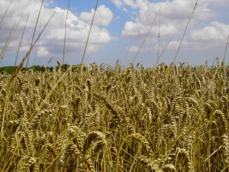
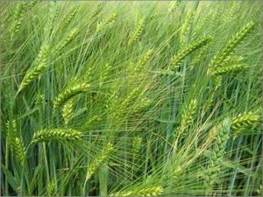
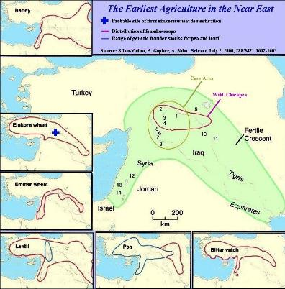
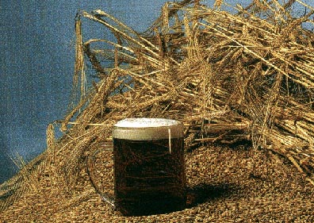
By 1700 BC no wheat could be grown in Southern Mesopotamia,

Slide 25
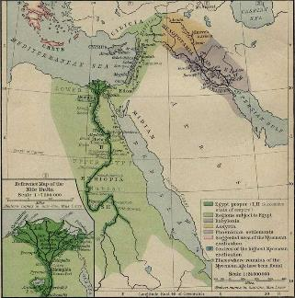
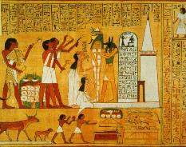
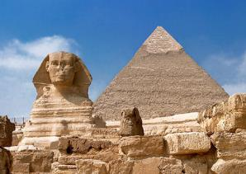

Egyptian: 2900BC-1680 BC
The Nile provided a dependable source of irrigation. Annual flood brought deposits of alluvial silt as natural fertilizer and washed away accumulated salts.
Rulers were given power to control the natural rhythms. Mythically sustained equilibrium boosted by a worldview that affirmed sacred values of nature.

Slide 26
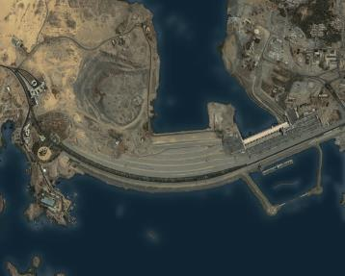
Egypt is the classical model of natural sustainability. It existed autonomously for over 2000 years likely its stability was attributable to the sustainability of its ecological relationships.
Nevertheless, they deforested, overgrazed and destroyed animal habitat.
The balanced approach was continued until the introduction of Western practices for fertilization and irrigation in the 19th century, then complete disconnect with Aswan Dam in 1970s.

Slide 27
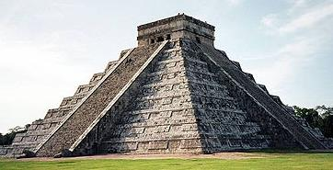
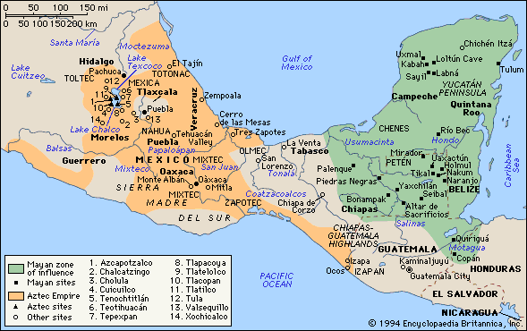
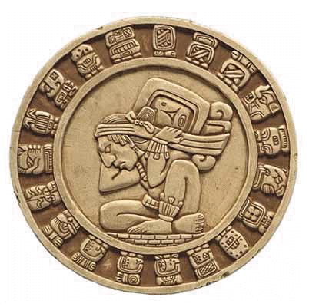
Mexican (Mayan-Aztec): 160 AD – 960 AD
Abundant rainfall, thin soils. Slash and burn agriculture (for maize).
Best soils in lowlands but expanded to slopes eventually utilizing 75% of environment cleared. Agriculture became more intensive and extensive.
Deforestation for fuel, construction, and plaster, affected water cycle.
Extended drought years brought ruin.
Relation between substructure (nature as a resource base) and superstructure (nature as a socio-economic inputs).

Slide 28
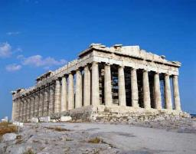
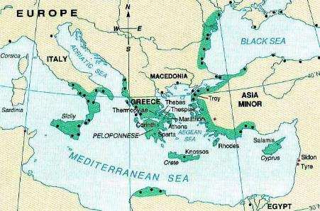
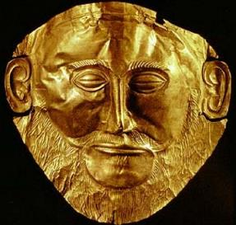
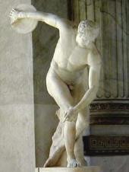
Classical (Apollonian): 1100 BC – 300 BC
Soil degradation, deforestation, loss of species, decline of agriculture
The ancients were unable to adapt their economies to the environment in harmonious ways.

Slide 29
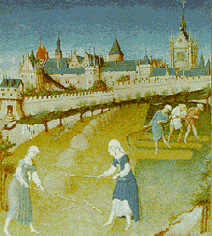
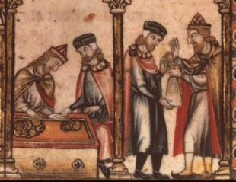
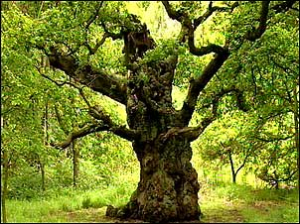
Western Europe: 900 AD – 1800 AD
Regrouping after collapse of Roman Empire: fertile land (plow), indented coastline, abundant navigable rivers, abundant iron and other metals, abundant timber.
Nature was seen successively as eschatological, adversarial, collaborative, and recreational.
It was to be conquered and tamed – fairy tales theme of scary wild places

Slide 30
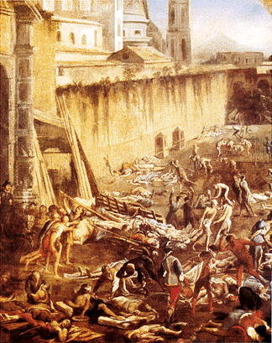
Western Europe: 900 AD – 1800 AD
By 1300 the population had reached 80 million and most of the medieval forest was cleared.
Through agriculture and fire the Europeans had modeled their landscape, especially it plant cover. Reworking a shade tolerant high forest into a sun-fleshed low forest full of shrubs, grasses, forbs.
Royal hunting reserves were being established.
The ecological limits of the agricultural economy
were evident the pressure alleviated through plague,
famine, and war. Many forests recovered but the
economy not until age of exploration and the
harnessing of additional “solar” resources, preferably
already concentrated in slaves, gold, and goods

Slide 31

Long-term dynamics of socio-ecological systems
Collapse:
How societies choose to succeed or fail (Diamond, 2005)
Deforestation and habitat destruction
Soil problems (erosion, salinization, fertility loss)
Water management problems
Overhunting
Overfishing
Introduced species
Human population growth
Increased per capita impact
Human induced climate change
Build up of toxic chemicals
Energy shortages
Full human utilization of earth’s photosynthetic capacity
Related to how we use
Ecosystem Services

Slide 32
Cycles of civilizations
“Clearing the past away has allowed the future to grow anew… The aim of wiping out the past has been to allow a superior dispensation to takes its place.”
Kriwaczek, Paul. Babylon: Mesopotamia and the birth of civilization. 2010. Thomas Dunne Books.

Slide 33

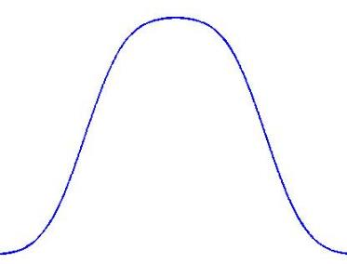
Collapse of Complex Societies (Tainter 1988)
Complexification is limited as a problem solving strategy.
  “More complex societies are more costly to maintain than simpler ones… as societies increase in complexity, more networks are created among individuals, more hierarchical controls are created to regulate these networks, more information is processed …
  increasing need to support specialists
  not directly involved in resource
  production, and the like”
  (Tainter 1988, p. 91).
Benefit from Complexity
Complexity

Slide 34
Similarity between Ecological and Society’s stages:
→structural → network → information G&D.
Tainter continues,
“All this complexity is dependent upon energy flow at a scale vastly greater than that characterizing small groups of self-sufficient foragers or agriculturalist. The result is that as a society evolves toward greater complexity, the support cost levied on each individual will also rise, so that the population as a whole must allocate increasing portions of its energy budget to maintain organizational institutions.”
We rely on a greater allocation of this energy to maintain the complex structures created.

Slide 35
System grows in complexity,
this provides benefit to the system for achieving its goals
More complex systems require more investment to maintain themselves
These costs get too high
Adding more complexity has less and less benefit, eventually it becomes detrimental
Collapse = decomplexifying is the best alternative
The “appropriate response of the system”, not a sign of failure

Slide 36
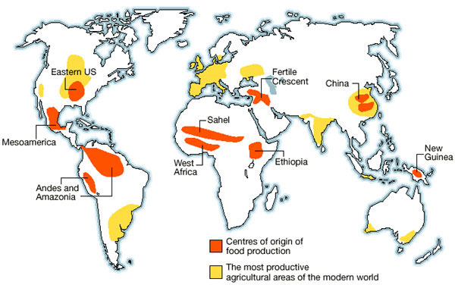
Long term impact of agriculture on agriculture

Slide 37
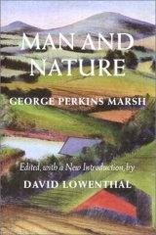
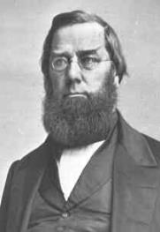
George Perkins
Marsh
Wrote Man and Nature in 1864.
“A certain measure of transformation of terrestrial surface, of suppression of natural, and stimulation of artificially modified productivity becomes necessary. This measure man has unfortunately exceeded.”
“Before Marsh no one had assessed the cumulative effect of all axes and hoes. For him the conclusion was inescapable. Man depends upon soil, water plants and animals. But in obtaining them he unwittingly destroys the supporting fabric of nature” (p.56)

Slide 38
What ideas helped shape these destructive socio-ecological relations?
Christian worldview adopted in Rome in 313 AD
Biblical attitude of human dominion over the natural
End times and earthly existence temporary
Static nature of nature – God’s rationally designed creation
Geocentric model of the universe
Application of providential thinking to economic progress
Belief that economic growth was unlimited and necessary
These ideas all framed the way humans interacted with nature.

Slide 39
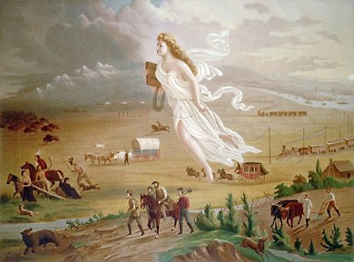
Progressive ideology
Increased knowledge and technology generally contribute to an increase in human well-being.
Manifest Destiny – Christian imperative to tame and control the natural world
American Progress by John Gast, circa 1872.

Slide 40
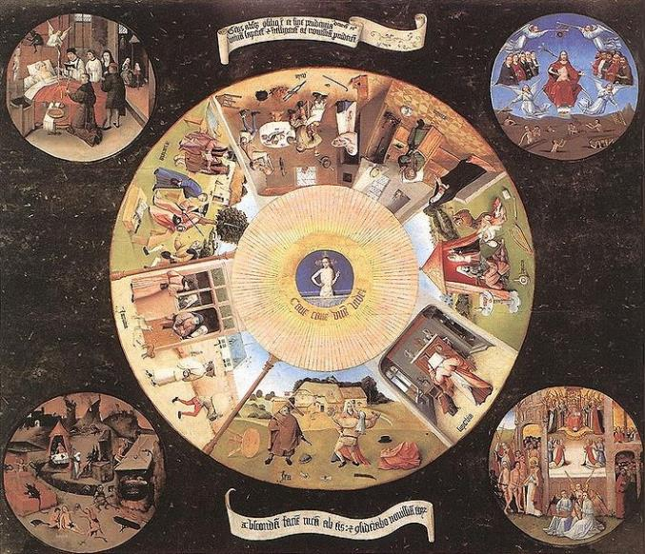
Assumption that insatiable appetites, formerly condemned as a source of social instability and personal unhappiness, could drive the economic machine.
Gluttony
Sloth
Pre-modern vices were henceforth transformed into the economic virtues that would turn the wheels of modern society
Greed
Lust
Envy
Pride
Anger
'The Seven Deadly Sins' by Hieronymus Bosch, 1485

Slide 41
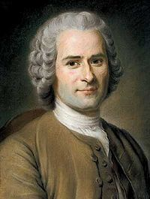
Rousseau was one of the first to attack this idea
Basic human needs: food, shelter, sex. “All other human wants are not essential to happiness, but arise out of man’s ability to compare himself to his neighbors and feel himself deprived if he does not have what they have. The wants created by modern consumerism arise from man’s vanity” (Fukuyama, p.196).

Slide 42
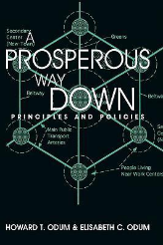
What are the consequences of this decomplexifying?
Can we maintain livability and well-being? Prosperity?
One way is to reprioritize goals away from material growth,
At a national, family, and individual scale:

Slide 43



www.factor10-institute.org

Slide 44


American Dream
Center for a New American Dream
vimeo.com/26573848

Slide 45



I CHING – 1st book in Chinese literature ~1000 BCE
元亨利貞 “yuan – heng – li – zhen”; translates as
To begin – to expand rapidly – to turn to good account – to remain solid
Each term takes over from the previous… there is no subject
The charm bears the four characters that open the I Ching: "Yuan Heng Li Zhen." www.mc.maricopa.edu/~thoqh49081/engagement/History/pictures/i-ching-charm.html

Slide 46

Example of seasons
Spring – beginning
Summer – expansion
Autumn – harvest
Winter – rectitude (until renewal)

Slide 47
It is not about giving up what we have but getting on a new path (drawn to a new state through reinforcing positive feedbacks).
focusing on quality, culture, social interactions, creativity…
How to build a eco-centric worldview?

Slide 48

COLLAPSE
Thank you for your Attention!

