Slide 1

Cold War in Europe

Slide 2
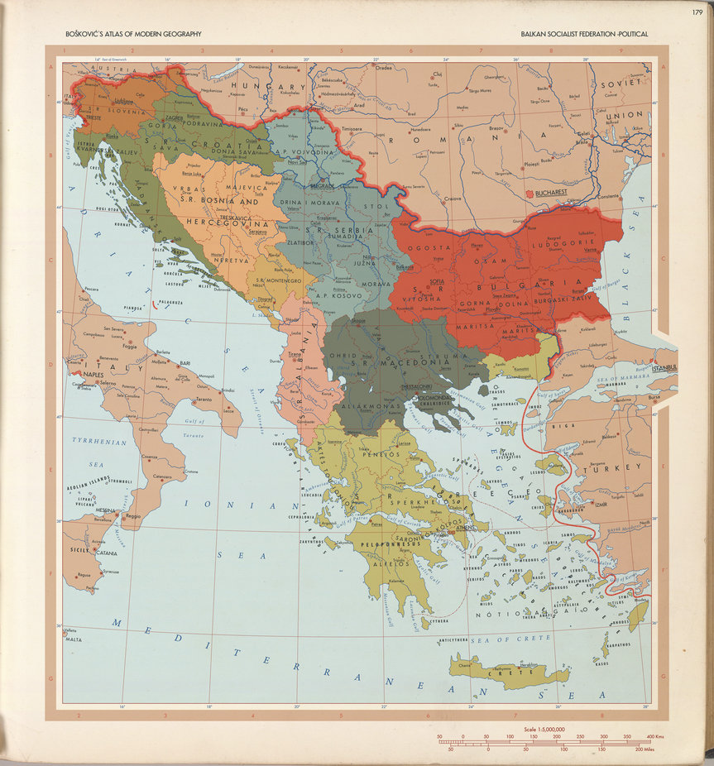
Plan of Balkan Federation 1947-1949

Slide 3
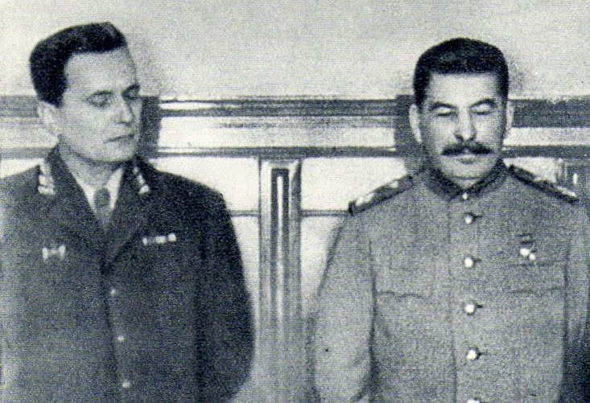
Josip Broz Tito and the first rupture of the bloc
Gradual opposition since January 1948
February 1948 Moscow talks
28 June 1948 Komintern:
Tito’s communist “excluded themselves from the family of fraternal communist parties”
Vidov dan / St. Vitus Day 1389
Gregorian Callender

Slide 4
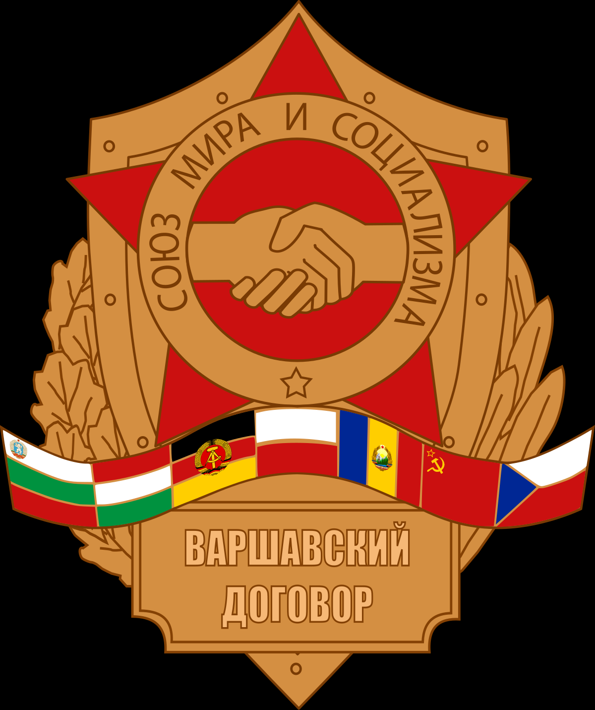
Emergence of the Warsaw Pact
5 May 1955 Federal Republic of Germany to the NATO
Warsaw Pact signed 11 May 1955
Military pendant to COMECON
Original text:
https://treaties.un.org/doc/Publication/UNTS/Volume%20219/volume-219-I-2962-Other.pdf
English translation:
http://avalon.law.yale.edu/20th_century/warsaw.asp

Slide 5
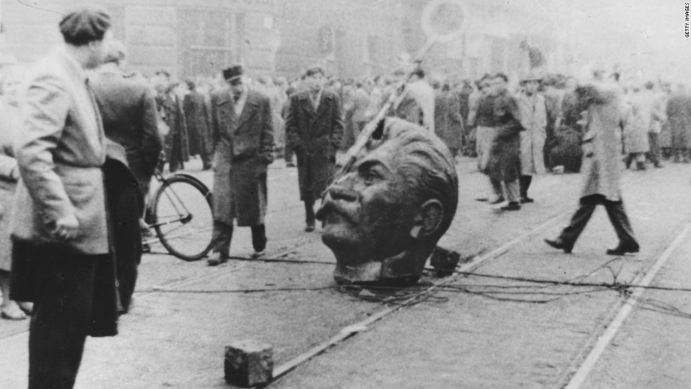
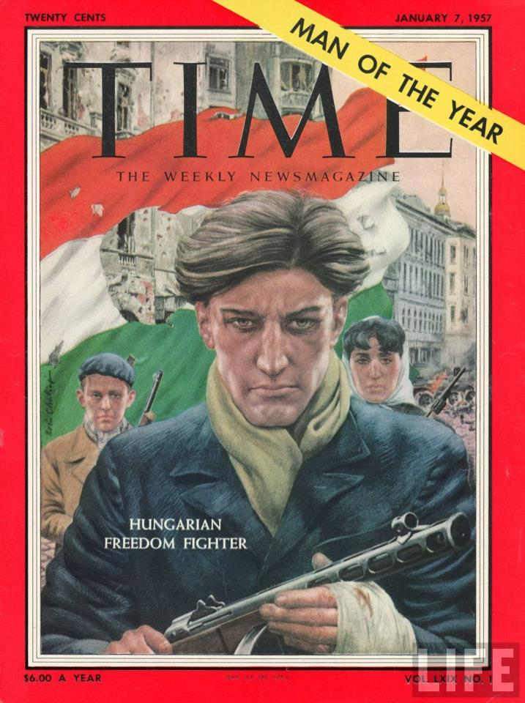
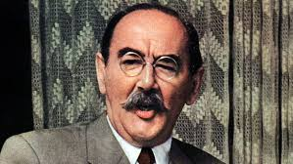
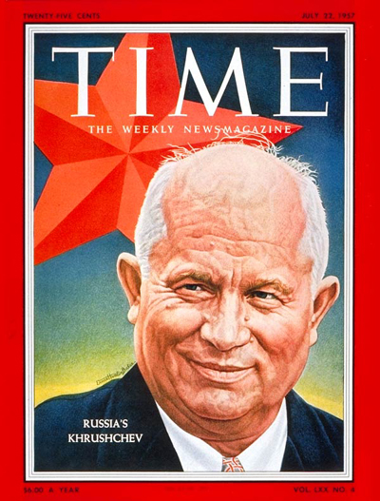
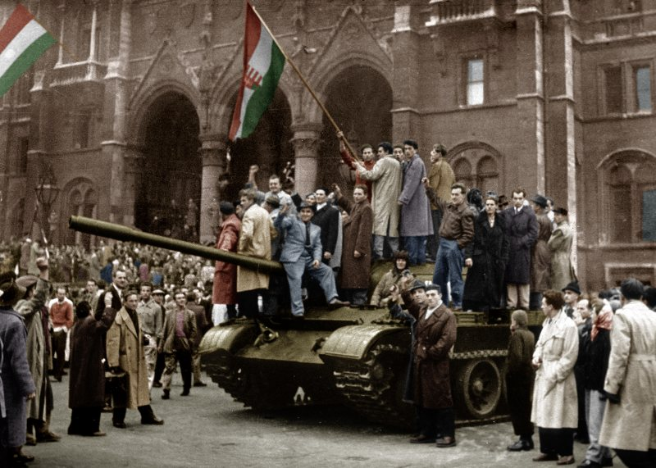
Hungarian Revolution 1956

Slide 6
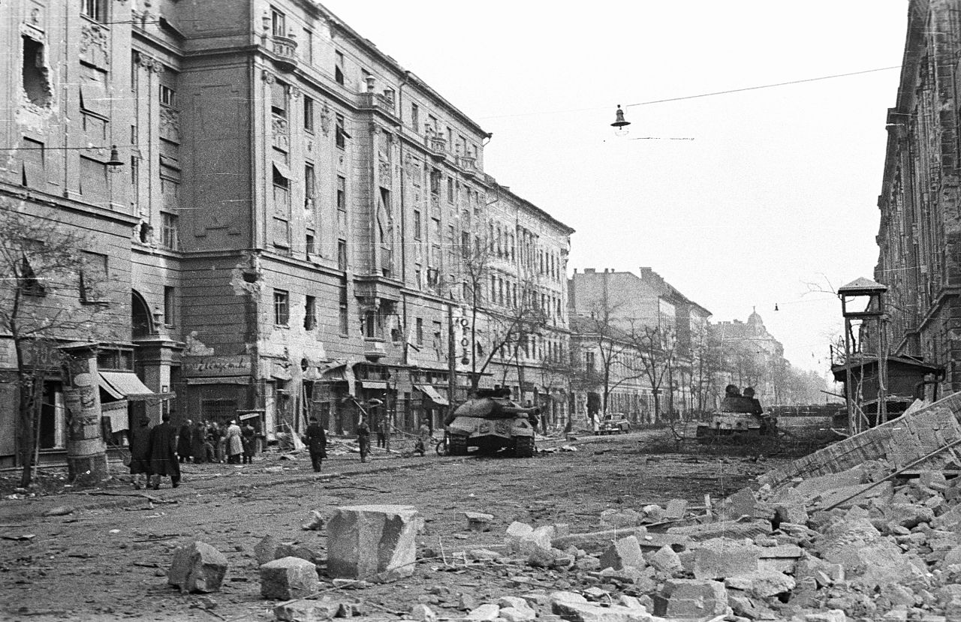
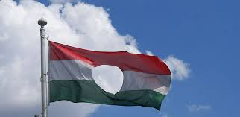
Revolution repressed
Double Soviet invasion (31 October – marshal Konev – and 4 November)
Reaction of the West influenced by the Suez Crisis:
  Richard Nixon: “We couldn't on one hand, complain about the Soviets intervening in Hungary and, on the other hand, approve of the British and the French picking that particular time to intervene against Nasser.”
Fear from the nuclear war between USA and USSR
General Assembly claimed withdrawal of Soviet troops (just a diplomatic gesture)
Hungary proclaimed neutrality (1 November)

Slide 7
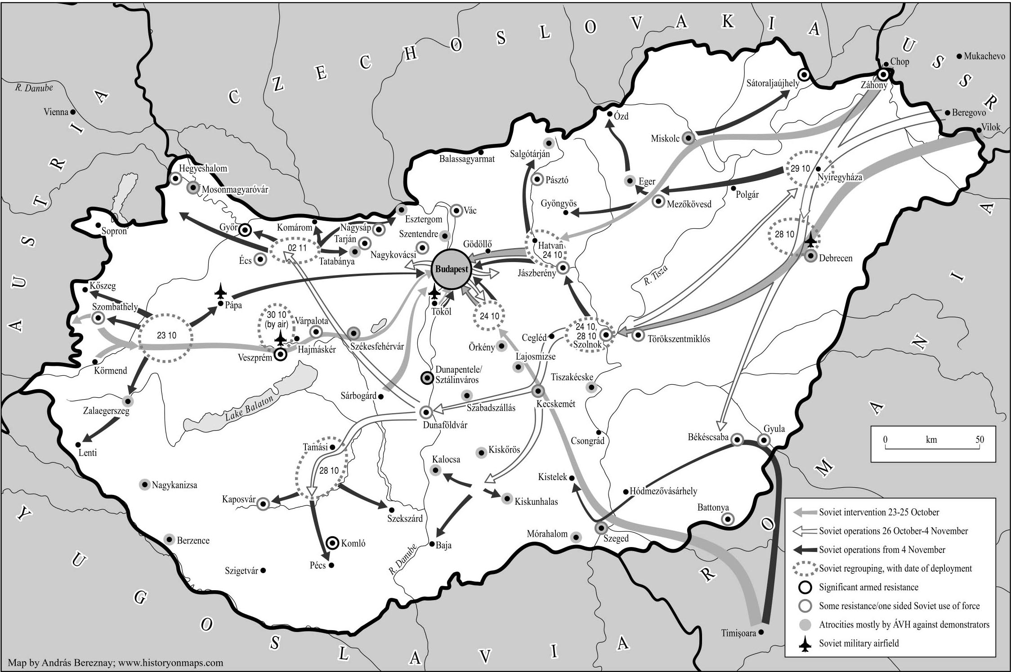
Soviet Intervention

Slide 8
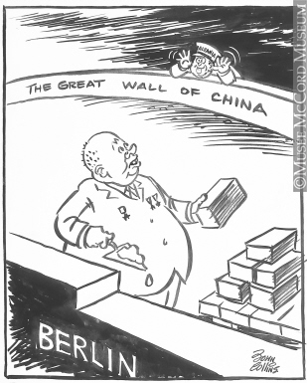
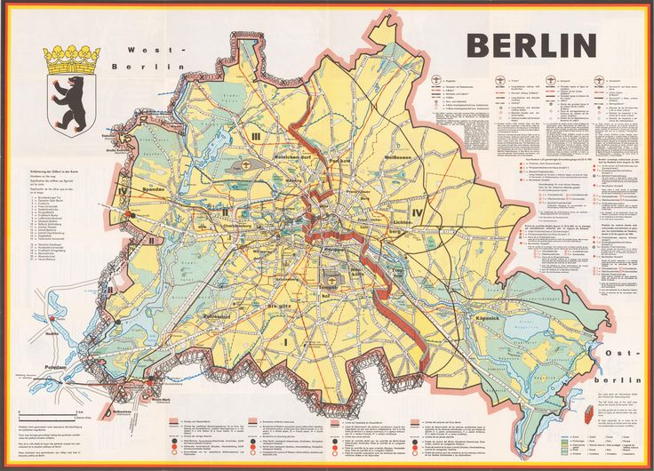
Khruschev goes wilder: Second Berlin Crisis 1961

Slide 9
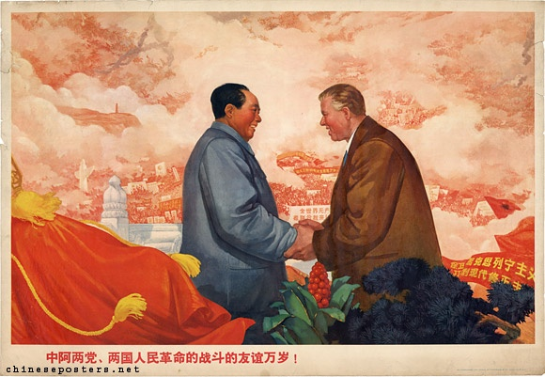
Albania goes Maoist
Enwer Hoxha and the dream of Great Albania
1961 Albania left the Warsaw Pact
Soviet assistance replaced with the Maoist one

Slide 10
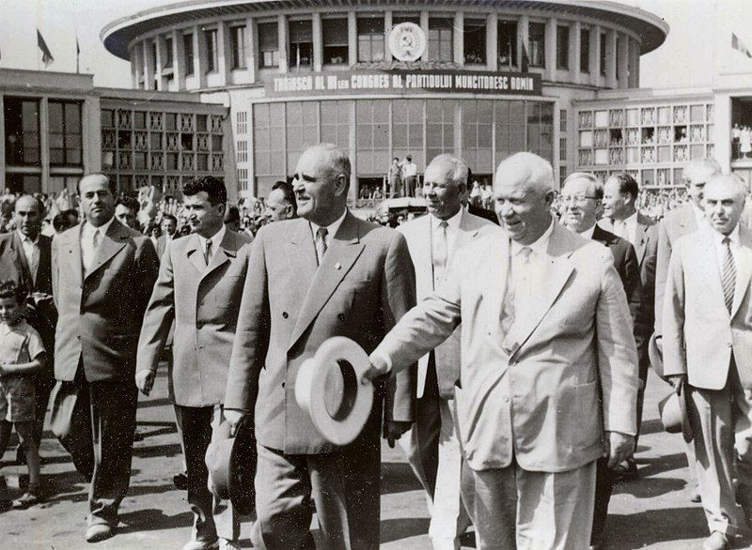
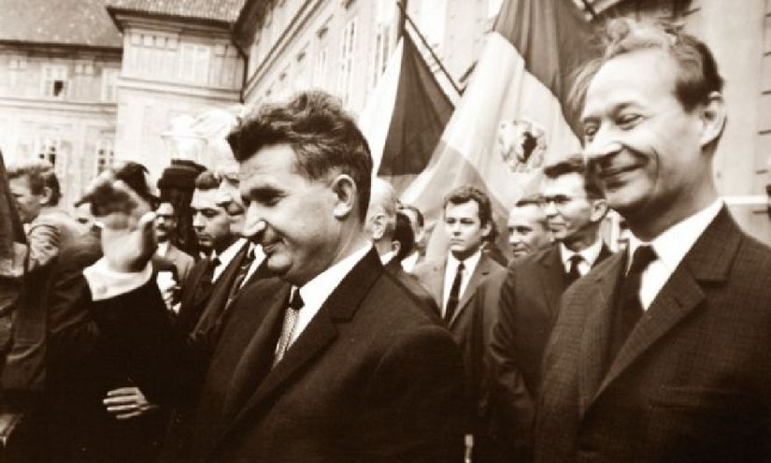
Romania goes local
Gheorge Gheorgiu Dej
patriotism
“Declaration of Independence” 1964 against “proletarian internationalism”
1965 Nicolae Ceauşescu
Rejection of Brezhnev doctrine in 1968

Slide 11
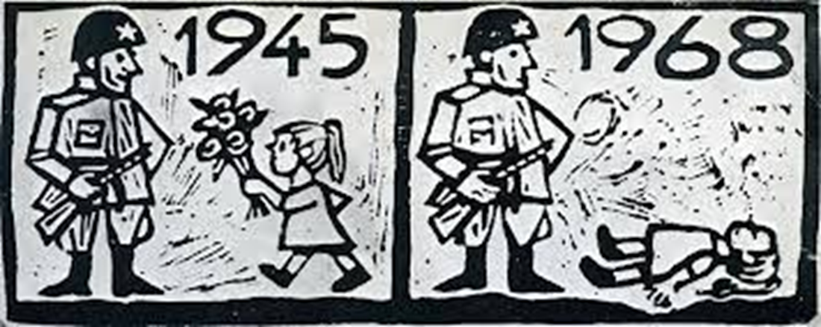
Prague Spring

Slide 12
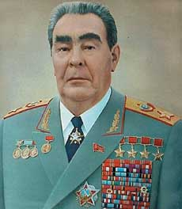
Warsaw pact strikes back
Summer 1968 – anti-reform campaign in press of WP countries
Mid-July – summit of WP in Warsaw – Brezhnev Doctrine of limited sovereignty
July/August – meeting of Soviets and Czechoslovaks in Čierna nad Tisou
Invasion was prepared since Dresden meeting (March) of USSR, DDR, Hungary, Poland, and Bulgaria politicians with Czechoslovak colleagues
Exact date of invasion decided on 16th August
Question of “letter of invitation” (Biľak, Kolder, Indra, Švestka, Kapek)
Invasion started on 21st August
Protocol of Moscow (26th August) – “temporal presence” of Warsaw Pact armies at the Czechoslovak territory

Slide 13
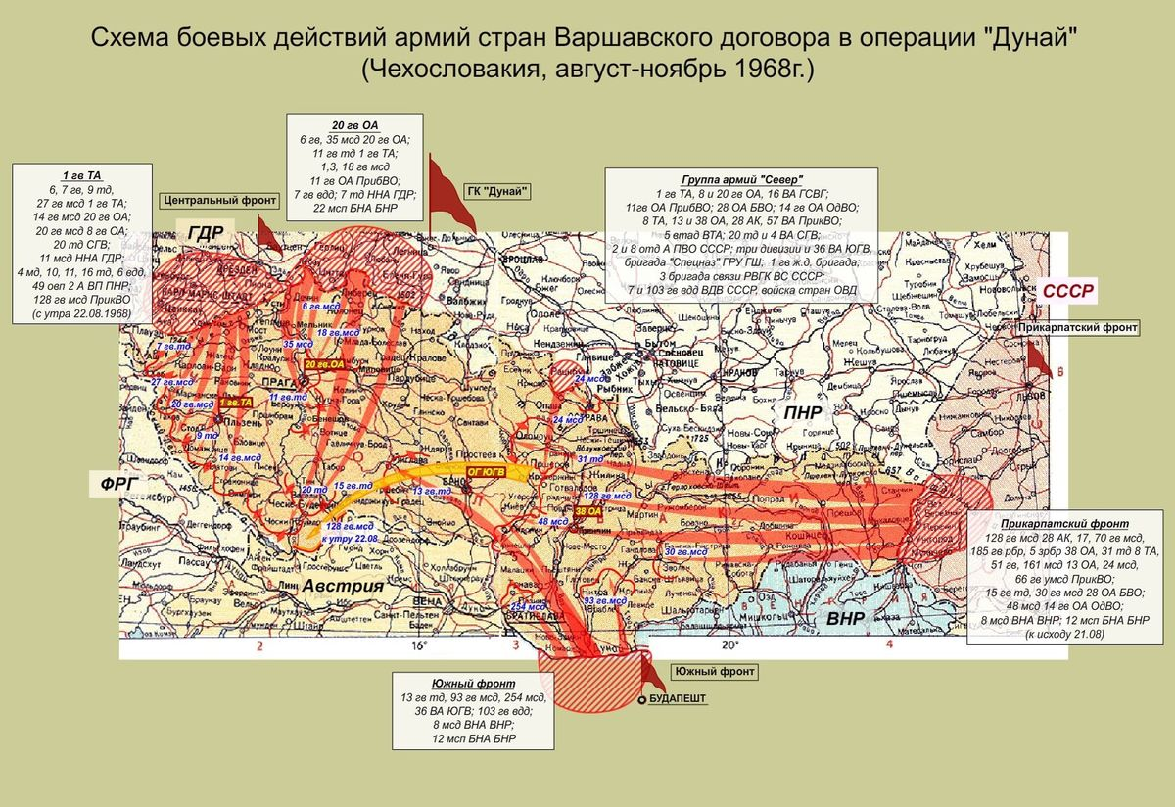
Termination of “Prague Spring” – Invasion of WP Forces

Slide 14
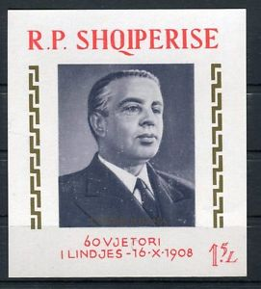
Reaction to Invasion
Rejection of Invasion by many Western Communist Parties (PCI, KPÖ)
Stance of Albania and China
  Enver Hoxha and Mao-Zedong
Stance of Western official institutions cold
Olof Palme rejected invasion, Urho Kekkonen remained silent

Slide 15
Brezhnev Doctrine (Pravda 25 Aug 1968)
In connection with the events in Czechoslovakia the question of the correlation and interdependence of the national interests of the socialist countries and their international duties acquire particular topical and acute importance. […] none of […] decisions [of the local communist party] should damage either socialism in their country or the fundamental interests of other socialist countries, and the whole working class movement, which is working for socialism. This means that each Communist party is responsible not only to its own people, but also to all the socialist countries, to the entire Communist movement. […] It has got to be emphasized that when a socialist country seems to adopt a “non­affiliated” stand, it retains its national independence, in effect, precisely because of the might of the socialist community, and above all the Soviet Union as a central force, which also includes the might of its armed forces. The weakening of any of the links in the world system of socialism directly affects all the socialist countries, which cannot look indifferently upon this. […] Discharging their internationalist duty toward the fraternal peoples of Czechoslovakia and defending their own socialist gains, the U.S.S.R. and the other socialist states had to act decisively and they did act against the antisocialist forces in Czechoslovakia.
https://sites.temple.edu/immerman/the-brezhnev-doctrine-1968/

Slide 16
Helsinki Process / Helsinki Trap
1973-4: Kissinger’s attempts in rapprochement with Russians
1973-1975 Conference on Security and Cooperation in Europe (CSCE → OSCE)
Final Act signed in Helsinki (https://www.osce.org/helsinki-final-act?download=true) in July 1975
Three “baskets”:
  Inviolability of the borders in Europe
  Promotion of contacts and links across the Iron Curtain in the spheres of trade and technology
  Human Rights preserved all around Europe

Slide 17
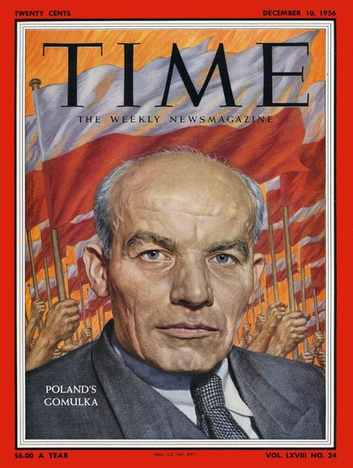
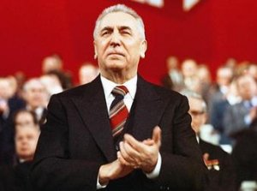
Polish protests and Soviet hesitations
1968 – Polish protests (“Poland waits for its own Dubček”) tempered by exchange of the party General Secretary (Gomułka → Gierek)

Slide 18
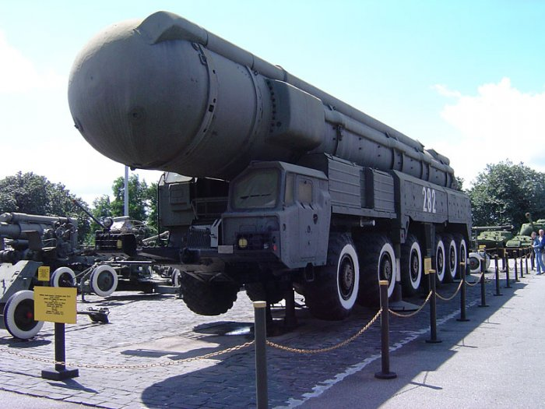
Changing international context in the late 1970s
Oil shocks, authoritarian regimes in the Middle East
Brezhnev turned his back from détente
New Globalism (Lundestadt)
Angola, Ethiopia, Afghanistan
Deployment of SS-20 IRBMs
Aggressive foreign policy as a kind of trade-off for economic and technological decline
Double-track decision of the NATO
in 1979
Notes:
Intermediate Range Ballistic Missile
The NATO Double-Track Decision is the decision of NATO from December 12, 1979, to offer the Warsaw Pact a mutual limitation of medium-range ballistic missiles and intermediate-range ballistic missiles combined with the threat that in case of disagreement NATO would deploy more middle-range nuclear weapons in Western Europe, following the so-called "Euromissile Crisis".[

Slide 19
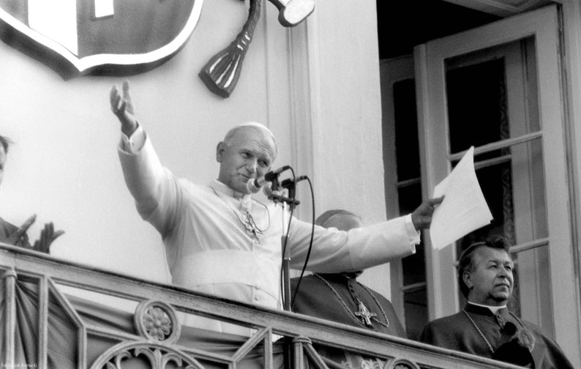
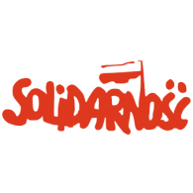
Poland protests again
Important symbolical step in 1978: Karoł Wojtyła elected Pope John Paul II.
1976-1977 season of discontent for economic as well as political reasons
Catholic Church and Independent Trade Union Movement “Solidarity”
Visit of John Paul II in Poland 1979

Slide 20
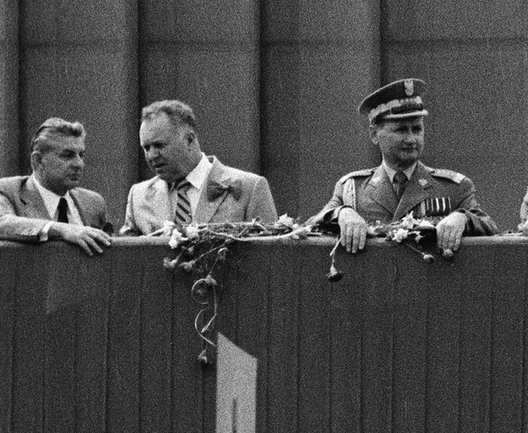
Reaction in Warsaw and in Moscow
September 1980 Gierek replaced by Stanisław Kania
Brezhnev and politburo in general reluctant and unwilling to intervene in Poland but threatened Poland herewith
Honecker, Husák and Zhivkov pleaded for invasion
Summer 1980 long planned maneuvers of the WP took place in Poland

Slide 21
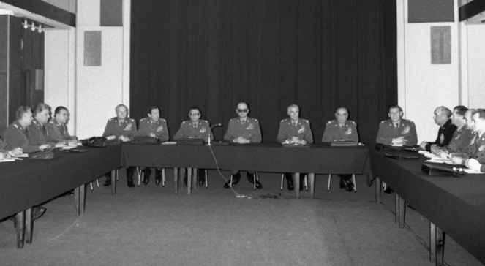
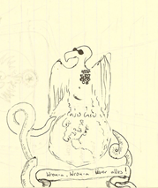
WRON
December 1981 Wojciech Jaruzelski declared martial law in Poland (till July 1983)
Military Council of National Salvation
(WRON)

Slide 22
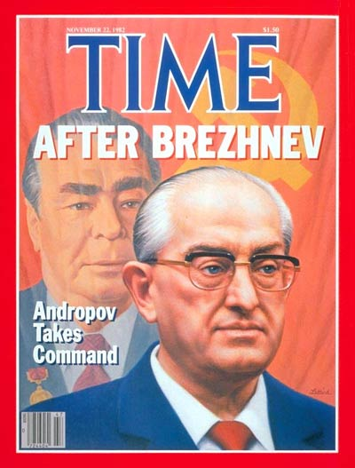
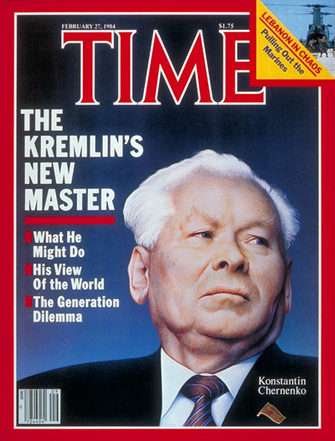
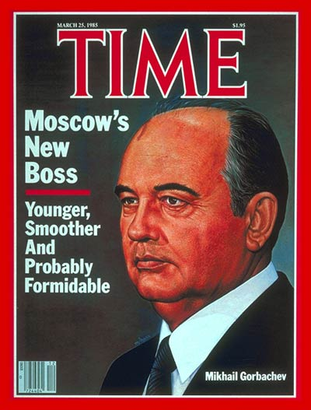
USSR: Change on the top in the quick pace
1982 Brezhnev replaced by Yuri Andropov
1984 Andropov replaced by Konstantin Chernenko
1985 Chernenko replaced by Mikhail Gorbachev

Slide 23
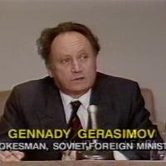
Gorbachev and Sinatra’s Doctrine
Perestroika and glasnost followed by relaxed foreign policy only reluctantly
Summits Reagan – Gorbachev in Reykjavik and further
Symbolical turn 1988 end of Soviet operations in Afghanistan
Genadi Gerasimov October 1989 Sinatra’s Doctrine
Notes:
Gerasimov told the interviewer that, "We now have the Frank Sinatra doctrine. He has a song, I Did It My Way. So every country decides on its own which road to take." When asked whether this would include Moscow accepting the rejection of communist parties in the Soviet bloc. He replied: "That's for sure… political structures must be decided by the people who live there."

Slide 24
Thank you for your attention!

