Slide 1
European integration today: challenges and opportunities

Slide 2
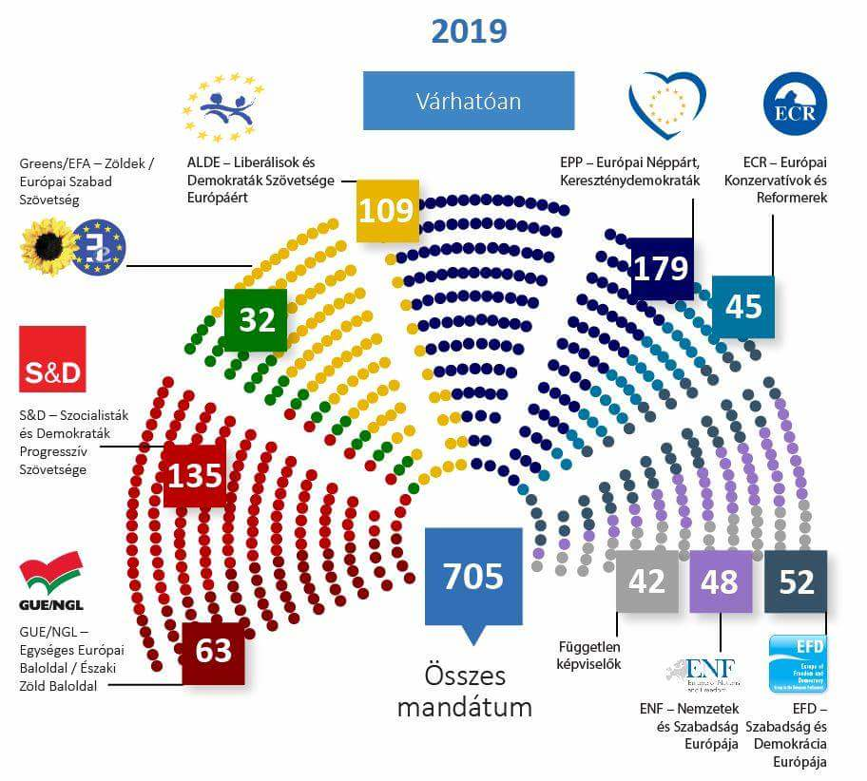
European Union: 2018/2019 context
Notes:
Biogeographical regions in the EU

Slide 3
Cleavages in the EU
Right – Left?
Material – Post-material?
Euroscepticism – Euro-optimism?
East – West?

Slide 4
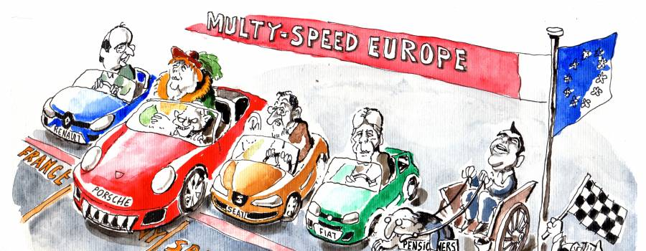
United or multi-tiered EU?
Eurozone post-crisis governance
Financial framework 2020-2026
Migration crisis and the disputes over values and principles
Perspective of further enlargement
Perspective of institutional changes
Finalité or muddling-through?

Slide 5
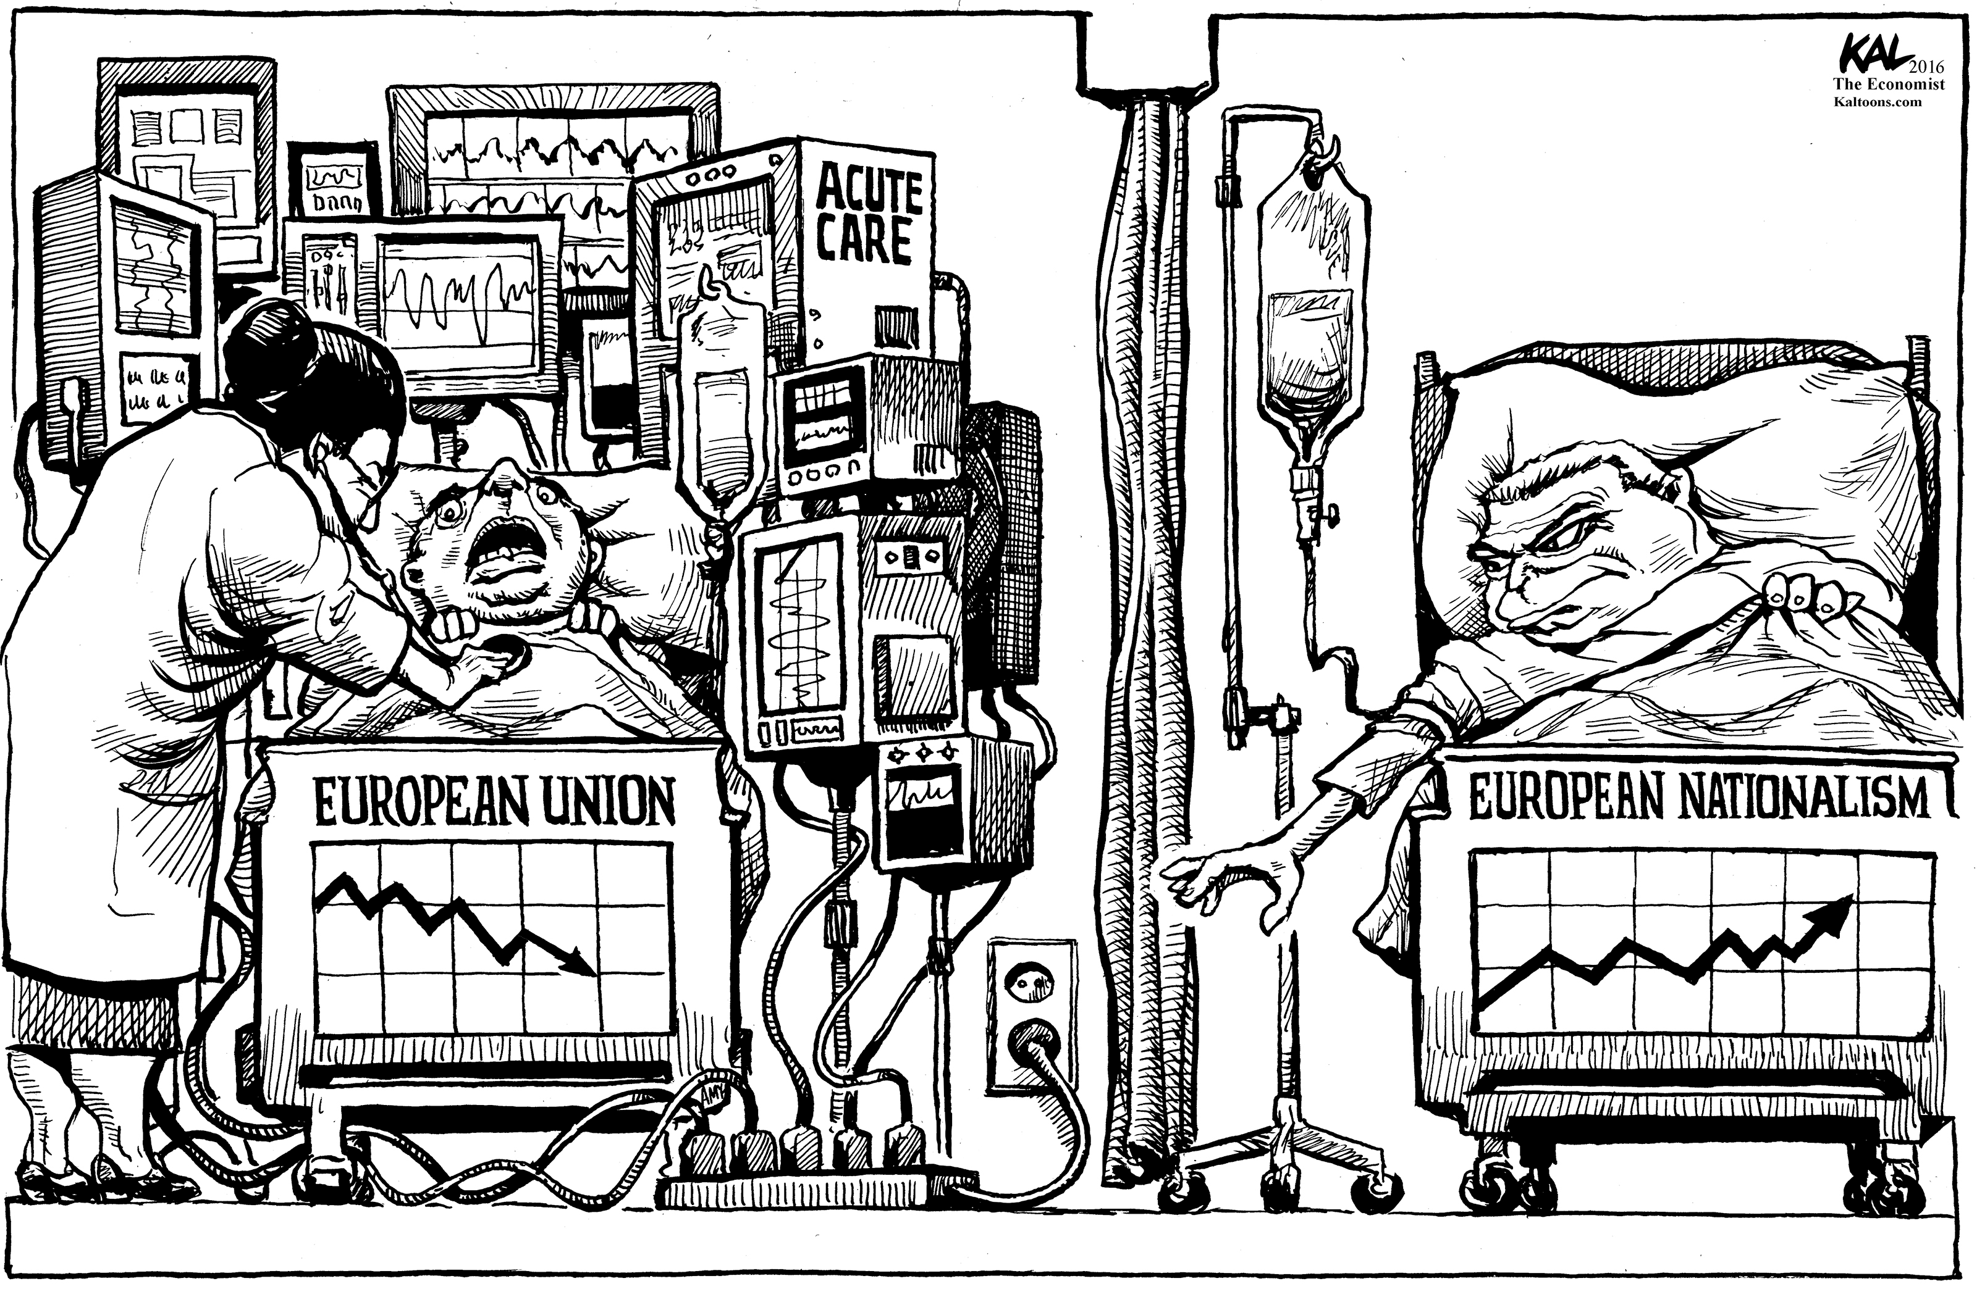
Scenarios of the EU future
White Paper drafted by Juncker’s Commission:
https://ec.europa.eu/commission/sites/beta-political/files/white_paper_on_the_future_of_europe_en.pdf
Notes:
Page 7, page 29 (annex 2)

Slide 6
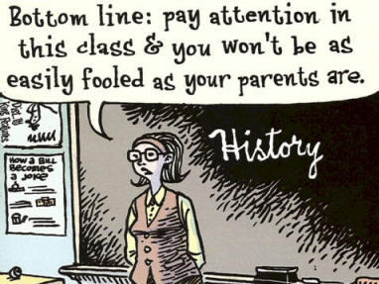
Wrap-up of the course
How did you like the focus of the course?
How did you like the structure of the course?
Do you think some assigned readings shall be replaced?
Do you think some lectures shall be changed or modified in a substantial way?
Would you like to have some seminars in a course like this?
If so, what would you expect to do in the seminars?

Slide 7
Thank you for your attention! Katerina and Vit wish you sincerely a successful exam period!
http://masarykuniversity.blogspot.com/2015/05/a-sort-of-guide-to-exam-period.html

