Slide 1
African solutions to African problems – AU capacities in peacekeeping exemplified by AMISOM
William Avery
Crisis Management Operations
November 26th, 2019

Slide 2
African Union
Formed 2002
55 member states
AU Parliament & Assembly
AU Commission
African Standby Force
AU Peace Fund
AU Peace & Security Council
“An integrated, prosperous and peaceful Africa, driven by its own citizens and representing a dynamic force in global arena.”
Notes:
OAU predecessor 1964-1999, 32 countries, focused on post colonial sovereignty grew into the AU – goal of strengthening & security, much like EU

Slide 3
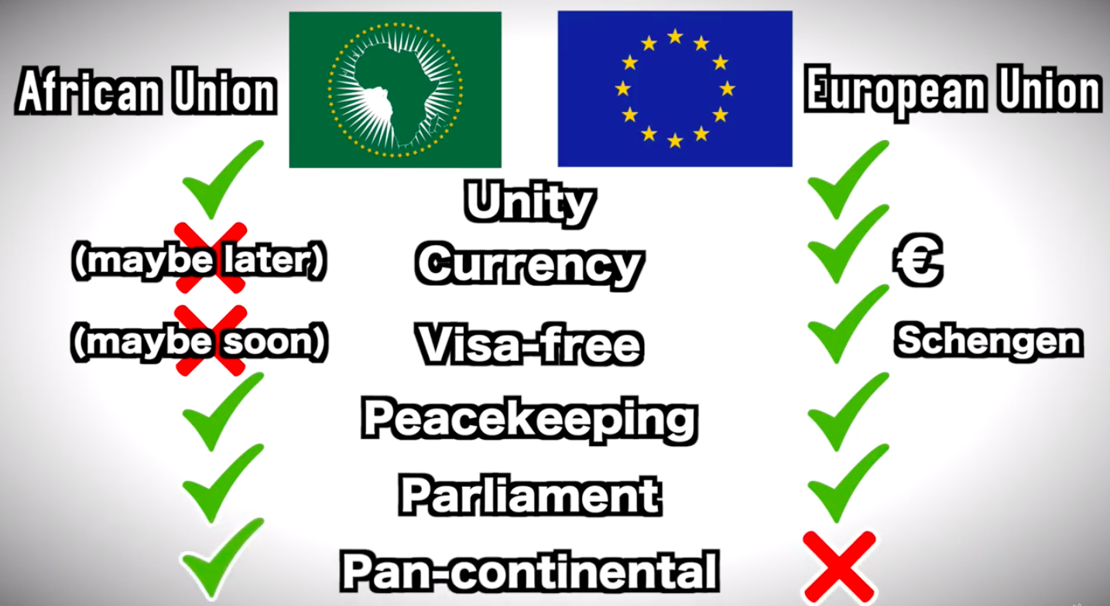
Notes:
Both promote Unity & Economic prosperity, single currency rumored by 2023 even a potential African Union Passport, PKOs in Darfur, Somalia, Burundi

Slide 4
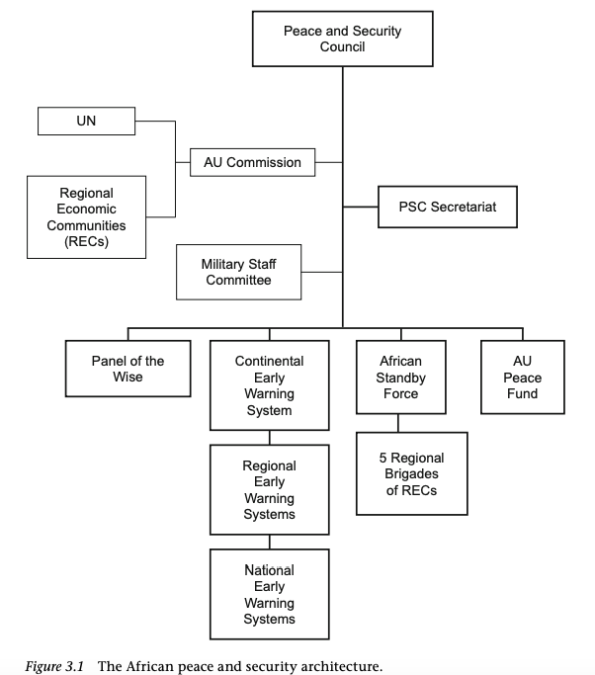
Notes:
works within UN framework - Mention EWS, ASF (5 brigades from all regions never been used much like EU battlegroups) & Fund which lacks resources 6% yearly contribution EU help AMIB mission only got 27%

Slide 5

As per the UN Security Council Resolution 2372(2017) AMISOM is mandated to pursue the following strategic objectives:
Enable the gradual handing over of security responsibilities from AMISOM to the Somali security forces contingent on abilities of the Somali security forces and political and security progress in Somalia;
Reduce the threat posed by Al-Shabaab and other armed opposition groups;
Assist the Somali security forces to provide security for the political process at all levels as well as stabilization, reconciliation and peace building in Somalia
Launched 2007 - 22000 total personnel
Notes:
Why Somalia? Years of civil war & unrest, warlords, over 30000 UN troops in Somalia in the 1990s mention TFG & Al SHabaab

Slide 6
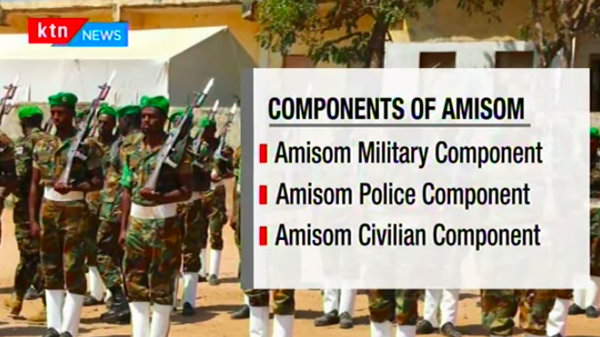

Slide 7
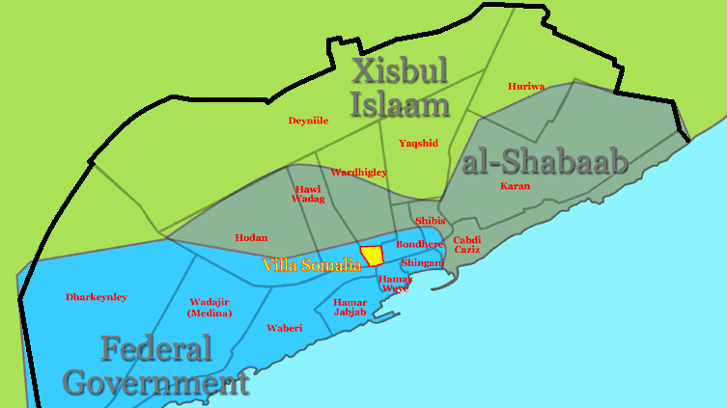
Military Component
Comprised of troops from Uganda, Burundi, Djibouti, Kenya and Ethiopia who are deployed in sectors covering south and central Somalia.
Transformation of Mogadishu after the Battle of Mogadishu (2010–11)
Notes:
Mogadishu has had 8 battles – Black Hawk Down, UN failed missions and withdrawal, Mogadishu now thriving – now operate international airlines

Slide 8
Police Component
Goal is fully self-sustainable Somali security force
AMISOM has provided support for screening, vetting, recruiting, training and mentoring the police at both the federal and state levels.
Specialized training for the Somali Police Force on investigations, anti-terrorism and counter-insurgency.
Notes:
First officers arrive 2010, not effective until after liberation of Mogadishu

Slide 9
Civilian Component
Mission Support
Political Processes
Stabilisation and Early Recovery
Protection, Human Rights and Gender
Security Sector Reform
Notes:
implementation of the AMISOM mandate, implementation of the country’s National Security and Stabilization Plan, restoration of governance & infrastructure, support to the disarmament, demobilization and reintegration of armed groups, facilitate the delivery of humanitarian aid

Slide 10
Future of AMISOM & AU
2016 Parliamentary Elections first since 1984
Transitional Federal Government (TFG) -> Federal Government of Somalia (FGS)
Current mandate expires on 31 May 2020
Reduction of troop levels to a maximum of 19,626 by 28 February 2020.
Africa-China relations?
Notes:
FGS today has international recognition – part of the mandate, free & fair elections, today still occasional firefights but AMISOM has certainly done better than UN missions

Slide 11
Sources
Isiaka A Badmus, The African Union’s Role in Peacekeeping : Building on Lessons Learned from Security Operations (Basingstoke ; New York (N.Y.): Palgrave Macmillan, , Cop, 2015), 84–111.
KTN News Kenya, “The Story of AMISOM in Somalia, Has It Achieved Its Mandate? (Part 1) |ENDGAME SOMALIA,” YouTube Video, YouTube, August 12, 2019, https://www.youtube.com/watch?v=U6APamAx5ig.
United Nations Security Council, “Resolution 2472 (2019),” Undocs.org, 2019, https://undocs.org/S/RES/2472(2019).
Ticket To Know, “The African Union Explained,” YouTube Video, YouTube, May 16, 2019, https://www.youtube.com/watch?v=i6q0gIxg3Mc.
“AMISOM Military Component - AMISOM,” AMISOM, 2016, http://amisom-au.org/mission-profile/military-component/.
“AMISOM Civilian Component - AMISOM,” AMISOM, 2016, http://amisom-au.org/mission-profile/amisom-civilian-component/.
“AMISOM Mandate - AMISOM,” AMISOM, 2016, http://amisom-au.org/amisom-mandate/.
Paul D. Williams, “Assessing the Effectiveness of the African Union Mission in Somalia (AMISOM)” (Norwegian Institute of International Affairs, 2018).

