Slide 1
The cooperation between EU and NATO: The case of the EU’s military operation Althea in Bosnia and Herzegovina
Júlia Močaryová

Slide 2
Hypothesis
“European Union, after consolidating its position as a normative power in Europe and expanding to the Central Europe, now took a chance in Bosnia and Herzegovina to prove their military independence from US-led NATO with the brand new, although still not polished Common Security Defence Policy.“

Slide 3
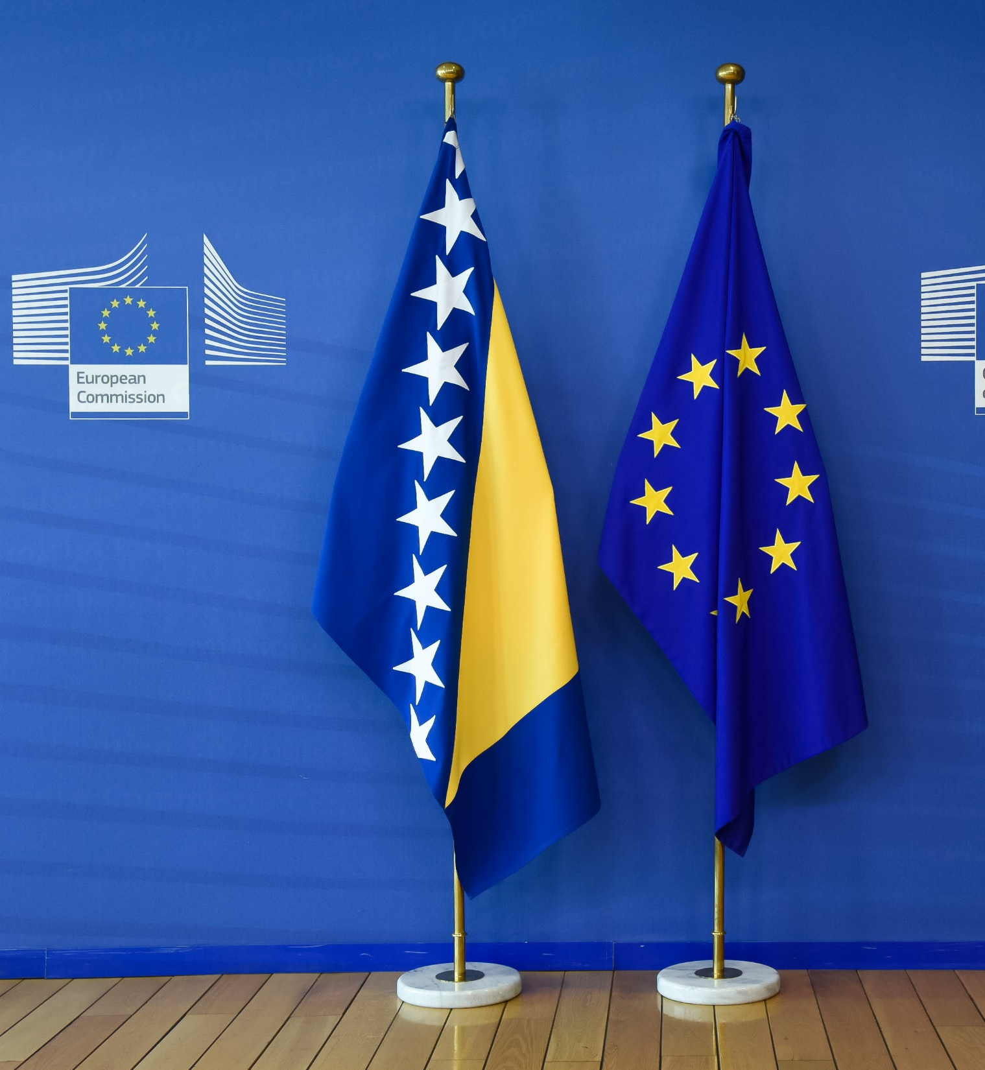
History in short
“Powder keg“ of the 90’s
Dayton accords 1995
NATO involvement alongside the UN
Path to operation ALTHEA
→ Berlin Plus
→ Common Security Defense Policy

Slide 4
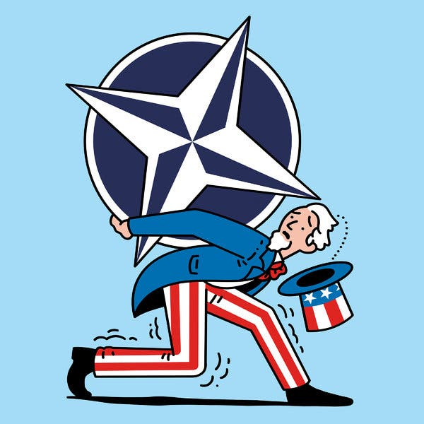
Clash of the Unions
NATO (US) involvement
EU involvement

Slide 5
EU and NATO cooperation
Complications due to outdated agreement
EU takes the wheel
The limitations of the CSDP (social vs military)

Slide 6
So what is it, then?
EU is not trying to prove anything (or is it?)
CSDP big step and complicated still
Bosnia as a possible member

Slide 7
What do you think?
Was EU trying to demonstrate that it can tie its own shoes with operation ALTHEA?
Does it hinder the cooperation between the two?
Is EU (and will it ever will be) capable of military independence?
Can we call the operation a success if it still continues to this day?

