Slide 1

The odd position of NATO in Libya – what is done under the NATO umbrella and what not?
Mauricio Eduardo Userralde Bustamante

Slide 2
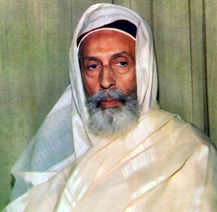
Background – King Idris
King Idris, the only Libyan King for 18 years
Became King in 1949 after UN Resolution
Idris allowed American and British military bases in exchange for development funds
Oil was discovered in 1959

Slide 3
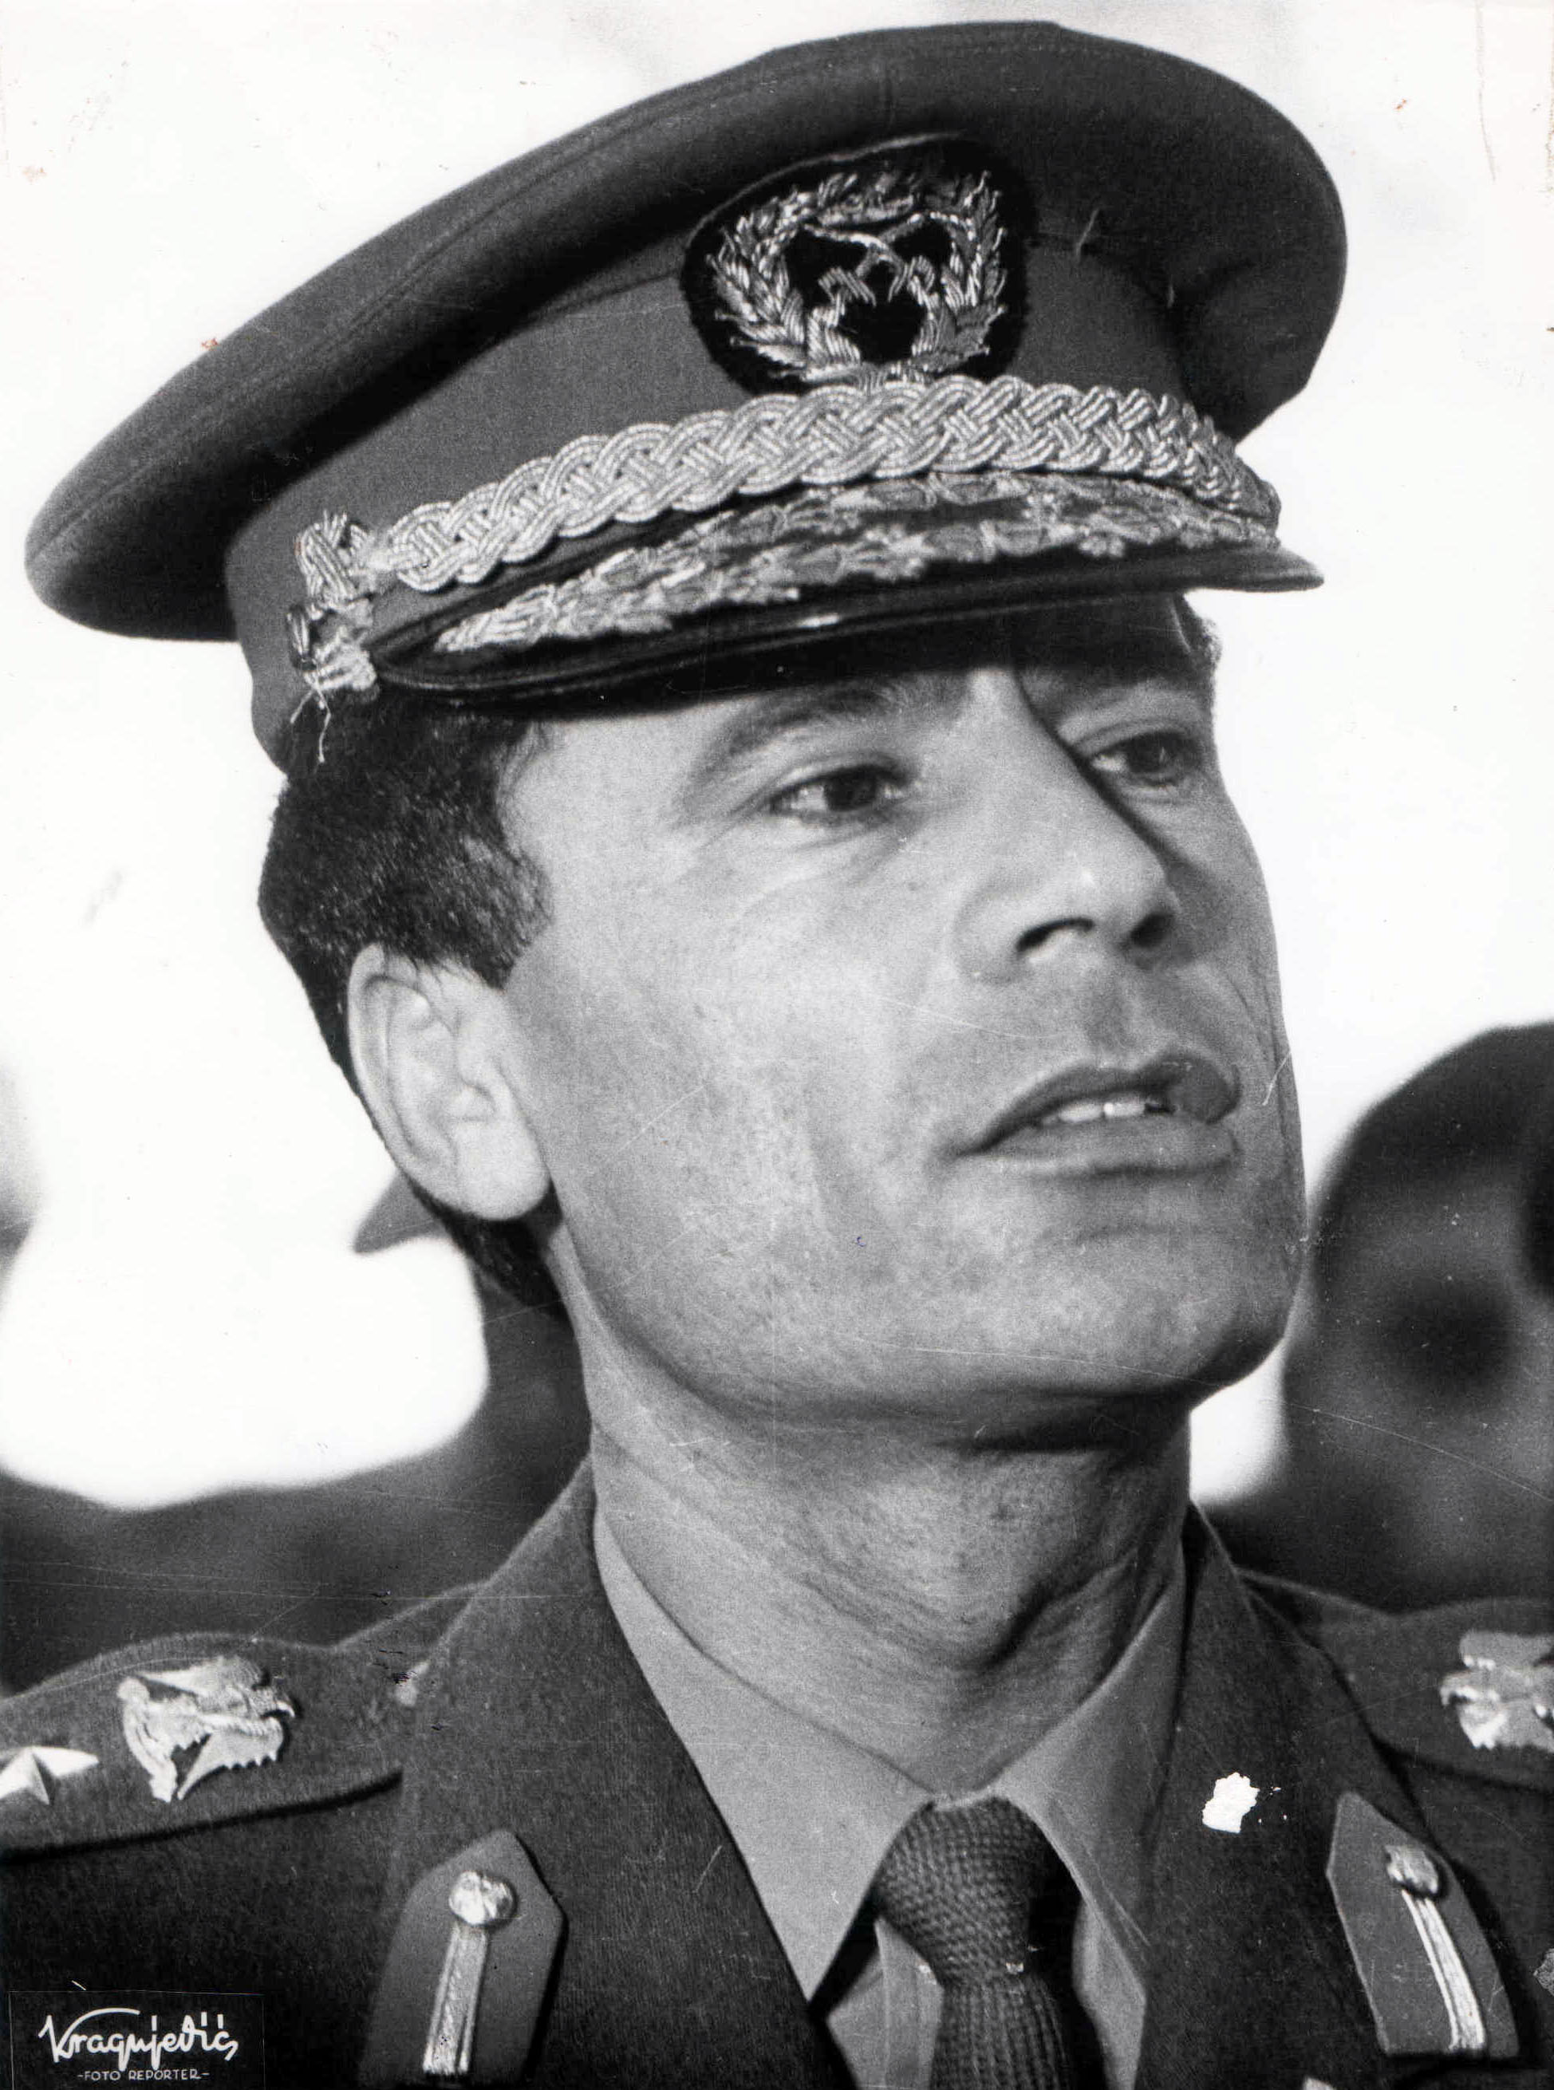
Kingdom overthrown by young Gaddafi
King Idris becomes ill and leaves command of the throne to his nephew
26 year old military official Gaddafi leads the revolution
Gaddafi becomes Libya´s Leader in 1969
For the first time, the Libyan identity is created

Slide 4
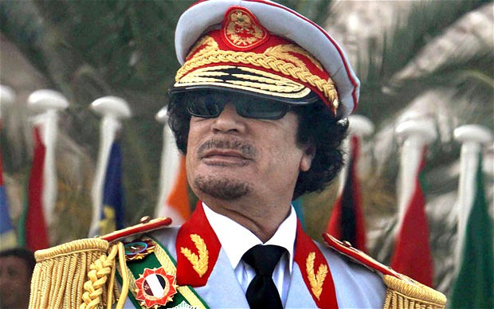
Gadaffi rule
Governed Libya for 42 years
His revolutionary ideas were not liked by the West
Pro African and Pro Arab
Supreme role in Northern Africa (South Sahara, Chad)

Slide 5
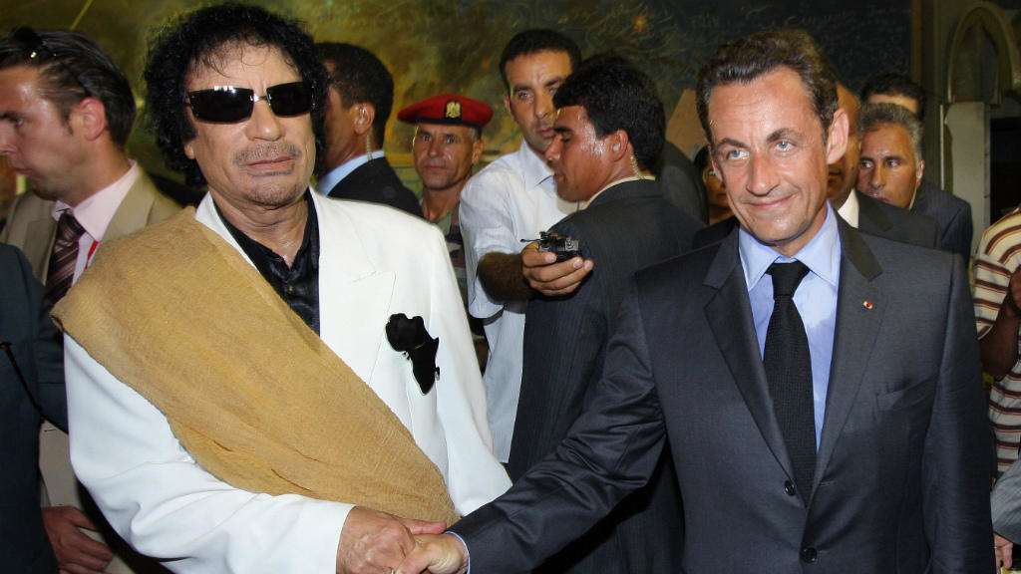
Libya prior to the conflict
Diplomatic relations with UK re-established in 1999
Restrictive trade measures removed by EU later
Libya joined WTO in 2004
State visits to the West started

Slide 6
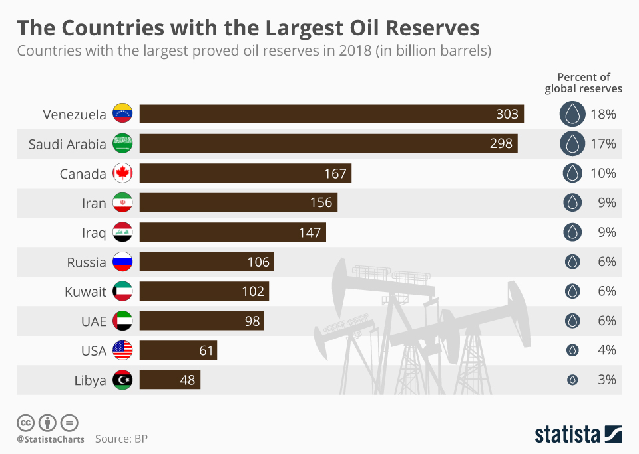
Libya prior to the conflict
35.000 million USD investment plan with 40% for foreign capital
16.000 GDP per capita in 2009
Top Africa´s growth UNDP, behind Arab Emirates

Slide 7
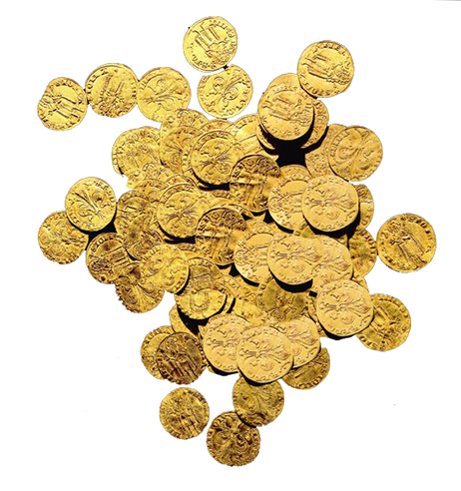
Gadaffi´s gold dinar plan
Creation of a true gold currency
Oil exports must be paid in gold dinar instead of USD
Libya had 143 tons of gold reserves
Gaddafi wanted the currency to be in all Africa

Slide 8
Hillary Clinton´s leaked emails about Libya and Sarkozy
"Qaddafi's government holds 143 tons of gold, and a similar amount in silver ... This gold was accumulated prior to the current rebellion and was intended to be used to establish a pan-African currency based on the Libyan golden Dinar. This plan was designed to provide the Francophone African Countries with an alternative to the French franc (CFA).

Slide 9
"According to knowledgeable individuals this quantity of gold and silver is valued at more than $7 billion. French intelligence officers discovered this plan shortly after the current rebellion began, and this was one of the factors that influenced President Nicolas Sarkozy's decision to commit France to the attack on Libya. According to these individuals Sarkozy's plans are driven by the following issues:
1. A desire to gain a greater share of Libya oil production,
2. Increase French influence in North Africa,
3. Improve his internal political situation in France,
4. Provide the French military with an opportunity to reassert its position in the world,
5. Address the concern of his advisors over Qaddafi's long term plans to supplant France as the dominant power in Francophone Africa.”

Slide 10
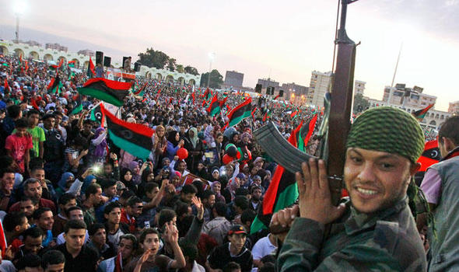
Arab Spring
After Tunisia protests, Libyan Arab spring started in February 2011
Libyan government stated that the rebellion was led by Islamic Groups, by which they justified their policy against them

Slide 11
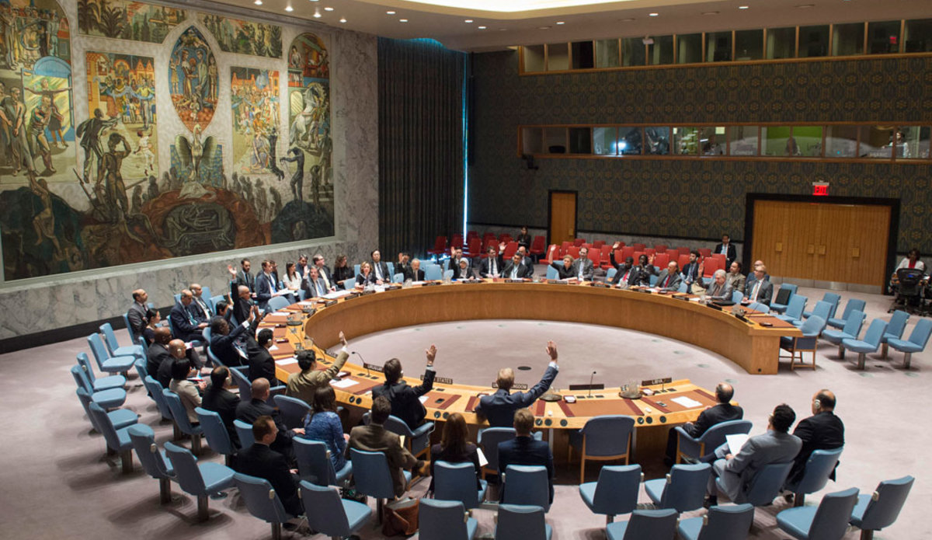
UN SC Resolution
1970
February 26, 2011 the resolution is passed by UN SC
Demanding end to violence
Negotiations between government and rebels
Arms embargo
Sanctions on political elite

Slide 12
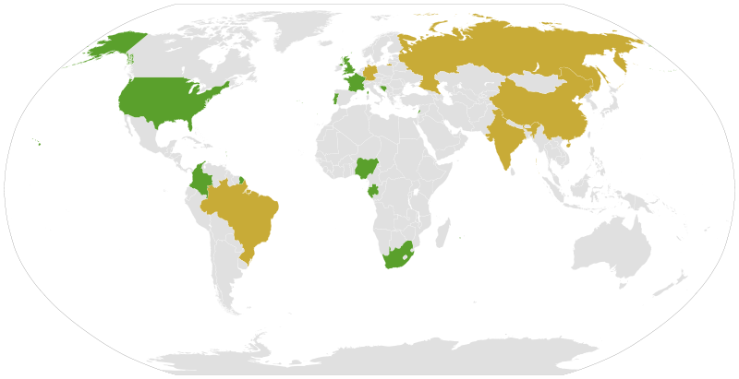
UN Resolution 1973
Proposed by UK, France and Lebanon. Rebels were almost defeated.
Passed on March 2011 with 10 votes and 5 abstentions

Slide 13




UN Resolution 1973
Operation Unified Protector
Embargo on arms import
No-Fly zone
Protection of civilians
Restriction of bank accounts

Slide 14

Article 42 UN Charter
“Should the Security Council consider that measures provided for in Article 41 would be inadequate or have proved to be inadequate, it may take such action by air, sea, or land forces as may be necessary to maintain or restore international peace and security”

Slide 15
UN SC 1973 Resolution | Done by NATO or members
Arms embargo | Airstrikes in infrastructure
No-fly zone | Bombing Gaddafi palaces
Protection of civilians | Military training to rebels
Restriction of bank account | Arm supplies to rebels (France)
 | Removing Gaddafi (declared by Obama, Cameron and Sarkosy)
 | Not action upon rebels killing civilians
 | Bombing Brega water-pipes factory (Source of ManMade river)

Slide 16
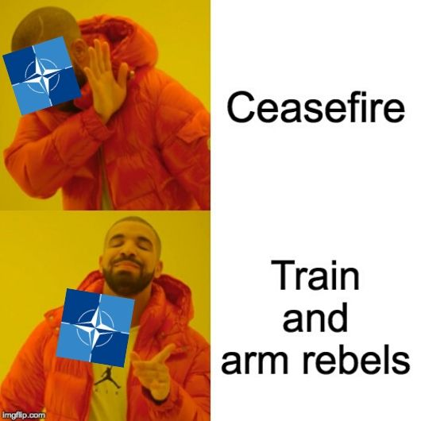
NATO´s denied offers for ceasefires and negotiations
Venezuela offered to mediate
Gaddafi accepted, rebels declined
African Union proposal for ceasefire and dialogue
Gaddafi accepted, NATO declined
Gaddafi offered ceasefire and constitutional government
NATO declined

Slide 17
Outcomes of Operation Unified Protector
Gaddafi was captured and killed 20th of October 2011
NATO left Libya 31st of October
Interim government was established and elections later
Lack of post-conflict reconstruction
Only 14 NATO Members engaged militarily

Slide 18

https://create.kahoot.it/share/natos-intervention-in-libya/6c432c91-1ff2-4b21-bbf2-b781b705fafd

