Slide 1
Comparison of political systems

Slide 2
Historical overview of political changes
Italy
France
liberal monarchy 1861-1922
Fascist dictatorship 1922-1943/5
First republic 1943/6-1992/3/4
Second republic 1992/3/4 onwards
Third republic 1871/5-1940
German occupation / Vichy 1940-1944
Fourth republic 1946-1958
Fifth republic 1958/9/62 onwards

Slide 3
Parliamentary democracy versus semi-presidential democracy
government
Parliament
Head of state
Head of state
government
Parliament
Voters
Voters

Slide 4
Maurice Duverger on semi-presidentialism
A political regime is considered as semi-presidential if the constitution which established it combines three elements:
The president of the republic is elected by universal suffrage;
he possesses quite considerable powers;
he has opposite him, however, a prime minister and ministers who possess executive and governmental power and can stay in office only if the parliament does not show its opposition to them.

Slide 5
Presentation on powers of Italian President

Slide 6
Presentation on powers of French President

Slide 7
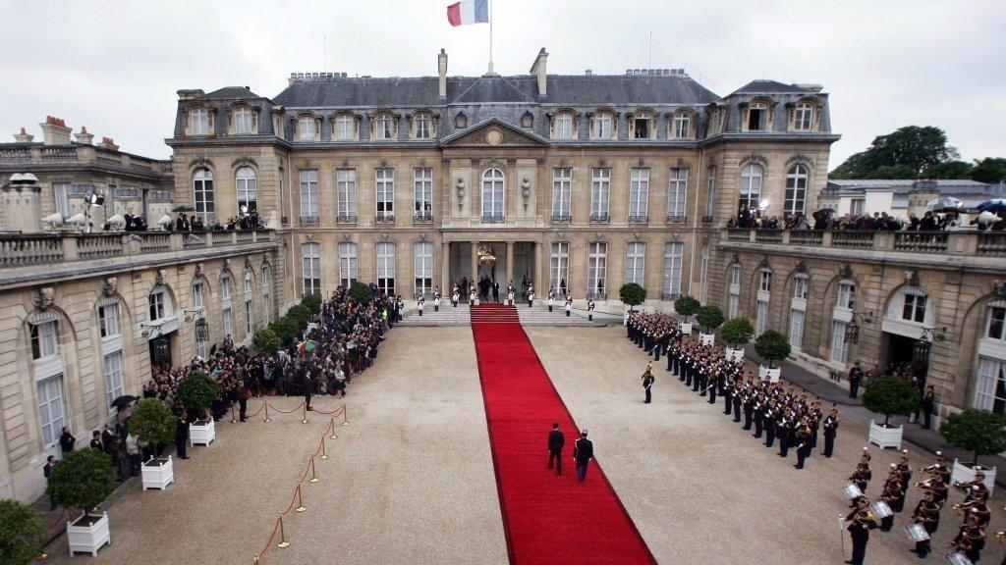
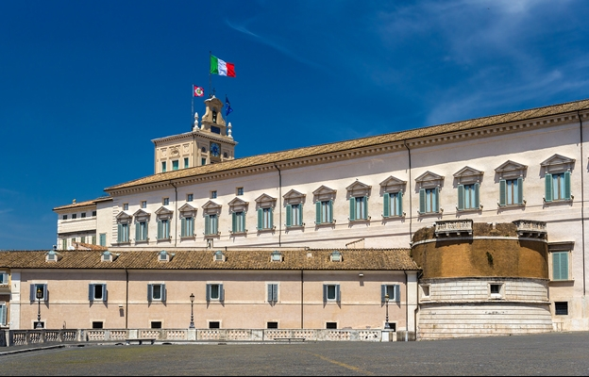
Heads of state: A comparison
A way of election?
Electoral period?
Executive role?
Representative role?
Palais de l'Élysée
Polarising element – Chirac versus Jean-Marie Le Pen (2002), Macron vs Marine Le Pen (2017)
Quirinale

Slide 8
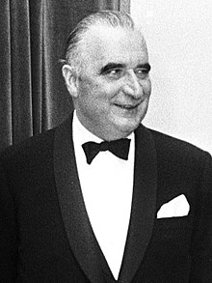
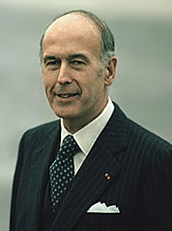
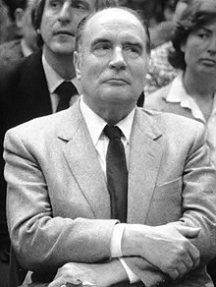
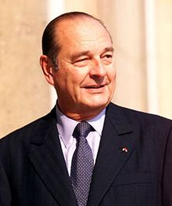
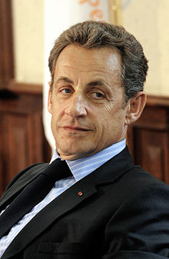
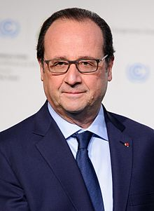
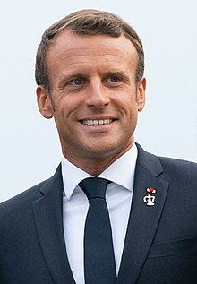
Presidents of the 5th Republic
Charles de Gaulle 1959-1969
Georges Pompidou 1969-1974
Valéry Giscard d'Estaing 1974-1981
François Mitterrand 1981-1995
Jacques Chirac 1995-2007
Nicolas Sarkozy 2007-2012
François Hollande 2012-2017
Emmanuel Macron 2017 onwards

Slide 9
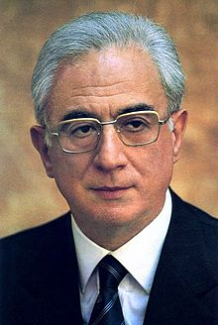
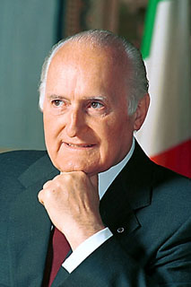
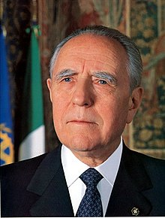
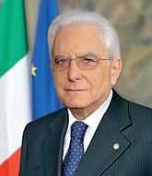
Italian Presidents if the current era
Francesco Cossiga 1985-92
Oscar Luigi Scalfaro 1992-1999
Carlo Azeglio Ciampi 1999-2006
Giorgio Napolitano 2006-2015
Sergio Mattarella 2015 onwards

Slide 10
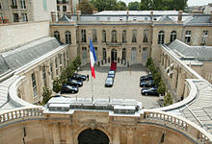
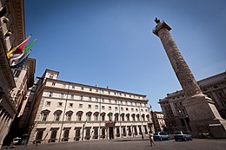
Governments
France
Italy
Hôtel Matignon
Coalition governments?
Single party governments?
https://en.wikipedia.org/wiki/Second_Philippe_government
Impact of President
Cohabitation – Chirac vs Mitterrand 1986-1988, Balladur vs Mitterrand 1993-1995, Jospin versus Chirac 1997-2002
Pallazo Chigi
Coalition governments more typical
More ministers being “experts” from beyond of the parliament
Berlusconi (2001-2006), Prodi (2006-2008), Berlusconi (2008-2011), Letta (2013-2014 grand coalition), Renzi (2014-2016), Gentiloni (2016-2018), Conte (2018-2019)
Governo dei tecnici
Monti (2011-2013)

Slide 11
Parliaments
Parlement français
Parlamento della Repubblica Italiana
Asymmetrical bicameralism
National Assembly
Assemblée nationale
Vote of (non)confidence
Can be dissolved by President
Agenda still dominated by proposal made by gvt.
Senate 348 seats
Sénat
NA stronger
Strong powers in legislation process
commission mixte paritaire
Symmetrical bicameralism
House of Deputies 630 seats
Camera dei deputati
Senate 315 seats
Senato della Repubblica
“Dribbling” (navette) of legislative proposal between these two chambers to agree on a law

Slide 12
Electoral systems
France
Italy
President
Directly, runoff system
Lower house
Modified runoff system, single member constituencies
Upper house
Indirect elections by 150,000 "grands électeurs")
regional councilors
department councilors
Mayors
municipal councilors
members of the National Assembly
Rural areas overrepresented
President
Indirectly by electoral college = both chambers of parliament
Rosatellum bis
Lower house + Upper house
31 per cent FPTP
61 per cent PR (one district, 3 per cent threshold)
The rest reserved for Italians living abroad
Some Senators appointed for life
Politics of electoral reforms since 1992

Slide 13
Constitutional courts
Conseil constitutionnel
Corte costituzionale
Ex-ante and ex-post examination of bills
So-called organic bills (government, treaties) must be assessed before being passed
Former Presidents + 9 members elected for 9 years
“Consulta”
Competence includes solving of controversies state-regions / regions-regions
15 judges appointed for 9 years
“Clean Hands”, Berlusconi= s trials and (limited) judicialisation of Italian politics

Slide 14
Regionalism in Italy

Slide 15
Regionalism in France

Slide 16
Thank you for your attention, political parties are the next topic

