Slide 1
Current French and Italian Societies

Slide 2
Regions and regionalism

Slide 3
Italian regionalism
Regions with “a special statute”:
Valle d’Aosta (Aosta Valley)
Trentino-Alto Adige (Trentino – South Tyrol)
Sardegna (Sardinia)
Friuli – Venezia Giulia
Sicilia (Sicily)
Plus other 15 “regions with ordinary statute” since the 1970
Notes:
1948, 1970, 1997-8 failed federalization, 2001 regions reinforced

Slide 4
Economic disparities in the contemporary Italy

Slide 5
Trend of electoral support for the Lega (Nord)

Slide 6
Regions in France
Notes:
As mentioned, each region in France is further divided into departments. While the current departments remain unchanged for the moment, the territorial reform provides that any given department can change regions under the droit d’option.
Of the new 13 regions in the new map of France, only seven experienced changes to the previously existing distribution.
The regions that changed are:
Grand-Est (Alsace, Champagne-Ardenne and Lorraine)
Nouvelle-Aquitaine (Aquitaine, Limousin and Poitou-Charentes)
Auvergne-Rhône-Alpes
Bourgogne-Franche-Comté
Occitanie (Languedoc-Roussillon and Midi-Pyrénées)
Hauts-de-France (combining Nord-Pas-de-Calais and Picardie)
Normandie (combining Basse-Normandie and Haute-Normandie)
The other 6 regions stay just as they were before:
Bretagne
Corse
Centre
Île-de-France
Pays de la Loire
Provence-Alpes-Côte d’Azur

Slide 7
Economics

Slide 8
Comparison of French and Italian basic economic trends

Slide 9
Basic survey based on OECD
https://data.oecd.org/italy.htm
https://www.oecd.org/economy/italy-economic-snapshot/
https://data.oecd.org/france.htm
http://www.oecd.org/economy/france-economic-snapshot/

Slide 10
Real GDP growth rate (Eurostat)
 | 2008 | 2009 | 2010 | 2011 | 2012 | 2013 | 2014 | 2015 | 2016 | 2017 | 2018
EU28 | 0.5 | -4.3 | 2.2 | 1.8 | -0.4 | 0.3 | 1.7 | 2.3 | 2.0 | 2.6 | 2.0
Euroarea | 0.4 | -4.5 | 2.1 | 1.7 | -0.9 | -0.2 | 1.4 | 2.1 | 1.9 | 2.5 | 1.9
F | 0.3 | -2.9 | 1.9 | 2.2 | 0.3 | 0.6 | 1.0 | 1.1 | 1.1 | 2.3 | 1.7
I | -1.0 | -5.3 | 1.7 | 0.7 | -3.0 | -1.8 | 0.0 | 0.8 | 1.3 | 1.7 | 0.8
D | 1.0 | -5.7 | 4.2 | 3.9 | 0.4 | 0.4 | 2.2 | 1.7 | 2.2 | 2.5 | 1.5
UK | -0.3 | -4.2 | 1.9 | 1.5 | 1.5 | 2.1 | 2.6 | 2.4 | 1.9 | 1.9 | 1.4
E | 0.9 | -3.8 | 0.2 | -0.8 | -3.0 | -1.4 | 1.4 | 3.8 | 3.0 | 2.9 | 2.4
NL | 2.2 | -3.7 | 1.3 | 1.6 | -1.0 | -0.1 | 1.4 | 2.0 | 2.2 | 2.9 | 2.6
CZ | 2.7 | -4.8 | 2.3 | 1.8 | -0.8 | -0.5 | 2.7 | 5.3 | 2.5 | 4.4 | 3.0

Slide 11
GDP per capita in PPS (Eurostat)
 | 2008 | 2009 | 2010 | 2011 | 2012 | 2013 | 2014 | 2015 | 2016 | 2017 | 2018
EU27 | 100 | 100 | 100 | 100 | 100 | 100 | 100 | 100 | 100 | 100 | 100
Euroarea | 109 | 109 | 108 | 108 | 108 | 107 | 107 | 107 | 107 | 106 | 106
F | 106 | 108 | 108 | 108 | 107 | 108 | 107 | 106 | 104 | 104 | 104
I | 106 | 106 | 104 | 104 | 101 | 98 | 96 | 95 | 97 | 96 | 95
D | 117 | 117 | 120 | 123 | 124 | 124 | 126 | 124 | 124 | 124 | 123
UK | 110 | 108 | 108 | 106 | 108 | 108 | 109 | 109 | 107 | 106 | 104
E | 101 | 100 | 96 | 92 | 91 | 89 | 90 | 91 | 91 | 92 | 91
NL | 140 | 138 | 135 | 134 | 134 | 135 | 131 | 130 | 128 | 128 | 129
CZ | 84 | 85 | 83 | 83 | 82 | 84 | 86 | 87 | 88 | 89 | 90

Slide 12
Unemployment as percentage of active population (Eurostat)
 | 2009 | 2010 | 2011 | 2012 | 2013 | 2014 | 2015 | 2016 | 2017 | 2018
EU27 | 9.2 | 9.9 | 9.9 | 10.9 | 11.4 | 10.9 | 10.1 | 9.1 | 8.2 | 7.3
Euroarea | 9.6 | 10.1 | 10.2 | 11.4 | 12.0 | 11.6 | 10.9 | 10.0 | 9.1 | 8.2
F | 9.1 | 9.3 | 9.2 | 9.8 | 10.3 | 10.3 | 10.4 | 10.1 | 9.4 | 9.1
I | 7.7 | 8.4 | 8.4 | 10.7 | 12.1 | 12.7 | 11.9 | 11.7 | 11.2 | 10.6
D | 7.6 | 7.0 | 5.8 | 5.4 | 5.2 | 5.0 | 4.6 | 4.1 | 3.8 | 3.4
UK | 7.6 | 7.8 | 8.1 | 7.9 | 7.5 | 6.1 | 5.3 | 4.8 | 4.3 | 4.0
E | 17.9 | 19.9 | 21.4 | 24.8 | 26.1 | 24.5 | 22.1 | 19.6 | 17.2 | 15.3
NL | 4.4 | 5.0 | 5.0 | 5.8 | 7.3 | 7.4 | 6.9 | 6.0 | 4.9 | 3.8
CZ | 6.7 | 7.3 | 6.7 | 7.0 | 7.0 | 6.1 | 5.1 | 4.0 | 2.9 | 2.2

Slide 13
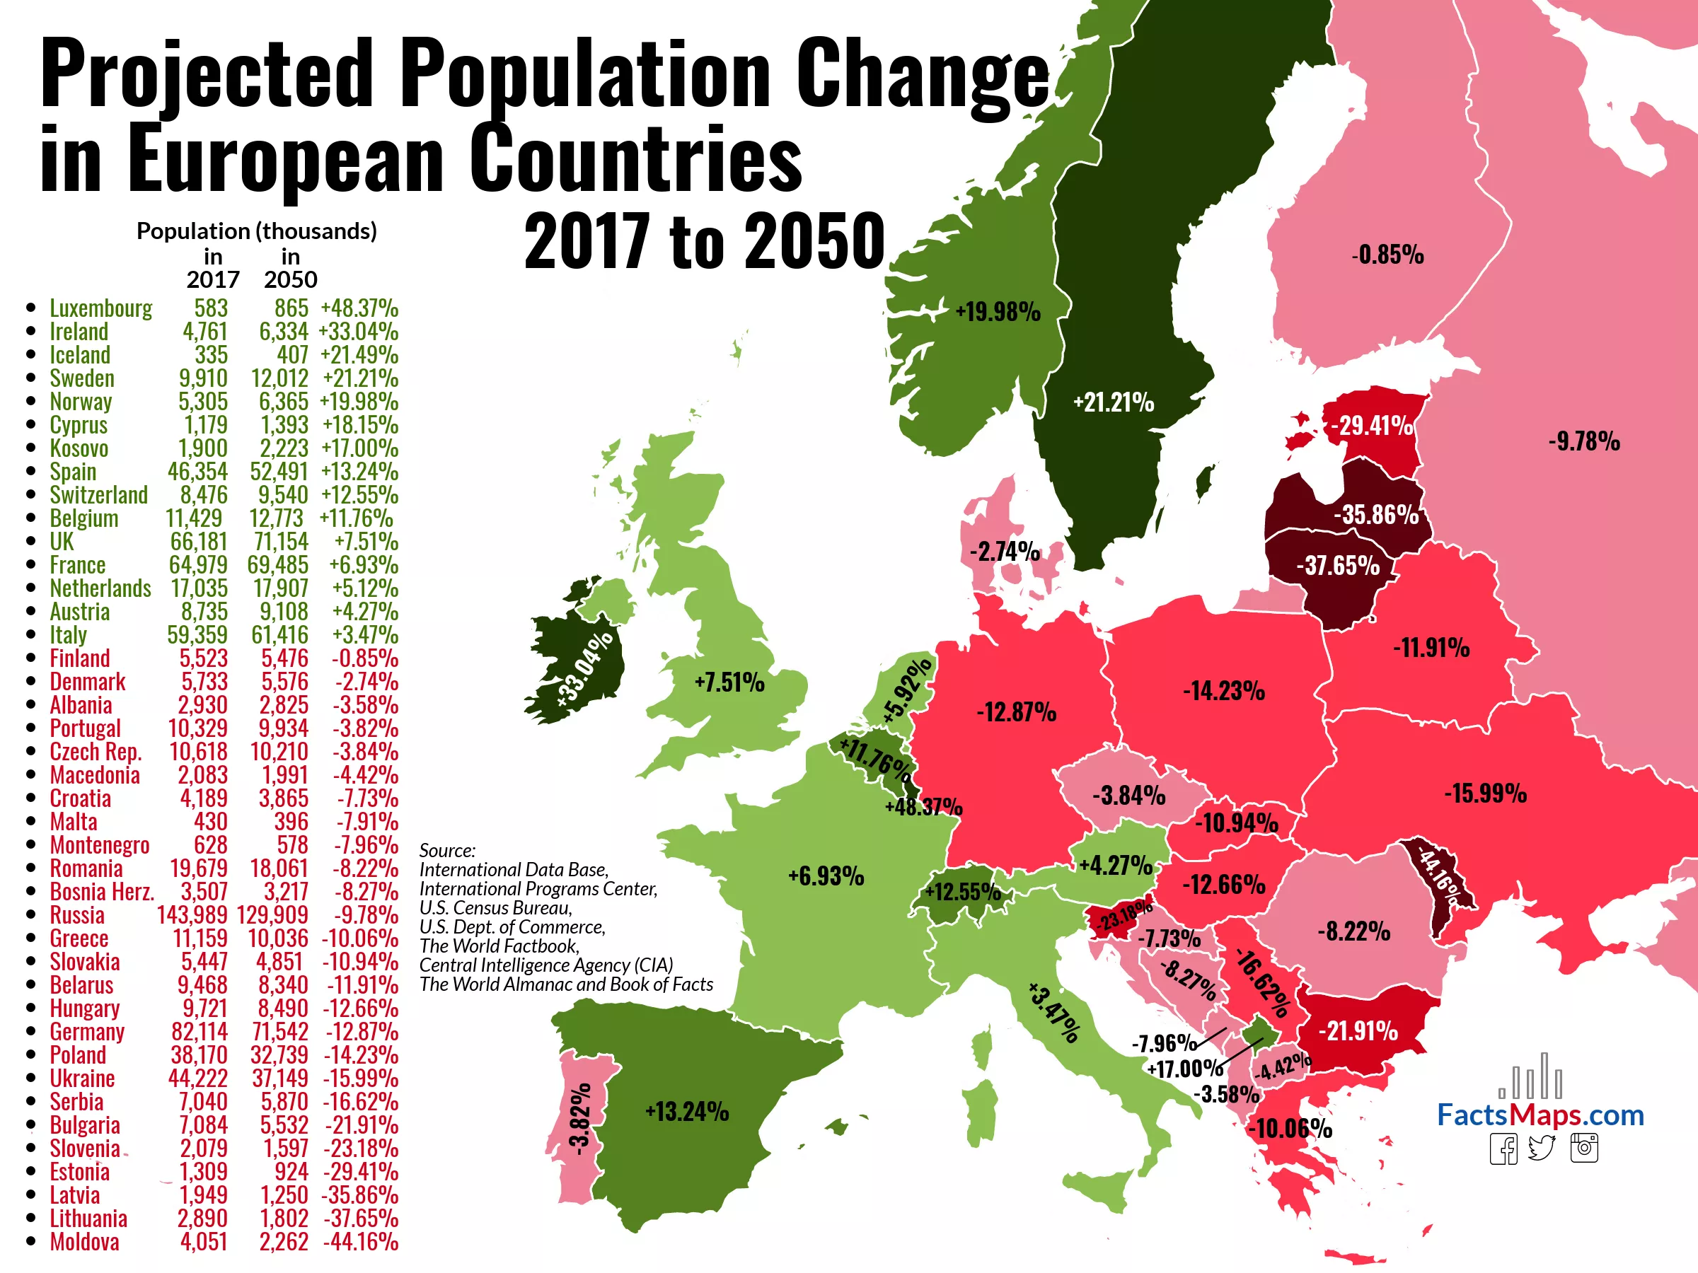
Population

Slide 14
Comparison of French and Italian basic demographic trends

Slide 15
Population (2019): Some comparison
France
Italy
67 million
8.2 million foreign born
13.1 per cent of the EU28
19.7 per cent of the population older than 65
18.1 per cent of the population younger than 14
60 million
6.2 million foreign born
11.8 per cent of the EU28
22.6 per cent of the population older than 65
13.4 per cent of the population younger than 14

Slide 16
Tertiary education
https://data.oecd.org/eduatt/population-with-tertiary-education.htm
https://data.oecd.org/eduresource/education-spending.htm
https://data.oecd.org/youthinac/youth-not-in-employment-education-or-training-neet.htm

Slide 17
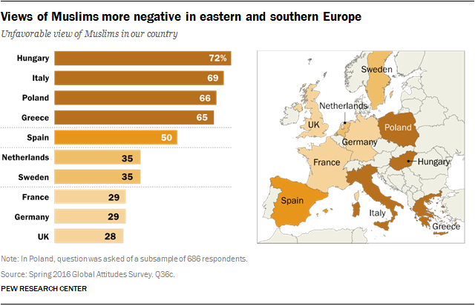
Muslim population

Slide 18
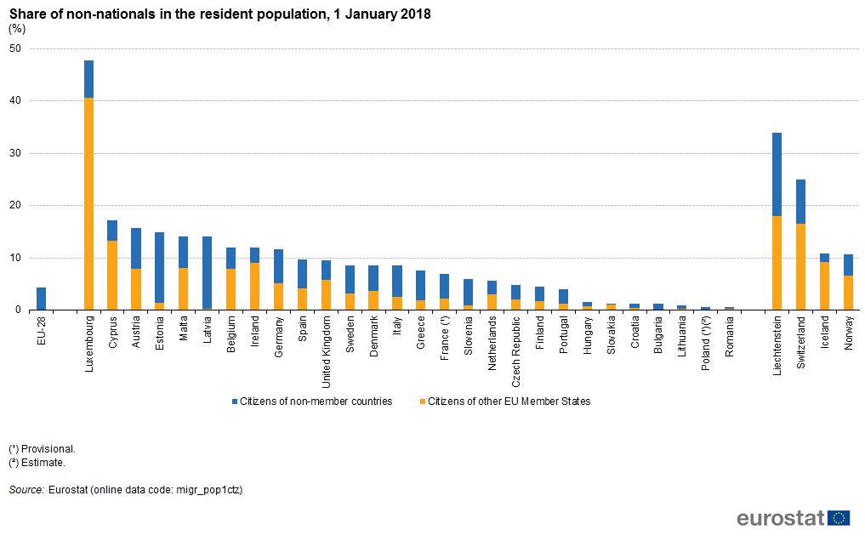
Migration
https://ec.europa.eu/eurostat/statistics-explained/index.php/Migration_and_migrant_population_statistics
https://ec.europa.eu/eurostat/en/web/products-datasets/-/MIGR_IMM4CTB

