Slide 1
Current French Politics

Slide 2
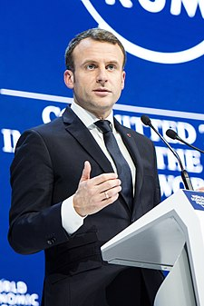
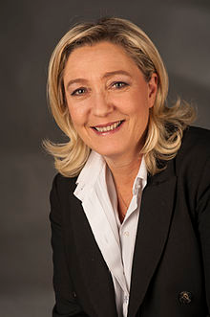
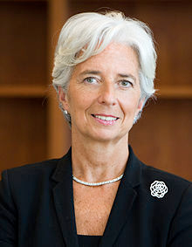
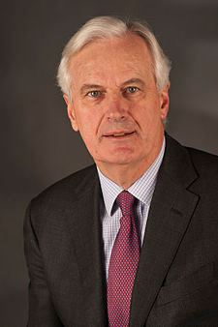
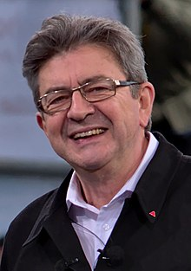
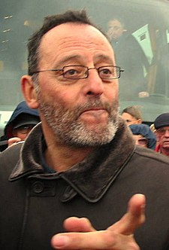
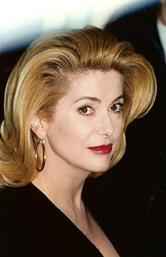
A brief quiz to warm ourselves up: Who is this person?

Slide 3
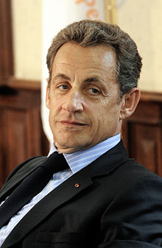
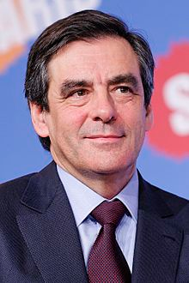
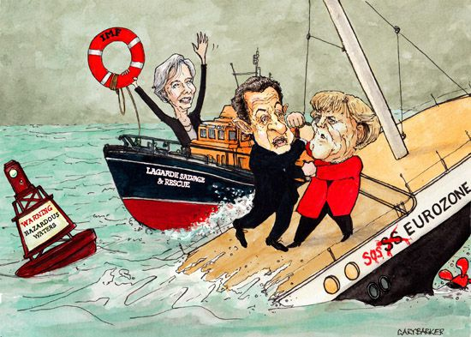
Presidency of Nicolas Sarkozy 2007-2012
Sarkozy – minister of interior 2002-2004 and 2005-2007 (civil unrests 2005)
Anti-immigration and securitization rhetoric in the campaign and in office
Crisis of the Eurozone and French-German Leadership (‘Merkozy’)
Economics of state interventionism (dirigisme)
British and French operation in Libya 2011 turning down Kaddafi’ s regime
Prime minister François Fillon

Slide 4
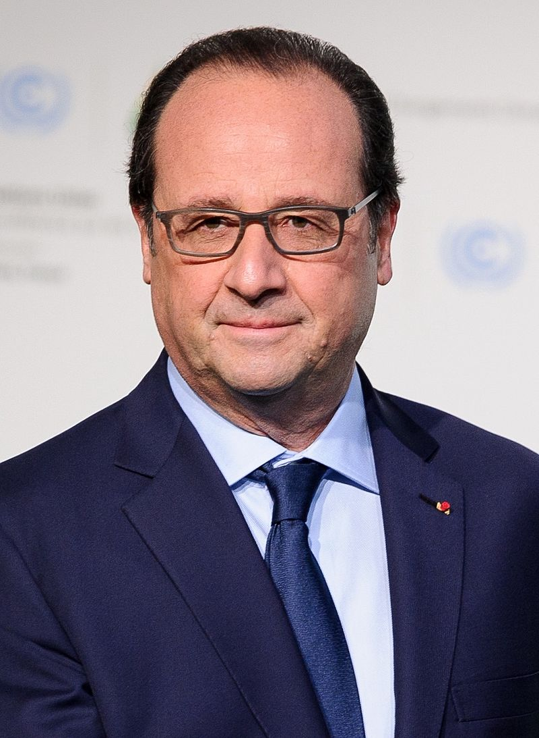
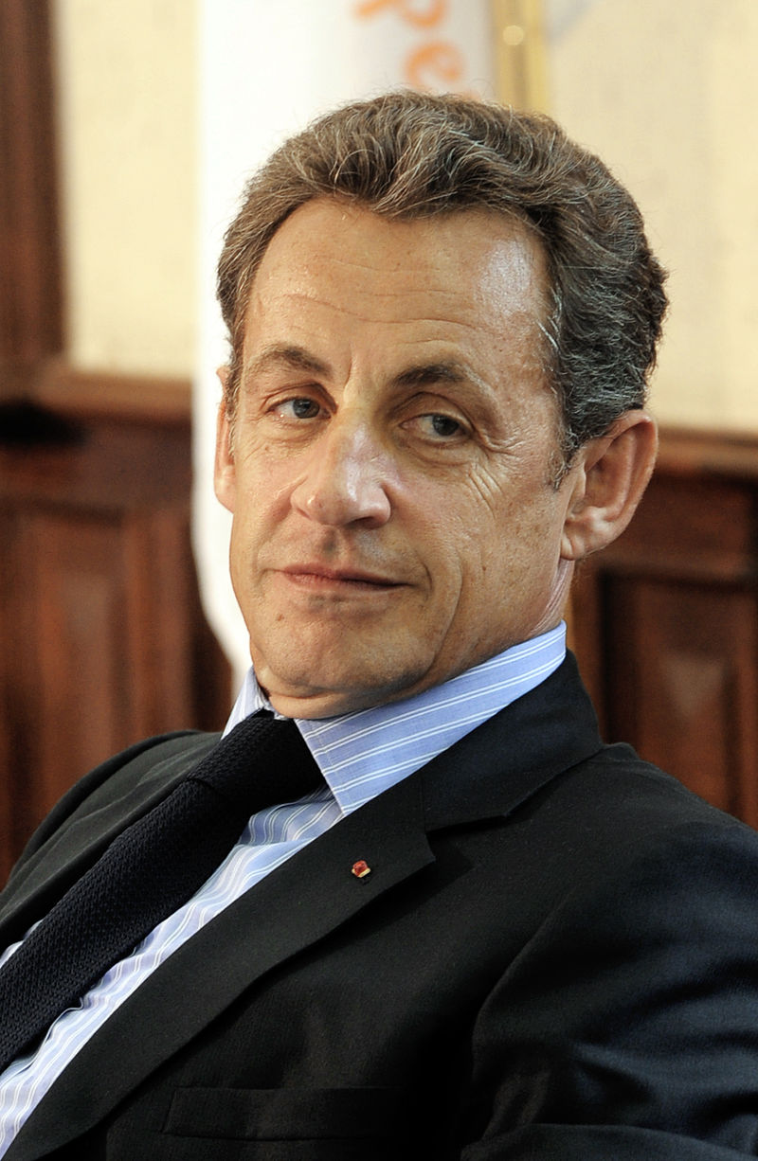
Presidential elections 2012
Main candidates:
François Hollande (28.6 per cent in the 1st round; 51/6 in the 2nd round)
Nicolas Sarkozy (27.2 / 48.4)
Marine Le Pen (17.9)
Jean-Luc Mélenchon (11.1)
François Bayrou (9.1)

Slide 5
Parliamentary elections 2012

Slide 6
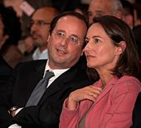
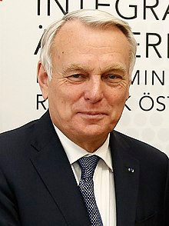
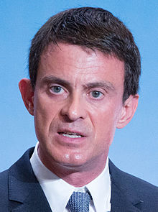
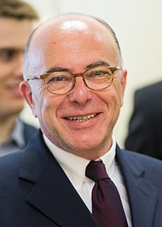
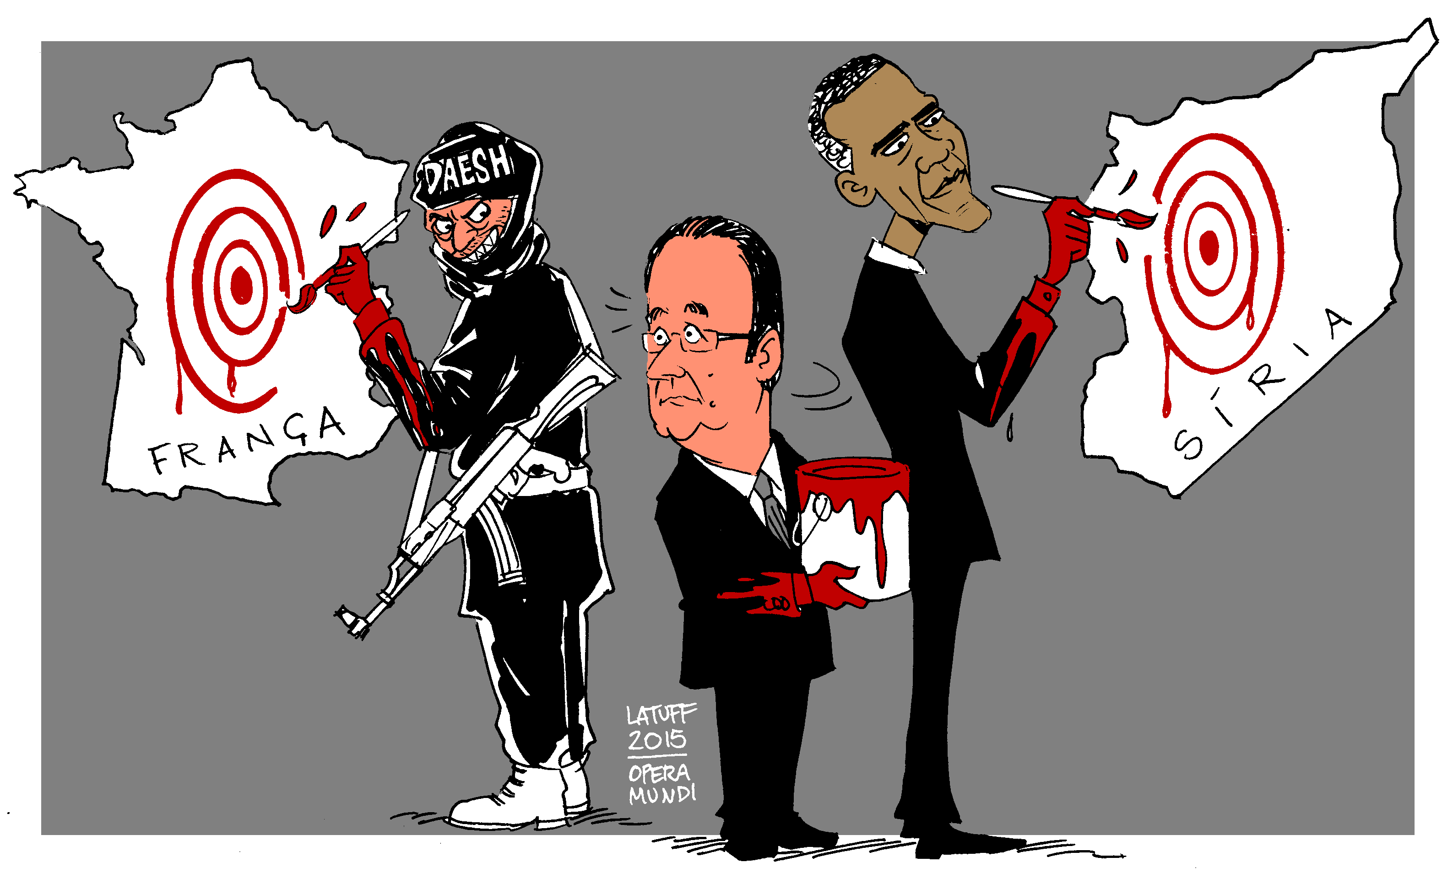
Presidency of François Hollande
First secretary of PS 1997-2008
Law on marriage of same-sex couples (2013)
Unpopular labour reform 2013 (Kurzarbeit)
January and November 2015 Paris and 2016 Nice terrorist acts
Economical and social difficulties
The least popular President of the 5th Republic
Prime ministers:
Jean-Marc Ayrault (2012-2014)
Manuel Valls (2014-2016)
Bernard Cazeneuve (2016-2017)

Slide 7
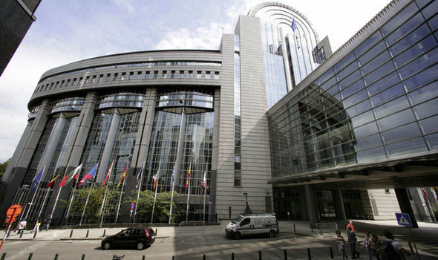
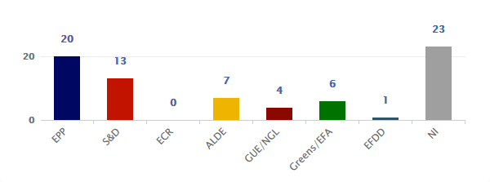
The European Parliament elections 2014

Slide 8
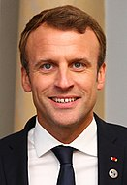
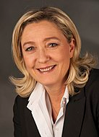
Presidential elections 2017
Main candidates:
Emmanuel Macron (24.0 / 66.1)
Marine Le Pen (21.3 / 33.9)
François Fillon (20.0)
Jean-Luc Mélenchon (19.6)
Benoît Hamon (6.4)

Slide 9
Parliamentary elections 2017
Effects of the electoral system:
http://www.parties-and-elections.eu/france.html

Slide 10
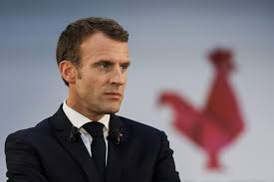
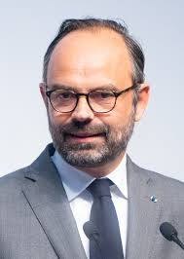
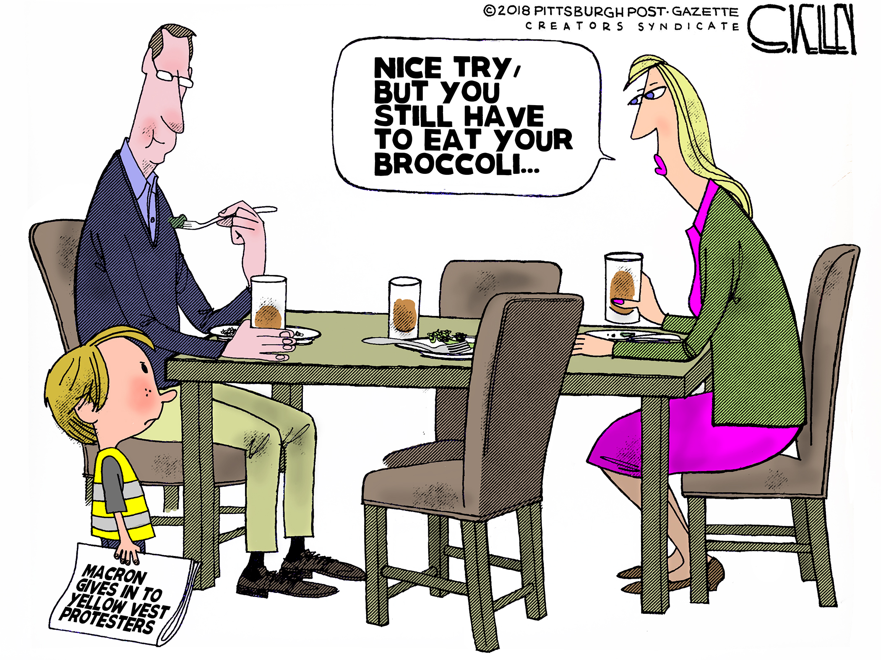
Presidency of Emmanuel Macron
Graduated from ENA
Assisted to Paul Ricoeur
Member of PS 2006-2009
Worked for the Rothschild Bank
Turning opinion on migration policies
Plans to reform the EU
2018-2019 Yellow Vests
Édouard Philippe (Les Républicains ! Member of PS 1990-1992)

Slide 11
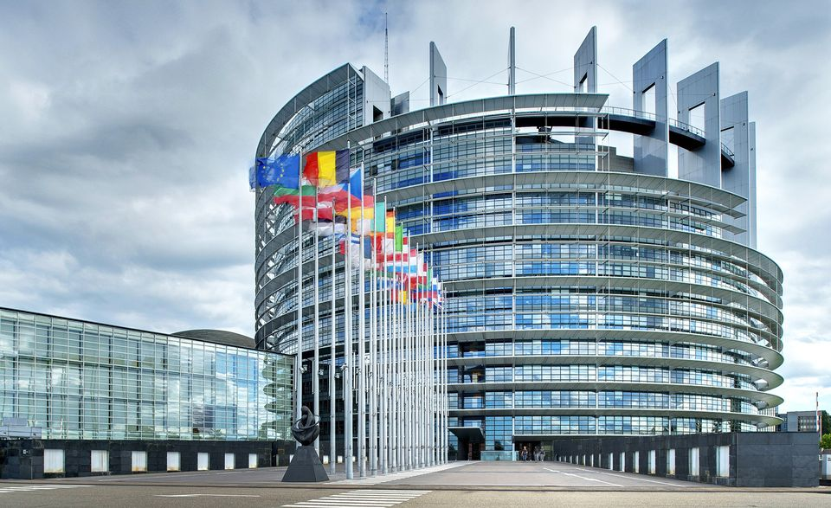
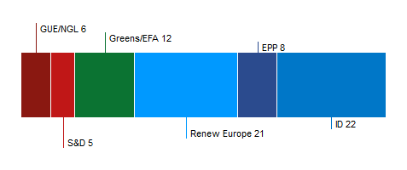
The European Parliament elections 2019

Slide 12
Current French Party Landscape

Slide 13
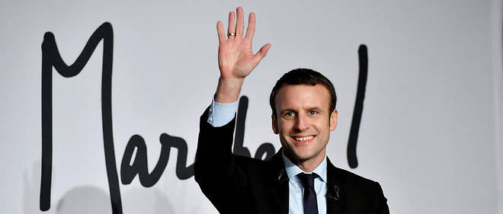
La République en Marche
Founded in April 2016
Enterpreneurial party?
New centre?
New liberalism?

Slide 14
Les Républicains
Post-Gaullist party
Union pour la nouvelle République (UNR)1958-1967
Union des démocrates pour la République (UDR) 1969-1976
Rassemblement pour la République (RPR) 1976-2002
Union pour un mouvement populaire (UMP) 2002-2015
Les Républicains (LR) 2015 onwards
Nicolas Sarkozy
François Fillon
Laurent Wauquiez

Slide 15
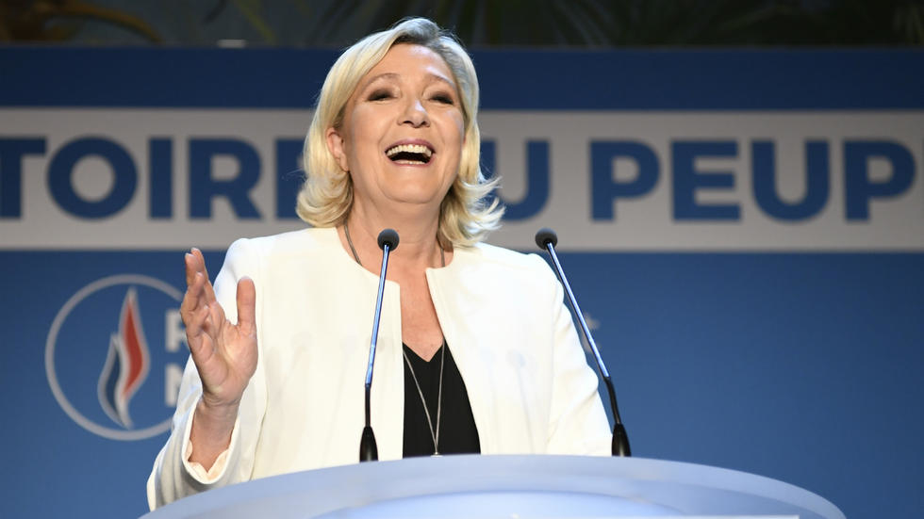
Rassemblement National
Ex-Front National
Check Robin’s presentation for details ☺

Slide 16
La France Insoumise
Founded in 2016
(2012 as Front de Gauche)
Jean-Luc Mélenchon (ex-PS): a candidate in 2017 presidential elections
Supported by philosopher Chantal Mouffe

Slide 17
6th Republic

Slide 18
Parti Socialiste
1905 (Section française de l'Internationale ouvrière)
1969 PS
François Mitterrand
François Hollande
Jacques Delors
Lionel Jospin
Pierre Mauroy
Michel Rocard
Laurent Fabius

Slide 19
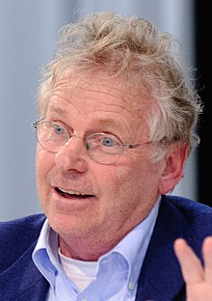
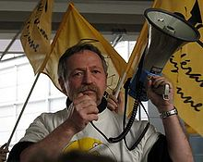
Europe Écologie Les Verts
Founded in 2010 by merger of Europe Écologie (Daniel Cohn-Bendit) and Les Verts (1984)
Participated at the gvt. of Jean-Marc Ayrault (2012-2014)
José Bové

Slide 20
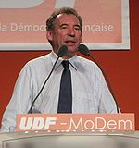
Mouvement Démocrate
(2002 as UDF)
Founded in 2007 by François Bayrou in order not to support Sarkozy
Centrism
Cooperation with Macron in 2017

Slide 21
Parti Communiste Français
Founded 1920
Popular Front 1936
Part of the government:
1944-1947 (tripartisme with MRP and SFIO)
1981-1984
Democratic centralism abandoned only in 1994
2012 run as as a part of FG (2007-2018)

Slide 22
Parti Radical de Gauche
Active since 1971
Roots reach to 1901
Tradition of the moderate left of the 3rd and the 4th Republic
Republicanism
Moderate socialism
Laïcité

