Slide 1
Current Italian Politics

Slide 2
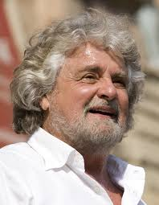
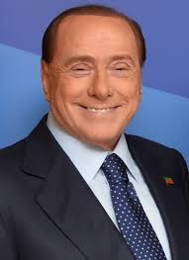
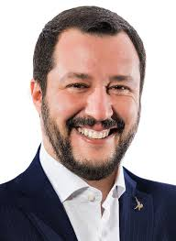
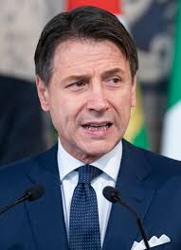
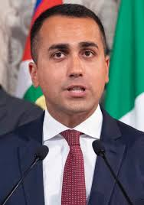
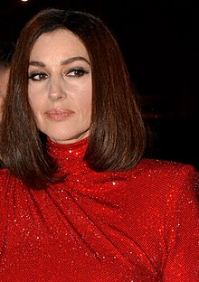
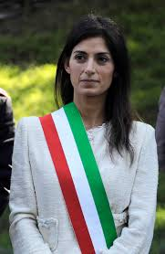
A brief quiz to warm ourselves up: Who is this person?

Slide 3
Parliamentary election 2008

Slide 4
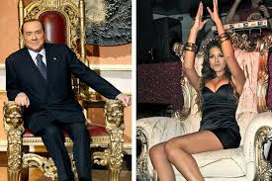
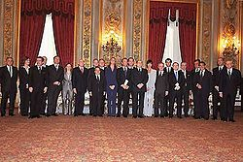
The Cabinet of Berlusconi 2008-2011
Coalition of People of Freedom and Lega Nord following fall of Prodi´s government and snap election
Plagued by trials against Berlusconi for corruption, sex offenses and frauds
Austerity package adopted in 2011
Berlusconi sentenced in 2012 for fraud, sentence included 5 years ban on running for public office for 5 years.

Slide 5
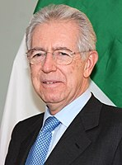
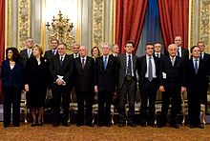
Governo tecnico of Mario Monti 2011-2013
Unpolitical rather than caretaker cabinet
Formation assisted by President Napolitano
Implementation of austerity measures to fight the debt crisis
Effort to proceed with the labour market reform unsuccessful
Mario Monti
Economist
University Professor
European Commissioner 1995-2004 (under Santer, Prodi, and Barroso)
2013 unsuccessful run with a party Scelta Civica

Slide 6
Parliamentary Elections 2013

Slide 7
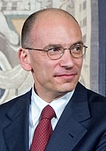
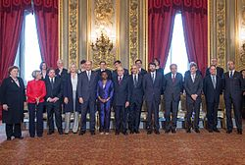
Government of Enrico Letta 2013-2014
Grande coalizione composed of PD, PdL, Scelta civica, Unione di Centro and Radicali Italiani
Critique of the slow pace of economic reforms
PD resigned from the cabinet support chaired by Matteo Renzi since 2014: “new phase” and “radical program of reforms”

Slide 8
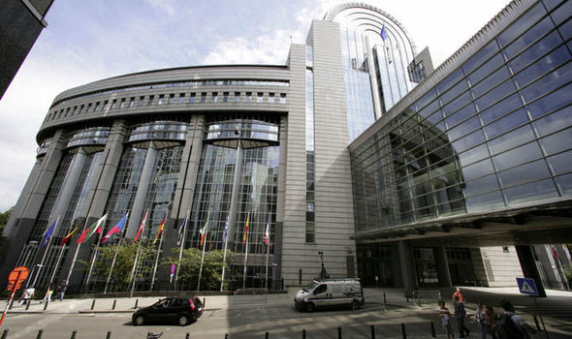
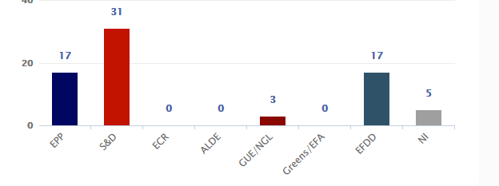
The European Parliament elections 2014

Slide 9
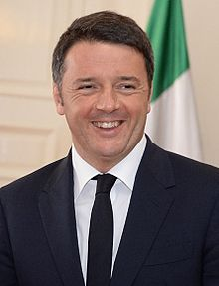
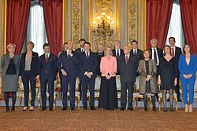
Government of Matteo Renzi 2014-2016
Ex-mayor of Florence
Moderate reform of labour market faced huge protests of trade unions
Failed to boost more substantial economic growth
Problems with immigration
Ambitious (failed) plan of reform of political system:
Abolishment of a perfect bicameralism (Senate into Bunderat)
Italicum – PR with a majority bonus
Reform rejected in referendum Dec. 2016

Slide 11
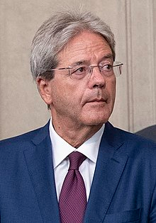
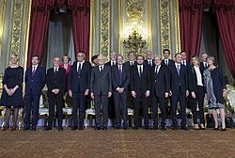
Government of Paolo Gentiloni 2016-2018
MFA under Renzi
PD plus small centrist parties
Return to Letta’ s moderate reform course
Some economic recovery
Ongoing problems with migration
New electoral system of Rosatellum
31 per cent FPTP
61 per cent PR (one district, 3 per cent threshold)
The rest reserved for Italians living abroad

Slide 12
Parliamentary Elections 2018

Slide 13
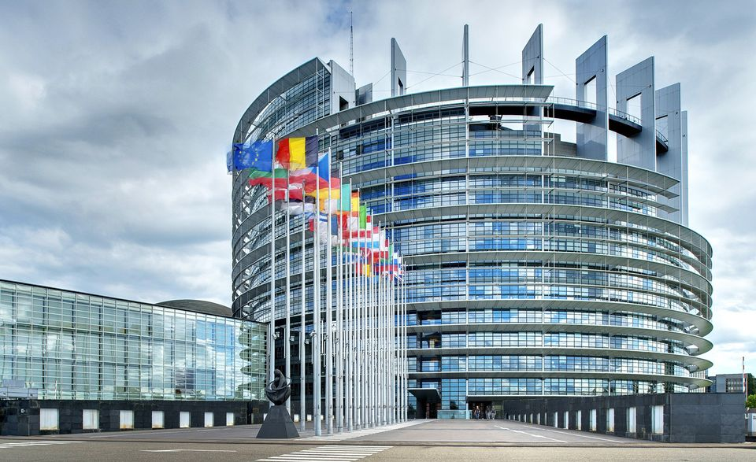
The European Parliament elections 2019

Slide 14
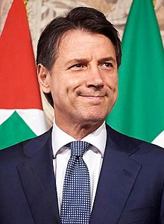
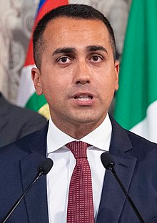
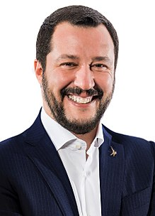
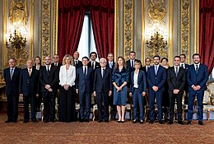
First government of Giuseppe Conte 2018-2019
Luigi Di Maio (M5S) plus and versus Matteo Salvini (L), some technocrats included
Di Maio – Minister of Economics and Labour
Salvini – Minister of Interior (anti-immigration measures)
Tax reform
Reduction of the seats of Chamber of Deputies (630/400) and Senate (315/200)
August 2019 – Salvini launched a motion of non-confidence hoping in snap elections

Slide 15
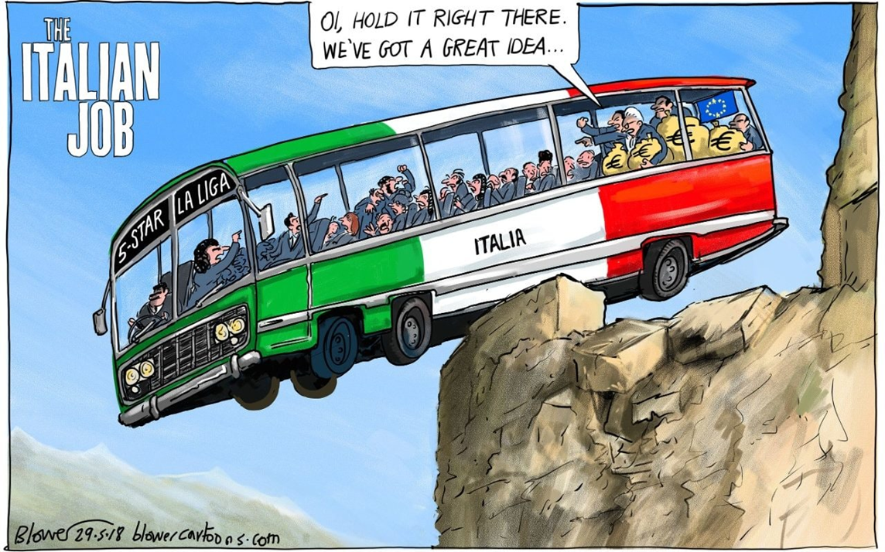
Notes:
British movie 1969, American remake 2003.

Slide 16
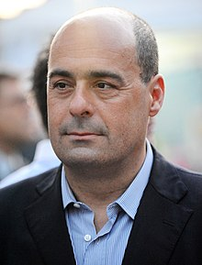
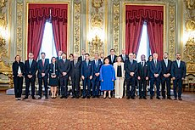
Second government of Giuseppe Conte 2018-2019
M5S plus PD
Nicola Zingaretti

Slide 17
Current Italian Party Landscape

Slide 18
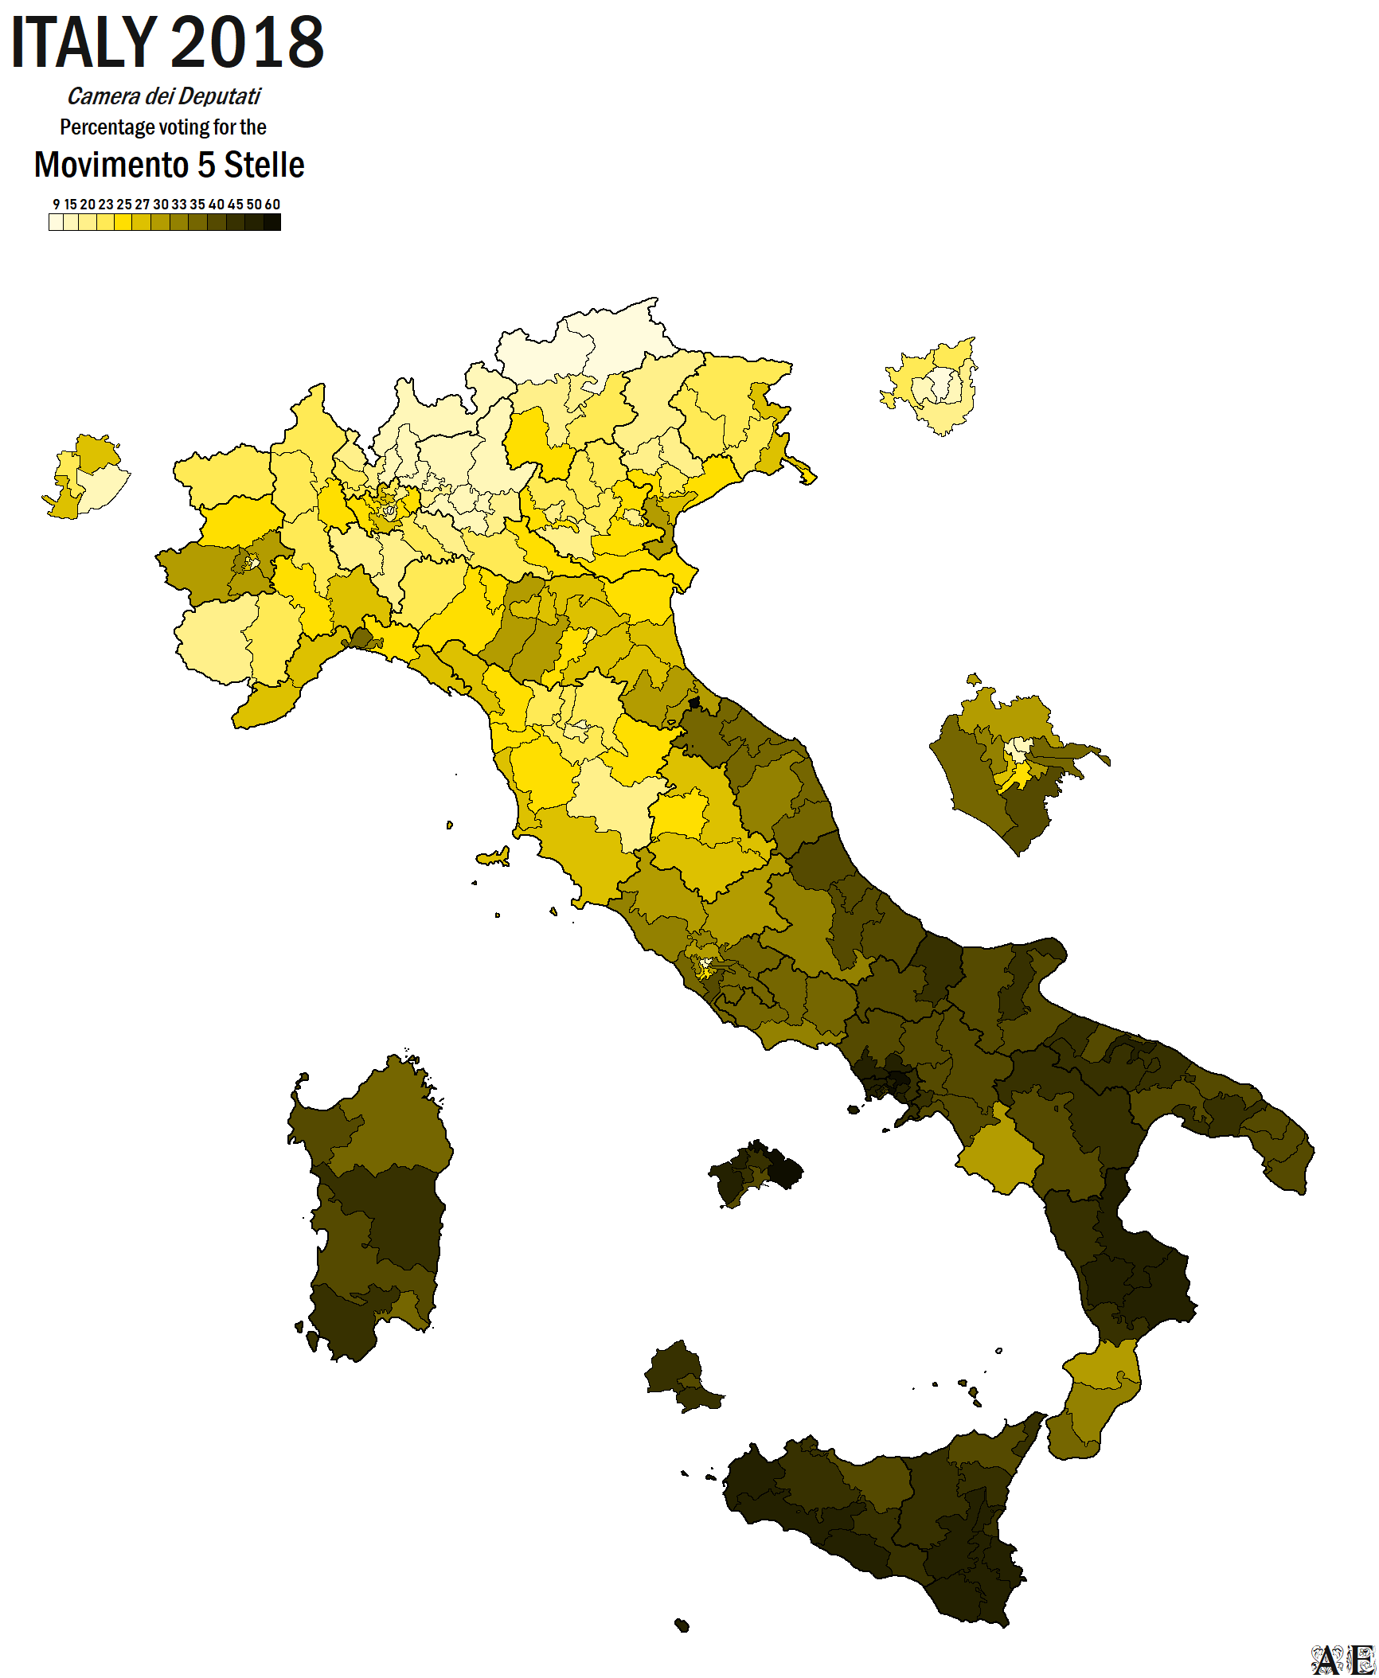
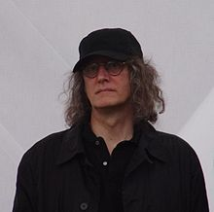
Movimento 5 Stelle
Protest populist movement
Specific forms of campaigning
Gianrioberto Casaleggio and Casaleggio Associati srl
Rousseau platform

Slide 19
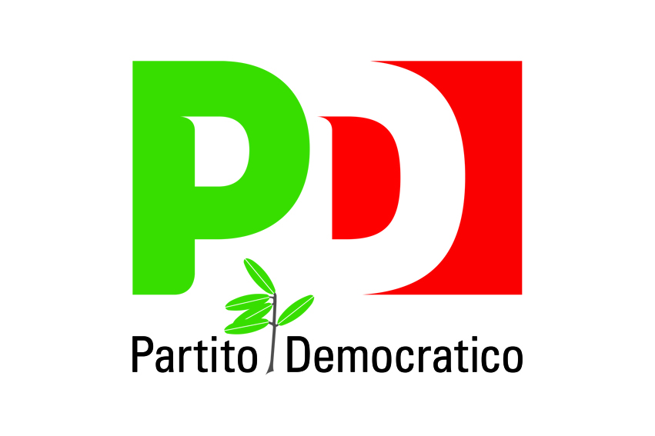
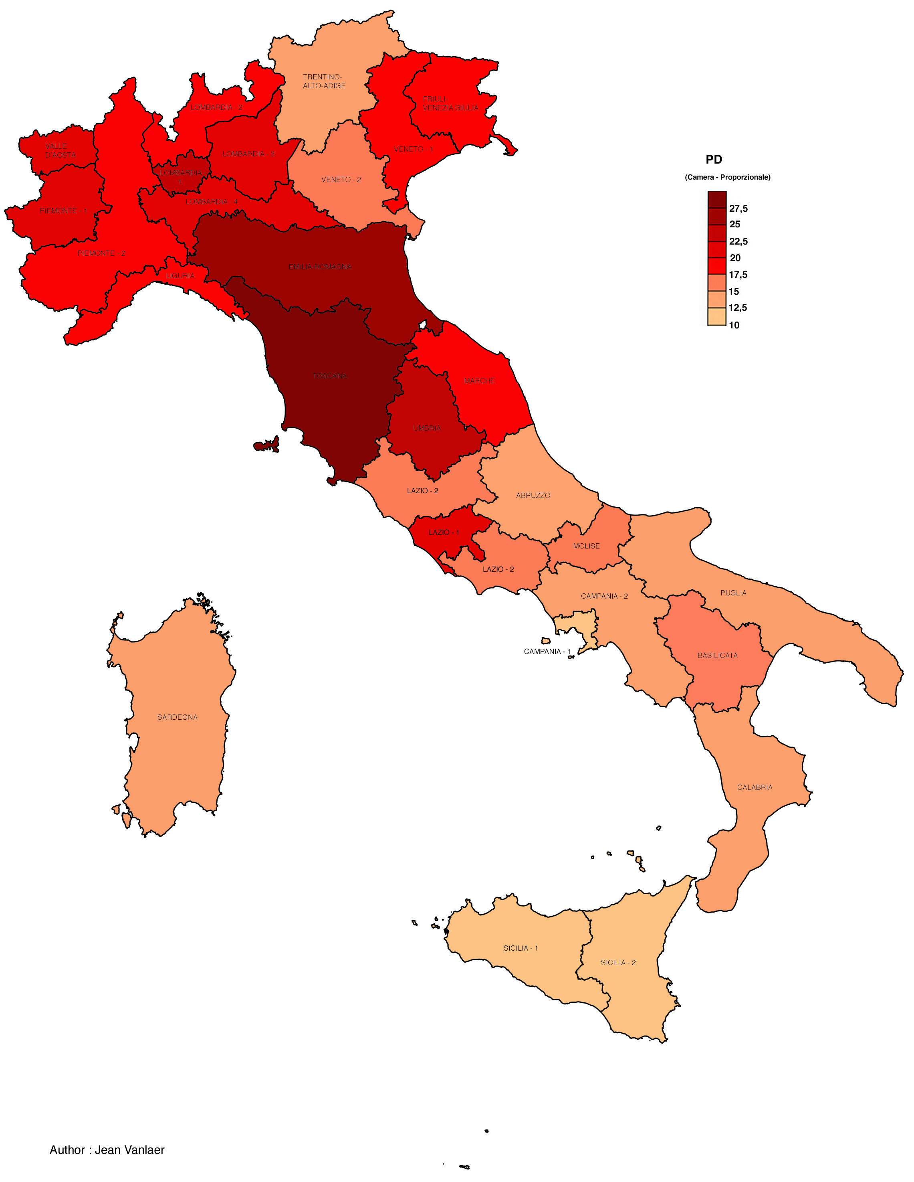
Partito Democratico
Transformed coalitions L’Ulivo and L’Unione (2007)
Ex-social democrats
Ex-reformed communists
Ex-centrist Christian democrats
Progressist, liberal, left center

Slide 20
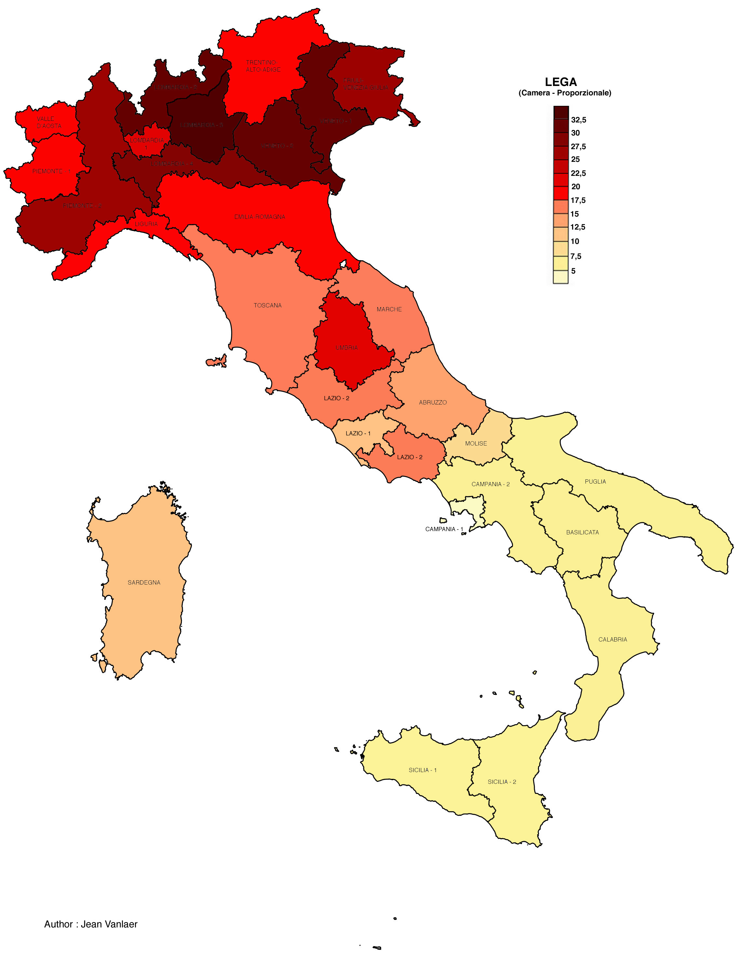
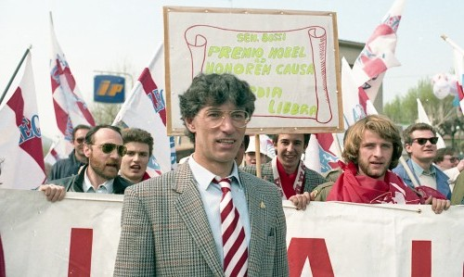
Lega (Nord)
Founded 1987
Padanian separatism and populist protest of Umberto Bossi
Salvini and the migration card
Euroscepticism instead of “federalist libertarianism”

Slide 21
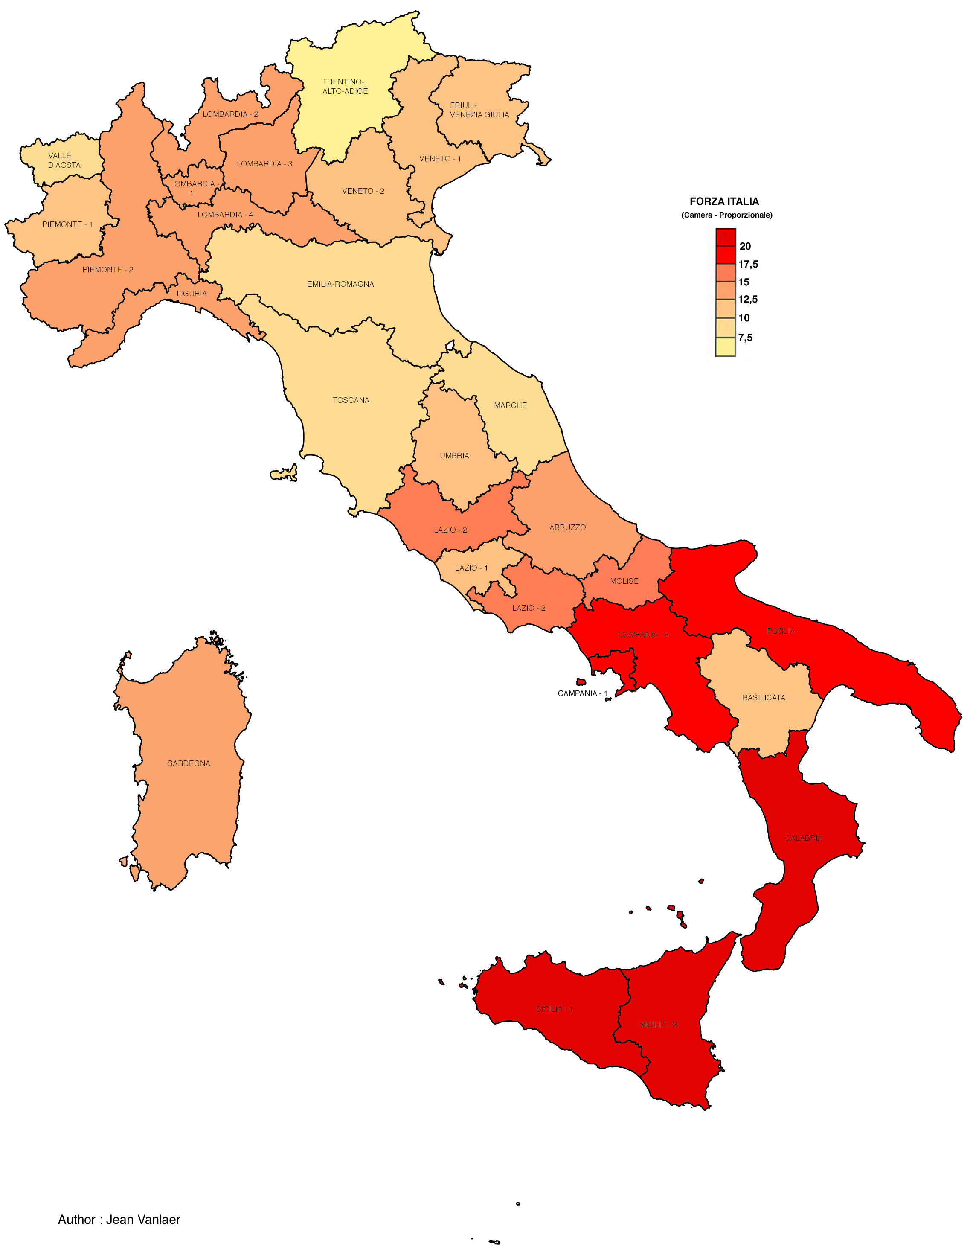
Forza Italia
A blueprint of an entrepreneurial party
Central role of the leader and his private initiative.
Party as a personal vehicle to carry primarily his or her personal business and political interests
Leader wields a crucial formative influence over ‘his’ political project
An entrepreneurial party is not a ‘product’ of a promoter/sponsor organisation or social movement, as had been the case with mass parties.
An entrepreneurial party is not connected with parliament, as the cadre party was, and it is not founded by a group of MPs seceding from another party.

Slide 22
Südtiroler Volkspartei
Founded in May 1945
Christian democratic profile the strongest but a catch-all party with factions
Regionalism
Pro-European

Slide 23
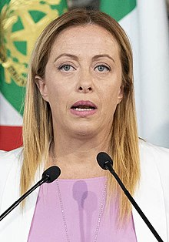
Fratelli d'Italia
Founded in 2012 as a split from PdL
National-conservative
Softly Eurosceptic
(electoral result for Alleanza Nazionale in 2006)

Slide 24
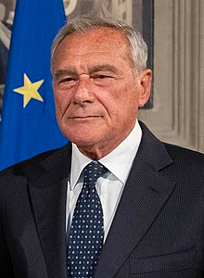
Liberi e Uguali
Founded in 2017 as a leftist splinter from Renzi’s centrist PD
Pietro Grasso
Ex-anti-mafia fighter

