Slide 1

Class 2: Racialised natures
Masters in Environmental Studies
Masaryk University, Brno, Czech Republic
November 2018
Christos Zografos, PhD
JUH-UPF Public Policy Centre, Department of Political and Social Sciences, Pompeu Fabra University, Barcelona, Spain
christos.zografos@upf.edu

Slide 2
This class
Three concepts:
  Environmental racism
  Environmental justice
  Othering

Slide 3
“…the uncontrolled growth of weeds and their emerging dominance in the landscape do appear to symbolize disorder, decay, and the absence of control that accompany years of political and fiscal neglect. Socially speaking, the significance of weeds is not what they do but, rather, what they represent; the same can be said for the abandoned autos, heaps of garbage, discarded needles, condoms, and drug paraphernalia, and broken glass that are pervasive throughout the park” (Brownlow, 2006, p.242)
Why, according to Brownlow, have disorder and decay fallen upon Cobbs Creek?
READING QUESTION

Slide 4
Disorder and decay in Cobbs Creek
Why?
  A key factor/ key change that brought about disorder and decay
Loss of social (community) control mechanisms that ensured park security for everyone
What reasons produced this phenomenon?
Racism: racism-induced and racism-related decisions
  Decisions of a man in power (Rizzo)
  Public Administration neglect of park, community, and its services
  Change in gang culture
3

Slide 5
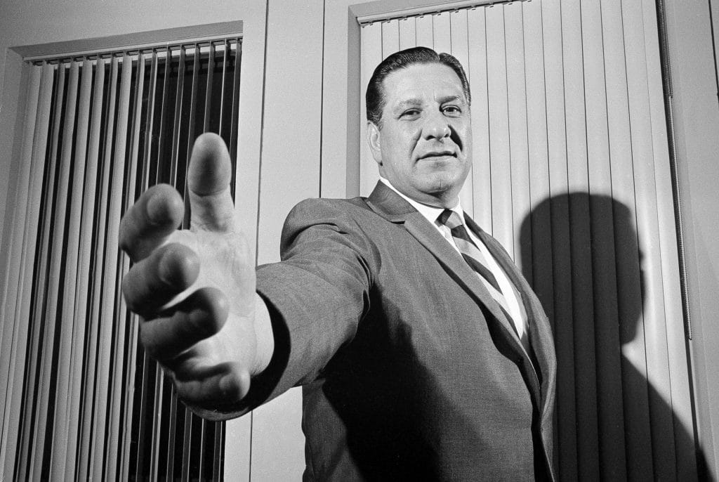
1. Decisions of a man in a seat of power
Frank (“The Big Bambino”) Rizzo: Police Commissioner turned Mayor
  Cuts park budget by 50%
  Reduces mounted Park Guard
  Removes park benches
Copyright: Bill Achatz/AP
Notes:
Police Commissioner & then Mayor Rizzo:
his actions led to a loss of surveillance (local community social control) mechanisms
Actions: Rizzo policies
1974: Mayor Rizzo cuts park budget by 50% (compared to previous admin)
reduce importance of mounted Park Guard (personal vendetta) through its reduction: from 500 guards to 24 and its integration with the Philadelphia Police Department,
removal of park benches upon which members of the community would sit and observe “the world passing by”. This also led to elimination of an important element of community self-surveillance (benches)

Slide 6
2. Result of neglect (of racist-origins)
Budget cuts started with Mayor Rizzo but continued: since early 80s (i.e. 3 decades=no increase)
steady decline in budgetary spending on the park further compounded the problem
budget cuts followed almost exact pattern as exodus of whites from the area (racism within Philadelphia’s powerful decision-making institutions)

Slide 7
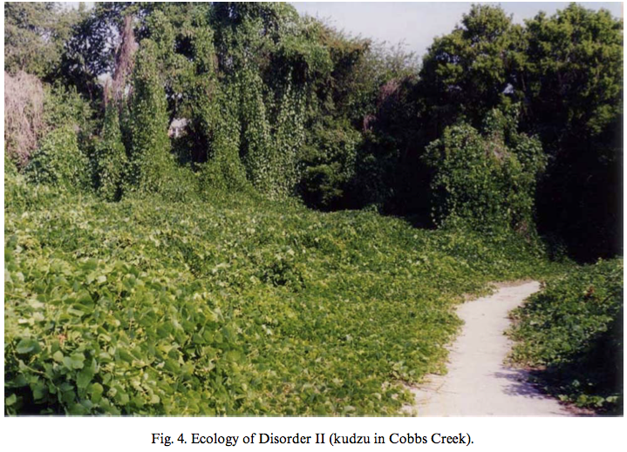
3. Change in gang culture
The 50s: the “organic” gangs
  “Homegrown” gangs’ informal agreement over park's neutrality
Late 60s – early 70s: Black Power
  Cobbs Creek’s early gangs (and informal security) quietly disappear
Late 70s: the power vacuum
  Decline of black identity movement
  Outmigration
The 80s: end of the agreement
  Violent gangs: no agreements, unwritten or otherwise
John: “The park was sort of that neutral ground because everybody came to the park, and you had picnics out there and all kinds of things in that community – cook outs”
Tom: “It was an unwritten agreement that the park would be neutral”
Notes:
The 50s: Gangs' informal agreement over park's neutrality
Late60s +early70s:
growing pressure of black power movement to cease black-on-black violence and focus energy and anger on greater social and political wrongs
Cobbs Creek’s early gangs quietly disappear: informal park security they ensured also disappears
late 1970s:
decline of black identity movement
and outmigration of middle-class blacks leaves power vacuum
1980s: re-emergence of gangs
structure and membership not like “organic, homegrown gangs of the 1950s and 1960s”
more violent forms and structures mimicked gang activity in cities like L.A., Chicago, and New York, where there were no agreements, unwritten or otherwise
End of agreement: emergence of violence

Slide 8
The bigger picture
Must analyse loss of social control mechanisms from wider perspective of evolution of power relations within city’s history
  civil rights movement, racial struggles, economic decay, etc.
  racist and racially explosive period: significant, if disproportionate, roles
Rizzo’s decisions to dismantle local social control mechanisms in Cobbs Creek: a form of social control
  means to control social organization and activity of politically active
  by removing primary public arena (the Park) of intercourse and exchange
7
Notes:
Loss of social control mechanisms must be analysed from a wider perspective of power relations' evolution within Philadelphia's recent history
civil rights movement, racial struggles, economic decay, etc.
the legacy of an overtly racist and racially explosive period in Philadelphia’s political history; one in which both the city’s governing, white elite and local black activists play significant, if disproportionate, roles.
Rizzo’s decisions to dismantle local social control mechanisms in Cobbs Creek can be seen as a form of social control
as a means of controlling social organization and activity among politically active black community during a period of racial upheaval
by removing/ controlling their primary public arena (the Park) of social intercourse and political exchange

Slide 9
Argument 1
Racism produces environmental degradation
Because: it offloads environmental ‘bads’ to non-white communities, by both depriving them of resources and reducing their own capacities to maintain a healthy environment
Evidence:
  The racist-motivated actions of Mayor Rizzo
  The changes in gang culture
Notes:
EVIDENCE:
The racist-motivated actions of Mayor Rizzo in Philadelphia (60s-80s) that reduced city resources dedicated to maintaining the park and African American community’s social control mechanisms (park security)
The changes in gang culture, which were related to race struggles and which transformed the park (without social control mechanisms) into a space of illegality and violence

Slide 10
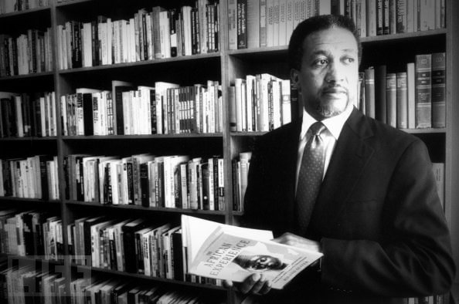
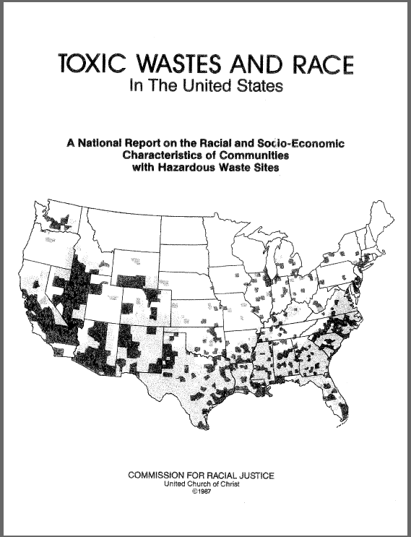
Environmental racism
The term: Reverend Dr. Benjamin F. Chavis Jr. – The UCCCRJ report (1987)
Jepson, 2007: “intentional or unintentional…
  …racial discrimination in environmental decision-making, …
  …systematic exclusion of people of color from the mainstream environmental movement, …
  …negligent enforcement of environmental protections, laws and regulations along racial lines, …
  …and disproportionate distribution of environmental burdens on racial and ethnic minorities where they live, work, and play”
Source: http://blackkudos.tumblr.com
Notes:
DEFINITION (from encyclopeadia of Environment & Society): intentional or unintentional racial discrimination in environmental decision-making, systematic exclusion of people of color from the mainstream environmental movement negligent enforcement of environmental protections, laws and regulations along racial lines, and disproportionate distribution of environmental burdens on racial and ethnic minorities where they live, work, and play.
THE TERM
Civil rights leader Reverend Dr. Benjamin F. Chavis, Jr. first articulated the term environmental racism for a US audience during the presentation of the 1987 report Toxic Waste and Race in the United States (at the National Press Club in Washington D. C.)
THE REPORT done by the United Church of Christ Commission on Racial Justice (UCCCRJ) was the first national study to document the strong correlation between race and hazardous landfill locations at a national level.
In 1982, popular protest and mobilization against the planned hazardous waste dump for 40 thousand cubic yards of polychlorinated biphenyls (PCB)-contaminated soil in Warren County, a predominantly African-American community in North Carolina, is widely viewed the transformative event in the environmental justice movement.
During the Warren County struggle over the planned waste dump, church activists and Chavis, drew widespread attention to the unequal burden of African Americans to hazardous waste storage sites and the community’s marginalization in environmental decision making
ENDEMIC TO US HISTORY: Parallel story deeply rooted in ideological constructions of race, nature, and society
Colonial dispossession of Native American homelands to their expulsion from national parks and wilderness areas for the benefit of 19th century white, middle-class tourists and environmentalists, such as John Muir.
For the African-American community, slavery’s expropriation of environmental knowledge, reconstruction-era land loss, and consequent rural exodus to segregated urban centers, forcibly reconfiguring the community’s relationship to the natural world.
In the 20th century, racial and ethnic minorities [e.g. Hispanos] have faced increasing environmental hazards as they represent large percentages of the urban working class exposed to the toxic threats of industrial society in the workplace to neighborhoods yet excluded from the mainstream environmental movement.

Slide 11
Environmental justice
ACTIVITY: So: what is environmental justice?
  Direct paraphrasing (in layman’s words): explain environmental justice to your mom who calls you today to ask how are things!
    What it involves? Its objective?
    Its key elements or dimensions?
  Present in class
EJ: concept closely related to environmental racism
Normative dimension out of environmental racism
What should be done then to avoid environmental racism?
Watch Environmental justice: https://www.youtube.com/watch?v=dREtXUij6_c
Watch Justice Matters: https://www.youtube.com/watch?v=SKqR0e54qhA
Notes:
Questions for presentations:
Why is your example a good example of environmental (in)justice?
ASK REST of the class:
What do you think of their definition? Did they leave something out?
What do you think of their example? Good?
5 min per group for: ppt + Q&A

Slide 12
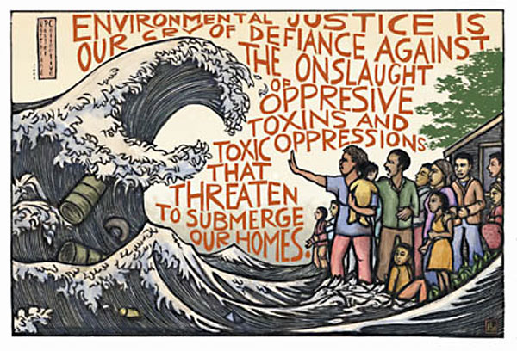
Justice
Justice as fair treatment (Waskey, 2007):
  Justice = a system of rewards and punishments that are designed to fit the actions of those receiving justice
Source: http://www.columbia.edu/cu/EJ/EJ_ricardolevinsmorales.jpg
Notes:
JUSTICE
Fundamentally, it is the moral principle that a person should receive the type of treatment that he or she deserves.
[Injustice is seen as a departure from a naturally occurring moral order.
In Western civilization, concepts of natural justice or divine justice have been the grounds or inspiration for developing numerous moral concepts.
Similar notions of a cosmic moral law expressive of justice are to be found around the world.
In all cases they involve ideas of fair treatment
To some are due rewards and to some are due punishments, but in all cases fairly delivered.
Justice = a system of rewards and punishments that are designed to fit the actions of those receiving justice]
[JUSTICE AND THE ENVIRONMENT
In the case of justice and the environment, there are a range of views over what is and what is not justice.
And these lie at the heart of what a state should establish in its governing of the relations between people. ]
TYPES:
Justice distributive when some authority acts to allocate available resources
Justice remedial when authority acts to remedy wrongs by re-storing what was lost.
Justice preventative when it acts as a form of equity to prevent irreparable harms from taking place.

Slide 13
Elements
Not only race: but also, gender, class (income), etc.
Not only distribution: but also, procedural; representational
National and international levels
Not only burden of uneven goods, but also uneven access to goods
Notes:
“How can we break down and re-imagine a system that is built up on those inequities”
(“…unable to profit from resources, and are made sick or poor”)

Slide 14
Environmental justice: not only race
Expanding scope
  Initially: race
  Robert Bullard: “Racism trumps class”
Expand to cover lower socio-economic groups and other minorities (First National People of Color Environmental Leadership Summit, 1991)
  Socio-economic status; class; other vulnerable groups: women, children and poor
Robert Bullard:
“even middle income African Americans are more likely to live in polluted neighbourghoods”
  Study: “African Americans making $50-60k income are more likely to live in polluted neighborhoods than White Americans who make just $10k/y
“minority neighborhoods (regardless of class) carrying a greater burden of localized costs than either affluent or poor white neighborhoods”
Notes:
Robert Bullard (http://www.ciesin.org/docs/010-278/010-278chpt2.html#fn50):
“… strong association between race and the location of hazardous-waste facilities. Race was by far the most prominent factor in the location of commercial hazardous-waste landfills, more prominent than household income and home values. For example, the commission study found:
Household incomes and home values were substantially lower when communities with hazardous-waste facilities were compared to communities in the surrounding county without such facilities. Mean household income was $2,745 less and mean value of owner-occupied homes was $17,301 less. The minority percentage of the population remained the most significant factor differentiating these groups of communities.
Growing empirical evidence shows that toxic-waste dumps, municipal landfills, garbage incinerators, and similar noxious facilities are not randomly scattered across the American landscape. The siting process has resulted in minority neighborhoods (regardless of class) carrying a greater burden of localized costs than either affluent or poor white neighborhoods. Differential access to power and decision making found among black and white communities also institutionalizes siting disparities.”
Initially, “environmental racism” only addressed explicit racist acts in hazardous wastes storage unit locations and the consequent distributive inequities of environmental burdens and toxic exposures. Over the past decade, the grassroots environmental justice movement and academic community, to a lesser degree, have expanded the application of “environmental racism” to include institutional discrimination in decision-making process and procedure of environmental policy making. In 1991, grassroots activists led the First National People of Color Environmental Leadership Summit. The Summit resulted in the acceptance of 17 Principles
of Environmental Justice that expanded claims of communities of color to participate as equal partners in environmental planning, policy implementation, and enforcement. Moreover, the Summit broadened the scope of environmental justice to include concerns from all vulnerable groups—such as women, children, and the poor.

Slide 15
Three dimensions of EJ (Schlosberg, 2007)
Distributive EJ: equal distribution of risks and benefits
  E.g. environmental racism = toxic environments disproportionally for African Americans; or for poor
Procedural EJ : fair and meaningful participation
  Outright exclusion: e.g. Franco-era hydro-electric projects – e.g. Riba-roja Ebre
  Participatory exclusions: e.g. water basin plans (water allocation) – e.g. CHE
Recognition EJ: ways of life, local knowledge, cultural difference
  ‘Where Green Ants Dream’: recognise aborigine cultural conceptions of space (for animal activity not to be disturbed) as equally valid as mining interests
Notes:
URKIDI AND WALTER 2011
E.g. current US law: fair treatment and meaningful involvement of all people irrespective of race, colour, nat’l origin, or other qualification in the development of environmental policies, laws, and regulations
DISTRIBUTIVE EJ: equal distribution of risks and benefits
E.g. environmental racism = toxic environments disproportionally for African Americans; or for poor
PROCEDURAL EJ DIMENSION: fair and meaningful participation in decision-making
Formal exclusion: when some views/ priorities are outright excluded from decision making – examples of this from several Franco-era hydro-electric projects (e.g. Riba-Roja de l’Ebre, etc.) that inundated villages to construct dams; examples also from contemporary dam construction and massive wind farm projects in China
Participatory exclusions: when multiple views are part of the decision-making process, but the planning authority has no obligation to take views into account for the design of the project but simply to answer (e.g. in written) to concerns raised; e.g. CHE water basin plan
RECOGNITION DIMENSION: recognise community ways of life, local knowledge, cultural difference
URKIDI AND WALTER, 2011
According to Fraser (1995), in the case of ‘rec- ognition’ the conditions for a just society are defined as the recog- nition of the personal dignity of all individuals. Recognition not only refers to the individual right to self-recognition (Honneth, 2001), but most importantly, to the RECOGNITION OF COLLECTIVE IDEN- TITIES AND THEIR PARTICULAR NEEDS, CONCERNS AND LIVELIHOODS.
Recognition is particularly relevant to indigenous communities. For years, these groups have demanded THE RECOGNITION AND PROTEC- TION OF THEIR CULTURE, LIVELIHOOD AND TERRITORIAL RIGHTS. They have OB- TAINED NATIONAL AND INTERNATIONAL LEGAL SAFEGUARDS DUE TO THEIR VULNERABILITY AND HISTORICAL DISCRIMINATION and by focusing on defining their indigeneity (Kirsch, 2007; Valdivia, 2005). Although signatory countries do not always respect it, ILO Convention 169 obliged signing countries (e.g. Chile, Argentina) to consult indige- nous communities before deciding on activities affecting them. Decision-making processes, however, usually do not take indige- nous communities truly into account, forcing them to engage in procedural disputes to defend their rights (Baker and McLelland, 2003).
EXAMPLES
E.g. ‘Where Green Ants Dream’; recognise aborigines’ cultural conceptions of space/ ecology (desert = space where ants dream) as equally valid as mining interests
E.g. enclosure of English commons: recognise informal (i.e. no proof of evidence) access rights of landless peasants – FROM PREVIOUS CLASS
E.g. recognise rights to land (e.g. access to non-timber forest products) based on custom and in the absence of “formal” (e.g. written) documentation – e.g. cases of concessions for commercial forestry in Brazil and Chile (Araucania; Bio-bio), where communities previously had non-formally recorded access rights

Slide 16
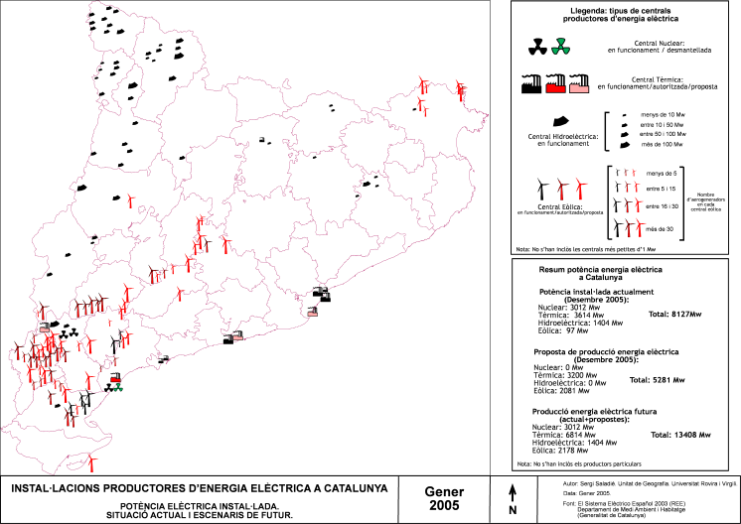
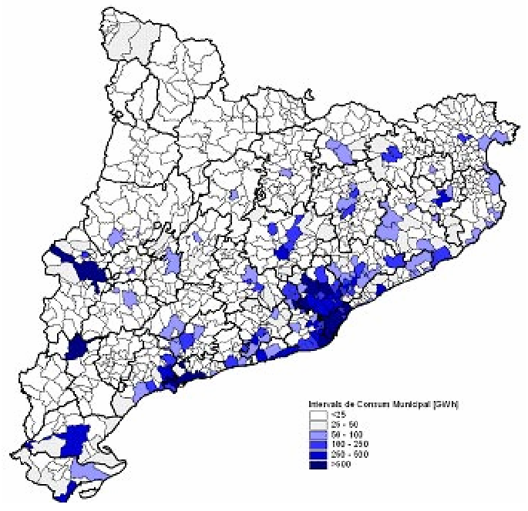
EJ at national level
National aspect: “not only within cities, but also urban-rural divide”
Terra Alta wind farms:
  Protests at macro-concentration
  Inequities: energy generation vs. energy consumption
    A neo-colonial relation between a centre and “extractive” periphery
  Procedural aspects: behind closed-doors agreements
Notes:
See: Zografos, C. and Martínez-Alier, J., 2009. The politics of landscape value: a case study of wind farm conflict in rural Catalonia. Environment and Planning A, 41(7), pp.1726-1744.

Slide 17
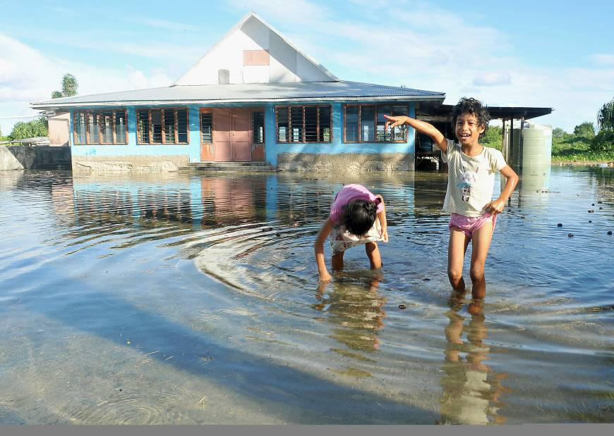
International dimension
“And even see that injustice on a global level”: small island nations forced to directly confront consequences to rising sea-levels but haven’t played any significant role in the indurstries that are causing climate change”
  Tuvalu:
  Possibly first country (nation) to disappear because of climate change effects
    SLR – lies only 2m above SL
  GDP: 135/175 (World Bank)
  Per capita CO₂ emissions (in metric tn, 2014) (knoema.com) = “0”
    Tuvalu = 0.06
    Spain = 5.31
    China = 7.82
    USA = 16.63
  Pacific Islands region = 0.03% of global CO2 emissions (germanwatch.org)
Source: KYODO/ www.japantimes.co
Notes:
https://germanwatch.org/download/klak/fb-tuv-e.pdf
Posed as posssibly the first country (nation) to disappear
CONSIDER: JUSTICE AS TREATMENT ACCORDING TO ONE’S ACTIONS
“And even see that injustice on a global level”: small island nations forced to directly confront consequences to rising sea-levels but haven’t played any significant role in the indurstries that are causing climate change”

Slide 18
Uneven goods
Uneven bads but also uneven goods
  “poor urban planning policies…but those trees get planted in the neighbourhoods that are already green”
  “benefits of programmes enjoyed by communities that are doing just fine”
Unequal distribution of environmental goods
Heynen et al., 2006:
  “inequitable distribution of urban canopy cover within Milwaukee”
  “those … with higher median household income, non-Hispanic White residents, and low housing- vacancy rates are more likely to have greater total canopy cover”
Notes:
Heynen, N., Perkins, H.A. and Roy, P., 2006. The political ecology of uneven urban green space: the impact of political economy on race and ethnicity in producing environmental inequality in Milwaukee. Urban Affairs Review, 42(1), pp.3-25.

Slide 19
Activity 3. Further dimensions of environmental justice
Question: “How does capitalism address the need to protect the environment?”
Solutions: how to protect the environment within capitalism?
Watch the two videos
Yaron Answers: https://www.youtube.com/watch?v=GsKESen_Ln8
Beyond Flint: https://www.youtube.com/watch?v=YOFzuFAfQ8U
Get into four groups and discuss the question
(Make notes/ keep focus during video)
Notes:
Yaron Answers: Capitalism and the Environment (stop: 08.48): https://www.youtube.com/watch?v=GsKESen_Ln8
What does the first narrative (video) about “the human environment” leave out? And, what does 2nd (video) narrative bring in?
Beyond Flint: ‘My community breathes different air than the white community’: https://www.youtube.com/watch?v=YOFzuFAfQ8U
Unequal costs and benefits; unequal wellbeing (pollution burden-bearing) and capacity to “move between environments”
Shifting costs, on basis of race and class
Beyond Flint (South Bronx); 25% of Manhattan’s waste; disproportionate asthma cases; asthma: “can’t do stuff that other people do in life”
None else is being asked away [sic] if you should breathe or do you want a job
The first narrative
“…so we actually today live in the best human environment from a health and wellbeing perspective in all of human history”
Our environment, or “our current environment”
Whose human environment?
What state of environment: different in different places
The power to influence public and legal decisions (e.g. NY City gives subsidy to company to stay and pollute)
Property rights: who has them (e.g. property rights to clean air), and how easily (e.g. with what support) can they be taken away – the power to acquire (buy land for business) and maintain (e.g. impoverished community) property rights
You have the choice to move somewhere else, etc.
Yaron Brook (Hebrew: ירון ברוק‎; born May 23, 1961)[1] is an Israeli-American entrepreneur, writer, and activist. He is an Objectivist and the current chairman of the board at the Ayn Rand Institute, where he was executive director from 2000 to 2017. He is also the co-founder of BH Equity Research and the author of several books, in which he analyzes a variety of topics from an Objectivist perspective.

Slide 20
EJ: Beyond EPA
South Bronx:
  25% of Manhattan’s waste;
  disproportionate asthma cases;
  asthma: “can’t do stuff that other people do in life”
“None else is being asked away [sic] if you should breathe or do you want a job”
Beyond equitable distribution of environmental risks and benefits, and fair and meaningful participation in environmental decision-making (EPA), Schlosberg (2007) adds:
“…capability of communities and individuals to function and flourish in society”

Slide 21
Othering
Notes:
OUTLINE FOR THIS PART OF THE PPT
The rationale for considering “othering” and “coloniality”: must consider how racism works as ideology
The colonial matrix of power
Gives different rights (e.g. over land) and obligations
Othering: coloniality based at “the modern opposition” (Noble)
What is othering
How it works
How othering and coloniality produce environmental injustice: evidence from AUS
Argument expansion 1: persistence of coloniality (through associations of indigenous populations with violence, backwardness, etc.) used to justify violent takeover of their lands in “post-colonial” societies
The case of Canadian mining in Guatemala
Argument expansion 2: the safe acceptance of “the other” used to justify procedural environmental injustice [in ex-metropolitan societies]
The Terra Alta case of (wind) energy generation in Catalonia

Slide 22
Environmental racism: in research
Strong quantitative and geospatial approaches to “prove” statistically racial discrimination
Critics:
  Assume racism and discrimination are discrete, overt acts that can be measured
  Study racism as an ideology operating in a particular political economic system
Racism as ideology: premised on practice of othering
Notes:
Seminal publication of Robert Bullard’s Dumping in Dixie (1990).
Drawing from strong quantitative and geospatial approaches, social scientists have attempted to “prove” statistically racial discrimination.
However, critics have strongly underscored the “racial pitfalls” of highly empiricist approaches that assume racism and discrimination are discrete, overt acts or social artifacts that can be measured through quantitative analysis.
Critics argue that this position belies any attempt to examine racism as an ideology operating in a particular political economic system.
[* belie: to show something to be false, or to hide something such as an emotion]
Racism as ideology: premised on practice of othering
Othering serves to justify (“explain”) reasonableness of racism
Racism as ideology: two key elements
“othering”
Coloniality of power
reasonableness = soundness

Slide 23
Activity
Watch this video: John Pilger - Imperialism in Australia https://www.youtube.com/watch?v=v3qItZbRAcg
  Warning: there is explicit mention of cruelty and extreme violence
Read the two texts: “Othering”
  Discuss: What is “othering”?
  What does “othering” do?

Slide 24
OTHERING 101: WHAT IS “OTHERING”?
By “othering”, we mean any action by which an individual or group becomes mentally classified in somebody’s mind as “not one of us”.
Rather than always remembering that every person is a complex bundle of emotions, ideas, motivations, reflexes, priorities, and many other subtle aspects, it’s sometimes easier to dismiss them as being in some way less human, and less worthy of respect and dignity [and equal rights], than we are.
https://therearenoothers.wordpress.com/2011/12/28/othering-101-what-is-othering/

Slide 25
Othering (Gabriel, 2012)
A "modern opposition of the relation between a Self and an Other” (Noble, 2015): othering (creation of an “other”)
Othering: dominant ideology of colonial culture (Rieder, 2008)
  Explain East (Other) to the West (Self); e.g. Muslim early encounters
  Binary relation: European Self vs. non–European Other
  Establish own identity through opposition to and vilification of Other
Deny Other those characteristics that define the Self
  E.g. reason, dignity, love, pride, heroism, nobility, human rights
  Ready for: exploitation, oppression, etc. – denying essential humanity
Said: Western identity and culture forged by othering logic
  Dehumanizes or devalues other people
  E.g. primitives, uncivilized, orientals, blacks, non-believers, women
  Denying Other her own voice, i.e. opportunity to speak for herself
  Instead: attributing qualities, opinions of own culture and identity
Notes:
Key element/ Ideology at basis of racism: dominant ideology of colonialist culture
Explains Eastern world to the Western world, using the binary relationship of the European Self confronting the non–European Other from overseas (Rieder, 2008)
For example: medieval representations of Muslims as “men of blood and violence” – probably partly due to experiencing contact with them as conquerors (Fletcher, 2003) tricked into slavish submission by an impostor who posed himself as a prophet (Muhammad) through a mixture of base incentives – the sensual paradise – and lies (Levitin, 2018 - LRB)
OTHERING = The process of casting a group, an individual or an object into the role of the ‘other’ and establishing one’s own identity through opposition to and, frequently, vilification of this Other. The Greeks’ use of the word ‘barbarian’ to describe non-Greeks is a typical example of othering and an instance of nationalism avant la lèttre. The ease with which the adjective ‘other’ generated the verb ‘to other’ … is indicative of the usefulness, power and currency of a term that now occupies an important position in feminist, postcolonial, civil rights and sexual minority discourses.
Othering is a process that goes beyond ‘mere’ scapegoating and denigration – it denies the Other those defining characteristics of the ‘Same’, reason, dignity, love, pride, heroism, nobility, and ultimately any entitlement to human rights. Whether the Other is a racial or a religious group, a gender group, a sexual minority or a nation, it is made rife for exploitation, oppression and indeed genocide by denying its essential humanity, because, as the philosopher Richard Rorty put it, “everything turns on who counts as a fellow human being, as a rational agent in the only relevant sense – the sense in which rational agency is synonymous with membership of our moral community” (Rorty, 1993, p. 124).
Some authors (notably Said, 1985, 1994) have argued that Western identity and culture are fundamentally forged by an othering logic, one that dehumanizes or devalues other people, such as primitives, uncivilized, orientals, blacks, non-believers, women and so forth. An essential feature of othering is denying the Other his/her own voice, denying him/her the opportunity to speak for him/herself and instead attributing qualities, opinions and views that refer to one’s own identity and culture.

Slide 26
Argument 2
Othering produces environmental injustice (and transformation)
Because: it allows mobilising resources that facilitate distributive/ procedural/ recognition injustice
(Related to the use of/ access to nature and natural resources)
Racism as ideology: premised on practice of othering
  Othering serves to justify (“explain”) reasonableness of racism
Notes:
Othering produces environmental injustice
Because it allows to mobilise resources that facilitate distributive (unequal distribution of environmental goods and bads, e.g. toxic environments for the benefit of colonisers), and/or procedural and representational (e.g. no participation in decisions taken for the environment) injustice
EVIDENCE/ CASE/ EXAMPLE (Ashcroft, 2009, pp. 79-82, Terra Nullius): De-humanising indigenous populations (don’t belong to community of “men”) to facilitate (e.g. mobilise military resources for) land (and other NR) dispossession
Captain Cook names Australia ‘Terra Nullius’ (land belonging to nobody), i.e. empty land, meaning land not inhabited by humans
This means that white colonisers have the right (given by the Kind/ Queen of England) to occupy its lands by any means (incl. the use of force)
Why ‘Nullius’?
Because aborigines are not human
Aborigines are “part of nature”: European observers categorised them like that based on “noble savage” idea
Britannica: uncivilized man, who symbolizes the innate goodness of one not exposed to the corrupting influences of civilization” (i.e. part of nature/ not civilisation that is a human artifact – and corrupts)
There are no human communities: there is no established political system or existing code of law
(Claiming sovereignty = bringing aborigines under ‘civilizing’ protection of British Crown)
There is no recognisable tenure in the land
But what = tenure? Land claims and conflicts for two centuries
As inhabitants = animals, place is unpopulated (i.e. land can be occupied)
Of course this was a very humanised world; el.g. Aborigines manipulated landscapes/ ecosystems for hunting with fire
Rather than children of Nature, they made nature part of culture (via Dreaming, etc.): nature not polarised from its human inhabitants
What justifies invasion and take over of lands?
Othering nomadic life
Absence of agriculture = European mind = unable to comprehend owner’s relationship with land
Rights of occupation established by Bible. According to John Locke:
“God gave the World to Men to make use of it … [and] the Earth…for the support and comfort of their being”
Where there has been no improvement of nature, men had not acted according to Genesis (to create property)
Where there was no evidence of “use” such as agriculture, buildings, monuments, and temples, it was assumed that people did not have a concept of landed property, hence could not been seen as possessors
Example of this: Establishment of settler colonies in Australia, which impose the domination of agrarian culture, stealing the land belonging to hunter-gatherers
Also: grazing lands of African savannah (“lost Edens in need of protection and preservation” from indigenous human occupants)

Slide 27
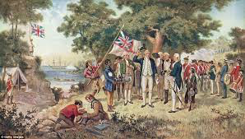
Terra Nullius
Captain Cook: Australia Terra Nullius
  “land belonging to nobody”
  White colonisers have right to occupy
Aborigines not human - “part of nature”
  “Noble savage”
No human communities:
  No established political system or existing code of law
  No recognisable tenure in land
As inhabitants = animals, the place is unpopulated, i.e. the land can be occupied
OTHERING:
  Denying humans (aborigines) that they are humans (links to racism)
  Denying them their rights (to land)
Collection of the Philosophical Institute of Victoria Hulton Archive—Getty Images
Notes:
EVIDENCE/ CASE/ EXAMPLE (Ashcroft, 2009, pp. 79-82, Terra Nullius):
Captain Cook names Australia ‘Terra Nullius’ (land belonging to nobody), i.e. empty land, meaning land not inhabited by humans
This means that white colonisers have the right (given by the Kind/ Queen of England) to occupy its lands by any means (incl. the use of force)
Why ‘Nullius’?
Because aborigines are not human
Aborigines are “part of nature”: European observers categorised them like that based on “noble savage” idea
Britannica: uncivilized man, who symbolizes the innate goodness of one not exposed to the corrupting influences of civilization” (i.e. part of nature/ not civilisation that is a human artifact – and corrupts)
There are no human communities: there is no established political system or existing code of law
(Claiming sovereignty = bringing aborigines under ‘civilizing’ protection of British Crown)
There is no recognisable tenure in the land
But what = tenure? Land claims and conflicts for two centuries
As inhabitants = animals, place is unpopulated (i.e. land can be occupied)

Slide 28
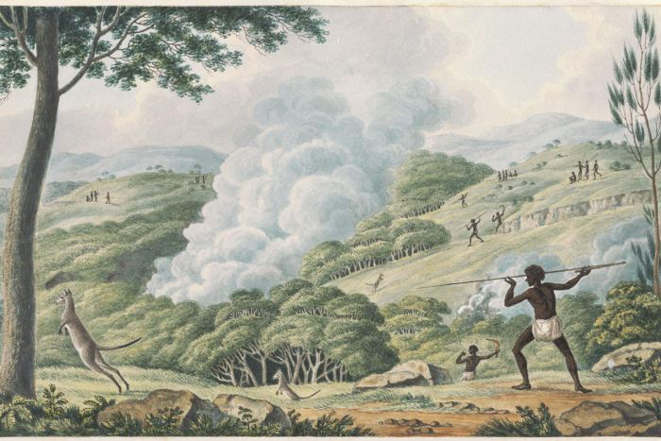
Terra Nullius: well…
But this was a very humanised world
Aborigines manipulated landscapes/ ecosystems with fire for hunting
  Make access easier through thick and prickly vegetation
  Maintain vegetation to encourage new growth and attract game
  Encourage development of useful food plants (cooking, warmth, spiritual reasons)
Aboriginal burning changed Australia’s climate (study):
  By burning (altering vegetation), Aboriginals altered the local climate
  They extended the dry season and delayed the start of the monsoon season
IMAGE: ABORIGINES USING FIRE TO HUNT KANGAROOS BY JOSEPH LYCETT, APPROXIMATELY 1775-1828. (NLA NLA.PC-AN2962715-S20)
Notes:
Of course this was a very humanised world; el.g. Aborigines manipulated landscapes/ ecosystems for hunting with fire
Fire manipulationhttps://www.dpaw.wa.gov.au/management/fire/fire-and-the-environment/41-traditional-aboriginal-burning)
Aboriginal people populated the Australian continent some 40,000 to 60,000 years ago, the major cause of fires would have been lightning. Aboriginal people learnt to harness the naturally recurring fire caused by lightning and other sources to their advantage, which resulted in skilful burning of landscapes for many different purposes.
Most of the fires were relatively low intensity and did not burn large areas. This constant use of fire by Aboriginal people as they went about their daily lives most likely resulted in a fine grained mosaic of different vegetation and fuel ages across the landscape. As a result, large intense bushfires were uncommon.
Fire was used to:
make access easier through thick and prickly vegetation
maintain a pattern of vegetation to encourage new growth and attract game for hunting
encourage the development of useful food plants, for cooking, warmth, signalling and spiritual reasons.
Aboriginal burning changed Australia’s climatehttp://theconversation.com/how-aboriginal-burning-changed-australias-climate-4454): Study by U Western Australia and UW-Madison
Well known that different vegetation types can alter evaporation, roughness, and surface reflectivity, leading to changes in the weather and climate.
We showed that the climate responded significantly to reduced vegetation cover in the pre-monsoon season. We found decreases in rainfall, higher surface and ground temperatures and enhanced atmospheric stability. In other words, there was a decline in the strength of the early monsoon “phase”.
Results lead us to suggest that by burning forests in northwestern Australia, Aboriginals altered the local climate. They effectively extended the dry season and delayed the start of the monsoon season.
Rather than children of Nature, they made nature part of culture (via Dreaming, etc.): nature not polarised from its human inhabitants
Of course this was a very humanised world
Aborigines manipulated landscapes/ ecosystems with fire for hunting
Major cause of fires: lightning
Skillful burning of landscapes (low intensity; small areas)
Constant use of fire resulted in a fine grained mosaic of different vegetation across landscape.
Fire was used to:
make access easier through thick and prickly vegetation
Maintain vegetation to encourage new growth and attract game
Encourage development of useful food plants (cooking, warmth, signalling and spiritual reasons)
Aboriginal burning changed Australia’s climate (study):
By burning forests in northwestern Australia (altering vegetation), Aboriginals altered the local climate
They extended the dry season and delayed the start of the monsoon season

Slide 29
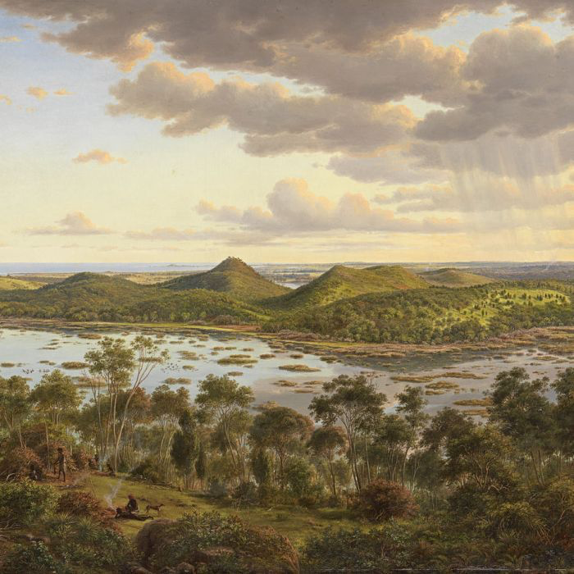
Terra Nullius: agriculture
Ashcroft, 2009: What justifies take over of lands?
No agriculture: European mind = unable to comprehend owner’s relationship with land
Rights of occupation established by Bible; according to John Locke:
  “God gave the World to Men to make use of it … [and] the Earth…for the support and comfort of their being”
  Where there has been no improvement of nature, men had not acted according to Genesis
  Where no evidence of “use” such as agriculture, buildings, monuments, and temples, it was assumed that people did not have a concept of landed property, hence could not been seen as possessors
Painting by Eugene von Guérard
Notes:
EVIDENCE/ CASE/ EXAMPLE (Ashcroft, 2009, pp. 79-82, Terra Nullius):
Source: Ashcroft, B., 2009. Caliban's voice: The transformation of English in post-colonial literatures. Routledge.
What justifies invasion and take over of lands? AT A DEEPER, IDEOLOGICAL LEVEL, OR ELSE AT THE LEVEL OF A COSMOVISION
Othering nomadic life
Absence of agriculture = European mind = unable to comprehend owner’s relationship with land
Rights of occupation established by Bible. According to John Locke:
“God gave the World to Men to make use of it … [and] the Earth…for the support and comfort of their being”
Where there has been no improvement of nature, men had not acted according to Genesis (to create property)
Where there was no evidence of “use” such as agriculture, buildings, monuments, and temples, it was assumed that people did not have a concept of landed property, hence could not been seen as possessors

Slide 30
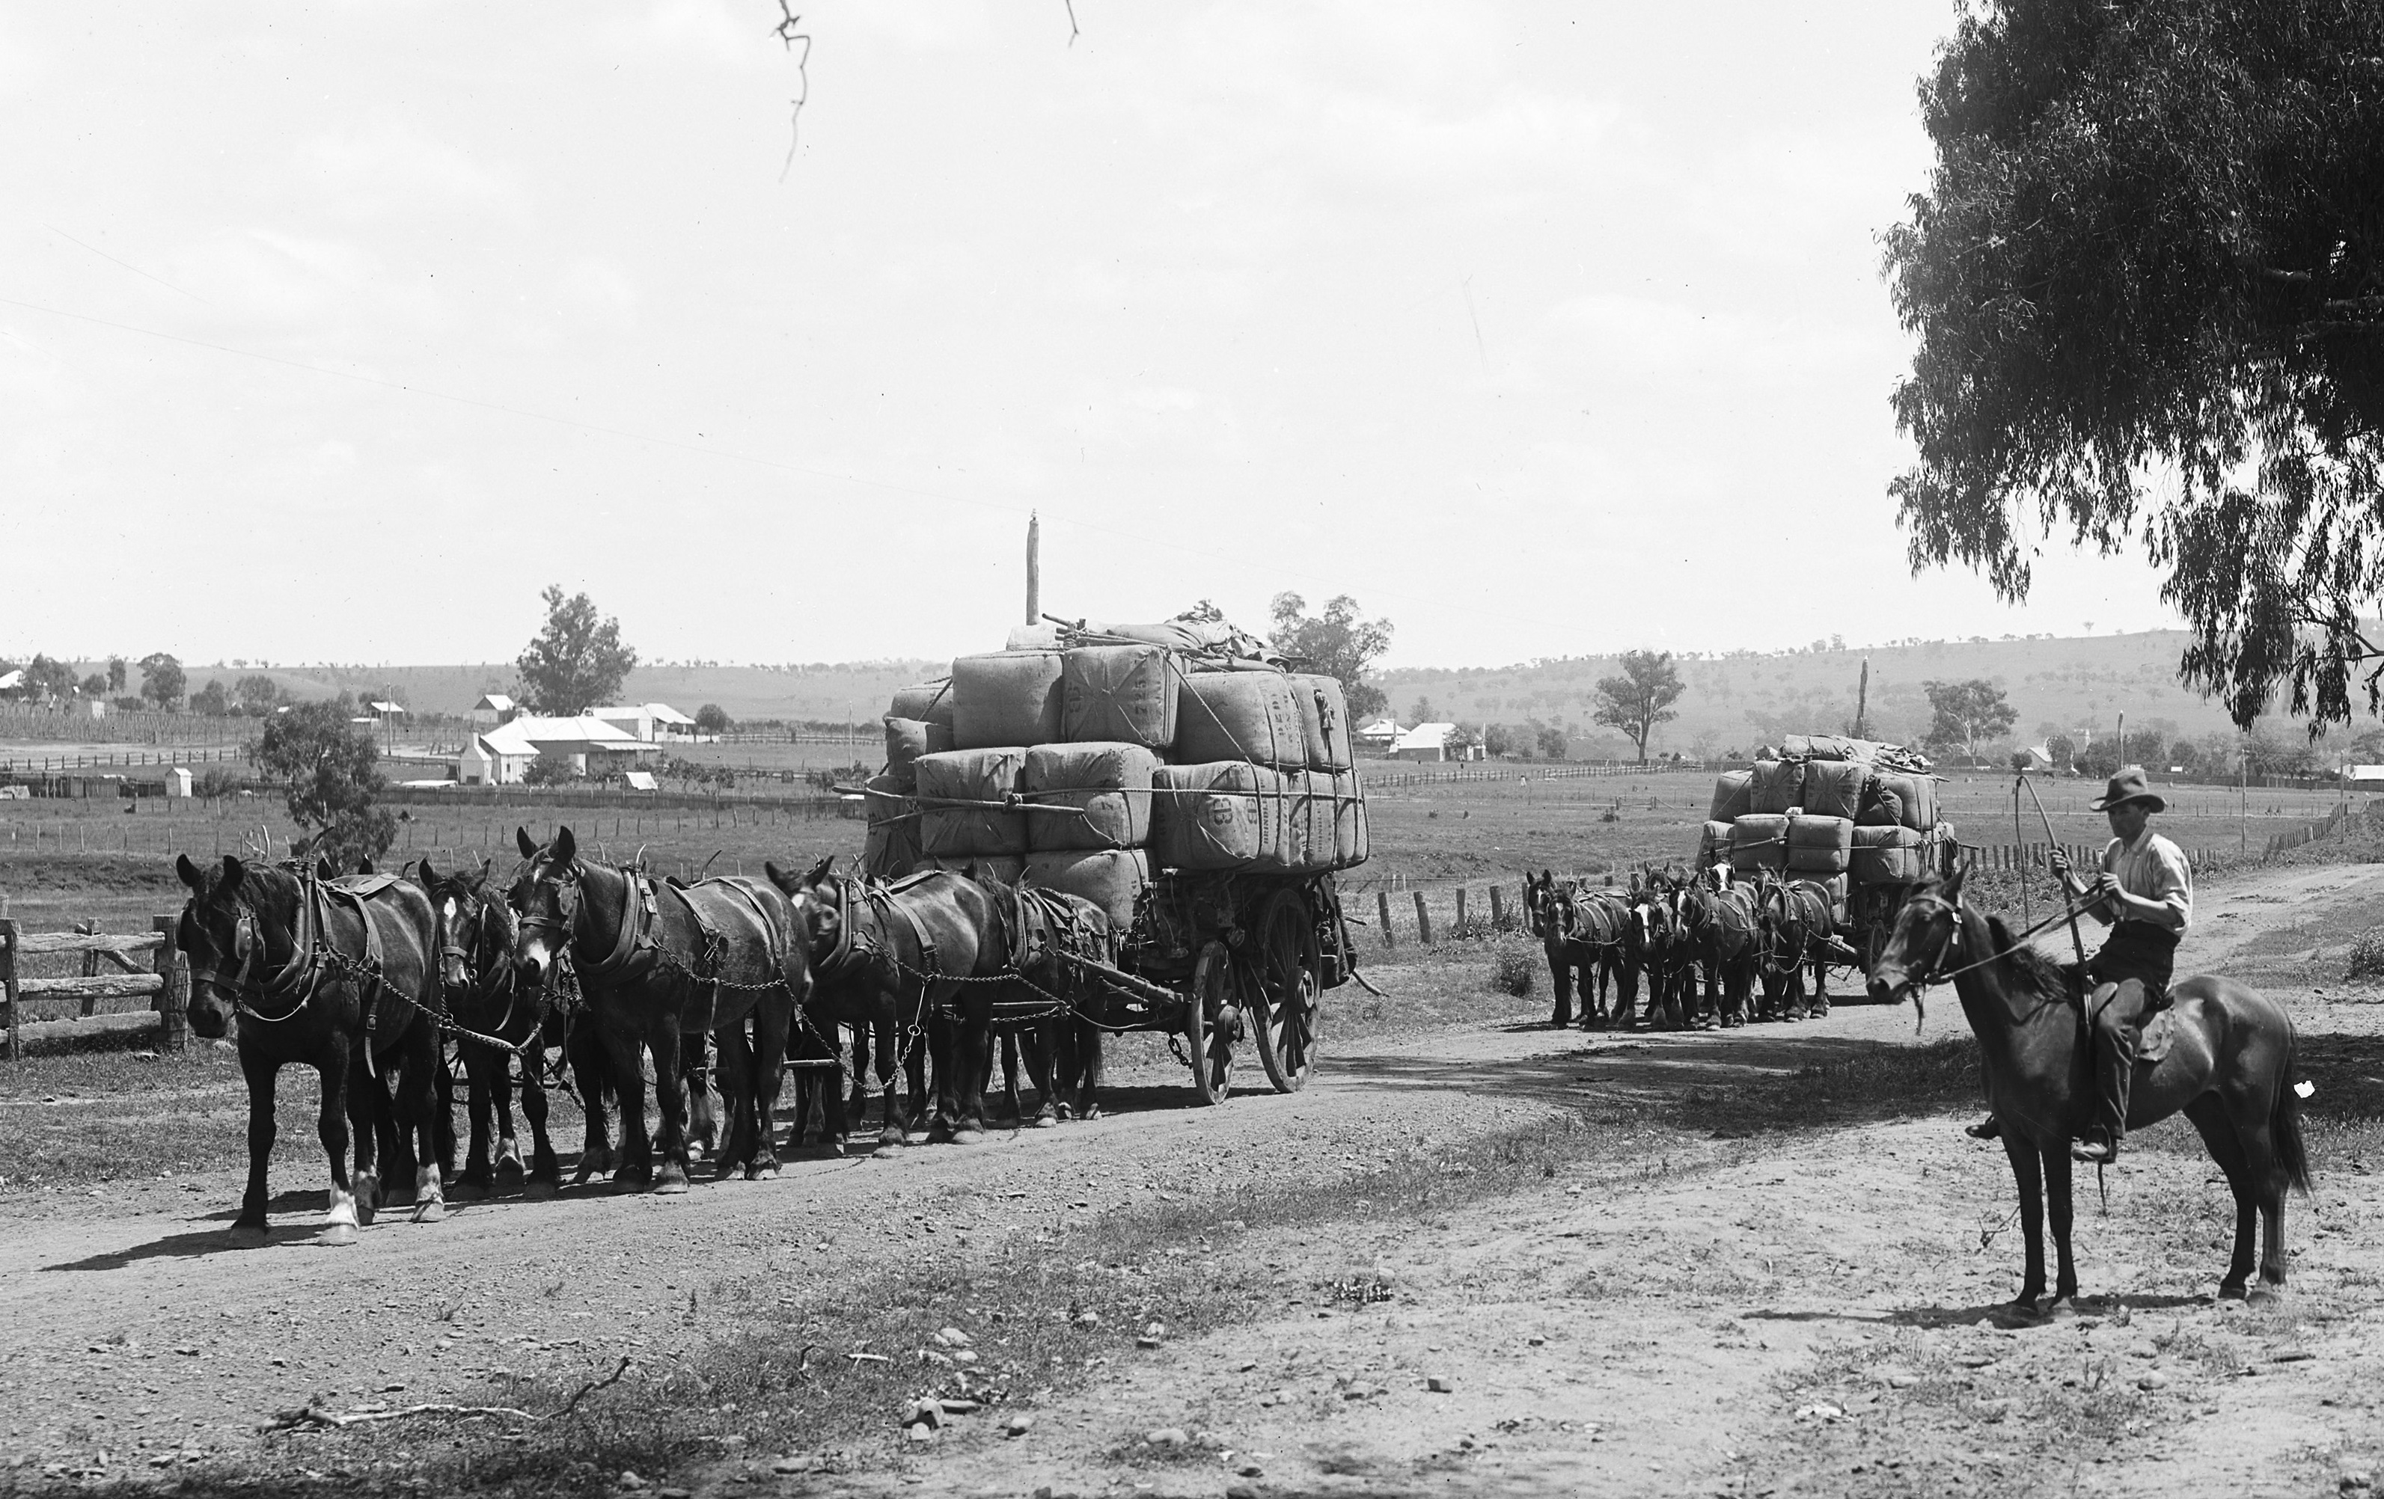
Terra Nullius: imposing agrarian ecologies
Establishment of settler colonies in Australia, which impose the domination of agrarian culture, stealing the land belonging to hunter-gatherers
Published by Kerry and Co, Australia, 1884-1917, MAAS Collection, 85/1284-1628

Slide 31
Othering and violent land dispossession (environmental justice)
Australia seen as “Terra Nullius” because Aborigines are (othered as) not humans, which justifies the violent dispossession of their lands
  distributive injustice re: resource allocation (who gets what)
Aborigines have…
  …neither voice in the process of deciding what to do with those lands (procedural EJ)…
  …nor recognition of their rights to land (recognition EJ)

Slide 32
Take-away points
Environmental racism – environmental justice
  Not only race; socio-economics, class, gender, religion too
  Distributive, but also procedural and representational
  Uneven bads; but also uneven goods
  At both nat’l and int’l level
Othering: helps forge an ideology for environmental discrimination and injustice (i.e. to justify these)
  E.g. colonialism: discrimination naturalised through othering that permitted (justified the use of force and) resource dispossession

