Slide 1
Class 3: Environmental subjects
Masters in Environmental Studies
Masaryk University, Brno, Czech Republic
November 2018
Christos Zografos, PhD
JUH-UPF Public Policy Centre, Department of Political and Social Sciences, Pompeu Fabra University, Barcelona, Spain
christos.zografos@upf.edu

Slide 2
Introduction
Answers to question
Subjects approach
Premises on other theories
Classroom activities
Notes:
FORMAT IN PPT = I HAVE UPLOADED ONE FOR THEM TO USE

Slide 3
Today’s reading
The reading
Anything you learned?
Class question
“According to Robbins and his study, lawn managers who are more aware of the environmental impacts of chemicals, and are more socially involved and concerned about their communities, are those who apply more intensively chemicals on their lawns
“How do Robbins’ middle-class lawn mainteners (“lawn people”) end up using chemicals which they know that are harmful not only for the environment but also to their own health?
“Why do they do this to themselves and the environment?”

Slide 4
Why do they do it?
Three reasons:
Hectic lives: no free time
Economic/ instrumental logics
The good citizen: moral responsibility to the community

Slide 5
Hectic lifestyles
“When I first moved here I was traveling a lot so I didn’t have time to do much in my yard. I thought, my lawn must need something, so I was treating it . . . I think of yard work as a fun activity . . . But I just don’t have the time anymore.”
Residents stated, with some degree of pride, how busy they and their families are with careers, hobbies, sports, and travel
This often translated into a feeling that they did not have time to worry about lawn chemicals

Slide 6
Economic/ instrumental logics
Association of chemicals inputs with housing values suggests instrumental motivations
Conserving well the lawn = relatively inexpensive investment for maintaining property values
Note: this is a socio-ecological system where homeowners are rewarded for environmentally detrimental behaviour!
Still: instrumental thinking only a small part of lawn manager-home owner logic
Notes:
Association of chemicals inputs with housing values…
which reach the homeowner
as well as neighborhood
…suggests obvious instrumental motivations

Slide 7
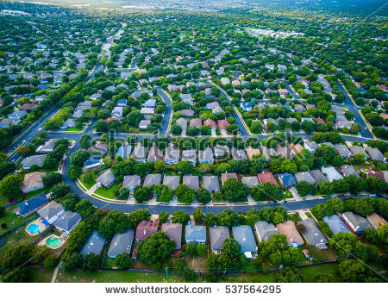
Beyond instrumentalism: community
Despite risks, chemicals use = good character; social responsibility
Ecological character of lawn: collective management
Decisions to use chemicals: something owed to neighbors
“I wouldn’t insult my neighbors by not keeping my house up”
Notes:
Despite risks, using chemicals
Sign of a good character
Sign of social responsibility
(Also, ecological character (materiality) of lawn: requires collective management otherwise plague will stay in neighbourhood)
Most important driver for lawn chemical use:
Sense there is a “neighborhood norm” (rule) of lawn management
Decisions about lawn chemical use in terms of something that they owed to their neighbors
“I wouldn’t insult my neighbors by not keeping my house up”
NOTES:
Materiality: how material properties of nature may influence human politics (e.g. ways of organising land management in a community, i.e. collective care); and history
Consider: ecological character of lawn problems: if you eliminate plague it can move next door, so next door needs to apply same level of care
Disregard for lawn care: free-riding and moral neglect
Participation in maintenance is a practice of civic good. Disregard for lawn care is, by implication, a form of free-riding, civic neg- lect, and moral weakness. This is further reinforced by the ecological character of lawn problems, including mobile, invasive, and adaptive species such as grubs, dandelions, and ground ivy. These pests, if eliminated in one yard, can easily be harbored in another, only to return later, crossing property lines, blowing on the wind, and burrowing underground. Intensive care by one party merely moves problems around; only coordinated action can control “outbreaks” and achieve uniformity. In this sense, lawn care differs from other kinds of individual invest- ment in community, such as Christmas lights, painting, or other efforts. It is a far greater problem, requiring coordinated collective action, at least where green monocultural results are desired.

Slide 8
The good citizen: moral responsibility
…imperative to mow in time for high school prom. Limousines came to the cul-de-sac to pick up several high school students, pictures were taken on front lawns, and everyone wanted their yards to look perfect
Suzanne: why she continued lawn chemical treatments even though her dog’s paws were bleeding, she replied: I guess we didn’t want the yard to look bad when everybody else’s looked so nice . . . You try to make it look as nice as you can, without offending other people
Lawn chemical use as something they felt they had to do to meet the expectations of their neighbours
Reveals: ways in which neighborhood forces (without physical coercion) certain kinds of lawn management onto individuals

Slide 9
Disciplining
When weeds grow prominent:
“I would feel really out of place. It’s not only how the yard looks to me, but how it looks to the neighbors. If it’s not in keeping with the neighborhood [then I’d have to spray more]”
“[in his mom’s neighbourhood] if you don’t cut twice a week you are a communist!
System of monitoring (when to “improve” lawn) that relies heavily on the view of one’s lawn by neighbors
Neighbour’s gaze
Notes:
System of monitoring (when to “improve” lawn) that relies heavily on the view of one’s lawn by neighbors

Slide 10
The argument
The maintenance of lawn yard landscapes through environmentally harmful lawn chemicals is an internalized environmental practice rooted on a socially enforced environmental aesthetic that associates good citizenship with environmentally harmful activities (use of chemicals)
Cos. benefit, but not force anyone
Power enacted internally through producing a certain kind of “subject”
Notes:
The argument (Robbins’):
Maintenance of lawn yard landscapes through environmentally harmful lawn chemicals: internalized environmental practice…
…which is:
Rooted on socially enforced environmental aesthetic
That associates good citizenship with environmentally harmful activities (use of chemicals)
Such behaviors benefit the corporate entities that produce, package, and market the goods and services that maintain such an aesthetic
But it cannot be said that these companies forced anyone, in any simple way, to act as they do
Rather, the exercise of power is enacted internally
Through production of a certain kind of “subject,” whose identity as a good citizen is associated with a set of specific [harmful/ polluting] environmental activities

Slide 11
Power shaping subjects
subject to someone else by control and dependence
tied to one’s own identity by a conscience or self-knowledge
Subject (Foucault, 1982): two meanings of word "subject":
Both meanings suggest a form of power which subjugates and makes subject to
Q: Who is this subject?
“turfgrass subjects” (p.115)
Subject = Lawn People!

Slide 12
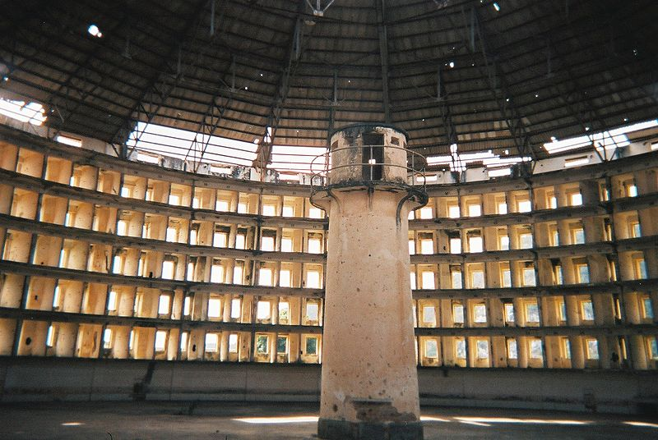
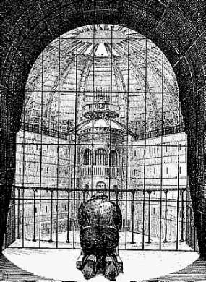
Making subjects: self-disciplining
Central problem of modern govt. (Foucault): “the conduct of conduct or else the power to act on the actions of others”
Modern governments develop technologies of power to achieve
Panopticon: what is it?
Prisoner feels he’s been watched and has to behave at all times in case guard is watching (Sharpe, 2009)
By feeling he’s been watched all the time he internalises the rule of discipline (behave as he is required)
Guard doesn’t even need be there!
Presidio Modelo prison, Cuba (Source: Friman, 2005)
Question: What’s this??
Source: /thefunambulist.net//thefunambulist.net/

Slide 13
Background to the approach
Subjects and subject-making

Slide 14
Foucault, power and liberalism
Foucault’s interest:
Liberalism (Britannica)
How power operates
Emergence of ‘technologies of power’ in modern (roughly 17th century onwards) period (Europe)
An interest on liberalism: key, modern political doctrine and practice of government
Protecting and enhancing freedom of the individual = the central problem of politics
Government is necessary to protect individuals from being harmed by others
But government itself can pose a threat to liberty
Laws, judges, and police are needed to secure the individual’s life and liberty, but their coercive power may also be turned against him
Problem: how to avoid (as much as possible) coercion/ authority abusing power but also secure individual liberty (do as one wants – more or less)?
Notes:
Britannica:
Political doctrine that takes protecting and enhancing the freedom of the individual to be the central problem of politics.
Liberals typically believe that government is necessary to protect individuals from being harmed by others,
but they also recognize that government itself can pose a threat to liberty.
As the revolutionary American pamphleteer Thomas Paine expressed it in Common Sense (1776), government is at best “a necessary evil.”
Laws, judges, and police are needed to secure the individual’s life and liberty, but their coercive power may also be turned against him.
Problem: how to avoid (as much as possible) coercion/ authority abusing power but also secure individual liberty (do as one wants – more or less)?

Slide 15
Central problem of modern government
Iverson and Painter, 2005:
Foucault identified the ‘conduct of conduct’ as the central problem of modern government
A way to deal with the central paradox of liberal government:
liberalism asserts sovereignty of free individual,
yet government requires that individual behaviour be regulated
Notes:
Iverson and Painter in https://foucaultblog.wordpress.com/2007/05/15/key-term-conduct-of-conduct/
Conduct of conduct = conducting (leading, driving, controlling) the behaviour (conduct) of citizens (subjects)

Slide 16
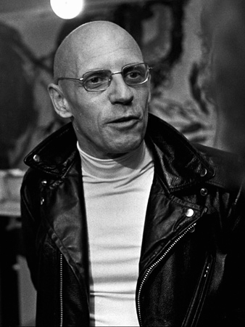
Foucault: exercising power
Power can be exercised in more subtle ways than outright oppression + coercion
i.e. by establishing normalised and ‘deviant’: behaviours (homosexuality), processes (democracy is inefficient), actions (stealing = crime), persons (lepers=unhealthy), places (Africa is dangerous, e.g. disease, crime, jungle), etc.
People integrate these as personal principles that guide their behaviour -> (as – liberal – government) you no more need to punish or compensate
They become subjects: individuals subjected (to the will/ desires of authority) through ties to own identity by self-knowledge (e.g. who you think you are)
In this way governments (those ‘in power’) discipline behaviour, people (in general) or certain groups, etc. without coercion
Source: http://www.michel-foucault.com
Notes:
The conduct of conduct = central problem of modern government
The concept of “man”: fundamental point of ref for human science inquiry. The double essence of “man”
Man as an object
Man as a subject
Historical review: the impossibility of “man”
But why taken for granted for so long?
A conceptual prerequisite for productive citizens (17-18th cent. Europe)
Body and soul can be manipulated and reformed
Institutions of discipline: Panopticon (surveillance cameras)
Seeking the “deviant”: pathological populations
Biopolitics of reformers: principles of welfare state
“Power-knowledge”
Subjectivation: classify and shape individual human beings into “subjects” of various kinds – e.g. heroic-ordinary, normal-deviant)

Slide 17
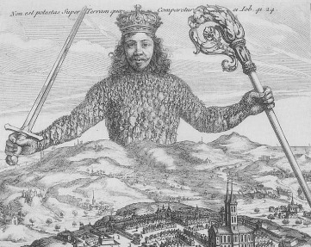
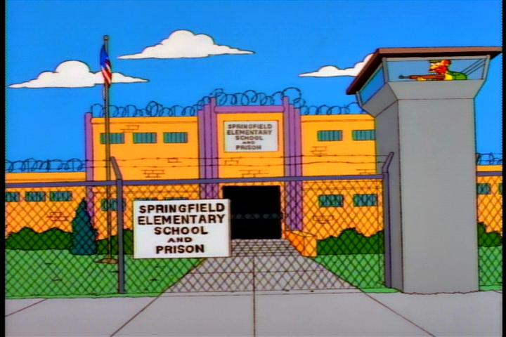
Governmentality
Governing that includes the active consent and willingness of individuals to participate in their own governance
Or else: the governing of people’s conduct through positive means
Not sovereign power: abide by laws and regulations of centralised power (e.g. royal power)
Not disciplinarian power: learn what to do and not to do; through punishment and reward (institutions that exercise authority)
Yes: the willing participation of the governed (consent and self-regulation)
Notes:
Governing that includes the active consent and willingness of individuals to participate in their own governance
Or else: emphasizes the governing of people’s conduct through positive means rather than the sovereign power to formulate the law. In contrast to a disciplinarian form of power, governmentality is generally associated with the willing participation of the governed
Not sovereign power: abide by laws and regulations of centralised power
Not disciplinarian power
Characteristic of modern period where power exercised through disciplinary means in a variety of institutions (e.g. penitiary system, schools)
Power exercised by those who represent authority
Teaches you through reward and punishment the rules you must follow in your life as a citizen (power-and-knowledge)
What is more: knowledge created in institutions is then used to control populations (e.g. university, demography, anthropology for governing populations through controlling them, e.g. in colonies; surveillance systems, etc.)
Yes: the willing participation of the governed
Three Minute Thought: What Is Governmentality?: https://www.youtube.com/watch?v=XvWsIR5_bOs

Slide 18
Individual responsibility
Self-responsibility and self-improvement (Hamann, 2009):
Just as illness and disease are more often addressed in the mainstream media as a problem of revenue loss for business [and hospitals or government revenue] than as an effect of poor environmental or worker safety regulations, corporations have stepped up the practice of promoting full worker responsibility for their own health and welfare, offering incentives to employees for their participation in fitness training, lifestyle management and diet programs. We can also find a sustained expansion of ”self-help” and ”personal power” technologies such as new techniques promising greater control in the self-management of everything from time to anger.
These and many other examples demonstrate the extent to which so much that was once understood as social and political has been re-positioned within the domain of self-governance, often through techniques imposed by private institutions such as schools and businesses.
Seeking to reshape people’s subjectivities into individuals who are responsible for themselves and must seek self-improvement

Slide 19
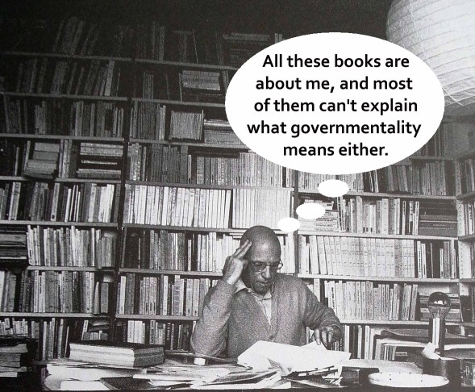
Governmentality
Way in which governments try to produce citizens (subjects) best suited to the ends and objectives of governments
A style of exercising power
Organised practices through which subjects are governed (Mayhew, 2004)
Mentalities, rationalities, techniques
E.g think back on ‘Lawn People’ (subjects)
Source: https://adrianblau.files.wordpress.com
Notes:
Used to mean several things, such as:
The “how” of governing (Jeffreys & Sigley, 2009)
Calculated means of directing how we behave and act
But also: Way in which governments try to produce citizens (subjects) best suited to the ends and objectives of governments
A style of exercising power
And: Organised practices through which subjects are governed (Mayhew, 2004)
Mentalities, rationalities, techniques

Slide 20
Activity: watch-n-discuss
Vox: Game of Thrones is secretly all about climate change
“…stopping it requires the world’s biggest nations – like China, India, and the US – to sacrifice a little in the short term and put away their political competition with each other.
A collective action story… story Northern Wall and forces it holds at bay “is about the mistaken belief that industrial civilisation can stand against the changing forces of nature
…but if our zombies are climate change, and we are not doing nearly enough to prevent catastrophic global warming, who should you really be annoyed with?”
QUESTION: Who should you be annoyed with? How change?
Halsey, 2004 (and ‘Man’ by Steve Cutts)
But I want to suggest that structural economic power relies for its efficacy not simply on the relations between government, law, and the economy, so much as on the flows of pleasure which invest the population at any one time.
Not only is it profitable to be environmentally destructive (in the sense of mining, manufacturing cars, clearfelling forests) it feels good too (in the sense of purchasing a gold necklace, driving on the open road, looking at a table, chair, or house constructed from redwood, mahogany, mountain ash or the like).
QUESTION: Who should you be annoyed with? How change?
https://www.youtube.com/watch?v=Xppoy2veSP0
https://www.youtube.com/watch?v=WfGMYdalClU
Notes:
Question: How to change all this? With what processes/ practices? Who should be targeted to achieve change, e.g. avoid climate change/ environmental disaster?
Is it a matter of convincing someone? And if yes, how (practices/ processes)?
Game of Thrones is secretly all about climate change
https://www.youtube.com/watch?v=Xppoy2veSP0
…stopping it requires the world’s biggest nations – like China, India, and the US – to sacrifice a little in the short term and put away their political competition with each other.
A collective action story… story Northern Wall and forces it holds at bay “is about the mistaken belief that industrial civilisation can stand against the changing forces of nature
…but if our zombies are climate change, and we are not doing nearly enough to prevent catastrophic global warming, who should you really be annoyed with?
Man (by Steve Cutts):
https://www.youtube.com/watch?v=WfGMYdalClU
Halsey, 2004 (and ‘Man’ by Steve Cutts)
…the vast bulk of environmental damage stems from privileging ‘the economic sphere over other social structures and issues’.
But I want to suggest that structural economic power relies for its efficacy not simply on the relations between government, law, and the economy, so much as on the flows of pleasure which invest the population at any one time.
Not only is it profitable to be environmentally destructive (in the sense of mining, manufacturing cars, clearfelling forests) it feels good too (in the sense of purchasing a gold necklace, driving on the open road, looking at a table, chair, or house constructed from redwood, mahogany, mountain ash or the like).
Environmental damage is in short as much a corporeal (bodily/ subjective) event as it is a corporate/ state practice

Slide 21
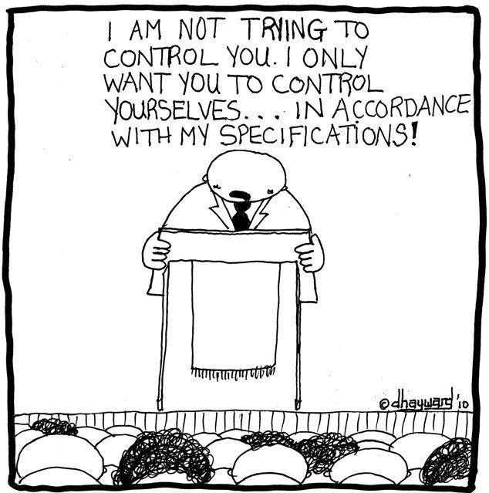
Take away points
Green governance: governmentality
Internalised power: Power can also be exercised internally
through construction of subjects who by understanding themselves in particular ways (e.g. “good citizens”) voluntarily (without coercion) serve state projects – e.g. produce nature in ways desired by state, corporations
E.g. turfgrass subjects or Lawn People
Copyright: David Hayward (source: geotimes.co.id)
Notes:
The way power is exercised within – rather than over – individuals, communities and societies. As people come to understand themselves, regulate their activities, and help oversee the actions of others, they are not merely the objects of external force, but are themselves embodied power. Foucault observes, “individuals are the vehicles of power, not its points of application” (Foucault 1980: 98) and further suggests that government (or sovereign) power depends upon the extension of the state itself
through internalization and acceptance of individuals as state subjects, a condition he refers to as “governmentality” (Foucault 1991).
More on internalised power:
Internalised power: power also expressed on how individuals come to obey + take for granted “property” laws
Internalising control & authority as normal/natural
Hence, neither questioning nor resisting it
Foucault: governmentality
Government power depends upon extending the state through internalisation and acceptance of individuals as state subjects
Way power exercised within individuals
Also: communities and societies

Slide 22
Course overview: What stuck with you
Pick a partner and respond in a piece of paper:
An “Aha” moment
“Now I realise why…”
A pleasant surprise
Something you thought was particularly interesting
Something you didn’t expect
A solution
Something that you had to struggle with to understand
Something you don’t agree with
Something that you agree with strongly
Something you want to know more about
A question that you have

Slide 23
Course core arguments
Capitalism and environmental degradation
Capital accumulation and the quest for value surplus produce environmental degradation; but also, environmental degradation is itself a condition for capital accumulation (surplus value)
Environmental justice (racialised natures)
Racism produces environmental degradation, because it disproportionally offloads environmental ‘bads’ to non-white communities, depriving them of resources and reducing their capacities to maintain a healthy environment
Environmental justice is about the fair: distribution of environmental goods and bads, participation in environmental decision-making, and representation of people’s diverse ways of connecting to the environment no matter their race, gender, ethnicity, sexual orientation, or class or income levels. Both nat’l and int'l dimensions of environmental justice are important
Othering helps forge an ideology for environmental discrimination and injustice (i.e. helps justify these). Discrimination naturalised through othering permits resource dispossession
Environmental subjects (internalised and diffuse power)
Power can also be exercised internally, through the construction of subjects who by understanding themselves in particular ways (e.g. “good citizens”) voluntarily (without coercion) serve state projects – e.g. produce nature in ways desired by state or corporations – even at the harm of themselves

