Slide 1
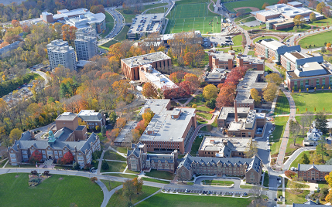
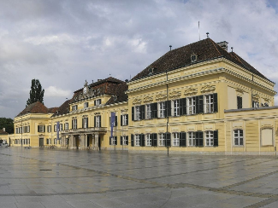
Foundations for Sustainability
HEN0670
Brian D. Fath, Ph.D. – bfath@towson.edu
Professor, Department of Biological Sciences, Towson University, Baltimore, Maryland, USA
Senior Research Scholar, International Institute for Applied Systems Analysis, Laxenburg, Austria

Slide 2
HEN 670: Syllabus highlights
Course Description:
  This graduate-level course investigates the concept of sustainability from first principles of energetics and ecology applied to socio-economic systems. It deals with the ecological, physical, economic, social, and moral dimensions of sustainability.
Grade evaluation (points available):
  Paper (100), Exercises (50), Discussion (100), Final Exam (150) = Total (400)
Format:
  Each session will begin with a 30 minute overview and summary of the topic/reading, 20 minute exercise, and 40 minute discussion. Students are expected to come to class prepared and ready to discuss with an open and curious mind.

Slide 3
Schedule
Thursday 26. 9. 14:00–15:40, room nr. P31
Lecture 1: Introduction to sustainability and the Sustainable Development Goals.
Exercise: students investigate one SDG in pairs, then look for overlaps and synergies
Thursday 10. 10. 14:00–15:40, room nr. P31
Lecture 2: Ways of valuing the environment. Introduction of cultural theory and ecosystem services
Exercise: recognizing diversity of opinions, choose the opposite side in discussion
Thursday 17. 10. 16:00–17:40, room AVC
Lecture 3: Limits to Growth, planetary boundaries, Flourishing overview
Exercise: identify ways we exceed limits, ways we are under limits
Thursday 24. 10. 14:00–15:40, room nr. P21
Paper topic due
Lecture 4: Foundations for Sustainability – Chapter 1 systems thinking and win-win
Exercise: systems thinking games, bathtub models
Thursday 31. 10. 14:00–15:40, room nr. P31
Lecture 5: Foundations for Sustainability – Chapter 2 Ecologic metaphysics
Exercise: thinking outside the box: view of life from a bug’s perspective
Thursday 7. 11. 14:00–15:40, room nr. P31
Lecture 6: Foundations for Sustainability – Chapter 3 mutualism
Exercise: communicating science to the general public
Thursday 14. 11. 14:00–15:40, room nr. P31
Lecture 7: Foundations for Sustainability – Chapter 4 (origins of life)– 5 reforming reductionism
Exercise: follow the money (or other natural currency) through the system
Thursday 21. 11. 14:00–15:40, room nr. P31 -
Tuesday 26.11., 8.00 - 9.40, room nr. U35
Paper due
                Lecture 8: Foundations for Sustainability – Chapters 6 – networks
Exercise: basic network models reveal synergism and mutualism
Thursday 28. 11. 14:00–15:40, room nr. P31
Lecture 9: Foundations for Sustainability – Chapters 7 – Rosen
Exercise: applications in your daily lives and in the Moravian landscapes
Thursday 5. 12. 16:00–17:40, room nr. P31
Lecture 10: Foundations for Sustainability – Chapters 8-9 – applications & Sustainability for all
Exercise: Czech path to SDGs

Slide 4
Sustainable Development
“development that meets the needs of the present generation without compromising the ability of future generations to meet their own needs”
  Our Common Future/ United Nations Brundtland Report, 1987

Slide 5
Goal
Some of the most threatening environmental problems are caused by widespread poverty
To develop?
  Or
To sustain?
Development is based on squandering our biological capital

Slide 6
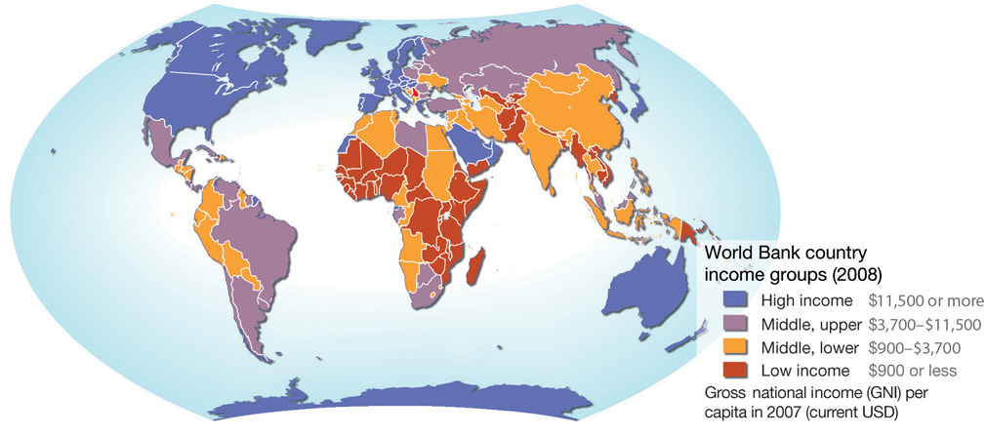

Slide 7
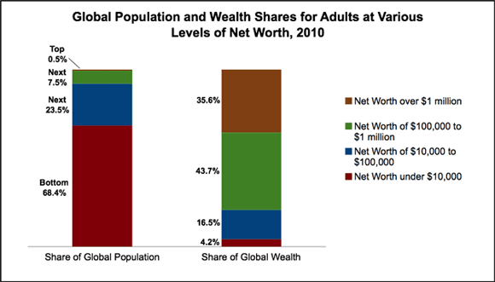

Slide 8
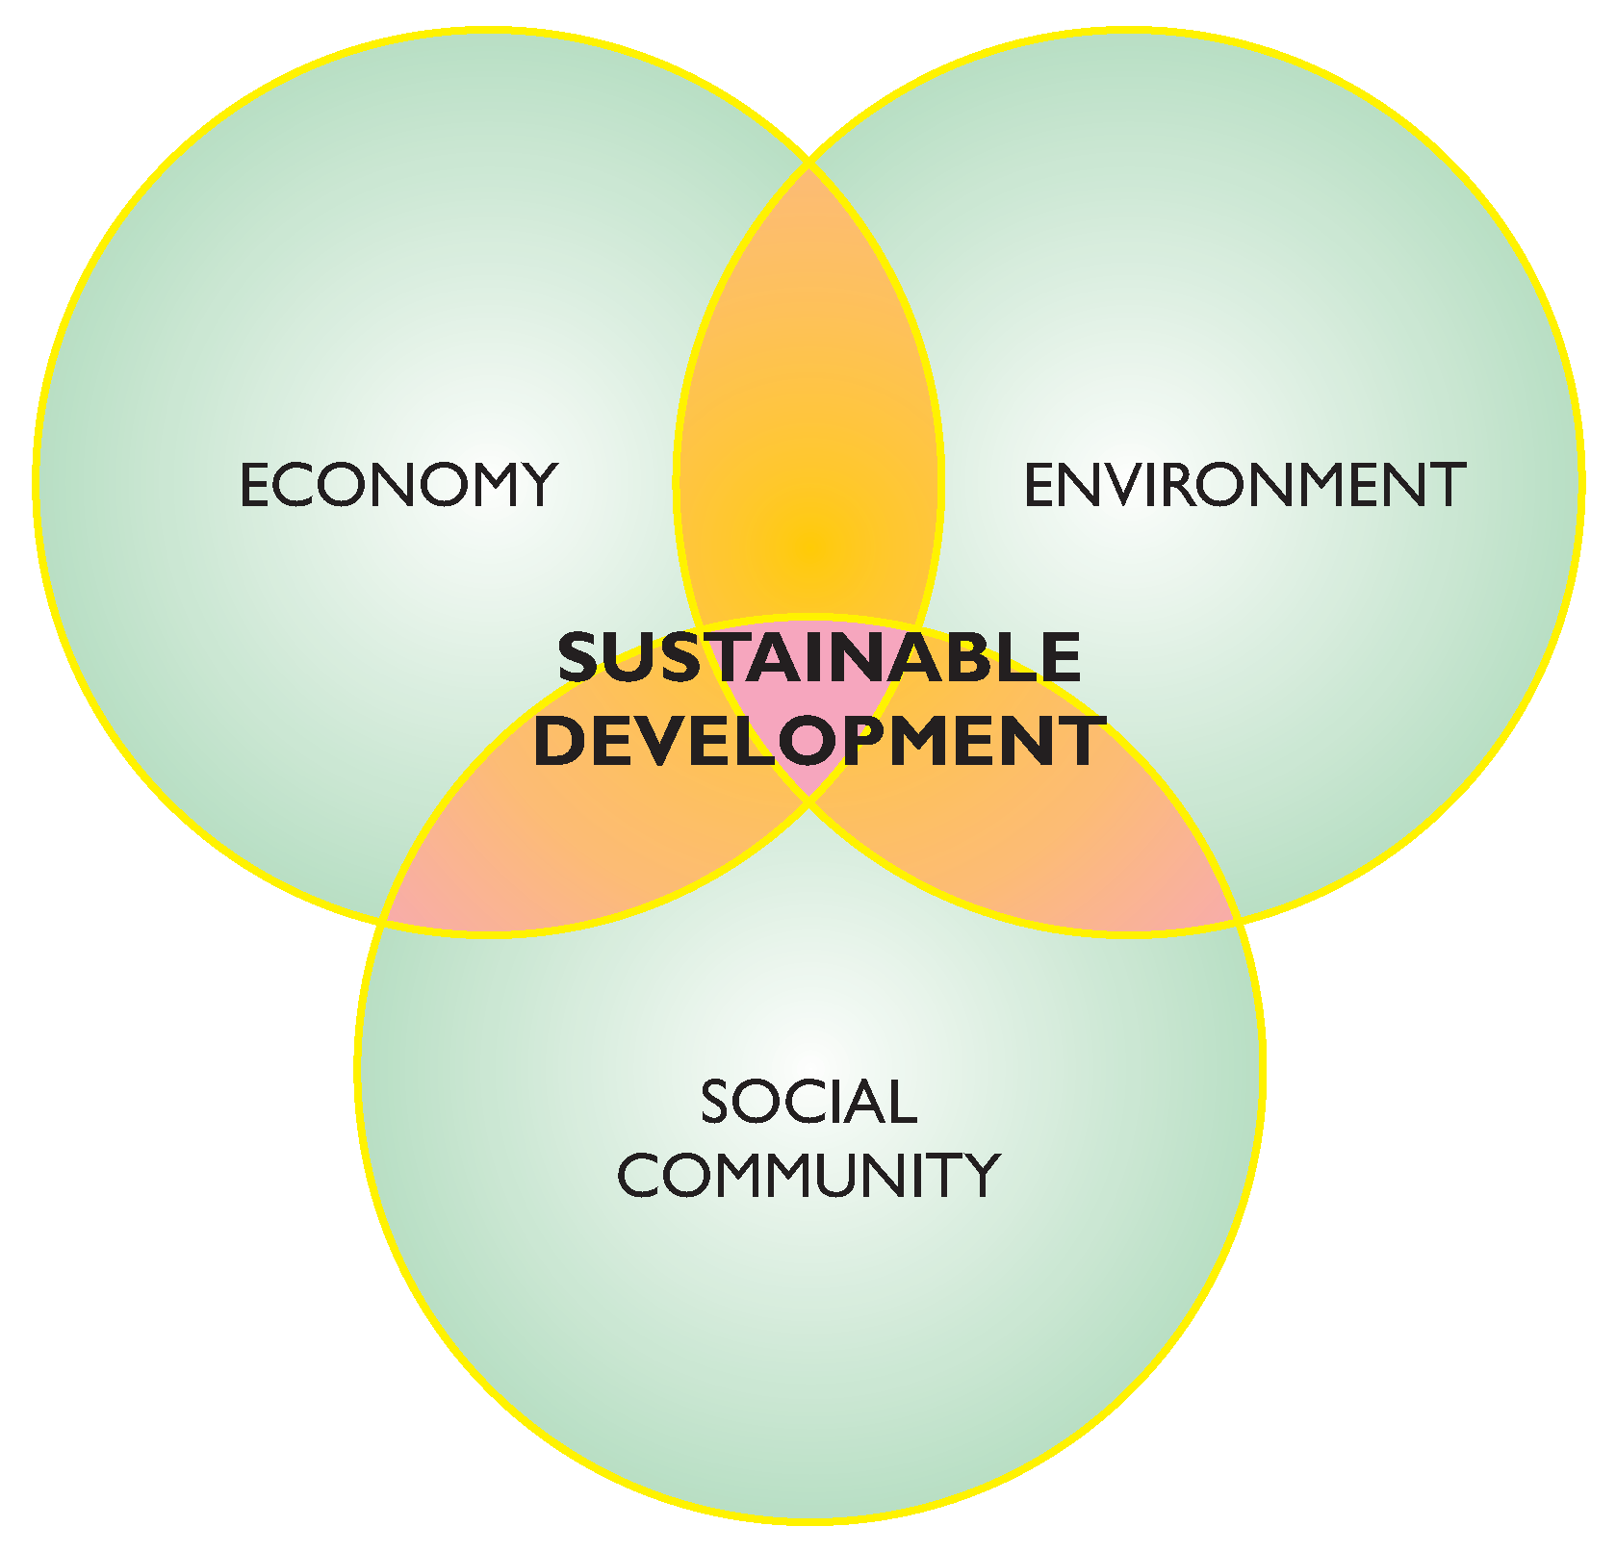
Three pillars of SD

Slide 9
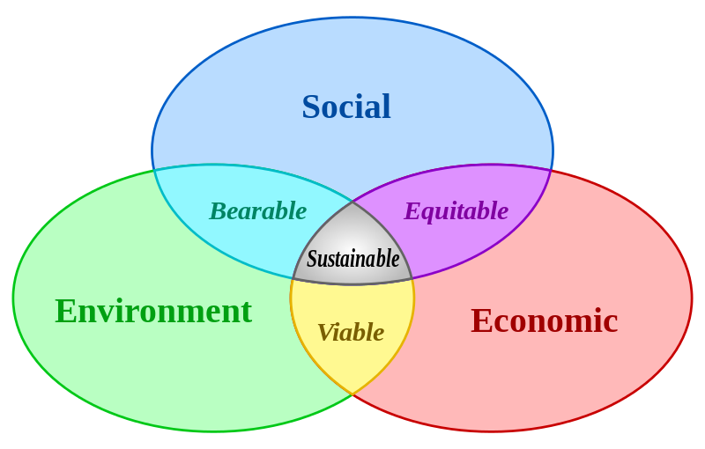

Slide 10
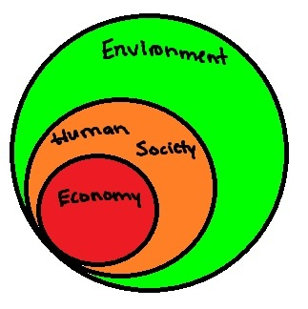
Environment is foundation for all aspects, others are subsets

Slide 11
Sustainable Development vs Sustainability
Sustainable Development: “development that meets the needs of the present generation without compromising the ability of future generations to meet their own needs” – Our Common Future/ Brundtland Report, 1987
Sustainability: “the capacity to endure” – wikipedia
What are “our needs”?

Slide 12
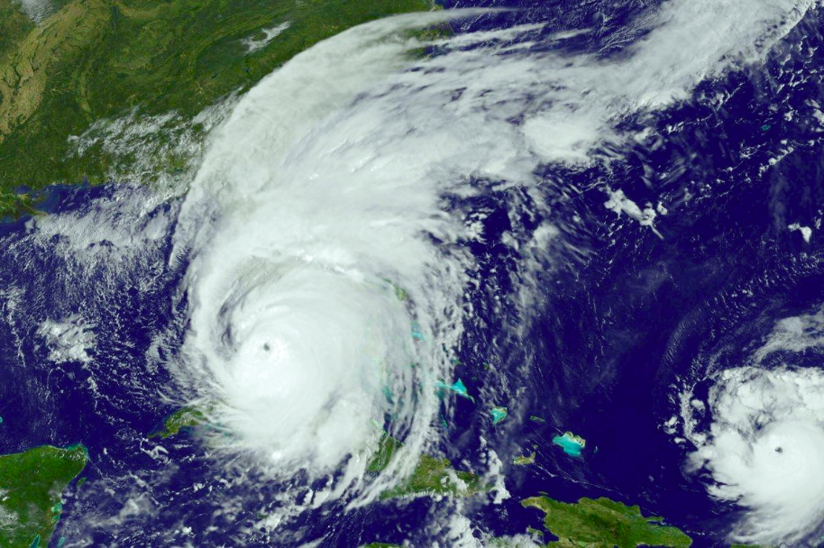
Hurricane
https://en.wikipedia.org/wiki/Hurricane_Irma

Slide 13
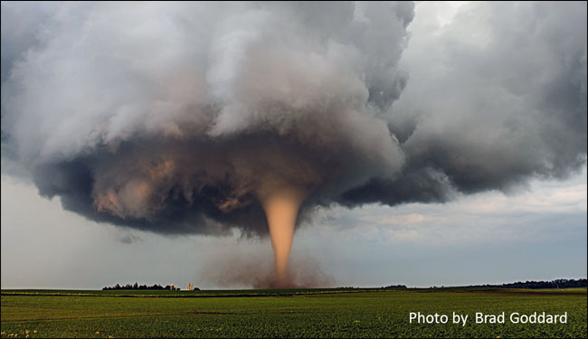
Tornado
https://www.weather.gov/safety/tornado

Slide 14
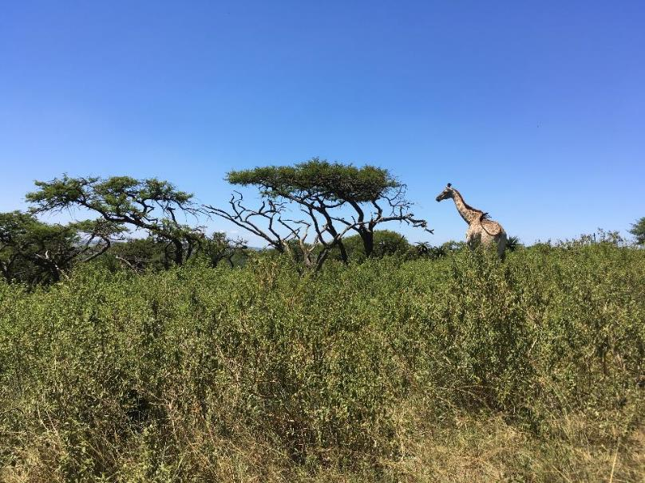
Ecosystem

Slide 15
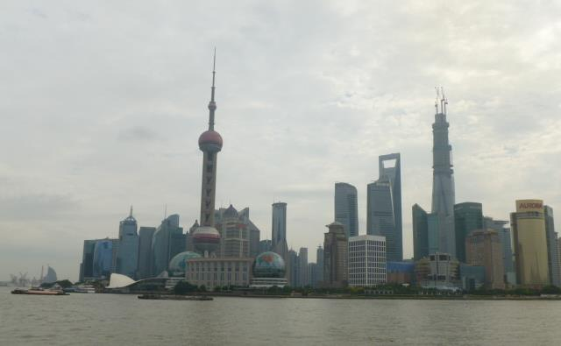
City

Slide 16
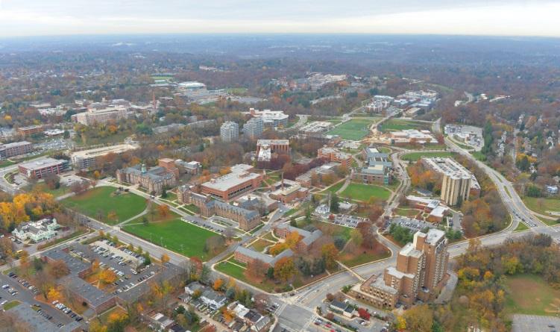
Campus

Slide 17
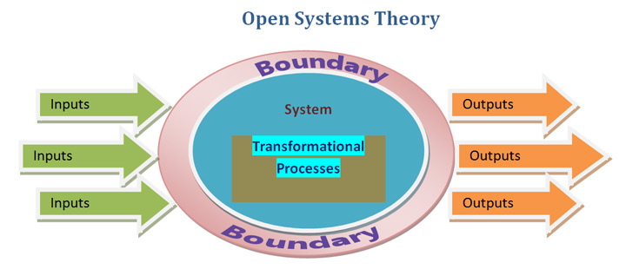
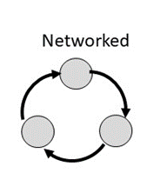
All are open systems with energy driving and maintaining the processes
All import, reuse, and export resources (water, wood, waste, minerals, metals, materials, etc.)

Slide 18
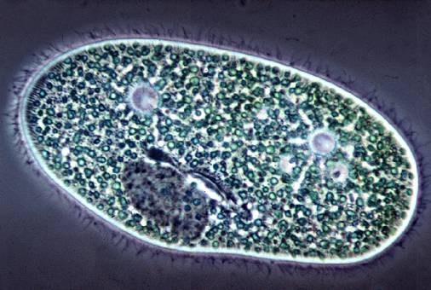
What is life?
A single cell possesses all the necessary aspects to be alive

Slide 19
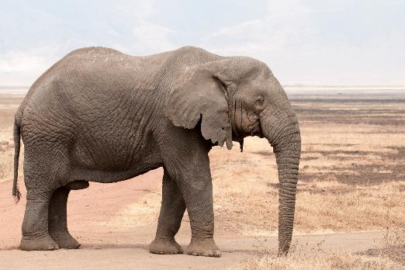
What is life?
Discrete Life
A single organism possesses all the necessary aspects to be alive

Slide 20
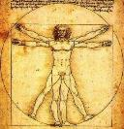
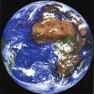
Mental models and outcomes
Real impacts of choice of system boundaries
Tragedy of the Commons
Humans win, environment degrades
Inherent in this paradigm, life is separate from environment in mind and action
Once fragmented, it is possible and likely that the value of environment is seen and treated as less than the value of life
Environment is consumed and degraded as manifest in many symptoms of ecological crisis
Life
Environment
Figures by Dan Fiscus

Slide 21
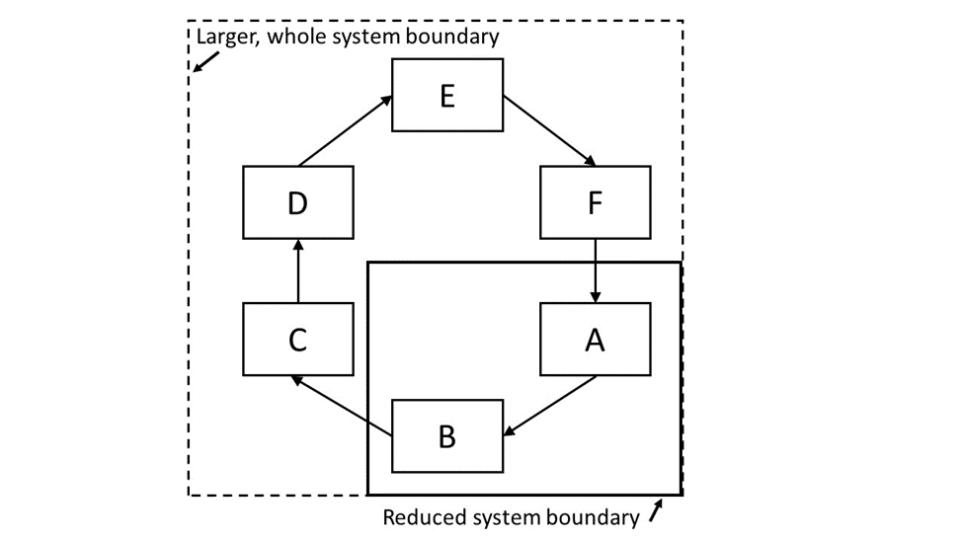
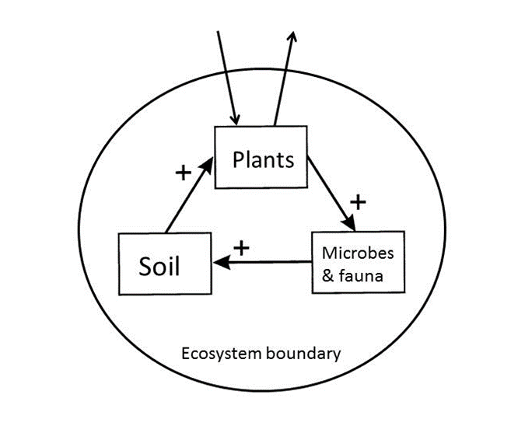

Slide 22
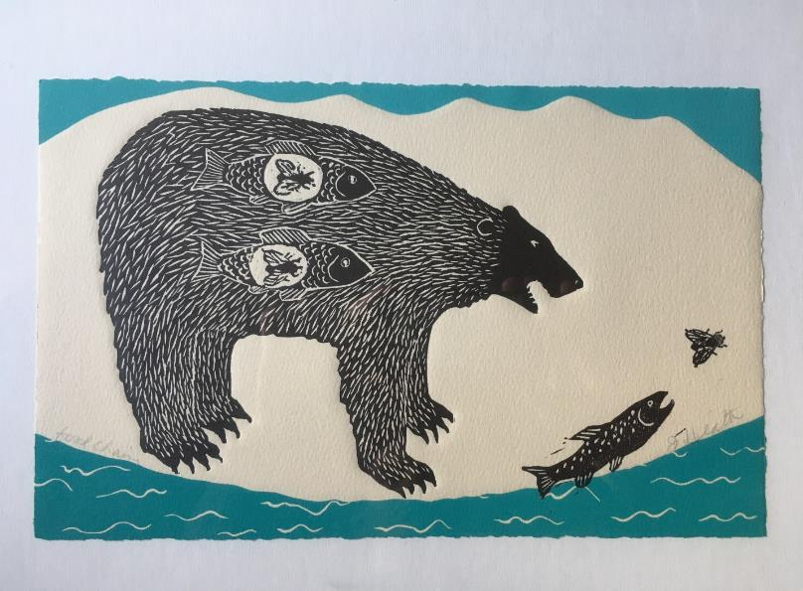
Ecosystem is full of
Interconnections and Interdependencies
Art work of Jan Heath, entitled “food chain”

Slide 23
A bottom up re-visioning is vital:
A new holistic paradigm for life
Contrary to the dominant mainstream view, the basis of all current biology and life science education, it now is becoming clear that life is not only (or even primarily) an organismal property.
In the view actively emerging, life is not centered on or emanating from organisms, nor is it primarily a localized, objectified or material phenomenon.
Life is inherently relational, distributed, and non-localized

Slide 24


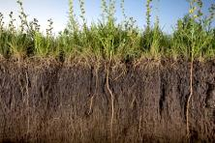
Abiotic and ecological interactions
Discrete Life
A single organism possesses all the necessary aspects to be alive

Slide 25
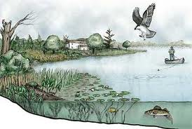
Interacting ecological community and its abiotic environment is an ecosystem
Sustained Life
An ecosystem possesses all the necessary aspects to sustain life

Slide 26
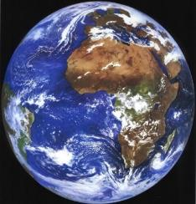

Recursive nature of nature
Life and environment are best understood and modeled as unified as a single “life–environment” system.
Bounty of the Commons
Humans win, environment improves
Fiscus D, Fath BD, Goerner S. 2012. E:CO 14(3), 44–88.

Slide 27
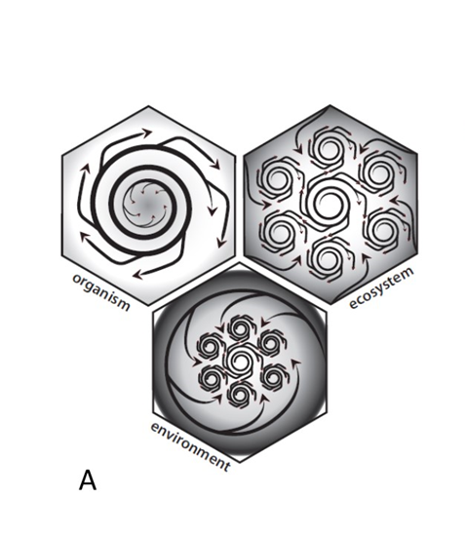
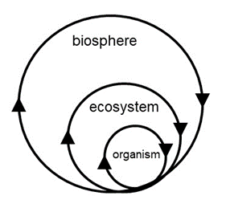
Three unit models of Life:
  Organism
  Ecosystem
  Environment
Artwork by McManus

Slide 28
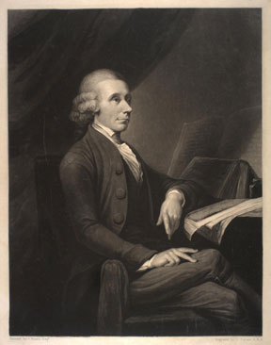
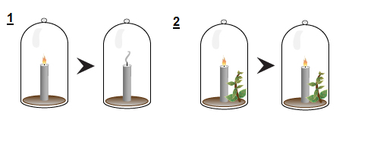
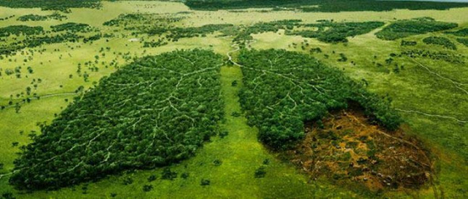
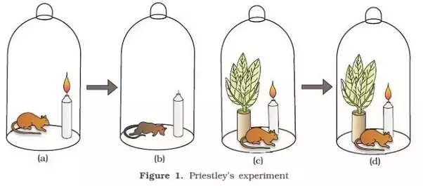
Joseph Priestley discovered oxygen in 1774
www.acs.org/content/acs/en/education/whatischemistry/landmarks/josephpriestleyoxygen.html

Slide 30
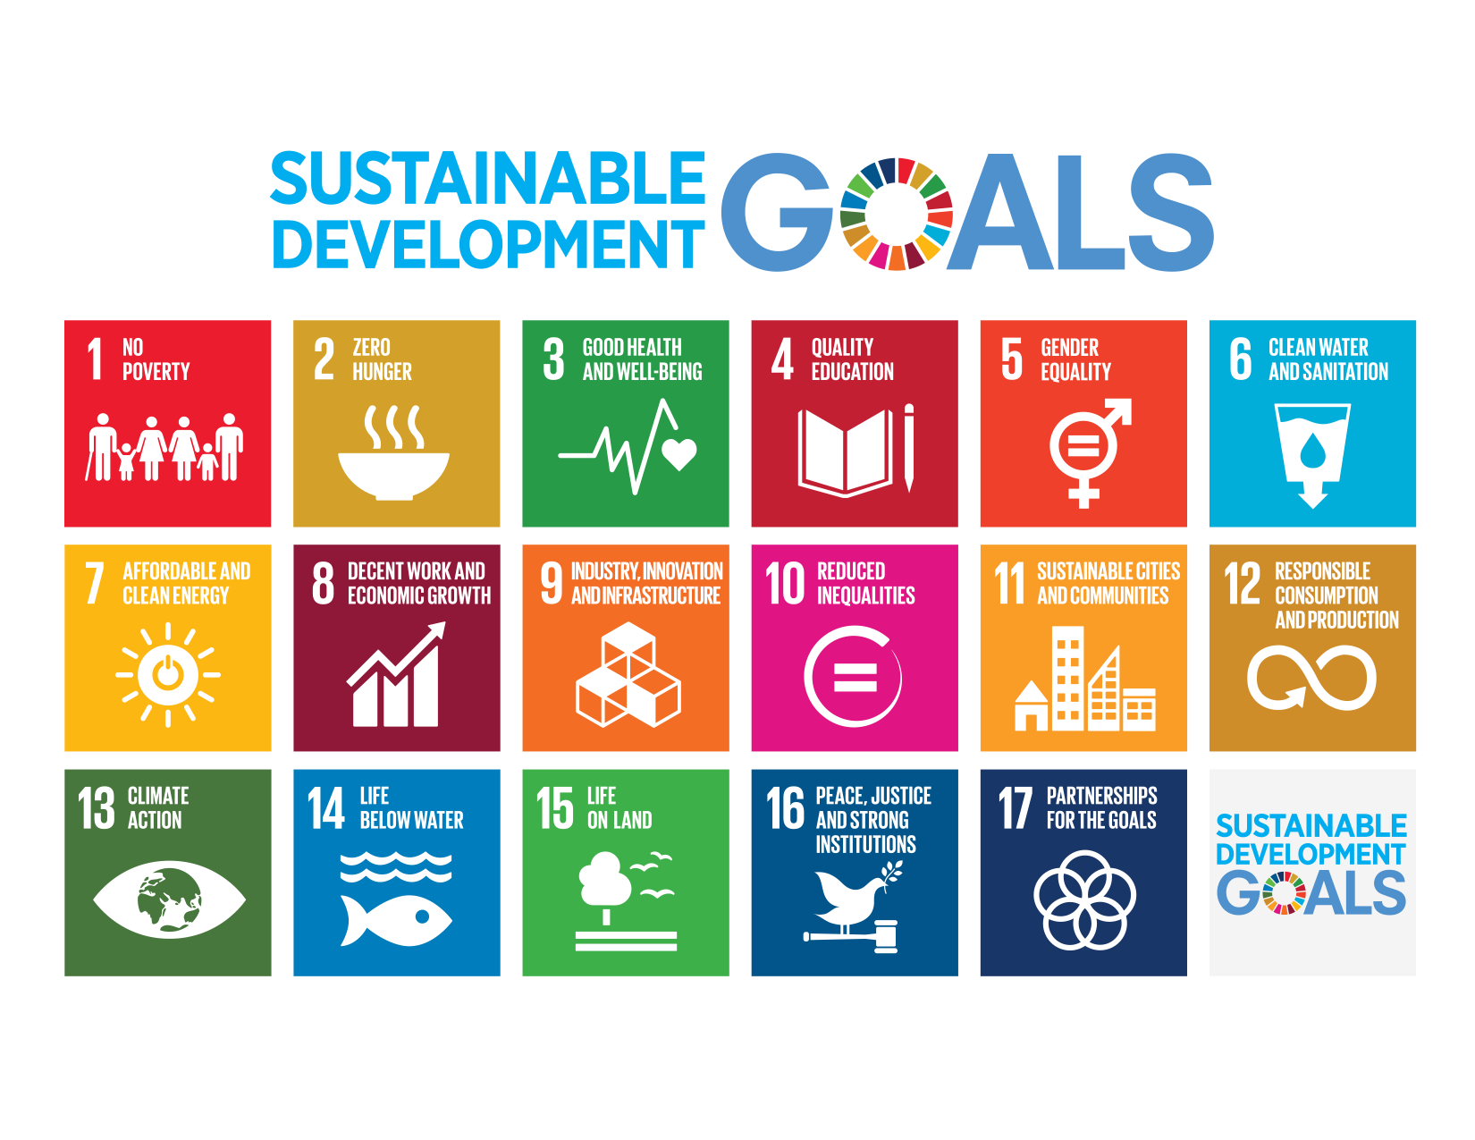
Adopted September 2015 – also called Agenda 2030

Slide 32
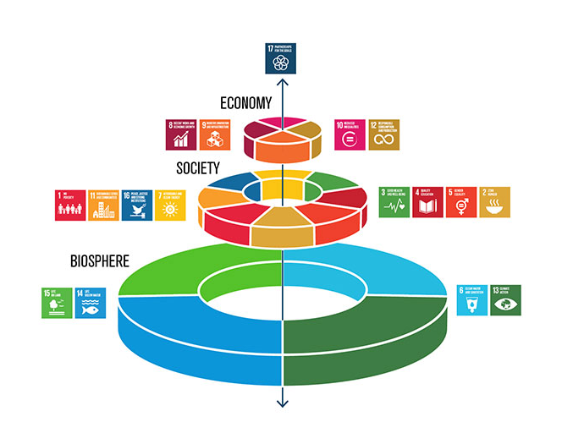

Slide 34
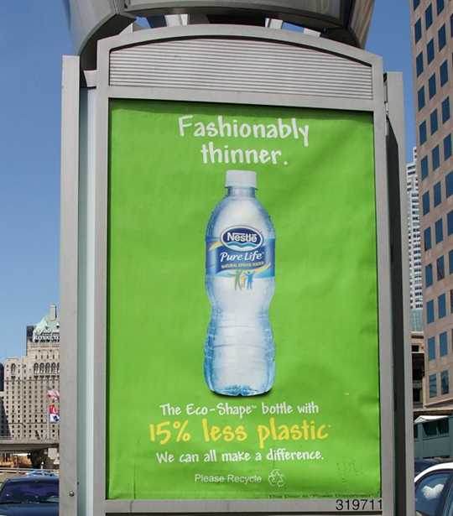
Misuse of the term sustainable
Adjective that means “green”
“A little better for the environment than the alternative”
Less bad
greenwashing

Slide 35
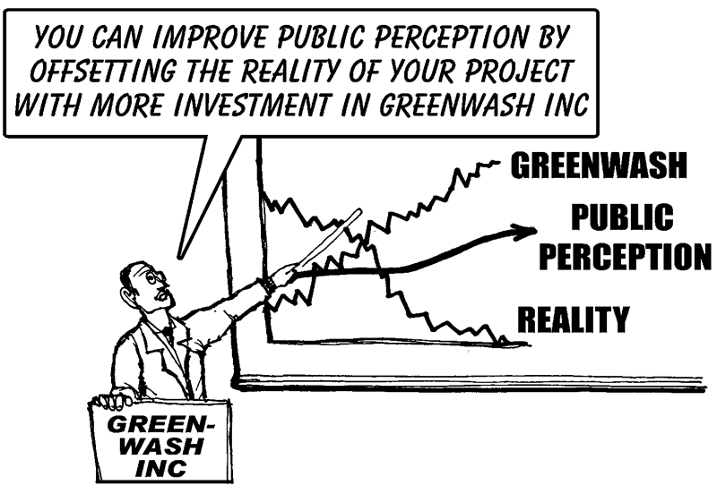

Slide 36



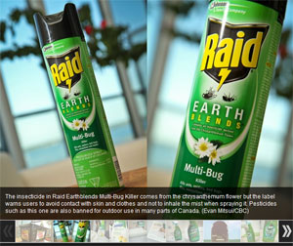
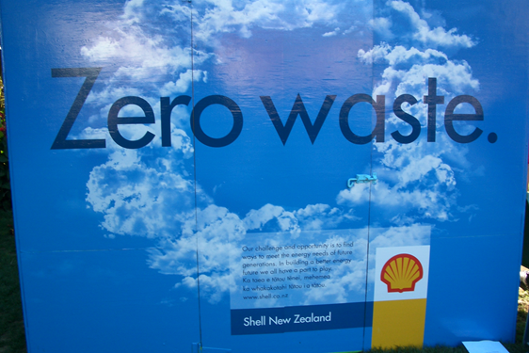

Slide 37
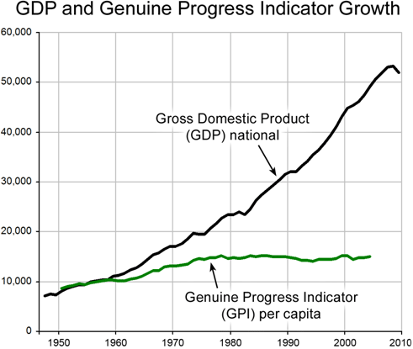
What are we tracking?
If development is not sustainable, is it development – why so many bad decisions?
Triple Bottom line:
Environmental, Social, & Economic Development

Slide 38
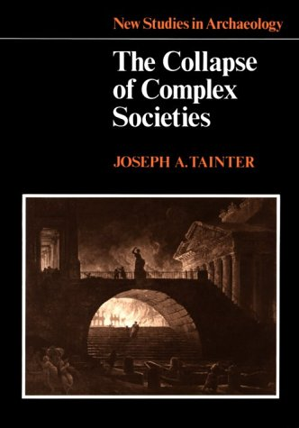
Is sustainability still possible?
“Growing human populations are eating more meat, using more carbon-based energy, shouldering aside more natural resources, and tapping into more renewable and nonrenewable commodities than ever before.”
“If humanity fails to achieve sustainability, when, and how, will unsustainable trends end?”

Slide 39
Is sustainability still possible?
Why has it proved so hard to conform human behavior to the needs of a life-supporting future?
Our political and economic institutions evolved before anyone imagined the need to restrain human behavior out of concern for the future.

Slide 40
Great Law of the Iroquois
In every deliberation, we must consider the impact on the seventh generation (~140 years into the future)
What is the purpose of expressing concern for the consequences of decision-making down to the seventh generation from their own?

Slide 41
Guidance for answers
Western insight into the needed physical and ethical transformations
Alternatively, we should look to other traditions as well: indigenous, Eastern

Slide 42
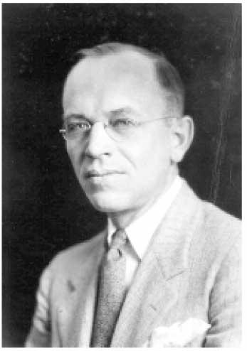
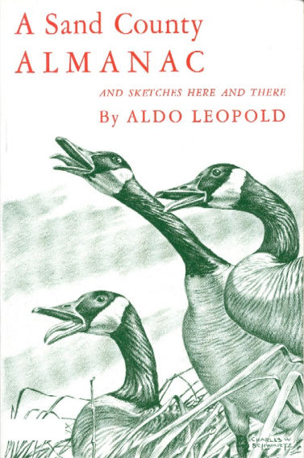
Aldo Leopold
Forest Service and Wisconsin professor, eloquent and passionate writer of our duty to protect the balance of nature:
  humans should extend to nature the same ethical sense of responsibility that we extend to each other.
A Sand County Almanac (1949) – regarded as the most influential book on conservation ever written.
“The land ethic simply enlarges the boundaries of the community to include soils, waters, plants, and animals, or collectively: the land.”

Slide 43
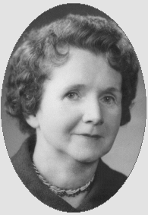
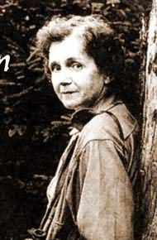
Rachel Carson
1960s – The modern environmental movement is born
1962 Silent Spring
Carson, writer and marine biologist, told how chemical use on farms, forests, and gardens, poison the environment. Insects were dying (not just the pest species) which meant no food for the birds. No birds, no bird song – a silent spring
Public awareness that humans are damaging environment

Slide 44
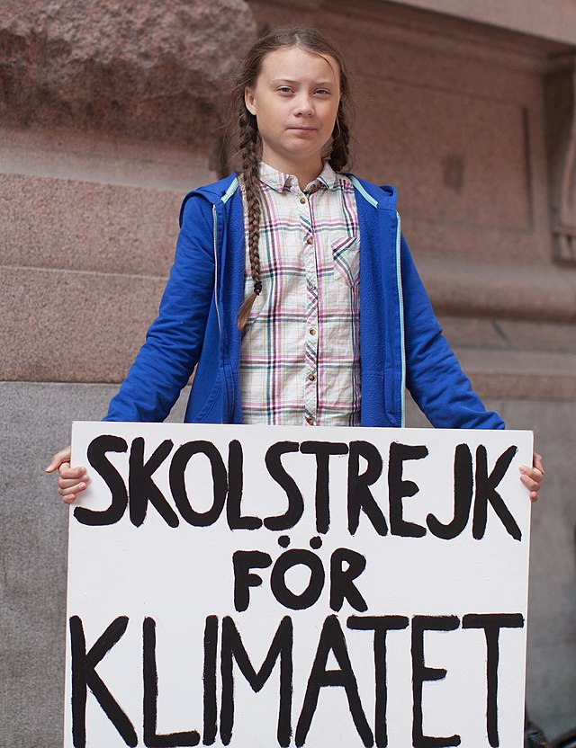
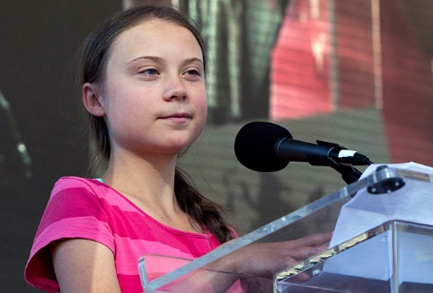
Greta Thunberg
2018 – School Strike for climate – Friday’s for Future
2019 Spoke before UN Climate conference
We will remember…

Slide 46
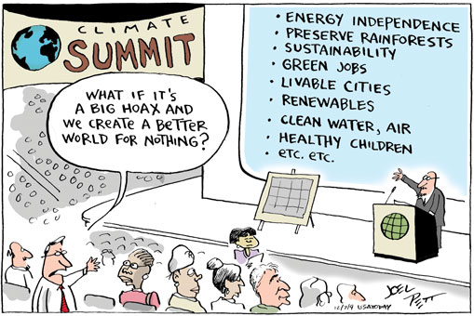

Slide 47
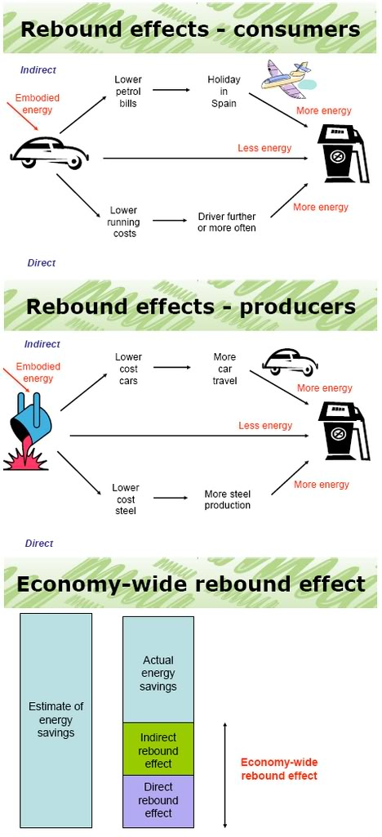
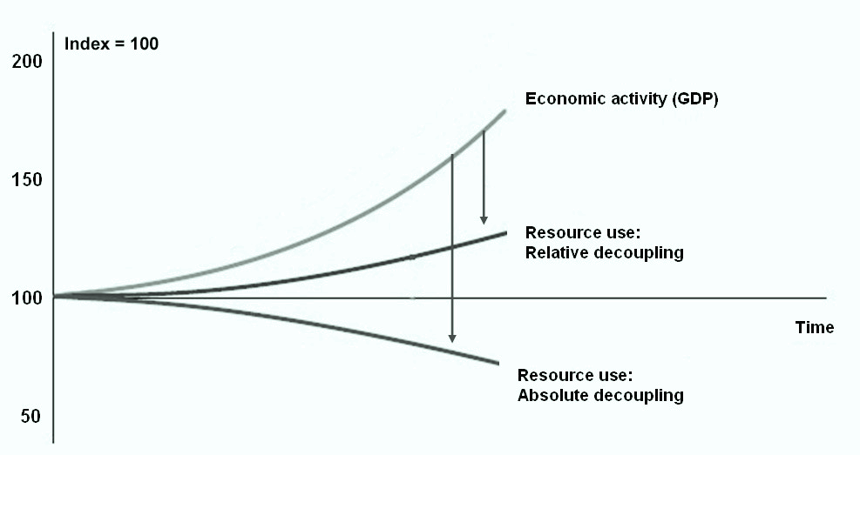
Decoupling –greater resource efficiency
Do more with less

Slide 48

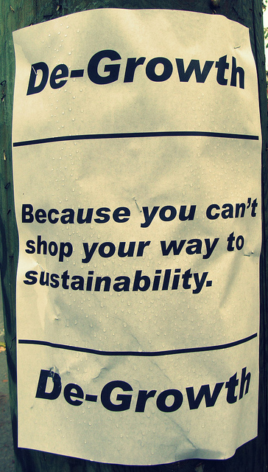
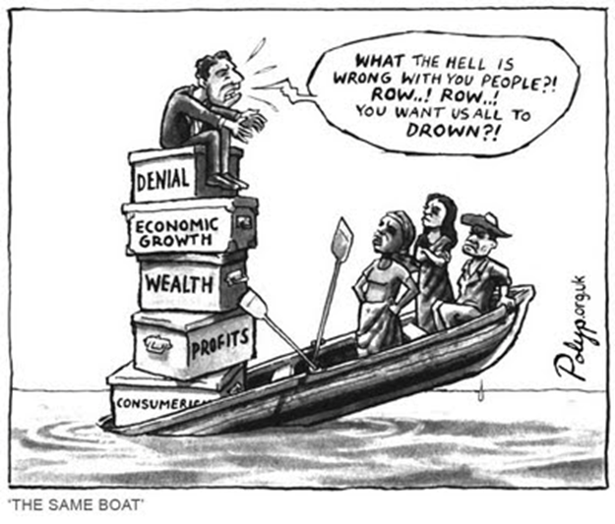
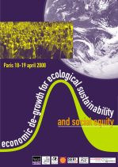
degrowth
Reduce scale to fit within planetary boundaries
Do less

