Slide 1
Macroeconomics II
Vladan Hodulák
This powerpoint serves as a study material for the students of the course Introduction to economics (MEB435/MEBn5035) at FSS MU in Fall 2019. Using this presentation for other purposes without consent of the author is prohibited.

Slide 2
Sectoral balances perspective
The most basic macroeconomics rule is that one person’s spending is another person’s income.
The sectoral balances approach helps us to understand the relations among the spending and income balances of the households, firms, government, and foreign sectors of the economy.
The sectoral balances must sum to zero.
A flow is measured as a certain quantity that is spent per unit of time.
A stock is measured at a point in time and is the product of prior, relevant flows.

Slide 3
The Sectoral Balances View of the National Accounts
Identity – a formula that is true by definition
GDP ≡ C + I + G + (X – M)
When these components of spending are summed, they equal aggregate demand for goods and services in a particular period.
Macroeconomic policy aims at influencing the individual components of GDP.
Net external income flow (FNI) - we have to add this to get the total sum of financial flows between the domestic economy and the external sector.
GNP ≡ C + I + G + (X – M) + FNI

Slide 4
The Sectoral Balances View of the National Accounts
(GNP – C – T) – I ≡ (G – T) + (X – M + FNI)
(GNP – C – T) – I - overall saving of the private domestic sector or private domestic financial balance.
(G – T) is the government financial balance.
(X – M + FNI) is the external financial balance or Current Account Balance (CAB)
The private domestic financial balance equals the sum of the government financial balance plus the current account balance.
It is impossible for all sectors to accumulate net financial wealth by running surpluses.

Slide 5
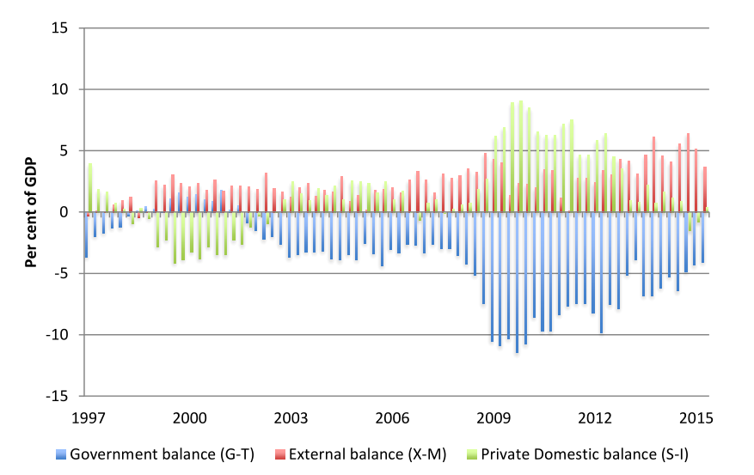
UK sectoral balances, 1997 to 2014

Slide 6
Important remarks
One’s financial asset is another’s financial liability.
Inside vs outside sector wealth.
Real assets
Examples of economic behavior (theory, causal relationships)
  The response of consumption to a change in income is called the Marginal Propensity to Consume (MPC). It is normally hypothesised that the MPC will be less than one, so that the residual of disposable income not consumed will be positive. That constitutes saving.
  Automatic stabilizers – net government expenditure higher when national income is lower and vice versa.
  Lower interest rates should lead to higher investment which should in turn increase output.

Slide 7
Balance of payments
Accounting accord of all monetary transactions between a country and the rest of the world
The sum of all accounts has to be equal 0 by definition
Composition (IMF × USA!)
  Current account (CA) – trade + factor income
  Financial (capital) account (including the reserve account) – net change of ownership of international assets
  Balancing item (statistical errors)
Relations between individual accounts
Net international investment position
  Accumulated CA, asset price changes, currency moves

Slide 8
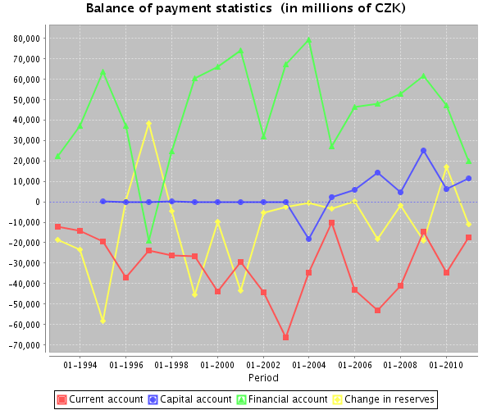
Source: The Czech National Bank

Slide 9
Net international investment position (% of GDP in 2014)
Switzerland | 119,6 | United States | -39,7
Japan | 74,8 | Slovakia | -70
Germany | 36,4 | Spain | -94,5
China | 17,1 | Ireland | -106,7
Russia | 16,7 | Portugal | -111,6
CZ | -35,6 | Greece | -121,9
Source: IMF

Slide 10
Balance of payments adjustment
CA deficits and the household analogy
  Most countries have to “earn” money from abroad to pay for imports and previously accumulated debts
CA deficits and governments deficits and debts
Financial crises are often accompanied by prolonged CA deficits and are solved through and adjustment process, often assisted by the IMF
Balancing mechanisms
  Exchange rate adjustment
  Internal prices adjustment
  Various others (debt forgiving, war, emigration)

Slide 11
Inflation and its causes
Inflation, hyperinflation and deflation
Neoclassical theory – Quantity theory of money
  M × V = P × Y
Cost push inflation
  Distributional struggle over the share of GDP between labor and capital
  Market structures and natural resources
Demand pull inflation
  Economy operating at full capacity

