Slide 1
Macroeconomics I
Vladan Hodulák
This powerpoint serves as a study material for the students of the course Introduction to economics (MEB435/MEBn5035) at FSS MU in Fall 2019. Using this presentation for other purposes without consent of the author is prohibited.

Slide 2
Definition
Macroeconomics – a study of the aggregate outcomes of human economic behavior
Issues of macroeconomics – employment, output, inflation, international context
Goal of macroeconomics – using the available economic resources (including labor) to its full potential
Challenge of macroeconomics
  How to maintain full employment but at the same time achieve price stability?
  How to encourage economic growth?
  How to stabilize the economy?

Slide 3
Two approaches to macroeconomics
Neoclassical approach (new classical, supply side, neo-Keynesian, new Keynesian)
  Derives macroeconomic from neoclassical microeconomics by aggregating individual behavior of households and firms
  Aggregate demand and supply
  Full employment considered to be the norm (natural level of unemployment)
  Emphasizes the self-regulatory tendencies of the market economy
Heterodox (post-Keynesian, institutionalist, Marxist)
  Places monetary arrangements to the center of the analysis (M-C-M)
  Emphasizes compositional fallacies

Slide 4
Heterodox approach
Marx, Keynes, the Great Depression
Fallacy of composition
  Errors in logic that arise when we infer that something, which is true at the individual level, is also true at the aggregate level
  Government vs household financial constrains
  Outcomes of government vs household increase in saving on the economy (paradox of thrift)
At the aggregate level, total spending equals total income and total output
The role of the government

Slide 5
Tools of macroeconomic policy
Fiscal policy
  is represented by the spending and taxation choices made by the government.
  is one of the major means by which the government seeks to influence overall spending in the economy and achieve its aims.
Monetary policy
  usually the responsibility of the central bank
  setting of a short-term policy target interest rate
  operating the interbank clearing mechanism acting as lender of last resort (to stop bank runs)
  regulating and supervising the banks.

Slide 6
National accounts
Gross Domestic Product (GDP) - the measure of all currently produced final goods and services evaluated at market prices.
Limits of GDP
  Unpaid work (housework, raising children, small farmers etc.), black market
  GDP and economic well-being
  Inequality
Alternatives to GDP -> HDI
Country comparisons
  GDP per capita × total GDP
  Purchasing power parity (PPP) × nominal (at market exchange rate)

Slide 7
Components of GDP
Consumption (C)
  Domestic consumption by households of goods and services
Investment (I)
  Capital investment by firms, inventory investment by firms, and real estate investment by households
  Investment expenditure increases the productive capacity of the economy and expands what we think of as potential GDP
Government spending (G)
  Government purchases of final goods and services (government transfer payments are not included)
Net Exports (NX or X - M)
  Exports (X) are goods and services sold abroad; imports (M) are goods and services produced abroad for domestic use

Slide 8
Ways to measure GDP
Expenditure approach
  the sum of final expenditures on goods and services measured in current market prices.
  Y = C + I + G + (X − M)
Production approach
  This approach measures gross value added.
  Value added in the production = gross value of output – value of intermediate consumption, which has been summed over all stages of production.
Income approach
  Sum of primary incomes distributed by resident producers of goods and services.
  This method adds together the producers’ incomes that firms pay in exchange for their services, namely wages for labor, interest for capital, rent for land and profit for capitalists.

Slide 9
GDP versus GNP
GDP is the total value of goods and services produced within a nation regardless of the ownership of the firm producing them.
GNP (Gross National Product) is the total value of goods and services produced by residents of the nation regardless of the location of the production
Measuring Gross National Income (GNI)
  the perspective of what can be done with income (Y): an individual can consume (C) it, pay taxes (T), or save it (S)
  Y = C + S + T = GDP = C + I + G + NX

Slide 10
Balance of payments
Accounting accord of all monetary transactions between a country and the rest of the world
The sum of all accounts has to be equal 0 by definition
Composition (IMF × USA!)
  Current account – trade + factor income
  Financial (capital) account (including the reserve account) – net change of ownership of international assets
  Balancing item (statistical errors)
Relations between individual accounts
Net international investment position
  Accumulated CA, asset price changes, currency moves

Slide 11
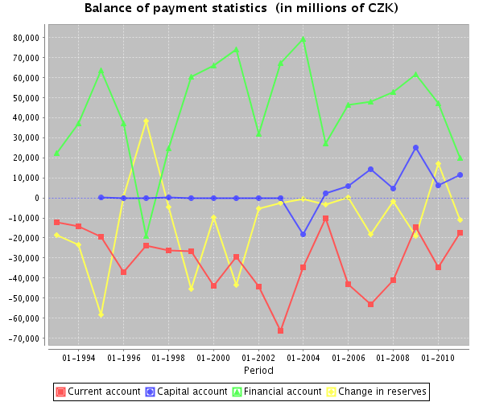
Source: The Czech National Bank

Slide 12
Net international investment position (% of GDP in 2014)
Switzerland | 119,6 | United States | -39,7
Japan | 74,8 | Slovakia | -70
Germany | 36,4 | Spain | -94,5
China | 17,1 | Ireland | -106,7
Russia | 16,7 | Portugal | -111,6
CZ | -35,6 | Greece | -121,9
Source: IMF

Slide 13
GDP Growth and the Price Deflator
Measuring economic growth
  The growth of GDP over time
  The GDP is measured at current prices (nominal GDP)
  Problems with rising prices
“Deflate” GDP - to correct our measure for the change in prices to get an idea of real economic growth.
Example:
  GDP₂₀₀₂ = P₂₀₀₂ × Q₂₀₀₂
  GDP₂₀₁₅ = P₂₀₁₅ × Q₂₀₁₅
  We always calculate ‘real GDP’ over time in terms of a base year.
  RGDP₂₀₁₅ = P₂₀₀₂ × Q₂₀₁₅
Problems with the method

Slide 14
Measuring CPI inflation
CPI: An index based on the cost of a fixed basket of consumer goods and services.
  Consumer goods and services, and their respective quantities (weights).
  It is assumed that the chosen basket of goods and services is representative of the purchases made by a typical household.
  Base year.
Rate of growth of the CPI index
  The growth rate of the CPI measures the rate of inflation (if positive) or deflation (if negative).
Other indexes.

Slide 15
Measuring National Inequality
Gini Coefficient – measures the distribution of income in the population.
The Lorenz Curve plots the share of total income received (vertical axis) by the lowest X per cent of income earners (horizontal axis).
The 45-degree line shows the case of perfect equality.
A Gini Coefficient of zero means that income is perfectly equally distributed as the economy is lying on the Line of Equality.
Alternatively, a Gini coefficient of one means that income is perfectly unequally distributed (that is, one person has all the income).

Slide 16
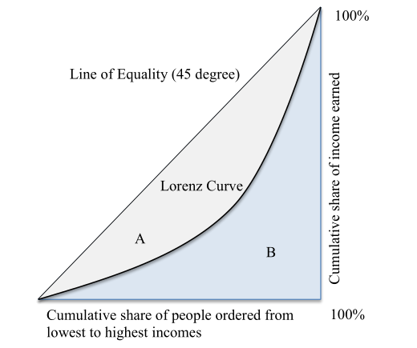
The Lorenz curve

Slide 17
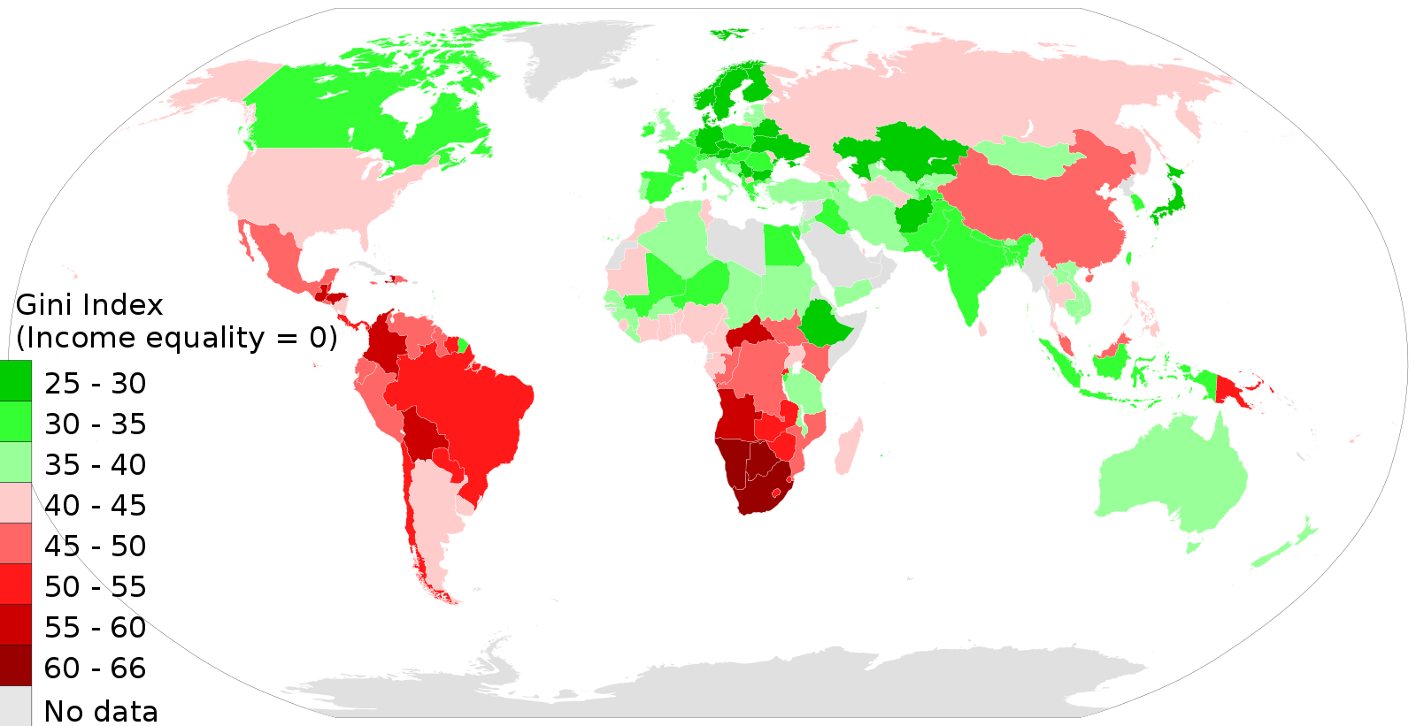
Gini coefficient in the world
Source: M Tracy Hunter

