Slide 1
Microeconomics
Vladan Hodulák
This powerpoint serves as a study material for the students of the course Introduction to economics (MEB435/MEBn5035) at FSS MU in Fall 2019. Using this presentation for other purposes without consent of the author is prohibited.

Slide 2
Markets
Market Exchange – transfer of property rights
Monetary
Barter
Characteristics of market exchange
Market
All the selling and buying activities of those persons wishing to trade
Suppliers and demanders
Neoclassical definition
Location
Market as an institution – set of rules
Competitive markets

Slide 3
Supply and demand
Demand curve – indicates for each possible price, how much of the good or service demanders are willing to pay
Characteristics of the demand curve
Downward sloping
Represents what people want and are able to purchase, given the price and their incomes
Deriving the demand curve – consumer theory
Theories of marginal utility (cardinal and ordinal)
Complements and substitutes
The demand curve allows us to say how a change in the price will affect quantity demanded if nothing else changes (ceteris paribus)

Slide 4
Supply and demand
Supply curve – indicates, for each possible price how much of the good or service suppliers wish to sell
Characteristics of the supply curve
Upward sloping
Represents how much of goods and services firms want to supply, given the price and their costs
Deriving the supply curve – theory of the firm
Marginal cost vs average cost
Increasing returns to scale
The supply curve allows us to say how a change in the price will affect quantity supplied if nothing else changes (ceteris paribus)

Slide 5
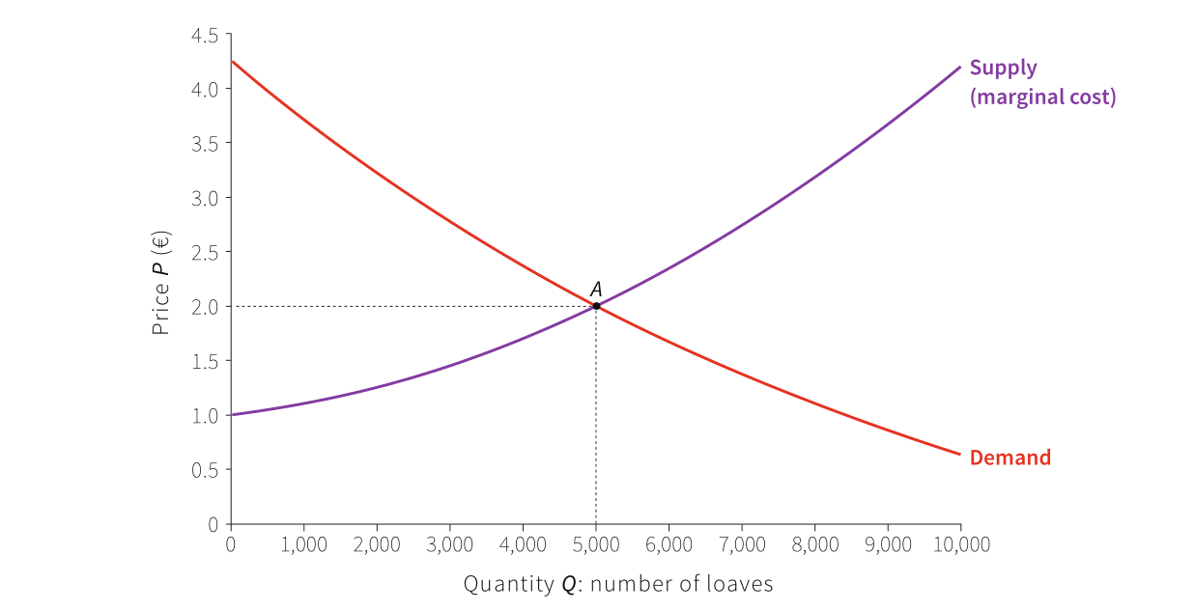
Supply and demand
Source: The Core Team (2015) The Economy

Slide 6
Supply and demand interacting
S and D interaction determines both the price (P) of a good and its quantity (Q)
Excess supply – at a particular price more of some good or service is supplied than is demanded
Excess demand – at a particular price more of some good or service is demanded than is supplied
The market clearing price – the price at which buyers want to purchase exactly the quantity that sellers want to sell
Equilibrium – a situation (price and quantity) in which there are no forces internal to the situation pushing it to change

Slide 7
Supply and demand interacting
Exogenous × endogenous source of change
Market clearing price and equilibrium
Homogenous product
THE RESULTS OF COMPETITIVE MARKETS
When a competitive market is in equilibrium, the price of the good will be equal to its marginal cost
P = MC
Competitive markets are an efficient means of economic interaction (the best way to allocate limited resources among unlimited wants)

Slide 8
Shifts in demand and supply
Moving along the curves
Functional relationship between the quantity and the price
Ceteris paribus
Shifting the demand curve
Changes in preferences
Changes in the prices of substitutes or complements
Other forces
Shifting the supply curve
Technological advance
Changes in the costs of inputs
Other forces

Slide 9
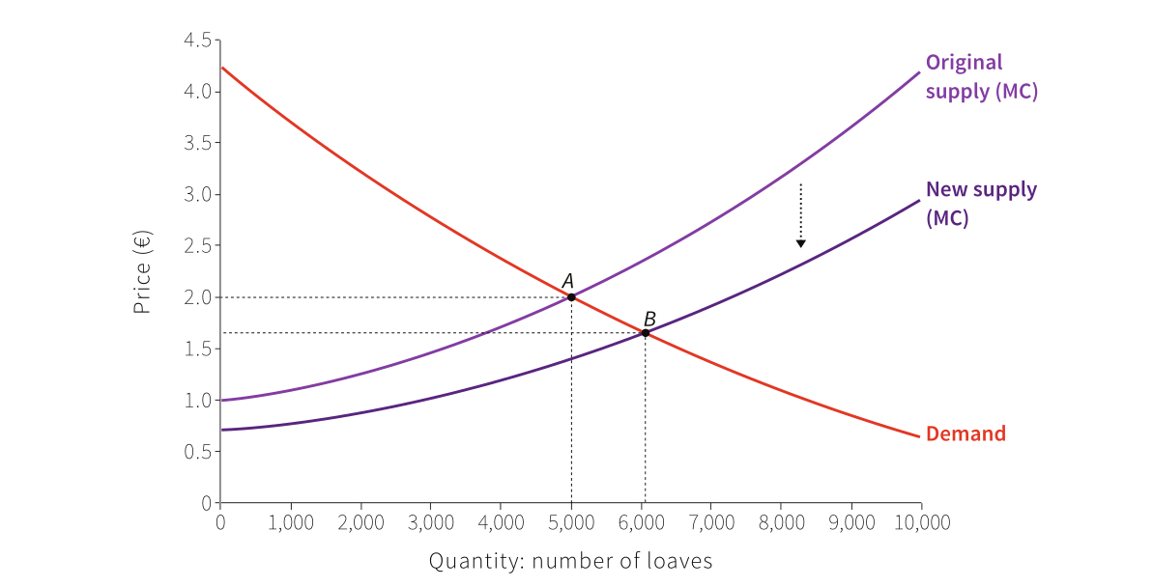
Shift in supply
Source: The Core Team (2015) The Economy

Slide 10
Economic coordination
Markets are only one of many ways people can coordinate
Various way of economic coordination in history
Types of coordination
Coordination by rules – interactions are governed by general principles of behavior
Coordination by command – interactions are governed by rules specifying precise behavior
The importance of information and motivation

Slide 11
Invisible hand
Invisible hand is a coordination by these specific rules
Market competition
Private property
Markets transmit economically important information and they provide the motivation to act on the information
Information - the price (rather than quantity) of a good measures its scarcity
Motivation
Motivation for the consumers
Motivation for the producers

Slide 12
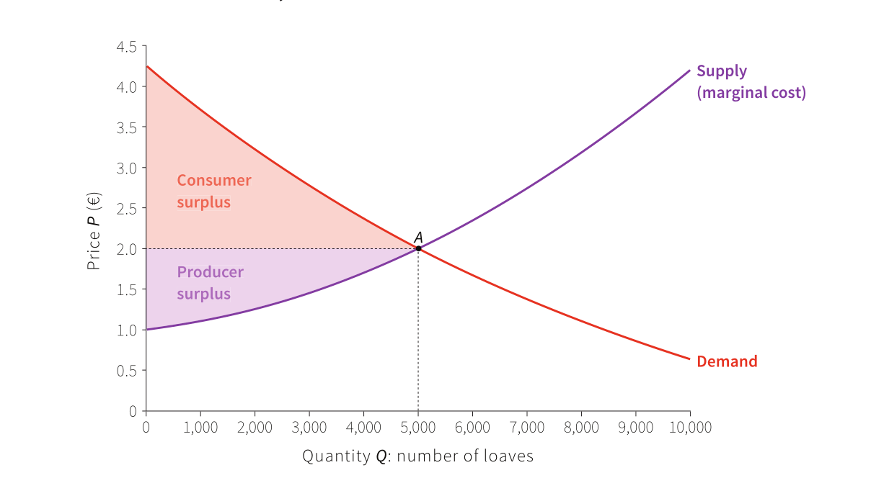
Efficiency of the market
Zdroj: The Core Team (2015) The Economy

Slide 13
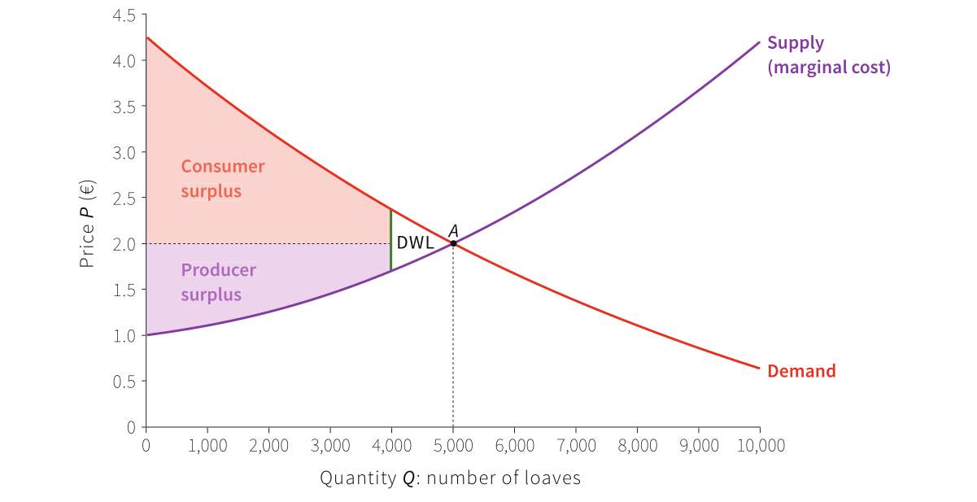
Market interventions
Zdroj: The Core Team (2015) The Economy

Slide 14
Coordination failure
Coordination failure – when the pursuit of self-interest does not produce desirable outcomes, even when accompanied by rules
Under certain conditions competition based on self interest but coordinated by markets will bring about a desirable allocation of economic resources
Under other conditions lack of cooperation results in coordination failure
Prisoners dilemma
Self interested behavior leads to suboptimal overall outcome

Slide 15
The Prisoner’s Dilemma
Original game |  | Prisoner B
 |  | Confesses | Denies
Prisoner A | Confesses | 3;3 | 1;4
 | Denies | 4;1 | 2;2
Incentives for FDI |  | Country B
 |  | Tax | Tax break
Country A | Tax | 3;3 | 1;4
 | Tax break | 4;1 | 2;2

Slide 16
Coordination failure
The tragedy of the commons
Possibility that environmental destruction will result from the uncoordinated pursuit of individual self-interest
Here again, what is rational for one is not beneficial for all
Atmosphere, oceans
Solutions
Social regulation
Private property

Slide 17
Market failure
Market failure occurs when the spontaneous interactions of self-interested buyers and sellers in markets results in generally undesirable outcome
Market prices often fail to take into account all the effects of our actions on others
Examples – pollution, software, voluntary work
Externalities
Positive
Negative

Slide 18
Reasons for market failure
Prices inadequately measure the scarcity of the goods in question
Discrepancy between private and social costs and benefits
Incomplete contract
Market power
Monopoly (oligopoly)
Barriers to entry
Increasing returns to scale
In general: P ≠ MC

Slide 19
Final remarks
Markets, pareto efficiency and just distribution of resources
Government failure
Private property solution to market failures
Narrow the gap between the private and the social costs or benefits
Market with pollution permits
Special interests and market failures

