Slide 1
Money and finance
Vladan Hodulák
This powerpoint serves as a study material for the students of the course Introduction to economics (MEB435/MEBn5035) at FSS MU in Fall 2019. Using this presentation for other purposes without consent of the author is prohibited.

Slide 2
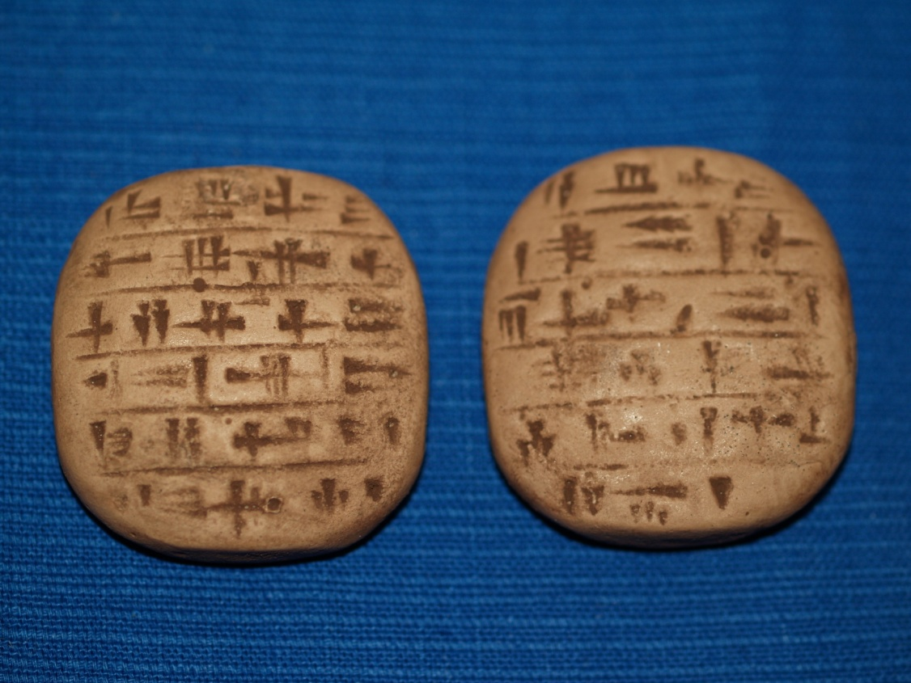
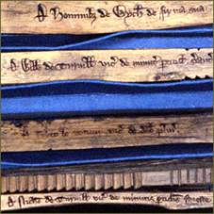

Slide 3
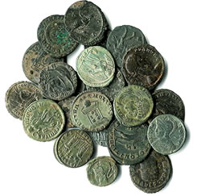
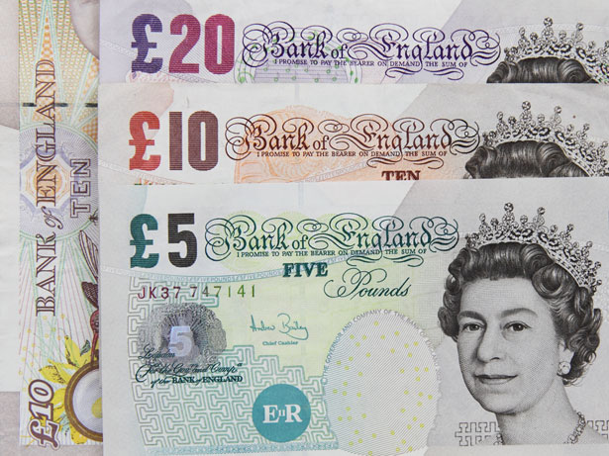
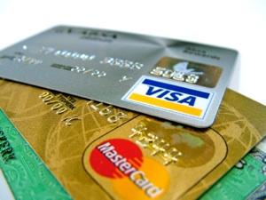

Slide 4
Money and society
What is money?
How is money produced?
How does it get/lose value?
What is the relationship between money and states?

Slide 5
The standard economic story (metallist)
Carl Menger (1892)
Problems of rational actors engaged in economic exchange
  Double coincidence of wants
Type of an evolutionary explanation – increasing effectiveness of economic exchanges
  Precious metals (gold, silver) were selected due to their properties, particularly their high exchangeability
  Paper and later electronic money were introduced as a transaction cost saving device, originally they were to represent the „real money“ deposited in vaults
With this theory, money is first and foremost a means of exchange, its other functions (unit of account, store of value) are secondary
Money is neutral (at least in the long run) and exogenous (to the economic system)
Inflation × deflation (a sustained increase/fall in the general price level)
Barter -> money -> credit

Slide 6
Problems with the standard approach
Questionable role of the state
  It is considered unnecessary for monetary system to operate
  States have a tendency to destabilize their monetary systems
  But in some cases it’s recognized that states have some important role to play (prevents counterfeiting, guarantees quality
Theoretical problems
  Hoarding of a thing makes it more scarce and thus less likely to be used as money
  Unstated presuppositions (economic exchange, property rights)
Empirical issues – anthropological surveys are at odds with the barter story, money predate coins by millennia

Slide 7
State/credit theory of money
Money is first and foremost a unit of account for recording debts, its primary purpose is to enable economic coordination for public purpose
It is an IOU (I owe you) and is created when an IOU is issued
Its value depends on the credibility of the promise
Money is an institution – a generalized and formalized type of an obligation (debt)
Anyone can issue money (obligations) and almost anything can represent it (cattle, salt, wood, paper)
The crucial problem is: How to make people accept it? How to make it generally recognized? (only then a generalized means of exchange is possible)
Money is endogenous and NOT neutral
credit -> money (-> barter)
Problems (role of the private sector, legitimacy issues)

Slide 8
Essence of money
What is money?
  measure of value
  People coordinate their economic behavior in various ways, the most common in-group coordination mechanism is some form of credit -> money usually measures debts (credits)
  It’s vital to differentiate between money (unit of account), money as an expression of debts and money things (what represents debts)
How is money produced?
  By issuing an IOU (× destruction of money)
How does it get/lose value?
  Credibility × quantity theory of money × taxes (it’s complicated)
Some historical examples – Sumer, Lydia, early US banking

Slide 9
Money and states
A state is able to determine its money (unit of account) once it enforces taxes/fees in it
Governments use money to mobilize resources for public purpose
Money is accepted for several reasons: trust, habit, authority, but the ultimate reason is power
The fact that a state issues its money and declares that it will accept it back in the form of taxes is an expression of power (+legal tender)
Governments can buy anything that is for sale in its currency and is in theory able to overbid anyone
Money has distributional consequences and is therefore prone to be abused for political gains
Debtor × creditor interests

Slide 10
Modern money
Usually one state – one currency rule
Governments owing in their own currency can’t be forced to go bankrupt but they can decide to do so
Fallacy of composition – what is true for a part (an individual) doesn’t have to be true for the whole
  Individuals × states
  In a closed economy is true by definition that expenditures = incomes
Hierarchy of money (government > banks > firms > households)
Most money today is issued by private commercial banks
Governments are for historical and political reasons limited in their power to exploit their monetary systems

Slide 11
Limits of domestic monetary power
Struggles over monetary systems
  Ancient Greece, Rome, England 17th century, Great Financial Crisis
Political and institutional constraints
  Central bank independence
  Deficit limit
  Debt ceiling
  Limited money supply (metal standard, currency peg)
Inflation and real constraints (output level)
International constraints
  Balance of payments constraints
  Debt in a foreign currency

Slide 12
Government debt (% of GDP in 2017)
Russia | 13 | UK | 85
Switzerland | 30 | Spain | 98
China | 48 | United States | 105
Germany | 64 | Portugal | 126
Ireland | 68 | Greece | 179
Hungary | 74 | Japan | 253
Source: IMF

Slide 13
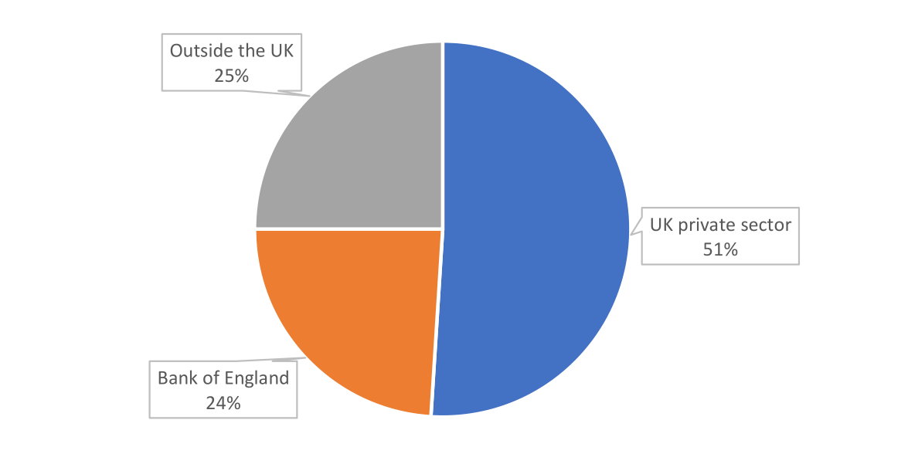
Who owns UK goverments debt?
Source: jubileedebt.org.uk, UK Treasury

Slide 14
Capital
Capital (investment)
  For an individual
  For the society as a whole
Capital consists of assets that can enhance one's power to perform economically useful work
Capital goods, are already-produced, durable goods or any non-financial asset that is used in production of goods or services
Financial vs. real capital
Interest is a payment for borrowing money
Interest rate is a price of credit and plays the role of the cost of capital.

Slide 15
Financial system and banking
Financial system - a system that allows the exchange of funds between lenders, investors, and borrowers
Orthodox account of banking
  Banks are intermediaries between lenders (savers) and borrowers
  Money multiplication – additional credits created from deposits
Heterodox account of banking
  Banks finance capitalist production (financial investments precede savings)
  Money created “out of thin air” loans created simultaneously with deposits
Problems with liquidity a and solvency
Minimum reserves requirements and capital requirements

