Slide 1
The Oslo Process
Mediation and Handicap

Slide 2
Mediation
U.S. late actor (September 1993/January 1)
  Madrid 1991
Norway change agent
  neutral and private
Pursuit of “holy grail”
  Clinton = Don Quixote

Slide 3
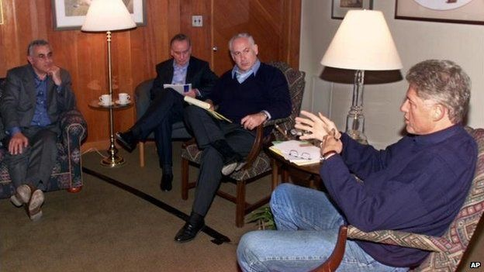
U.S. Foreign Policy And the Peace Process
Since 1979
Clinton era

Slide 4
Mediation
The Oslo Process
Political advantages vs. genuine intent
  Hebron (1996)
  Wye River (1998)
  Camp David (2000)

Slide 5
Hebron
Netanyahu and Arafat agree to control over Hebron and redistribution of IDF (H1 & H2)
Completed part of Oslo II (1995) and signed in January 1997
Both sides never ratified agreement

Slide 6
Wye River
Memorandum agreed upon and signed by Netanyahu and Arafat.
It was aimed to resume the implementation of the 1995 Interim Agreement on the West Bank and Gaza Strip (Oslo II Accord)
  security
  economy
By end of 1998 little progress made on points.

Slide 7
Camp David
Ehud Barak and Arafat met and attempted negotiated peace agreement in July 2000
  Territory
  East Jerusalem
  Refugees and “right of return”
No agreement was signed.

Slide 8
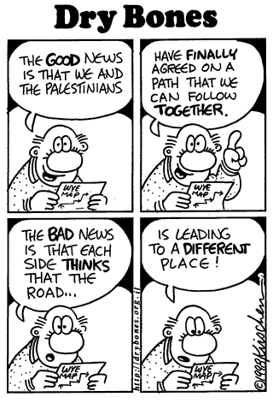
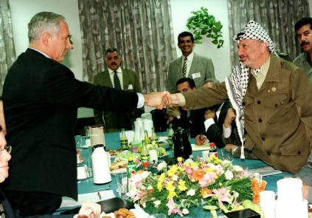
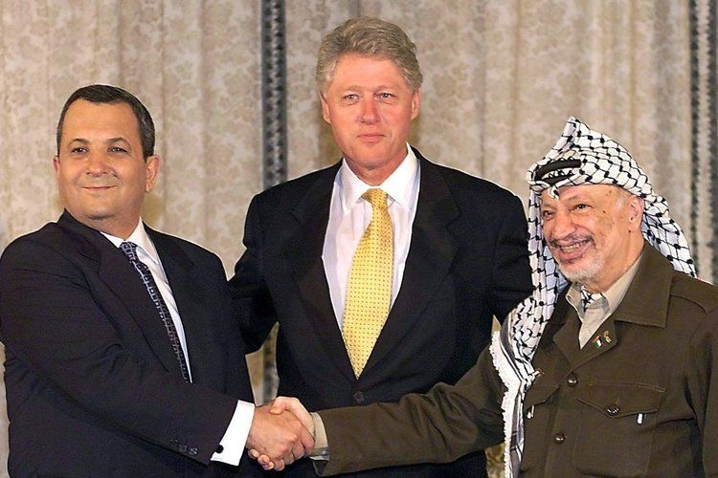

Slide 9
Handicap
Assassination of Yitzhak Rabin (1995)
  death of dream
    interpretation of true intention
Election of Likud (1996)
Election of Labor (1999)
Scandal and corruption with PLO
  finances
  faux elections

Slide 10
Handicap
Financial aid limited use in statecraft
  unlike in 1970s
Intent to build constituencies to support Oslo
  bandage to Palestinian economy
  Crutch to keep Israel engaged
Scott Lasensky, “Paying for Peace: The Oslo Process and the Limits of American Foreign Aid,” Middle East Journal, Vol. 58, No. 2 (Spring, 2004)

Slide 11
Handicap
Power
  IDF
  Labor, Likud, Kadima
  PLO/PA
Status quo
  political support
  religious groups
  Hamas/Hezbollah

Slide 12
Handicap
Reality on ground different than on paper and has been since 1993.
  “Rainbow” lines interpretation over decades
    Green line (1967)
    “Blue line” (1949 Armistice Line)

Slide 13




Slide 14
Conclusions
The U.S. has spent international and domestic political capital to reach a final agreement.
Israel, regardless of government has sought some peace though often blinded by reality on ground, reciprocal violence and prejudice.
Palestinians, are divided. Peace sought and small success achieved by PLO/PA is overshadowed by inter-party (Fatah) fighting and violence by Hamas, whom rejects the Oslo process.

Slide 15
Readings
Scott Lasensky, “Paying for Peace: The Oslo Process and the Limits of American Foreign Aid,” Middle East Journal, Vol. 58, No. 2 (Spring, 2004)
Yehuda Avner, “An inept attempt at a flawed peace,” Jerusalem Post, December 2, 2008.
Stuart E. Eizenstat, “Loving Israel. Warts and All,” Foreign Policy, No. 81 (Winter, 1990-1991), pp. 87-105.
“Elusive Peace: Israel and the Arabs,” PBS Documentary, http://www.youtube.com/watch? v=50ZktlbxsgY

Slide 16
