Slide 1
Local Ownership:
What does it mean on the ground other than rhetoric

Slide 2
Local Ownership
Involvement of locals in designing and implementation of peacebuilding
Increases legitimacy of UN operation
Increases sustainability of peace
Debate between communitarian and liberal views of peacebuilding
International actors tend to view from liberal stance
Gap between theory and practice

Slide 3
Asymmetric Relationship
Donors have their own agenda before local involvement
Asymmetry regarding the knowledge on local system

Slide 4
Who are the locals?
Ambiguity of the concept
Government institutions? Civil society organization? Indigenous peoples?
International actors tend to focus on elites and ignore civil society
Limited contact with rural population
Legitimacy of local partners
Problem of spoilers
Capacity building

Slide 5
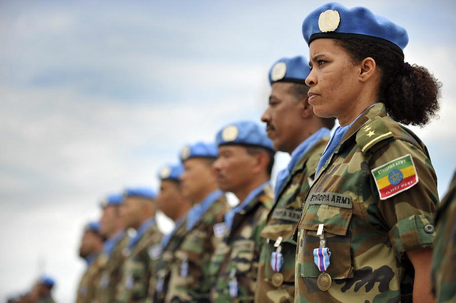
The case of UNMIL

Slide 6
UNMIL
Mandate to assist in reestablishing national authority
Liberian Government has executive and legislative powers
Involvement in justice system
Capacity building
Control of the whole process by Liberian Government
80 percent of the population is outside of judicial reforms
More interventionist approach would make more effective results
Lack of leverage over Liberian government
International aid was not conditional on progress

Slide 7
Thanks for the attention

