Slide 1

Blurring the line between external and internal security: The case of EU´s maritime operation Sophia
Crisis Management Operations
Sergei Rivlin

Slide 2
Operation EUNAVFOR MED Sophia
launched on June 22, 2015 as part of an EU comprehensive approach to manage illegal migration
disrupt the networks of traffickers and smugglers.
EU’s comprehensive response includes root causes:
military conflict
poverty
harassment.

Slide 3
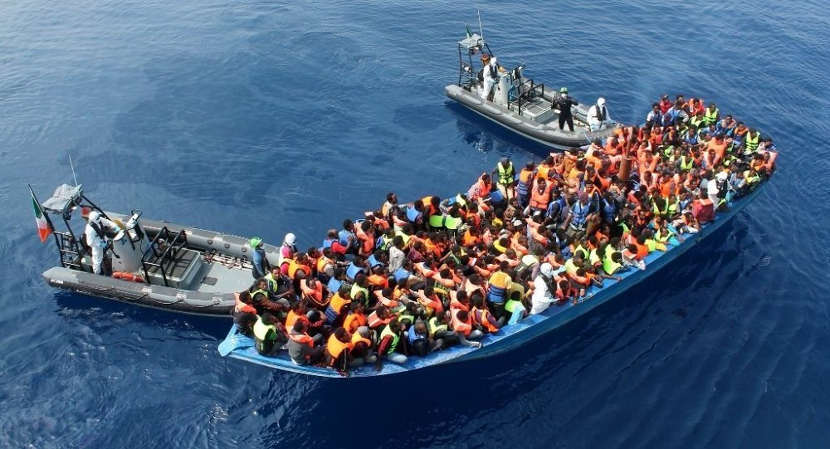
The mission's core mandate:
systematically identification,
capture and disposal of smuggler’s
ships
disrupt the southern smuggling
and trafficking business model
prevent further death in the sea

Slide 4
Background
Crisis in the Mediterranean Sea:
3,500 people died in 2014
3,700 people died in 2015
- more than 1,200 in couple months
22,000 in total since 2000s

Slide 5
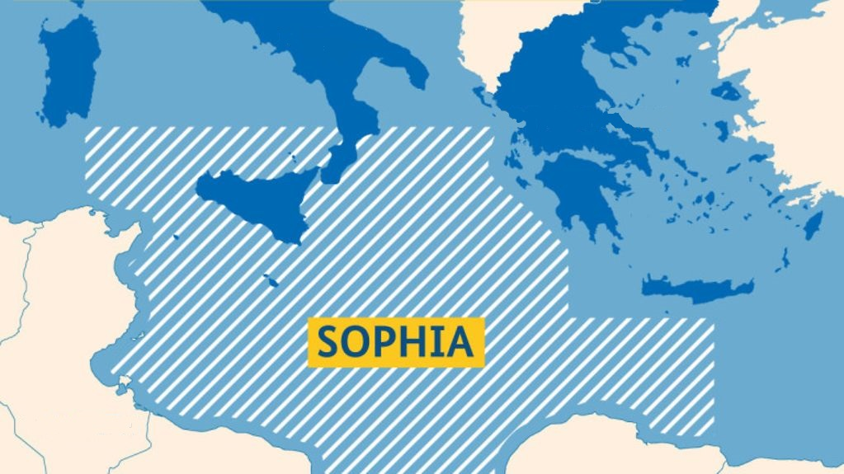
Location of the operation Sophia

Slide 6
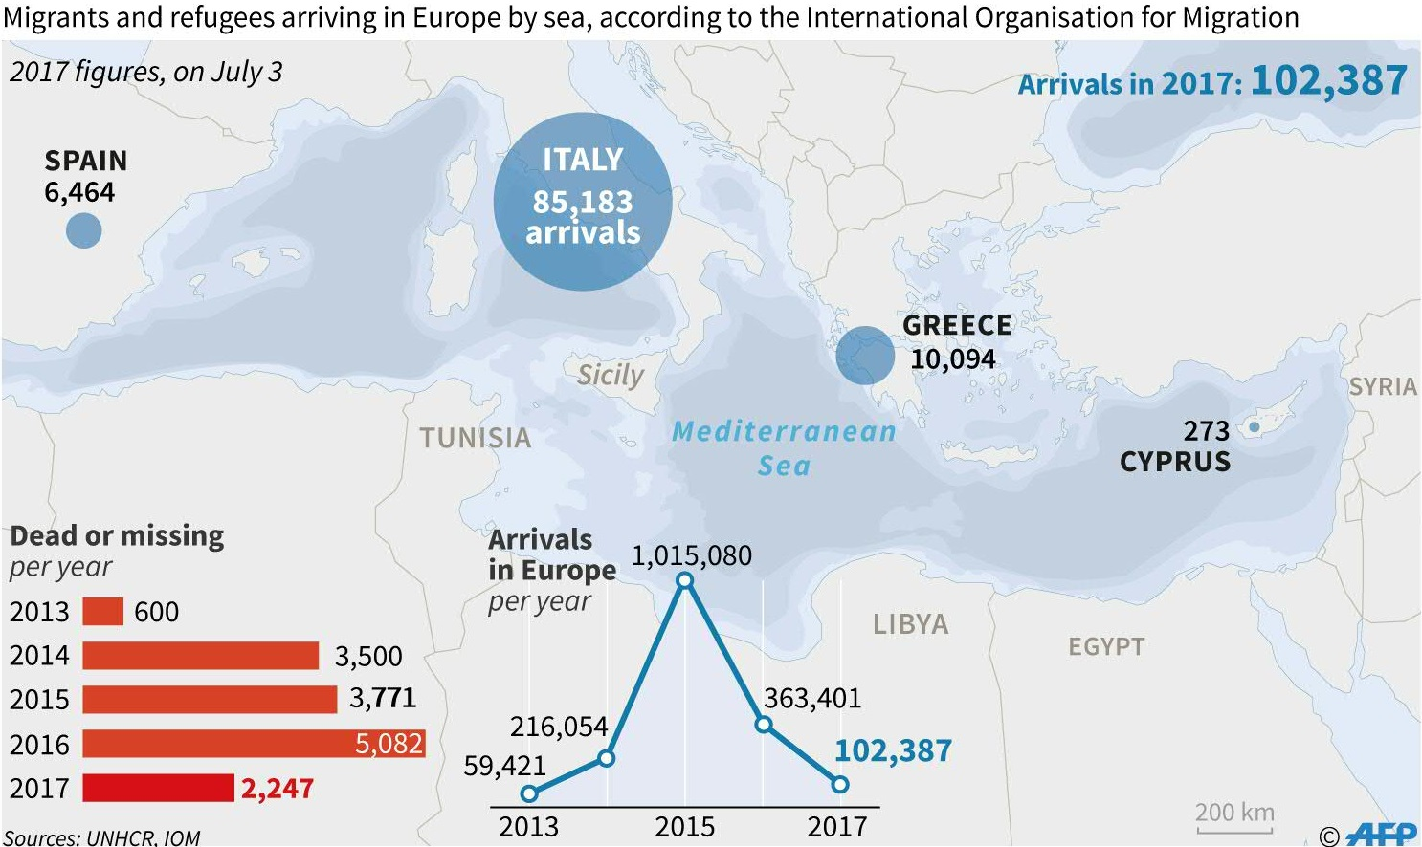
Migration across the Mediterranean to Europe

Slide 7
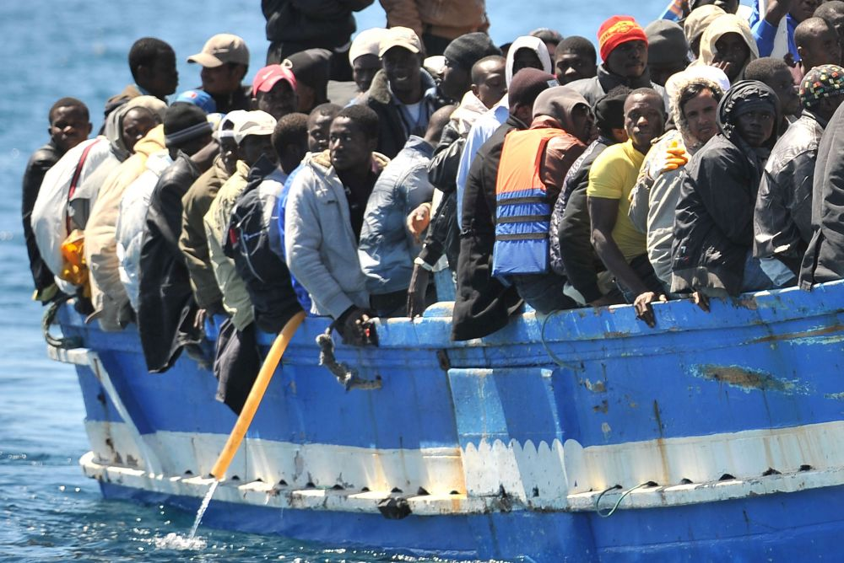
Problem-solving programs
improve border
management
voluntary return to
origin countries
ensure adequate
reception conditions
for migrants in Libya

Slide 8
Expansion of the mandate
create a monitoring mechanism to ensure the long-term effectiveness of training for the Libyan coast guard;
conduct new observations and collect information on illicit trafficking in oil exports from Libya;
expand the exchange of information on trafficking in persons with the law enforcement agencies of the Member States, FRONTEX and EUROPOL
FRONTEX - European Border and Coast Guard Agency
EUROPOL - The European Union Agency for Law Enforcement Cooperation

Slide 9
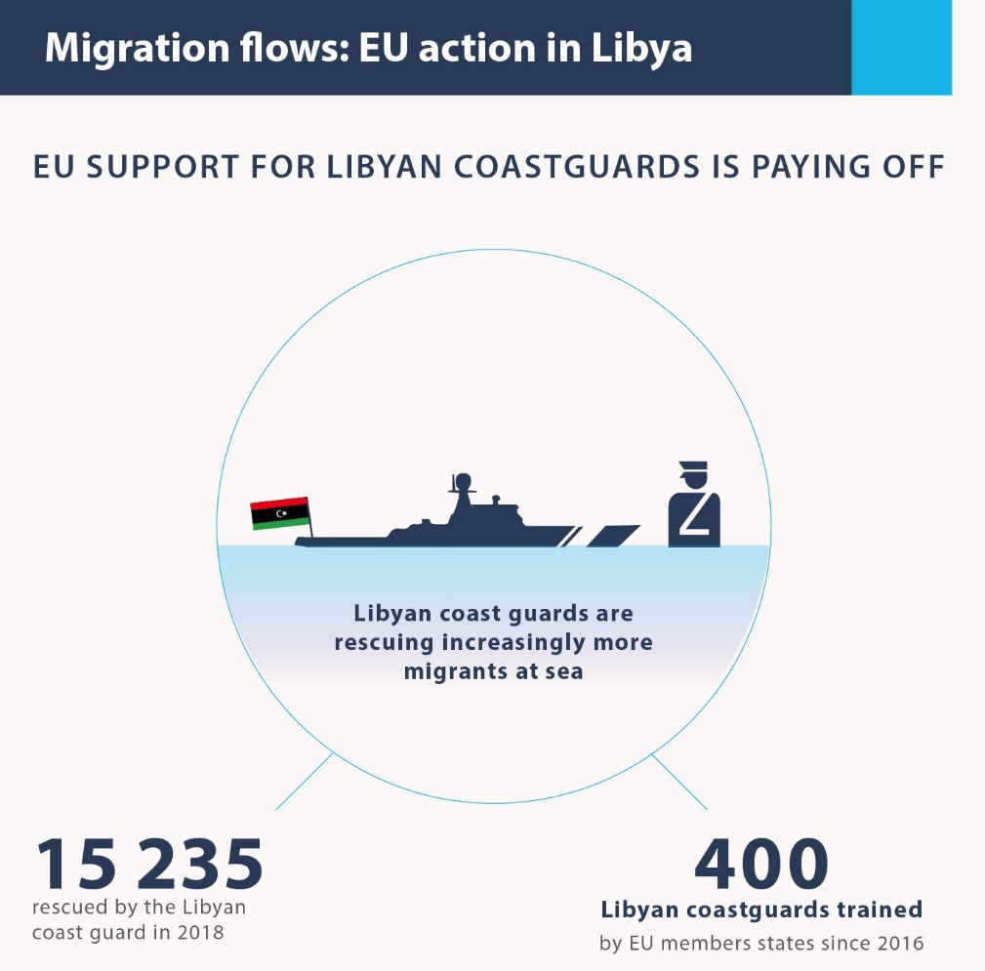
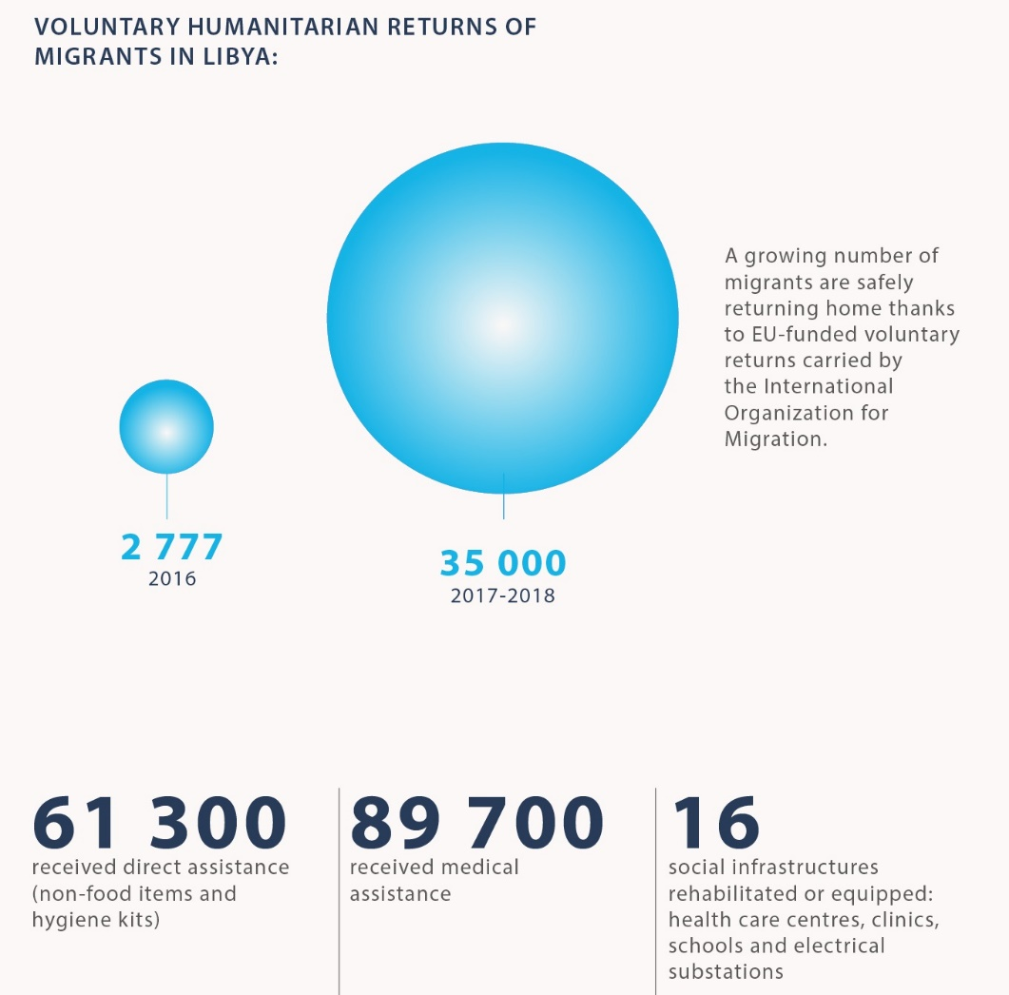
Palpable outcomes

Slide 10
Thanks for your attention

