Slide 1
Součty čtverců

Slide 5
Kontrasty

Slide 6
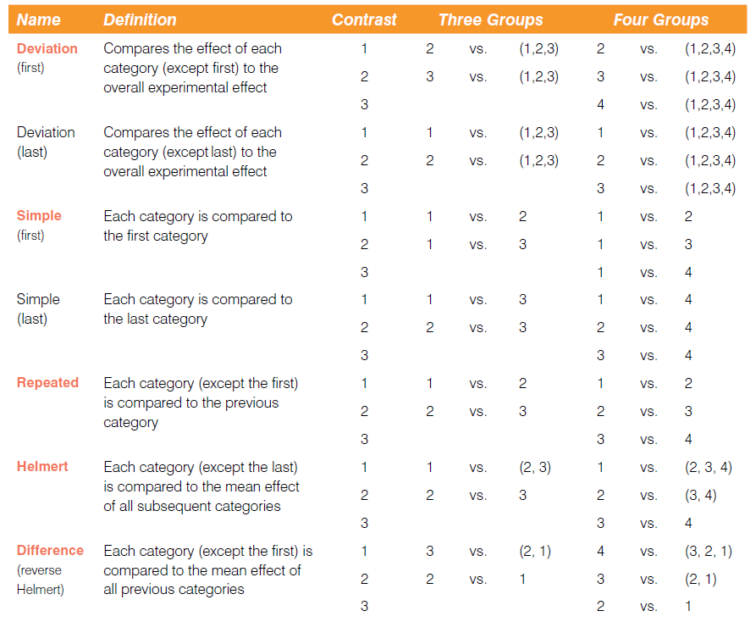

Slide 7
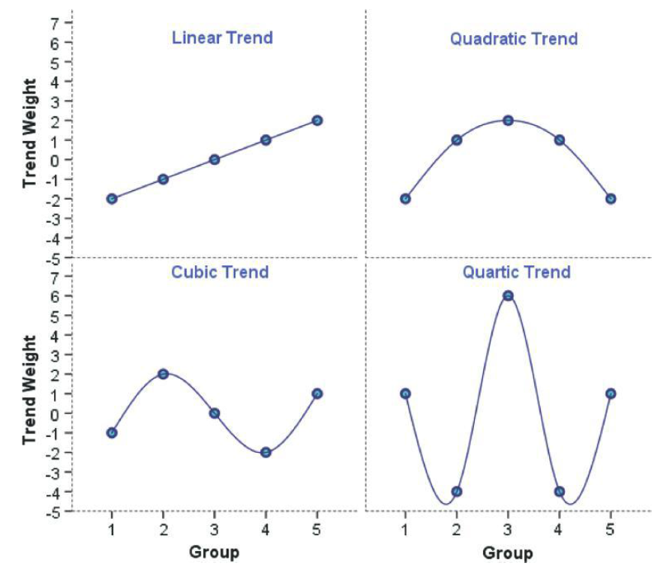

Slide 8
Post-hoc testy

Slide 9
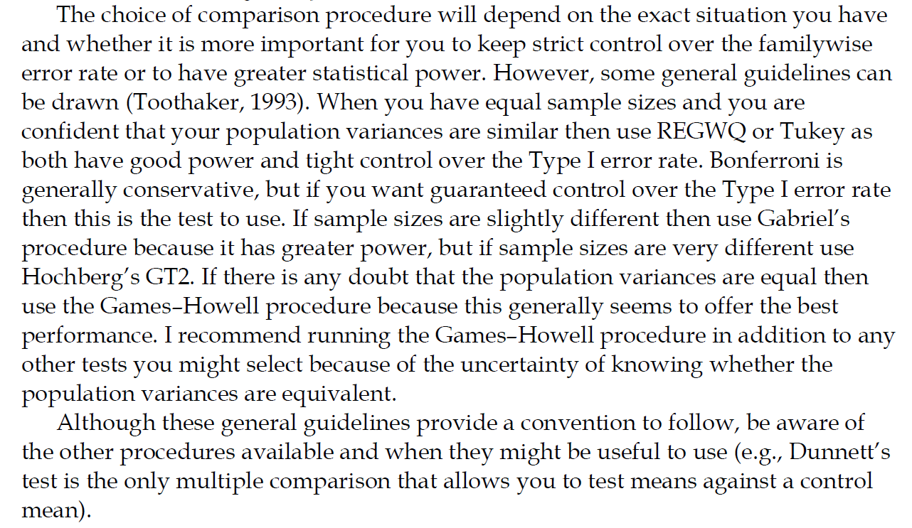

Slide 10
Tabulky

Slide 11
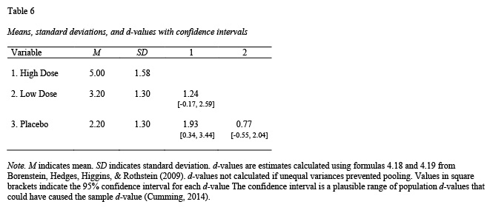
One-way ANOVA

Slide 12
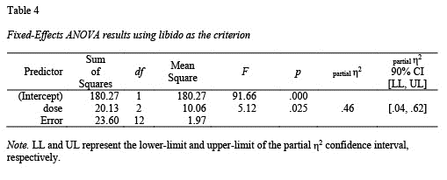
One-way ANOVA

Slide 13
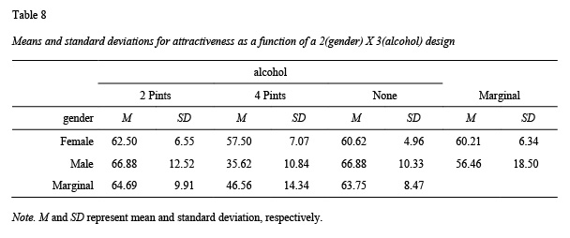
N-way ANOVA

Slide 14
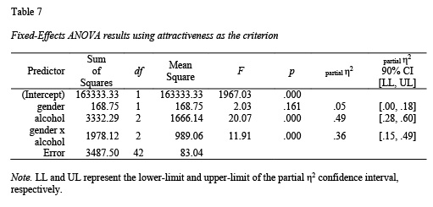
N-way ANOVA

Slide 15
Fixed vs Random Effects
viz http://web.pdx.edu/~newsomj/mlrclass/ho_randfixd.pdf

