Slide 1
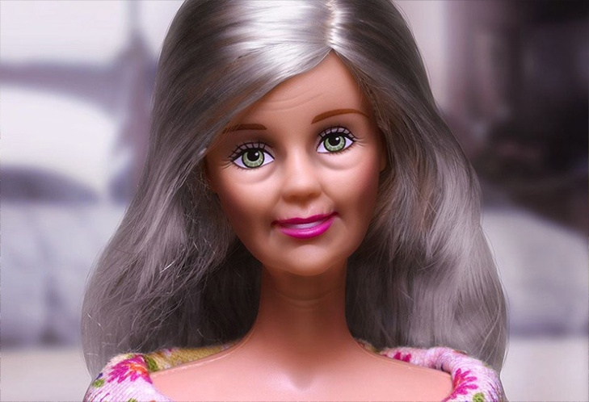
Ageing & future
Is anti-ageing good for you?
And for society?
Lucie Vidovićová
Office for Population Studies
Faculty of Social Studies
Masaryk Uni Brno

Slide 2
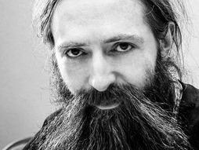
Good bye to ageing?!!
„Human to live to 1000 years was already born, and is maybe about 50 years old today…“
Aubrey de Grey (*1963)
Co-founder and chief science officer of Strategies for Engineered Negligible Senescence (SENS) Research Foundation in California, USA (Aprox. $14.9 million revenue in 2014)
http://www.sens.org/sites/srf.org/files/reports/SENS%20Research%20Foundation%20Annual%20Report%202015.pdf (p. 16)
http://www.express.co.uk/news/science/665807/KEY-TO-ETERNAL-LIFE-Someone-already-born-will-live-to-1-000-and-immortality-IS-possible

Slide 3
Perspective of evoution THEORY
Source: Olshansky, J. 2008 OIA

Slide 4
Source: Olshansky, J. 2008 OIA

Slide 5
Source: Olshansky, J. 2008 OIA

Slide 6
Source: Olshansky, J. 2008 OIA

Slide 7
Source: Olshansky, J. 2008 OIA

Slide 9
Source: Olshansky, J. 2008 OIA

Slide 10
Source: Olshansky, J. 2008 OIA

Slide 11
Source: Olshansky, J. 2008 OIA

Slide 12
Source: Olshansky, J. 2008 OIA

Slide 13
Source: Olshansky, J. 2008 OIA

Slide 14
Source: Olshansky, J. 2008 OIA

Slide 15
Source: Olshansky, J. 2008 OIA

Slide 16
Source: Olshansky, J. 2008 OIA

Slide 17
Good bye to ageing?!!
„Human to live to 1000 years was already born, and is maybe about 50 years old today…“
Aubrey de Grey (*1963)
Co-founder and chief science officer of Strategies for Engineered Negligible Senescence (SENS) Research Foundation in California, USA (Aprox. $14.9 million revenue in 2014)
http://www.sens.org/sites/srf.org/files/reports/SENS%20Research%20Foundation%20Annual%20Report%202015.pdf (p. 16)
http://www.express.co.uk/news/science/665807/KEY-TO-ETERNAL-LIFE-Someone-already-born-will-live-to-1-000-and-immortality-IS-possible

Slide 18
https://www.youtube.com/watch?v=AvWtSUdOWVI
https://www.youtube.com/watch?v=8iYpxRXlboQ
Source: Olshansky, J. 2008 OIA

Slide 19
In 2005, MIT's Technology Review, in cooperation with the Methuselah Foundation, announced a $20,000 prize for any molecular biologist who could demonstrate that SENS was "so wrong that it is unworthy of learned debate." The judges of the challenge were Rodney Brooks, Anita Goel, Vikram Sheel Kumar, Nathan Myhrvold, and Craig Venter. Five submissions were made, of which three met the terms of the challenge. De Grey wrote a rebuttal to each submission, and the challengers wrote responses to each rebuttal. The judges concluded that none of the challengers had disproved SENS, but the magazine opined that one of the rebuttals had been particularly eloquent and well written, and awarded the contestant $10,000. The judges also noted "the proponents of SENS have not made a compelling case for SENS," and wrote that many of its proposals could not be verified with the current level of scientific knowledge and technology, concluding that "SENS does not compel the assent of many knowledgeable scientists; but neither is it demonstrably wrong.".^{[47]}
https://en.wikipedia.org/wiki/Aubrey_de_Grey;
Primary source unavilable: "Is Defeating Aging Only a Dream?". Technology Review. Retrieved 23 August 2012.

Slide 20
Inflection points in „new ageing enterprise“ (Felsted & Wright, 2014)
[1.0] Philosophy of Ageing  Ageing as a Reflection
  (Sophocles; M.Aurelius; Cicero De Senectutem;… )
[2.0] Bio-medical diseases of Ageing  Ageing as a Problem
  (development of geriatrics and gerontology beginning of 20th cent.)
[3.0] Demographics of Ageing  Ageing as a Challenge
  (Peterson (1999): „Grey Down …“)
[4.0] Optimal Ageing  Ageing as a Reward
  (Longevity Dividend & „Grey is the new Gold“; Longevity Revolution)
[5.0] Post – ageing  Ageing as an Artefact
Felsted, K.;Wright, S.D. 2014. Toward Post Ageing: Technology in an Ageing Society. Springer.
Notes:
cílem nevého tématu není jen pouhá další optimalizace vo verze 4.1 , ale spíše překonání stáří, jeho transcendence/ přesažení

Slide 21
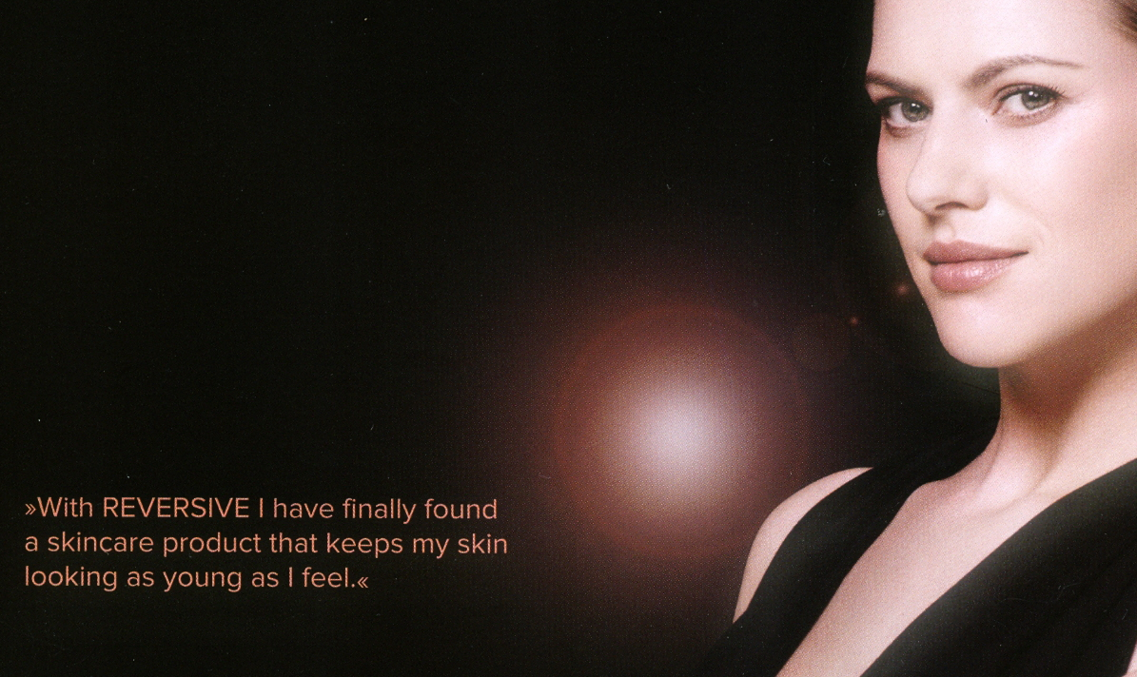
[5.0] Post – ageing  Ageing as an Artefakt
where growing old can be summarised by the statement “the older people get, the younger they feel”  both morbidity and feelings of senescence are compressed to latter age;
the goal is not [4.0] to [4.1] “further optimisation“, but surpassing ageing, to transcend it, to end it [5.0]
Felsted, K.;Wright, S.D. 2014. Toward Post Ageing: Technology in an Ageing Society. Springer; p. 37-38.

Slide 22
[5.0] Post – ageing  Ageing as an Artefakt
where growing old can be summarised by the statement “the older people get, the younger they feel”  both morbidity and feelings of senescence are compressed to latter age;
the goal is not [4.0] to [4.1] “further optimisation“, but surpassing ageing, to transcend it, to end it [5.0]
Anti-ageing trance?
Felsted, K.;Wright, S.D. 2014. Toward Post Ageing: Technology in an Ageing Society. Springer; p. 37-38.

Slide 23
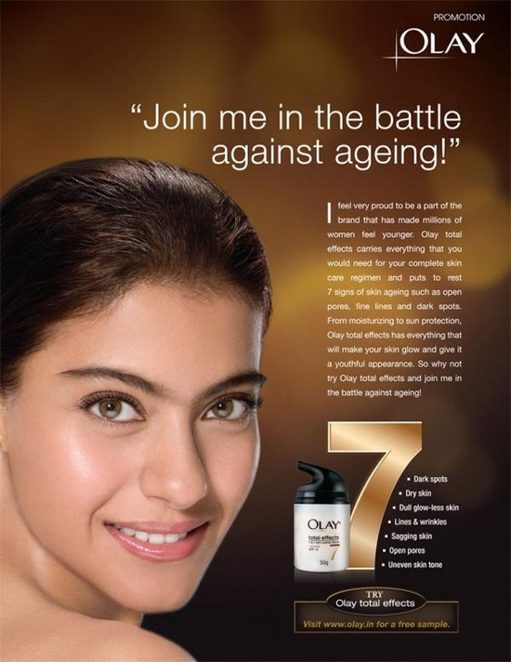
Anti-ageing Soldiers
cosmetic interventions
warriors in a battle with old age disease;
intra-cellular processes of ageing (life extension)
make human immortality possible…
Vincent, J. A. (2007). „Science and imagery in the ‘war on old age’“. Ageing and Society, 27, pp 941-961.
Notes:
čtyři skupiny profesních „bojovníků“, kteří biologický fenomén stárnu
doi:10.1017/S0144686X07006630.
Stuckelberger, A. (2008). Anti-ageing Medicine: Myths and Chances. Zurich: vdf Hochschulverlag AG, an der ETH.
tí chtějí napadnout a porazit:

Slide 24


“Pro-aging trance“
= a psychological strategy which people use to cope with aging, and which is rooted in the belief that aging is not only immutable and unavoidable, but desirable in some sense, as part of the natural or divine order that should not be perturbed.

Slide 25

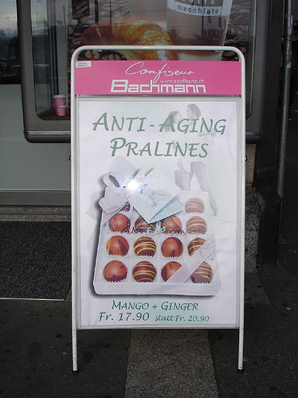
Anti – ageing on
medicine
movement
industry
war
creams
vaccination
fitness program
substances
facial masks
food
choccolate
…
Photo: John Vincent
Notes:
stargate.wikia.com/wiki/Anti-aging_vaccine

Slide 26
Anti – ageing medicine
„Simply defined, “antiaging” medicine is any intervention that delays the development of age-dependent pathology and other adverse age-related changes that are not officially listed as diseases.“
(Butler et al. 2000)
Butler, RN, Fossel, M., Pan, CX et al. 2000. Anti-aging medicine: What makes it different from geriatrics? Geriatrics 55: 36- 43.

Slide 27
Is There An „Anti-aging“ Medicine?(2001)
„Anti-ageing“ medicine is a multi-billion dollar industry in the U.S. It is under the control of non-scientists who use terms like „virtual immortality“ and „an ageless society“ to attract customers to untested remedies that have not withstood the rigors of serious clinical trials.“
… Unfortunately, serious research is being mistaken for „anti-aging“ medicine, which argues that we already know the mechanisms of aging and the appropriate interventions to slow, stop, or even reverse the aging process.
… In contrast , we prefer that longevity researchers adopt the term „longevity medicine“.
ILC workshop report 2001: iii

Slide 28
Is There An „Anti-aging“ Medicine?(2001)
„Anti-ageing“ medicine is a multi-billion dollar industry in the U.S. It is under the control of non-scientists who use terms like „virtual immortality“ and „an ageless society“ to attract customers to untested remedies that have not withstood the rigors of serious clinical trials.“
… Unfortunately, serious research is being mistaken for „anti-aging“ medicine, which argues that we already know the mechanisms of aging and the appropriate interventions to slow, stop, or even reverse the aging process.
… In contrast , we prefer that longevity researchers adopt the term „longevity medicine“.
ILC workshop report 2001: iii

Slide 29
Gerontology versus Geriatrics: Different Ways of Understanding Ageing and Old Age
…both the points of similarity and difference in how ageing and old age have been viewed by gerontology and geriatric medicine. The authors argue that until relatively recently both disciplinary fields shared a common viewpoint that distinguished between age-associated illness and age-related decline. The former was represented as abnormal or pathological ageing and was recognised as the province of medicine; the latter was termed ‘normal’ ageing and formed the domain of the gerontological sciences – from the biological to the social. This modern distinction is now being questioned and with it the notion of the ‘normality’ of ageing. Age-associated disease is being re-presented as age related – with ageing being seen as constituting a multiplicity of pathways of decline. In social gerontology, this is leading to a more profound questioning both of the status and meaning attached to old age in contemporary society.
Gilleard, higgs, 2016; Gerontology versus Geriatrics: Different Ways of Understanding Ageing and Old Age; Springer; The Palgrave Handbook of the Philosophy of Aging
pp 31-48

Slide 30
In terms of introduction…
Think carefully before having plastic surgery...
British Association of Aesthetic Plastic Surgeons president Rajiv Grover said people should ''think very carefully'' before opting for cosmetic surgery.
http://www.bbc.com/news/health-26013282

Slide 31
To sell or not (with ads), that is the question…
http://www.bbc.com/news/health-16676735

Slide 32
To sell or not (with ads), that is the question…
http://www.bbc.com/news/health-16676735
Ban on marketing
Vulnerable patients
Requalification of fillers as medicine (eg. Botox)
Increased control of implants and of surgeons
https://www.bbc.com/news/av/health-16312853/breast-implant-patient-extremely-concerned

Slide 33


Marketing to 50+: „Don´t Call´em Old, Call´em Consumers!“
Baars, J. 2012. Aging and the Art of Living. Baltimore, Maryland: The Johns Hopkins Uni Press. P.66
https://contently.com/strategist/2014/07/16/4-tips-for-marketing-to-baby-boomers-in-the-digital-age/
Notes:
mládí/stáří
věk/“bezvěkost“ (age-lessness)
věda / pavěda
už víme/ ještě nevíme
sociální hnutí/medicína
kosmetika/medicína
zdraví/“jen“krása
šarlatáni + PR /experti
zákazník / pacient
peníze / zase peníze
Avalible / exklusive
Surgery /entertaiment

Slide 34
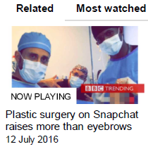
BBC News: „Plastic surgery on Snapchat raises more than eyebrows“
Tummy tucks, boob jobs and buttock lifts are being watched by millions on Snapchat.
People are using the social media app to view extremely graphic videos of cosmetic surgery procedures being carried out in real time.
Although the videos are hugely popular –
and are making surgeons such as
"Dr Miami" into celebrities - they raise
questions about marketing plastic
surgery to young women and girls
and whether cosmetic surgery should be
turned into a form of entertainment.
Notes:
mládí/stáří
věk/“bezvěkost“ (age-lessness)
věda / pavěda
už víme/ ještě nevíme
sociální hnutí/medicína
kosmetika/medicína
zdraví/“jen“krása
šarlatáni + PR /experti
zákazník / pacient
peníze / zase peníze
Avalible / exklusive
Surgery /entertaiment

Slide 35
Dualities: balancing on the edge & borders crossing
Youth / old age
Age / age-lessnes
Science / quasi-science
We (already) know/ we dont´t know (yet)
Social movement (construct) / biology & medical science
Cosmetics / medical science
Health / “only“ beauty
Charlatans & PR / experts
Customer / pacient
…
Pro-Ageing / Anti-Ageing (trance) ?

Slide 36
The data
ad hoc module of Medical Information Centre Survey (2015)
representative for adult Czech population 18+
N = 1798
Project of Office for Population Studies, Faculty of Social Studies, Masaryk Uni, Brno

Slide 37
„Pro-“ or „Anti-“ ageing trance?
Old age is… | %
…the biggest enemy of men and humankind. | 3
…a disease, which should be cured. | 1
…just part of life, nothing more, nothing less. | 37
…natural thing given by the nature. | 48
…a crown, a reward for long life | 6
Old age? I don’t think about it at all, I don´t care. | 4
Notes:
Draft závěru AKA doměnka:
Relativně malý úspěch/popularita AntiA může být dána tím, že bojuje proti extrémním/inferiorním představám stárnutí, ne proti mainstreamovým, většinovým představám (nejsou-li tyto pouze v survey označeny jako sociálně nejlíbivější– metodologická otázka).
Potvrzovala by to i tabulka na tomto slide i tabulka „co definuje starého člověka“ (slide 15), kde je řada kategorií pro (klasickou) AntiA medicínu nedosažitelné. (sociální definice stáří nelze odoperovat ani utlumit tabletkou ALE reakci okolí lze změnit změnou sebe!!! A zde navazuje teorie assimilation/hyphenation/multiculturalism …

Slide 38
„Pro-“ or „Anti-“ ageing trance?
Old age is… | %
…the biggest enemy of men and humankind. | 3
…a disease, which should be cured. | 1
…just part of life, nothing more, nothing less. | 37
…natural thing given by the nature. | 48
…a crown, a reward for long life. | 6
Old age? I don’t think about it at all, I don´t care. | 4
Anti-ageing trance
Nature/ Idle
Pro-ageing trance

Slide 39
Old age is… | Age
 | 15-24 | 25-49 | 50-64 | 65+
…the biggest enemy of men and humankind. | 5 | 3 | 2 | 4
…a disease, which should be cured. | 1 | 1 | 1 | 2
…just part of life, nothing more, nothing less. | 32 | 37 | 41 | 35
…natural thing given by the nature. | 48 | 49 | 46 | 48
…a crown, an award for long life. | 4 | 5 | 8 | 8
Old age? I don’t think about it at all, I don´t care. | 11 | 4 | 1 | 3
Total | 100 | 100 | 100 | 100
Notes:
we may suspect there will be difference by age of the respondent, but there is not really, with exception of the idle stand „I dont think about it“, which is overrepresented in the youngest category, but for our purposes we are treating this opinion as systém mising

Slide 40
Defining ageing
(perception by age groups)
*)
*) „Old age? I don’t think about it at all, I don´t care“ omitted

Slide 41
Defining ageing
(perception by age groups)
*)
*) Idle (Old age? I don’t think about it at all, I don´t care) = Sysmis

Slide 42

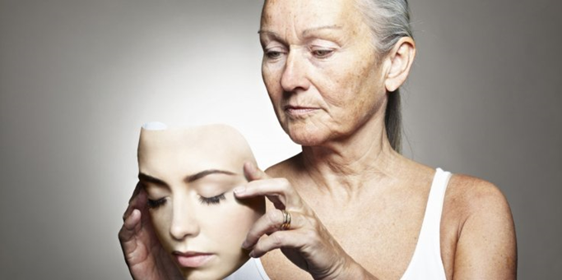
Key indicators: Anti-ageing measures
Question: These days, scientists discuss various possible ways to prolong the human life beyond the usual threshold, i.e. in the future we would live even more than 100 or 120 years. Some procedures are already being tested. To what extent do you approve such effort? (L_ext)
Question: Regardless of the possibilities to really prolong the life in the future, some people already today make an effort to look and feel younger with use of various means. To what extent do you approve such peoples´ effort? (Youth)

Slide 43
(Dis)Approval of anti-ageing measures
Life extension efforts by experts
Efforts to look/feel young

Slide 44
Approval of
(by perception of ageing)
Life extension by experts
Youthful look by people

Slide 45
Dis/approval by age groups
 | 15-24 | 25-49 | 50-64 | 65+
L_ext OK | 20 | 23 | 21 | 19
L_ext KO | 35 | 35 | 41 | 39
Youth_OK | 32 | 37 | 40 | 32
Youth_KO | 17 | 14 | 18 | 20

Slide 46
Dis/approval by age groups
 | 15-24 | 25-49 | 50-64 | 65+
L_ext OK | 20 | 23 | 21 | 19
L_ext KO | 35 | 35 | 41 | 39
Youth_OK | 32 | 37 | 40 | 32
Youth_KO | 17 | 14 | 18 | 20

Slide 47



Dis/approval by gender
 | Life extension by experts |  | Youthfulness by people
Approval | 24 | 19 | 31 | 41
N/Nor | 42 | 41 | 50 | 44
Disapproval | 35 | 39 | 19 | 14

Slide 48
Effort to look younger

Slide 49



Approval of youthful effort by marital status/partnering
 | single | married | divorced | widow | cohabit. | total
 | 27% | 31% | 42% | 24% | 39% | 31%
 | 43% | 39% | 50% | 30% | 55% | 41%

Slide 50
Dis/approval by education

Slide 51
Dis/approval by income

Slide 52
Approval by occuaption (selection)

Slide 53
Anti-ageing procedures approval by the size of municipality

Slide 54
Acceptance of AntiA procedures
What is the most acceptable procedure?

Slide 55
Acceptance of AntiA procedures
What is the most acceptable procedure?
hair dye (63%)
special nutrition & healthy diet (18%)
vitamins & food supplements (9%)
Botox & other anti-wrinkles (0,6%)
joints, retina…, replacement (7%)
plastic surgery (0,3%)
hormonal therapy (0,1%)
changing body parts for mechanics (e.g. robotic hand) (2%)
genetic engineering (0,1%)
all of them, individual matter (11%)

Slide 56
Acceptance of AntiA procedures
What is the least acceptable procedure?
hair dye (9%)
special nutrition & healthy diet (5%)
vitamins & food supplements (3%)
Botox & other anti-wrinkles (36%)
joints, retina…, replacement (2%)
plastic surgery (9%)
hormonal therapy (7%)
changing body parts for mechanics (e.g. robotic hand) (6%)
genetic engineering (24%)
non of them (2 %)

Slide 57

Do you plan anytime soon …?
To buy food supplements, vitamins | 36
Wellness holiday | 13
Exotic holiday | 9
Non-invasive procedures for rejuvenation (n = 48) | 3
Plastic surgery (n = 13) | 1
Consumption and consumers in latter age Survey (N = 1443) | 100
x

Slide 58
Summary
Bigger prevalence of „pro-age trance“ and „idle“ perception of old age
  leads to disapproval of experts´ effort of life extension and efforts to look younger
however, only smaller share of the population has strong, outspoken criticism against anti-ageing (L_ext 36%, Youth_16%); and/or labels the various AntiA procedures as unacceptable (89%);
older respondents, women (esp. older), lower educated (esp. in seniors), lower income, smaller municipalities „fear“ the anti-ageing trance more (higher disapproval of expert life extension) - usual suspects in social exclusion debates;
late mid-age, women (esp. younger, single), divorced and cohabitating, higher (but not highest) income & big cities are more prone to approval of personal anti-ageing endeavours – usual targets of marketing campaigns.
If anti-ageing potentionaly means longer life in better helath we should be aware of the unequal distribution of opportunities and challenges related to anti-ageing trance.
Anti-ageing can be understood as a part of social exclusion mechanisms and/or result of social power structures variations.
Notes:
zastánci AntiA – jsou vzdělanější
mají větší SES
ale nejsou nutně větší odmítači stárnutí – čtu data dobře?

Slide 59
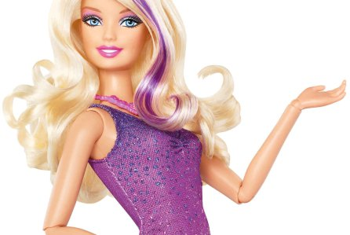
immortality for you, sir?

Slide 60
Pictures
https://d.ibtimes.co.uk/en/full/1428231/anti-aging-drugs-senolytics.jpg?w=736
http://www.vivawoman.net/wp-content/uploads/2012/04/anti-aging.jpg
https://www.ifa-fiv.org/wp-content/uploads/2013/06/olay-anti-ageing.jpg
http://www.lifeextension.com/~/media/lef/images/lpages/welcome/welcome_panel3_bg.jpg

